Slide 1
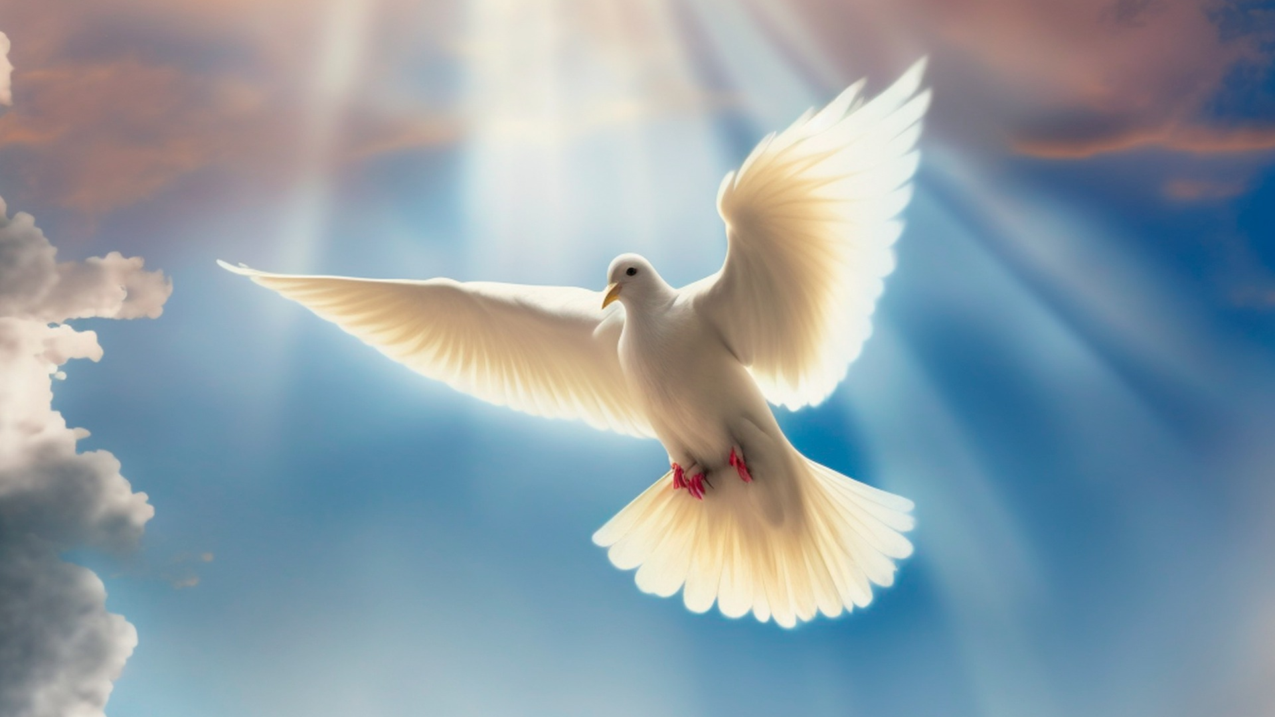

Theme of the week : Holy Spirit
“For this reason, I remind you to fan into flame the gift of God, which is in you through the laying on of my hands, for God gave us a spirit not of fear but of power and love and self-control” (2 Timothy 1:6)
6TH -10TH OCTOBER

Slide 2
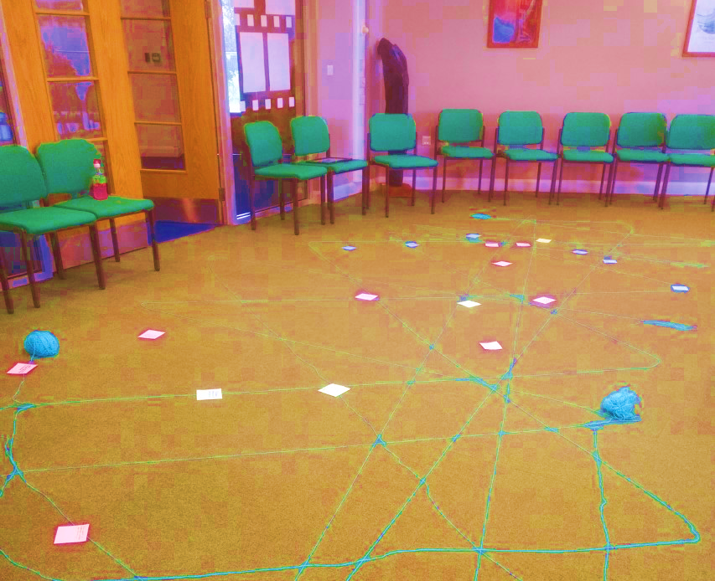

MORNING PRAYER IN THE CHAPEL THIS WEEK
Monday 6th October – 10A
Tuesday 7th October – 11R
Wednesday 8th October – 11M
Thursday 9th October – 10N
Friday 10th October - 10T
Please bring your pens along…

Slide 3
Theme of the week:
Holy Spirit
On this week...
Monday | Tuesday | Thursday | Friday
Christmas Club LOCATION : F04 (Maths Corridor) TIME:12:25 – 12:50 Father Jonathon is in every Monday at Lunchtime. Come in and say Hello! | Christian Union LOCATION : G16 TIME:12:20 – 12:50 | Fundraising Club LOCATION : F01 TIME:12:20 – 12:50 WEEK A | Rosary Club LOCATION: Chapel TIME:12:15 – 12:25
Keep an eye out for even more events going on in the following weeks!

Slide 4
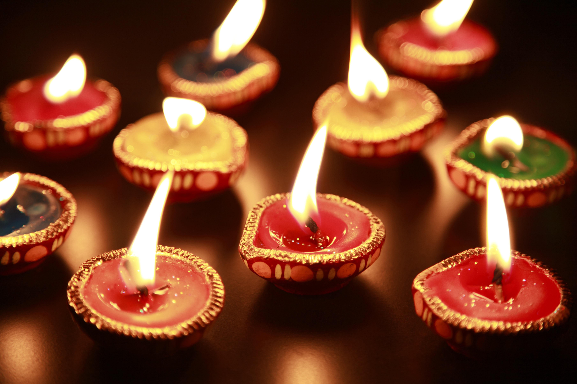
Christian union
Community of young people who want to know more about Christianity or who love Jesus
It is in G16 every Tuesday
Make new friends!!
Discover more about God
Read scripture
Play games lots and lots of fun games
Everyone welcome!

Slide 5

Bible study
Every Friday lunchtime in G15
For year groups 10 and above
Community of Christians to read and study God's word
Bibles are provided but you can bring your own (and a notepad)!

Slide 6

Music Groups to get involved with...
Wednesday | Thursday | Friday | Other things
Choir Open to all Year Groups. Lunchtime in G17 | Rock School After school in the Music Department. | Orchestra Lunchtime G17 All instruments welcome | If you are interested in anything to do with Music Tech, please see Miss Bloomfield for further information. ________________________ Interested in being in a band with other students? You do not need to have played an instrument to be in this band. If you are interested, please see Mrs Blackburn OR Miss Bloomfield
Keep an eye out for even more events going on in the following weeks!

Slide 7
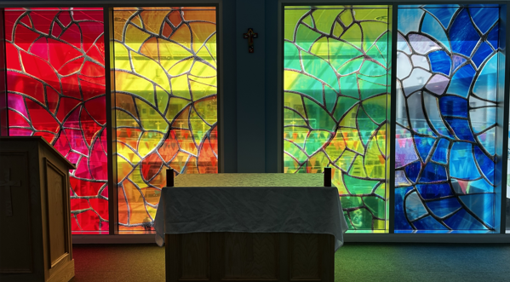
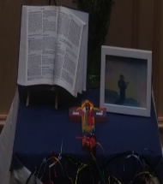
Mass at 8:20am on Friday Morning in the Chapel.
Everyone is welcome.
This week Friday Mass will be led by
9M and 9R.

Slide 8

Important Festivals of All Faiths and other events this week!
(Month of October is dedicated to the Rosary)
Mon 6th – Mon 13th Oct – Sukkot (Judaism)
Tues 7th Oct – Feast Day of Our Lady of the Rosary (Christianity)
Thurs 9th Oct – Feast day of St John Henry Newman (Christianity)
Fri 10th Oct – World Mental Health Day

Slide 9
Theme of the week : Holy Spirit
“For this reason, I remind you to fan into flame the gift of God, which is in you through the laying on of my hands, for God gave us a spirit not of fear but of power and love and self-control” (2 Timothy 1:6)

Slide 10


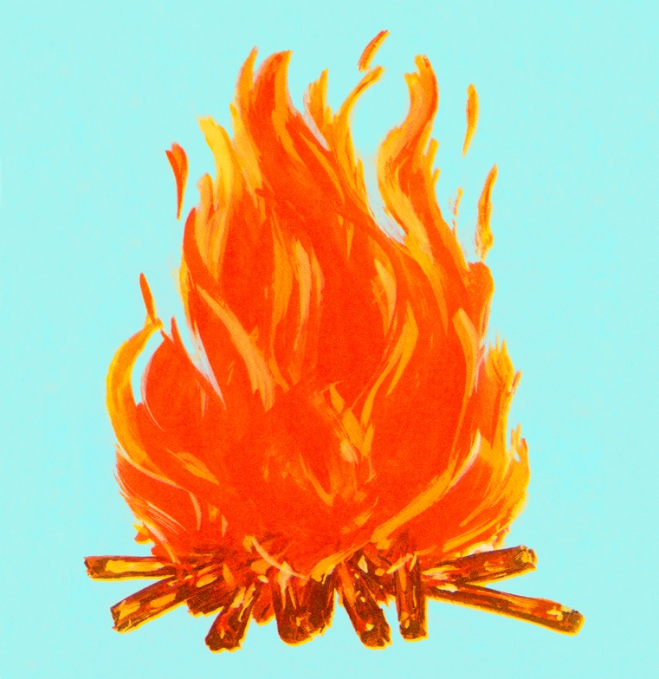
What makes you feel alive?
What gifts or talents do you think God has placed in you?
What spark is inside you that you want to fan into flame?
What one step can you take this week to “fan into flame” your gift?
How can we use our gifts to bless others?
How can you use your gifts to serve others, even if you feel unqualified or afraid?
“For this reason, I remind you to fan into flame the gift of God, which is in you through the laying on of my hands, for God gave us a spirit not of fear but of power and love and self-control” (2 Timothy 1:6)
Class Discussion

Slide 11

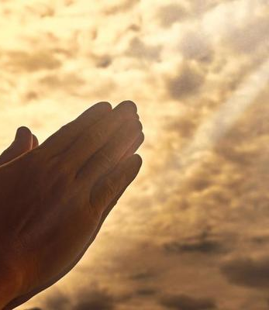
Lord,
Open our eyes to see the gifts You’ve placed in us. Help us not to compare ourselves to others, but to recognize the unique ways You have created us to serve. Show us how we can use these gifts for Your glory.
Amen

Slide 12
Theme of the week : Holy Spirit
“For this reason, I remind you to fan into flame the gift of God, which is in you through the laying on of my hands, for God gave us a spirit not of fear but of power and love and self-control” (2 Timothy 1:6)

Slide 13
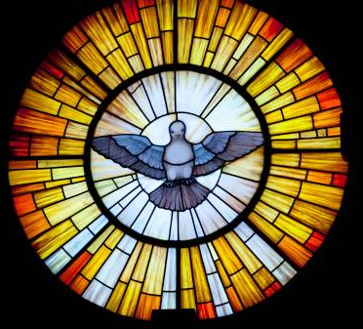
Holy Spirit - The term 'spirit' covers aspects of faith, hope, and love, as well as the presence of the Holy Spirit in our lives.
The Role
Inspiration: Christians say the Holy Spirit helps them understand scripture and make moral decisions.
Comfort: It's seen as a source of peace and strength during hard times.
Transformation: Christians believe it helps them grow in character—becoming more loving, patient, kind, etc.
"Many religions and philosophies have a concept of an inner guide or universal energy—like chi in Chinese philosophy or Atman in Hinduism. The Holy Spirit plays a similar role in Christianity."

Slide 14

“For this reason, I remind you to fan into flame the gift of God, which is in you through the laying on of my hands, for God gave us a spirit not of fear but of power and love and self-control” (2 Timothy 1:6)
Whether you are religious or not, your gift is like a fire. It needs attention, fuel, and courage.”
We all have inner potential—creativity, kindness, leadership, resilience.
“Fanning into flame” means nurturing that potential through learning, practice, and courage.
It is about not giving up when things get hard.
Remember that your life has value and purpose, even if you define that purpose yourself.
This verse comes from a letter written by Paul, a leader in the early Christian church, to a young man named Timothy. Paul is encouraging Timothy to stay strong and passionate about the good things he’s been given—especially his faith and calling.
Just as a fire needs oxygen to grow, so does faith need to be actively developed.
Exploring The Bible

Slide 15

TAKEAWAY 1
Don’t let your potential fade. Keep working on your strengths and passions and let them shine.
TAKEAWAY 2
Everyone has gifts or talents—things that make them unique. You have something valuable inside you. Don’t let it go to waste—grow it, share it, and let it make a difference.
Like a small flame, your gifts need attention and effort to grow.

Slide 16
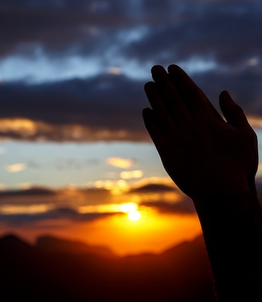
Lord,
We don’t want our gifts to be hidden. Stir up a passion in us to grow, learn, and step out in faith. Even when we feel unsure, remind us that You are with us and that You’ve equipped us for a purpose.
Amen

Slide 17
Theme of the week : Holy Spirit
“For this reason, I remind you to fan into flame the gift of God, which is in you through the laying on of my hands, for God gave us a spirit not of fear but of power and love and self-control” (2 Timothy 1:6)

Slide 18

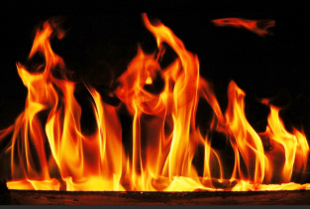
✨🔥 Holy Spirit Quiz: “Fan into Flame”
(2 Timothy 1:6)

Slide 19
1. Who is writing this verse?
A. Peter
B. Paul
C. Timothy
D. John
✅ Correct Answer: B

Slide 20
2. What does Paul encourage Timothy to do with the gift of God?
A. Hide it
B. Give it away
C. Fan it into flame
D. Forget about it
✅ Correct Answer: C

Slide 21
3. What does “fan into flame” suggest about the gift of God?
A. It needs to be protected
B. It should be shared with everyone
C. It is dangerous
D. It can grow stronger with effort
✅ Correct Answer: D

Slide 22
4. How did Timothy receive the gift of God, according to this verse?
A. Through prayer
B. Through fasting
C. Through the laying on of hands
D. Through reading Scripture
✅ Correct Answer: C

Slide 23
5. What does “laying on of hands” often symbolize in Christian tradition?
a) Punishment
b) Healing and blessing
c) Silence
d) Confusion
✅ Correct Answer: B

Slide 24

REFLECTION: Think about someone who helps you make good choices. What qualities do they have?
The Holy Spirit is often described as a guide.
Who guides you in your life, and how?
“Courage isn’t the absence of fear—it’s choosing to act anyway.”
“A spark becomes a flame when you feed it with effort and courage.”
Your gift is not just for you—it’s meant to light up the world around you.
Fear, comparison, and doubt are common—but they don’t have to win.
3 minutes REFLECTION
Notes:
Allow time for music to play and

Slide 25
Lord,
Keep the fire of Your presence alive in us and help us to finish strong in all You have called us to do.
Show us where we can serve, encourage, and uplift those around us.
Let our life reflect Your love.
Amen

Slide 26
Theme of the week : Holy Spirit
“For this reason, I remind you to fan into flame the gift of God, which is in you through the laying on of my hands, for God gave us a spirit not of fear but of power and love and self-control” (2 Timothy 1:6)

Slide 27


Digital Unplug
Purpose: Visual reminder of “fanning into flame” the gift of God (2 Timothy 1:6).
SHARE: “What’s one gift YOU need to fan into flame?”
Holy Spirit Flame Craft
Activity: Each student decorates a paper flame with words or drawings that represent how the Holy Spirit works in their life (e.g., gives courage, peace, love).
OR Write the gifts you have around your flame.
As a form, how can we use our gifts to serve our school community/our neighbours?
Optional: Create a classroom “Holy Spirit Wall” with all the flames.
Notes:
How to Use:
Ask them to write or draw inside the flame how the Holy Spirit works in their life (e.g., gives courage, brings peace, helps them love others).
OR Write the gifts your have around your flame. As a form, how can we use our gifts to serve our school community/our neigbours?
Display the finished flames on a classroom wall or bulletin board titled “Fan into Flame the Gift of God”.
Prompt with:
“What spark is inside you that you want to fan into flame?”

Slide 28
Lord,
We pray for unity as we utilize our gifts.
Help us to recognize that each gift is interconnected and vital.
Renew our passion so that we may not only stir the gift within ourselves but also encourage, empower and inspire others to do the same.
Amen

