Slide 1

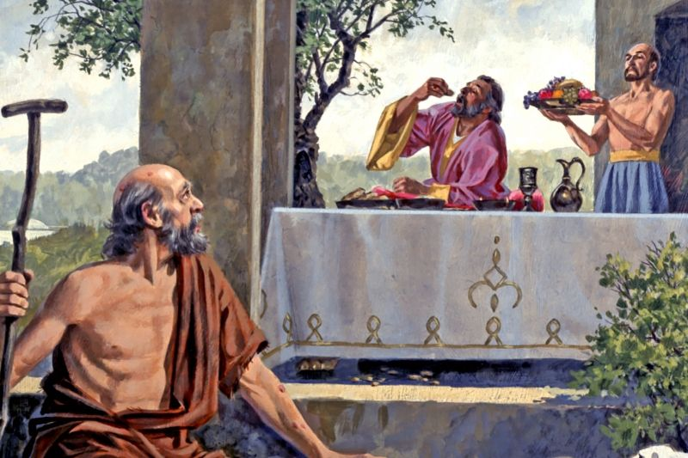
Charity
‘There was a rich man and at his gate was a poor named Lazarus.’ (Luke 16:19)

Slide 2
What’s on this week…
Monday | Tuesday | Wednesday | Thursday | Friday
Father Jonathan will be in the Chapel at lunchtime. Pop in to say hello. | Christian Union LOCATION : G16 TIME:12:20 – 12:50 | The Rosary LOCATION: Chapel TIME:12:15 – 12:25 | Fundraising Club LOCATION : F01 TIME:12:20 – 12:50 | Rosary In the Chapel. 12:15pm Wilding Group G12 12:20 – 12:55pm

Slide 3
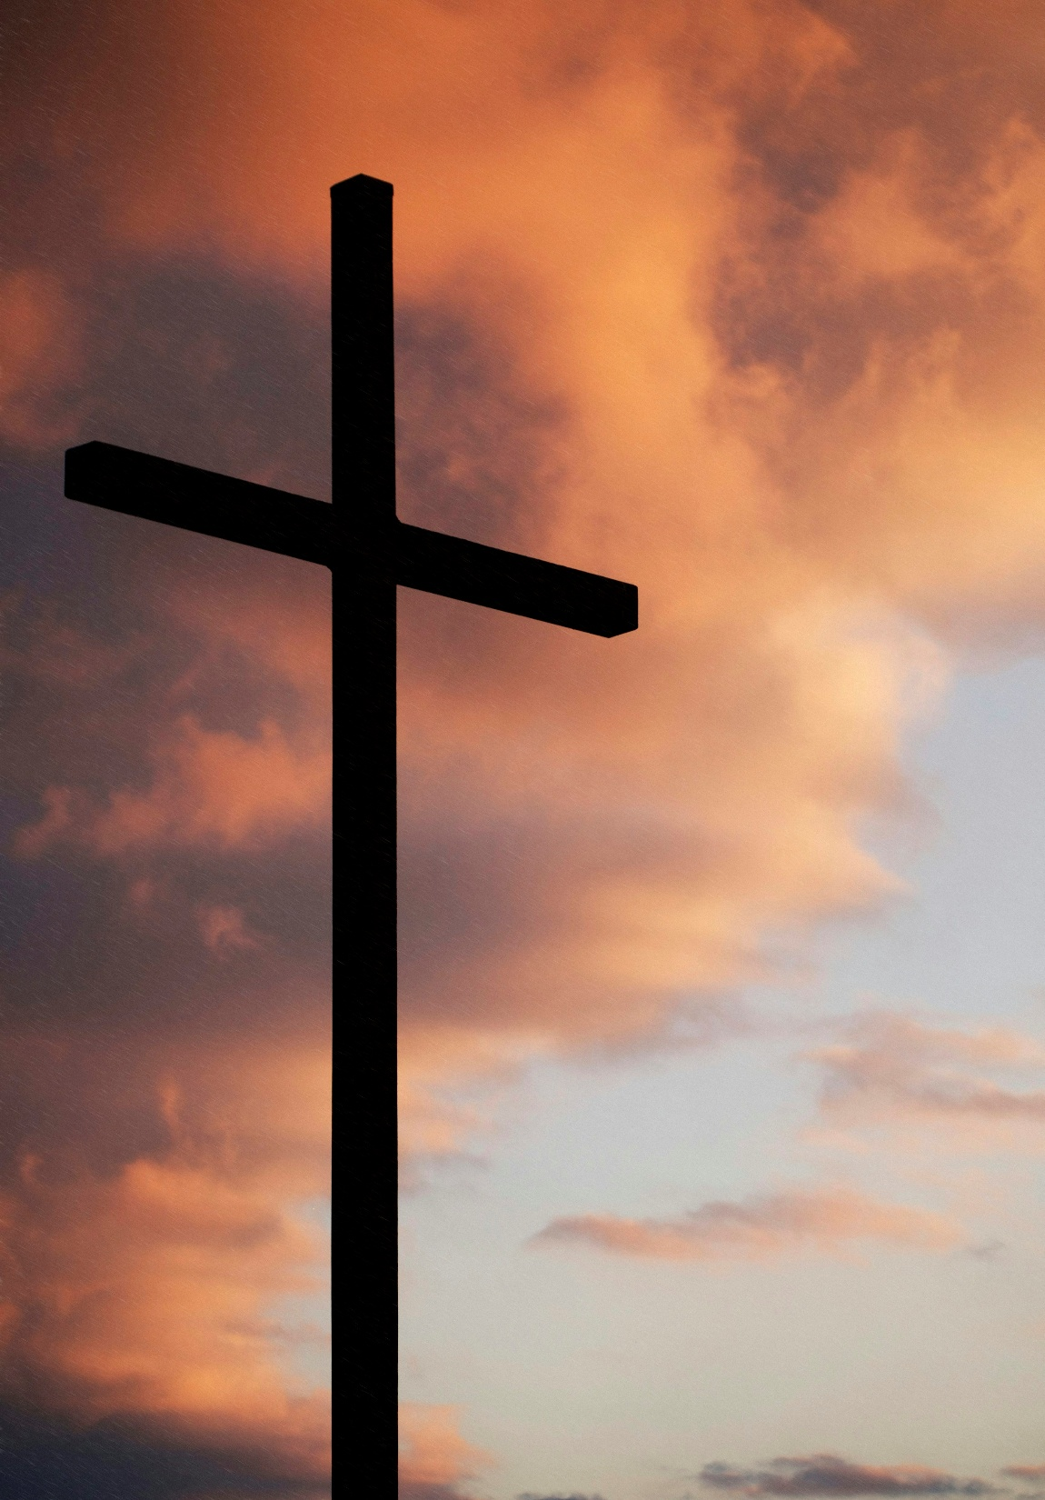
Morning Prayer Schedule
Monday – 10S
Tuesday – 11I
Wednesday – 11N
Thursday – 11T
Friday – 11Y
Once registration is complete, please come to the Chapel for 8:45am. Students please bring a pen and leave your bags in your form room.

Slide 4
‘There was a rich man and at his gate was a poor named Lazarus.’ (Luke 16:19)
What do you think are the key themes in Luke 16:19?
Notes:
Please read the scripture and question aloud to the class. Ask them to think about the key themes as the watch the video on the next slide.

Slide 5
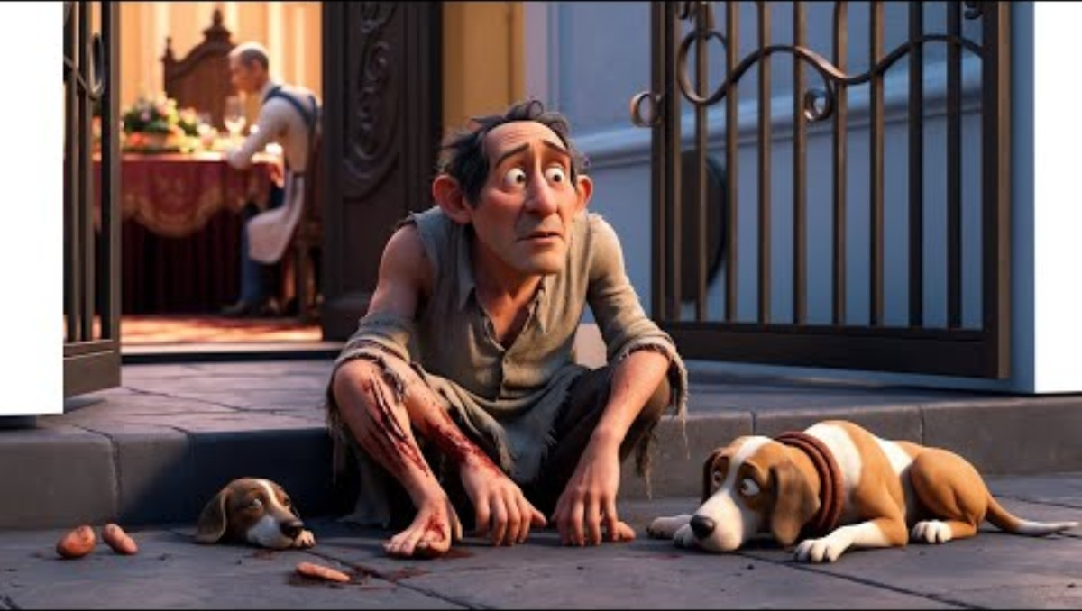
Notes:
Please play the video for your form class. Ask students to think about the stark contrast between earthly wealth and eternal fate.

Slide 6
‘There was a rich man and at his gate was a poor named Lazarus.’ (Luke 16:19)
What do you think are the key themes in Luke 16:19?
Notes:
Please ask students what were the key themes that they identified.

Slide 7
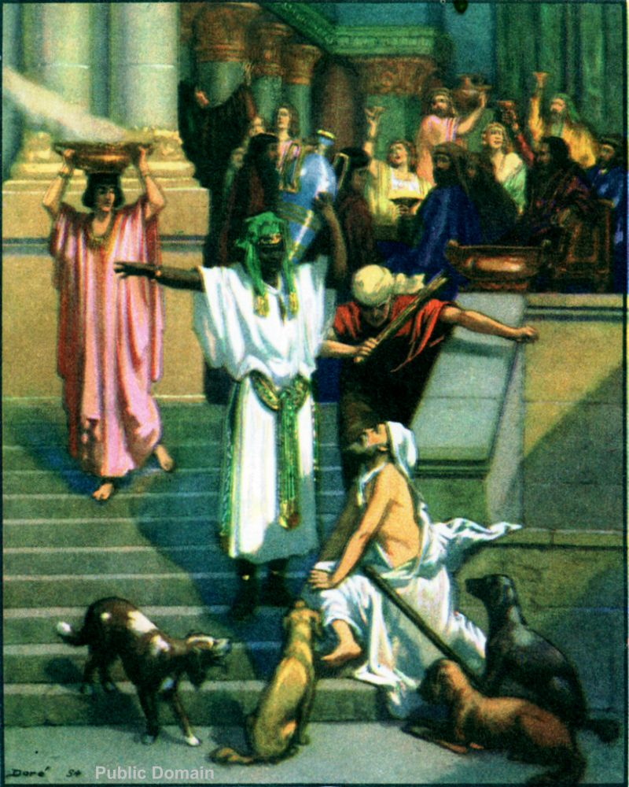
Key Themes in John 3:16
Consequence of Greed
The story serves as a warning against the love of money, which Jesus identifies as a strong indicator that someone does not know God.
Compassion for the Poor
Jesus emphasizes the need for followers to show concern for the poor and vulnerable.
Stewardship of Wealth
Worldly possessions have no value in the afterlife, and earthly wealth should be used for the benefit of the poor.
Afterlife and Finality
The "unbridgeable gulf" between the rich man and Abraham signifies that one's eternal state is determined by their actions and choices during life.

Slide 8
Let Us Pray
Lord,
Open my eyes to the needs around me,
That I may never walk past the suffering unseen.
Give me a heart like Yours—
Tender, generous, and ready to serve.
Amen.

Slide 9
Charity
‘There was a rich man and at his gate was a poor named Lazarus.’ (Luke 16:19)

Slide 10

Putting Luke 16:19 into Action
Each and everyday people put Luke 16:19 into action by focusing on charity and helping those in need.
If you enjoy fundraising and supporting a good cause, have you considered a career in the charity sector?
This roles include but are not limited to; digital designers, business managers, community outreach, finance, fundraising, communications and many more.

Slide 11
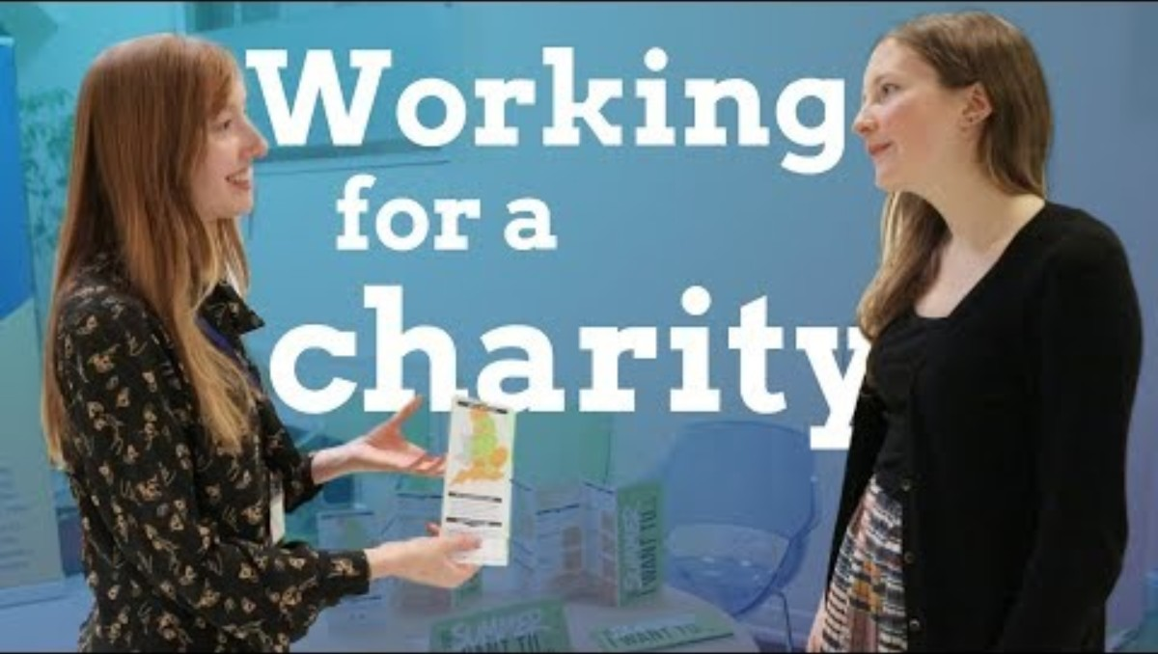
Career Spotlight and Advice

Slide 12
Let Us Pray
Lord,
Guard me from selfishness and pride.
Teach me to give, not from my excess, but from love.
Let my hands be open and my table wide,
So none who hunger go without.
Amen.

Slide 13
Charity
‘There was a rich man and at his gate was a poor named Lazarus.’ (Luke 16:19)

Slide 14
Quiz Time
‘There was a rich man and at his gate was a poor named Lazarus.’ (Luke 16:19)
Form a team of 2 with the person sitting next to and get ready to test your knowledge on Luke 16:19.

Slide 15
1. Multiple Choice
In the parable of the Rich Man and Lazarus (Luke 16:19–31), what was the condition of Lazarus?
A. He was wealthy and powerful
B. He was a sick beggar covered in sores
C. He was a merchant who lost everything
D. He was a disciple of Jesus

Slide 16
2. True or False
The Rich Man regularly helped Lazarus by giving him food and shelter.

Slide 17
3. Short Answer
Where did Lazarus go after he died?

Slide 18
4. Multiple Choice
What was the Rich Man’s request to Abraham after his death?
A. To be given another chance at life
B. To allow Lazarus to bring him water
C. To be sent back to warn others himself
D. To judge Lazarus harshly

Slide 19
✅ Answers:
1. B. He was a sick beggar covered in sores
2. False – The Rich Man ignored Lazarus
3. He was carried to Abraham’s side (or Abraham’s bosom)
4. B. To allow Lazarus to bring him water
5. (Sample answer): The parable teaches that ignoring the needs of the poor and suffering has eternal consequences. Charity is not optional—it reflects our heart and our obedience to God’s commands.

Slide 20
Let Us Pray
Lord,
Help me live the truth
That dignity belongs to all Your children.
May I never be like the rich man,
Blind to Lazarus at my gate.
Show me how to love with action and mercy.
Amen.

Slide 21
Charity
‘There was a rich man and at his gate was a poor named Lazarus.’ (Luke 16:19)

Slide 22
Let Us Pray
Lord,
In my daily life—at work, at home, on the street—
Let me reflect Your kindness.
Help me listen, help me give, help me care.
May I never miss a chance to show Your love.
Amen.
Notes:
Digital Unplug - Please start with the Prayer. Please read aloud Luke 16:19 and then introduce the discussion question to the class. Please allow the students individual thinking time (up to 2-4 minutes) before beginning the class discussion. Once the class discussion begins, please switch off the board to allow students to focus on the discussion and have some time offscreen for the form class.

Slide 23
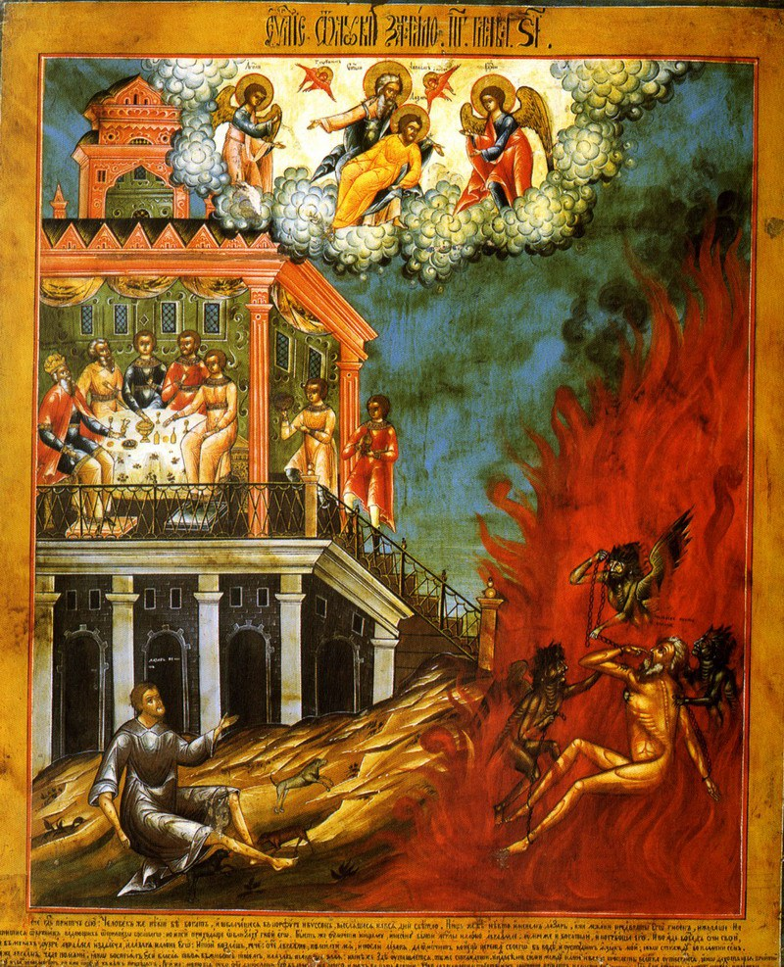
Digital Unplug – Class Discussion
What does being rich mean to you, and why do you think people might have different ideas about it?
Take 4 minutes to think about the question. Consider all aspects of life; relationships, faith, feelings, etc. Get ready to feed back and share your viewpoint with the class.
Notes:
Digital Unplug - Please start with the Prayer. Please read aloud Luke 16:19 and then introduce the discussion question to the class. Please allow the students individual thinking time (4 minutes) before beginning the class discussion (5-10 minutes). Once the class discussion begins, please switch off the board to allow students to focus on the discussion and have some time offscreen for the form class.

