Slide 1

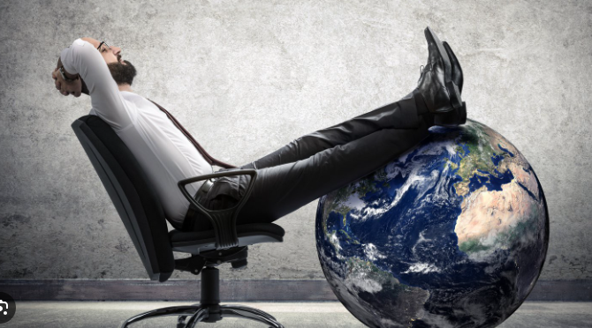
Thoughts and Prayers
22nd – 26th September
Possessions
There was a rich man who had a manager, and charges were brought to him that this man was wasting his possessions.” (Luke 16:1)

Slide 2


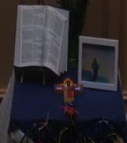
Mass at 8:20am on Friday Morning in the Chapel.
Everyone is welcome.
This week Friday Mass will be led by 8T.

Slide 3

Possessions
There was a rich man who had a manager, and charges were brought to him that this man was wasting his possessions.” (Luke 16:1)

Slide 4
A call to use what you have(gift and talents) – our possessions wisely!
Draw or list your most valued possessions on a 'treasure map', including material and non-material items.
Share one item (with the person next to you) and tell them why it matters to you
Reflect on which of these treasures/possession can not be bought?
“What would you keep if you could only have 5 things for the rest of your life?”
Notes:
https://youtu.be/b_RjndG0IX8?t=6
DO SOMETHING

Slide 5


Dear God,
Let us pray
We give thanks for all the blessings in our lives.
Help us to see all we have as gifts from You.
May we use our gifts not just for ourselves, but to serve others and honor You.
Amen

Slide 6
Possessions
There was a rich man who had a manager, and charges were brought to him that this man was wasting his possessions.”
(Luke 16:1)

Slide 7
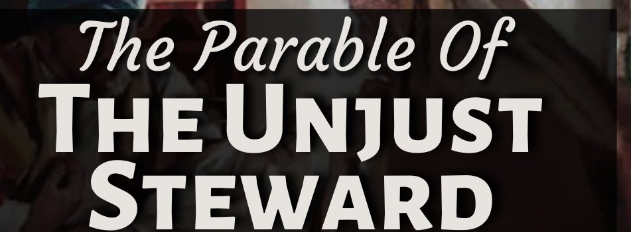
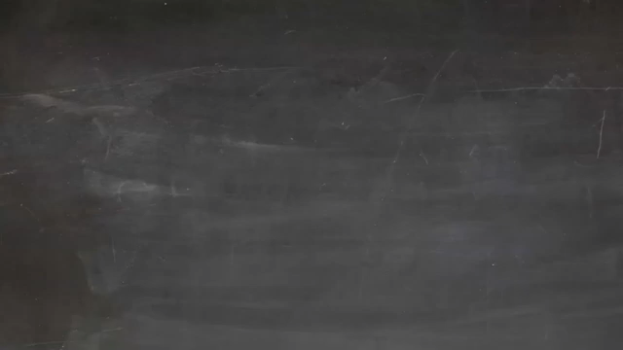

There was a rich man who had a manager, and charges were brought to him that this man was wasting his possessions.”
(Luke 16:1)
Jesus begins a story about a manager (or steward) who is in trouble. He’s been wasting his boss’s money, and now he’s about to be fired.

Slide 8

LUKE 16:1 IN A NUTSHELL
The Context:
The parable begins with a description of a rich man's manager who is accused of wasting his master's possessions
The Master's Reaction:
The master commends the manager for acting smartly, even though the manager's actions were dishonest.
Jesus' Teaching:
Jesus uses this story to illustrate a broader lesson about using worldly possessions wisely to prepare for the future, whether on earth or in eternity.
The Dismissal:
The manager is called to give an account of his stewardship, implying he is being fired
The Strategy:
Instead of panicking the manager uses his remaining time to reduce the debts of his master's debtors, hoping to gain their favour for when he is out of a job.
This parable sets the stage for a deeper lesson about how we handle responsibility, especially with things that don’t belong to us.

Slide 9
Takeaway
1. Responsibility Matters
3. Wisdom Isn’t Always Obvious
Later in the parable, Jesus praises the manager—not for being dishonest, but for being clever and thinking ahead.
Jesus wants us to be wise and thoughtful in how we live, especially with things like money, time, and relationships.
Even though the manager did not own the money, he was trusted to take care of it. This is like being trusted with:
*A group project at school
*A sibling
*Your own time and choice
The manager’s poor choices caught up with him. He had to face the consequences and think fast about what to do next.
2. Choices Have Consequences
Question to think on: how do we handle responsibility, especially with things that don’t belong to us?

Slide 10

Dear God,
You have trusted us with so much—our time, our talents, and the people in our lives.
Help us to be faithful stewards of all You have given us.
Teach us to make wise choices, even when it’s hard.
When we make mistakes, give us the courage to face them and the wisdom to grow from them, in Jesus’ name.
Amen
Let us pray

