Slide 1

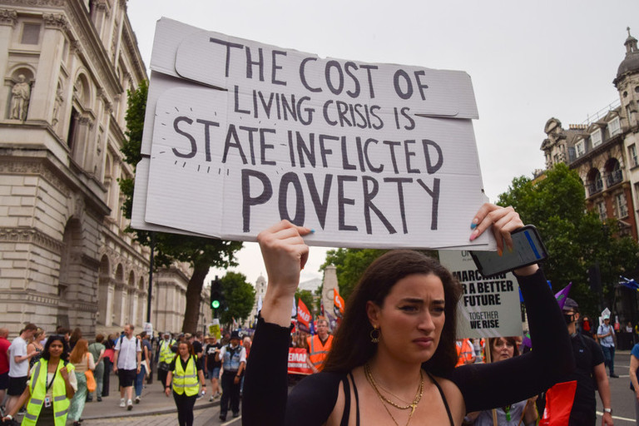
Y11 → Y12 Politics A-Level AQA
Summer Transition Work
Name: __________________________________

Slide 2
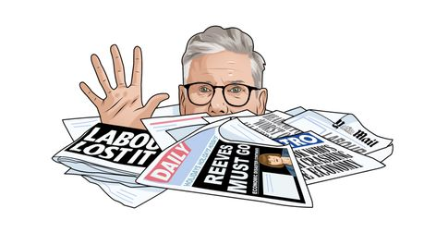
What does the Politics A-Level look like?
The course is split into three papers, which are:
Paper 1: The government and politics of the UK
This section of the course looks at the government and politics of the UK, including the European Union. It will include:
The constitution
The structure and role of Parliament
The Prime Minister and cabinet
The judiciary
Devolution
Democracy and Participation
Elections and Referendums
Political parties and pressure groups
The EU
Paper 2: The government and politics of the USA (and comparative politics)
This section of the course looks at the government and politics of the USA, including a comparison with the UK. It will include:
The constitutional framework of US government
The legislative branch of government: Congress
The executive branch of government: President
The judicial branch of government inc. the Supreme Court
The electoral process and direct democracy
Political parties and pressure groups
Civil rights with focus on the impact of one key political issues such as the right to bear arms, abortion, gender etc.
Comparative politics – UK/USA
Paper 3: Political ideas
This section of the course looks at key political ideas with a focus on individuals and their ideologies throughout history. It will include:
Liberalism
Conservatism
Socialism
Nationalism
You will study the course over Y12-Y13 and then sit three exam papers. (You will need a Grade 5 in GCSE History to take this course). You will be assessed at the end of Y13 and will sit three papers, all equally weighted at 33 ½ % of your final mark! (There is NO coursework). Each paper is 2 hours long. There is a mix of medium length ‘explain’ questions (9 marks) and longer essay questions (25 marks).
The Politics course is being taught as part of the History department. You will be taught by two teachers, similarly to A-Level History. History and Politics are excellent A-Level combinations!

Slide 3

Transition Tasks
For your transition tasks, we are going to try and give you a basis in reading news articles to understand current political affairs. We are not going to ask you to learn specific content for the course, as all content will be taught fresh in September onwards.
However, a key part of the A-Level is developing skills in reading academic texts and engaging in current/very recent political debate. You may be talking about something has happened very recently in the news, when doing your exam in Year 13.
Similarly, when you are studying the course, we will be giving you additional reading homework to broaden your wider knowledge and understanding. This correlates directly to higher grades in the final exam.
This transition work is therefore designed to introduce you to texts of this style and for you to pull pertinent, and specific, information out. It will also give you an overview of some parts of the course you will study over the two years, which should be very interesting to read and learn about for you!
Please read each of the extracts and complete any relevant attached tasks. This will be handed in in your first lesson of Y12, to your teacher, to be checked for completion only.

Slide 4
Reading and Tasks

Slide 5
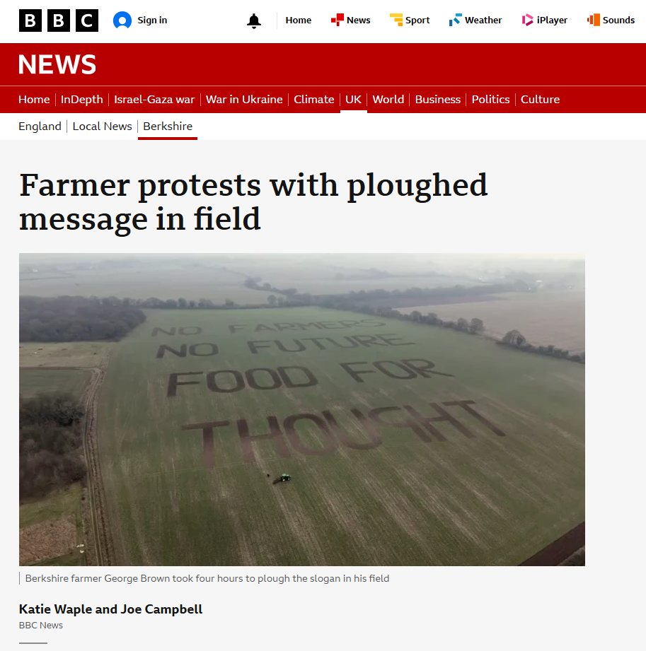
https://www.bbc.co.uk/news/articles/c0l19nxk73wo
A farmer has ploughed a message into his field as a protest against changes to inheritance tax.
George Brown, from Newbury, Berkshire spelt out the words "no farmers, no future, food for thought" in his field below the Heathrow flight path.
From April 2026, inherited agricultural assets worth more than £1m, which were previously exempt, will be liable to the tax at 20%, which is half the usual rate.
A government spokesperson said its £5bn investment in farming was "the largest budget for sustainable food production in our country's history".
The changes to inheritance tax were announced by Chancellor Rachel Reeves as part of the budget in the autumn.
The move prompted anger among farmers and led to national protests.
Mr Brown said he hoped his message would allow the public to "hopefully realise just how important their food is."
"My family have been farming for 170 years. My great-grandparents had it and I'm fourth generation and it's looking like the last at this rate.

Slide 6
"The long and short of it is, if there is no food there is no future, it's as simple as that. So that's the message and I've left it open to interpretation for people."
Thousands have already watched an online video of Mr Brown spelling out his message.
Mr Brown has already joined in protests against the tax changes.
"At the end of the day if you tax it on the land sale, rather than taxing it on death, then your family who want to continue farming can do so.
"It will protect the genuine farmer and it would also stop sheltering the investor who wants to buy into farmland to hide £3m," he said.
He said the slogan in the field should remain visible for about 18 months.
A government spokesperson said: "Our reform to Agricultural and Business Property Reliefs will mean three quarters of estates will continue to pay no inheritance tax at all.
"While the remaining quarter will pay half the inheritance tax that most people pay, and payments can be spread over 10 years, interest-free.
"This is a fair and balanced approach which helps fix the public services we all rely on.“
Answer the following questions, based on this particular political debate:
What message did George Brown plough into his field, and why did he choose this method to express his protest?
What are the key changes to inheritance tax for agricultural assets starting April 2026, and how do they differ from previous rules?
Why is George Brown concerned about the impact of these tax changes on farming and the future of food production?
How has the government responded to the concerns raised by farmers like George Brown regarding the inheritance tax reform?
What alternative solution does George Brown suggest to address the taxation issue, and what problem does it aim to solve?

Slide 7
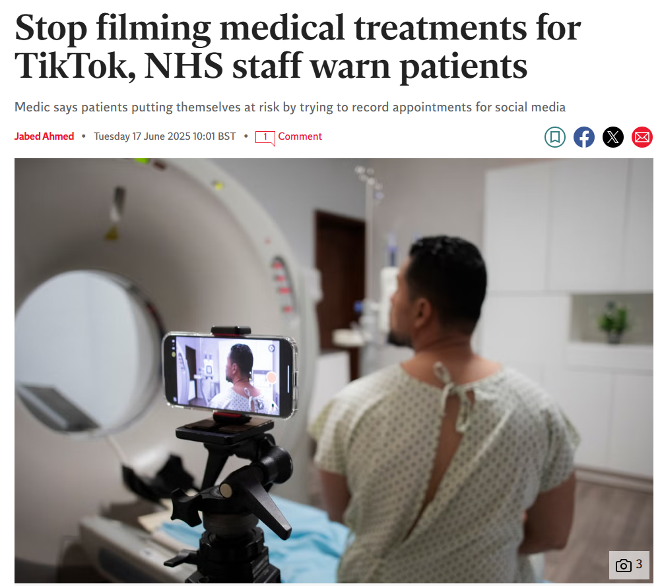
https://www.independent.co.uk/news/health/nhs-tiktok-filming-warning-patients-staff-b2771329.html
People are risking their health and that of others by filming medical procedures for TikTok and Instagram, medics have warned. The Society of Radiographers (SoR) said filming NHS staff and treatments places undue stress on health professionals during treatments, and risks publicising people’s private medical data. Filming can also distract staff and cause them discomfort, potentially compromising the quality of treatment provided, the society warned. It said there has been a worrying trend of people videoing their procedures on their phones, often without asking permission. The SoR is calling for clear and widespread NHS policies that prevent patients from filming or photographing their procedures without explicit permission. This will ensure a safer and more respectful environment for both staff and patients, it said.
Ashley d’Aquino, a therapeutic radiographer working in London, told the SoR’s Annual Delegates’ Conference that she had been approached by other members of staff, in her capacity as a union representative, over patients recording some of their cancer treatment. She added: “I had one patient whose relative started filming while I was trying to set up the treatment. It wasn’t the right time – I was trying to focus on delivering the treatment. We had another member of staff who agreed to take photos for a patient. But when the patient handed over her phone, the member of staff saw that the patient had also been covertly recording her to publish on her cancer blog.”

Slide 8
Most NHS staff wear identity badges and their names and job titles may be visible on videos posted online. “It makes people feel very uncomfortable and anxious,” Ms d’Aquino added.
A radiology department assistant from the south coast was using a cannular on a cancer patient, and the patient’s 19-year-old daughter started filming the procedure.
“She wanted to record the cannulation because she thought it would be entertaining on social media,” she said. “But she didn’t ask permission.
“In the next bay, a patient was having consent taken for a virtual colonoscopy, which is an invasive and potentially embarrassing procedure. That could have all been recorded on the film – including names and dates of birth. Anyone could be in the room – you don’t know their personal story. There are people who come into our department who have a limited social media presence because of risks to their safety. Patients filming make them feel unsafe in their own hospital. I spent the weekend afterwards worrying: did I do my job properly? I know I did, but no-one’s perfect all the time, and this was recorded. I don’t think I slept for the whole weekend.”
Dean Rogers, SoR director of industrial strategy and member relations, said the issue affects all health workers. He said there are some hospitals which have good policies around patients taking photos and filming procedures. However, he said this must in place in all hospitals trusts across the country.
“Hospitals need to ensure that they meet the needs of patients while also looking after staff members’ wellbeing,” Mr Rogers said. “And, in this case, safeguarding the one simultaneously safeguards the other – allowing healthcare professionals to do their job in safety, while also protecting patients’ privacy and helping them to receive the best possible care.”
Ms d’Aquino said there may be some valid reasons for patients to record medical conversations.
“Patients making audio recordings of consultations, for example, can enhance their understanding and retention of medical information,” she said.
Professor Meghana Pandit, NHS England’s co-national medical director for secondary care, said: “We want to do everything possible to support patients’ understanding of their diagnosis and treatment, but it’s vital that, if patients wish to record any part of their NHS care, they discuss this with their healthcare professional first and it remains for personal use only.”
Answer the following questions, based on this particular political debate:
What are the main concerns raised by the Society of Radiographers regarding patients filming medical procedures in NHS settings?
What policies or solutions does the Society of Radiographers propose to address the problem of unauthorized filming?
Why might some patients want to record their medical consultations or procedures, and how should these recordings be managed according to the article?
Consider the broader political and ethical implications of this issue: How do privacy rights, patient autonomy, and staff wellbeing intersect in this debate? What role should government and NHS policy play in balancing these interests?

Slide 9
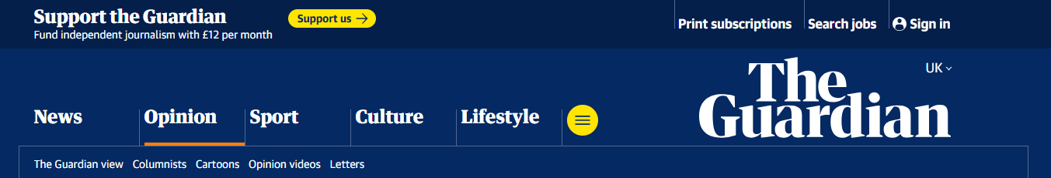
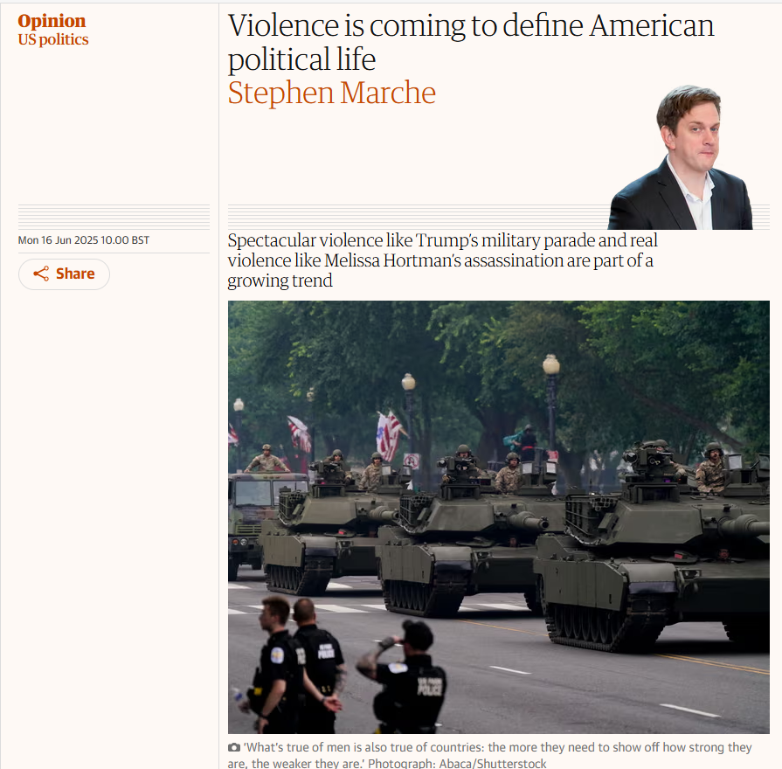
https://www.theguardian.com/commentisfree/2025/jun/16/us-politics-violence-trump-parade-protests
America reached its apex of self-parody shortly after 7pm on 14 June 2025. In that moment, the background band at Donald Trump’s military parade segued from Jump by Van Halen to Fortunate Son by Creedence Clearwater Revival, just after the announcer explained that M777 howitzers are made out of titanium.
Nobody, apparently, had considered the lyrics: “Some folks are born, made to wave the flag, they’re red, white and blue, and when the band plays Hail to the Chief, they point the cannon at you.” If this was some kind of surreptitious protest by the musicians, I salute them, but given the time and the place, sheer obliviousness is a better explanation. The crowd, pretty thin, did their best imitation of a cheer.

Slide 10
The US clearly does not know how to do an authoritarian military parade. To be fair, they are just getting started. Authoritarian military parades are supposed to project invincible strength. They are supposed to make your own people impressed with the inhuman discipline of your troops, and to strike fear into your enemies at the capacity of your organization. In Trump’s parade, the soldiers resembled children forced to participate in a half-assed school play, trying to figure out how to avoid embarrassment as far as possible, and the military itself looked better suited to running a Kid Rock tour than a country’s defence.
But do not confuse Trump’s debased parade with a joke or an innocent piece of entertainment. The Trump parade took place in the immediate aftermath of the assassination of Melissa Hortman, a Minnesota state representative. While it was under way, security forces were firing teargas on protesters in Los Angeles. Violence is coming to define American political life – spectacular violence including the parade and real violence like the assassination of Hortman. Political destabilization is arriving far too quickly to be perceived in its entirety. So much is happening so fast that it’s impossible to keep track of the decline. Increasingly, the question is becoming: when are we going to start calling this what it is?
When I published my book The Next Civil War in 2022, the US was very far from the threshold of what the experts at the Peace Research Institute Oslo defined as civil war, which is 1,000 combatant deaths a year. They defined civil conflict as 25 deaths a year, so the US already fits comfortably in that category. But the definitions of war and conflict never applied perfectly to the American reality, because it is so much bigger and so much more geographically diverse than other countries. As we start to see violence overtaking American political life, the transition is more like a sunset than a light switch. Every day violence becomes more and more settled as the means of US politics.
The parade, and the “No Kings” counter-protests, were both distractions from the fact that American political life is moving away from discourse altogether. Don’t like what the senators of the other party are saying? Handcuff them. Don’t like protesters? Send in the marines. Don’t like the makeup of the House of Representatives in Minnesota? Kill the top Democrat. The political purpose of the parade, from Trump’s point of view, was to demonstrate his mastery of the means of violence. He needed to show, to the military and to the American people, that he can make the army do what he tells it, and established traditions and the rule of law will not alter his will.
But the primary effect of the parade was to demonstrate an immense weakness, in Trump and in the American people. It was a parade reminiscent of the most vacuous regimes in history. In 1977, Jean-Bédel Bokassa, the leader of the Central African Republic, declared himself emperor and indulged in a coronation that imitated the coronation of Napoleon I in immaculate detail. He even went so far as to use eight white Norman horses to pull the carriage, but the French horses were not used to the climate and several died. Trump’s parade felt like a lazier version of that.
The spectre of defeat hovered over the entire celebration of supposed strength. The last time the US military threw a parade was 1991, which was the last time they triumphed over an opponent, the last time their war machine produced the results they had been attempting. The US has not won a war since then. But hey, if you can’t win a war, at least you can throw a parade.
Except they couldn’t even throw a parade! The end of the show was almost too perfect. A frail Lee Greenwood, a country singer long past his “best before” date, sang God Bless America raggedly, lousily. “Our flag still stands for freedom,” he sang. “They can’t take that away.” Oh can’t they? Trump at the centre fidgeted like a rich kid bored with his servants and toys. The whole business was like watching some sordid fairytale: the unloved boy who everybody hated grew up to force the American people to throw him a birthday party and give him a flag. And then almost nobody came.

Slide 11
What’s true of men is also true of countries: the more they need to show off how strong they are, the weaker they are. The weakness, rather than the strength, is terrifying. Whoever is so scared and so needy as to need that parade is capable of anything. That goes for Trump, and that goes for his country.
Answer the following questions, based on this particular political debate:
According to the passage, how does Trump attempt to demonstrate his control over the U.S. military and political system through the parade, and why does the author believe this ultimately signals weakness rather than strength?
What examples does the writer give to show that violence is becoming a bigger part of politics in the United States?
How does the writer compare Trump’s parade to another leader’s event in Africa in the 1970s, and what does this comparison suggest?
What is the difference between a civil conflict and a civil war, and why does the writer think these definitions don’t fully explain what’s happening in the U.S.?

Slide 12
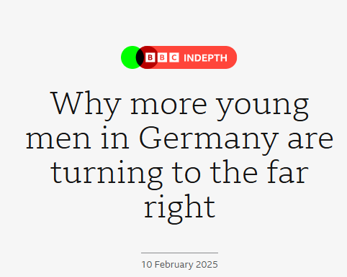

https://www.bbc.co.uk/news/articles/cy082dn7rkqo
"What my parents taught me is that they used to live in peace and calm, without having to have any fear in their own country," says 19-year-old Nick. "I would like to live in a country where I don't have to be afraid."
I meet him in a small bar on a street corner in the ex-mining town of Freiberg, Saxony – where he is playing darts.
It's a cold, foggy night in February with just over two weeks to go until Germany's national election.
Nick and his friend Dominic, who is 30, are backers or sympathetic to Alternative für Deutschland - a party that has been consistently polling second in Germany for more than a year and a half, as the far right here and elsewhere in Europe attracts an increasing number of young people, particularly men, into its orbit.
One particular reason why Nick – and many other young German men – say they are afraid is the number of attacks in Germany involving suspects who were asylum seekers – most recently, the fatal stabbing of a toddler and a man in a park in the Bavarian city of Aschaffenburg. Immigration is now Nick and Dominic's main concern, although they don't oppose it in all forms.
"The people who integrate, who learn, who study here, do their work - I have no problems with them," says Dominic, though he is critical of anyone he sees as taking advantage of the asylum system.
"But these days such statements are seen as hostile," says Dominic. "You're called a Nazi because of Germany's past.“
The AfD - which has long been accused of anti-migrant rhetoric - is celebrating endorsements from tech billionaire, Elon Musk, who owns the social media site X. He has hosted a live discussion with party leader Alice Weidel on the platform and dialled into a party rally.
Now, as Germany waits to see just how well the far right does in the upcoming election, the question is why so many young men in particular are being drawn to the far right and what the consequences could be for a country that's deeply conscious of its Nazi past.
Pew research in 2024 found that 26% of German men had positive views of the AfD compared to 11% of women, and the share of men holding this opinion has risen 10 points since 2022.
In the elections for the European Parliament in 2024, according to German exit polls the number of under 24-year-olds, both male and female, who voted for the AfD in Germany rose to 16 per cent, up by 11 points from 2019.
This comes at a time of rising general anxiety among young people according to a recent study by the German Institute for Generational Research.
In a sample size of 1,000 Germans aged 16 to 25, anxiety levels were the highest amongst respondents who class themselves as far-right while they were the lowest amongst people who put themselves in the middle of the political spectrum.
Women were more likely to be concerned for their rights and those of minority groups while men were found to be more worried about conservative values that are less based around rights.

Slide 13
Dr Rüdiger Maas, from the German think tank the Institute for Generational Research, says parties on the left often focus on themes such as feminism, equality and women's rights.
"Overall, men don't see themselves in these themes," he tells us. "That is why they have a tendency to vote further right."
Hard, populist right parties have also done well in countries such as France, Austria, the Netherlands, Poland, Spain and Italy.
"Sixty per cent of young men under 30 would consider voting for the far right in EU countries and this is much higher than the share among women," says Prof Abou-Chadi, in analysis drawn from a subset of the 2024 European Election Study.
As well as gender, migration and economic issues, social media is playing a part. Platforms like TikTok allow political groups to bypass mainstream, traditional media, which the far right regard as hostile.
It's clear that AfD "dominates" TikTok when compared to other German parties, says Mauritius Dorn from the Institute for Strategic Dialogue (ISD). It has 539,000 followers on its parliamentary account, compared to 158,000 for the SPD who currently have the most seats in the German parliament.
And it isn't just official accounts but a "considerable number of unofficial fan accounts also help to disseminate the party's content", says Mr Dorn.
Through setting up 10 "persona-based" accounts with different user profiles, they found, "those users who are more on the right-wing spectrum… see a lot of AfD content whereas users from the leftist spectrum see a more diverse set of political content."
TikTok has said it doesn't "differentiate" between the right, left or centre of politics and works to stay at the "forefront" of tackling misinformation.
Dorn observes that other parties recognised sites such as TikTok "too late", which means they're playing catch-up in establishing a strong footprint on the platform.
We've met one AfD influencer, Celina Brychcy - a 25-year-old TikTokker who has more than 167,000 followers - 53% of whom are male, with 76% aged between 18 and 35.
She mainly shares dance, trend and lifestyle videos, but also pro-AfD content.
Ms Brychcy says she doesn't make money from promoting the AfD but does it because she believes in the cause and wants to "get a message across".
Her political ideals include wanting the return of military service, more support for mothers who want or need to stay at home and stricter border controls.
When I press her about whether her views amount to a rejection of multiculturalism she replied no, but believes people should "integrate."
"There are certain people who just don't fit in with us Germans," she added but repeatedly insisted she is not racist and doesn't have "anything against foreigners."
Ms Brychcy is also against "role reversal" when it comes to the way men and women dress.
A reaction against "gender ideology" is another issue identified by Tarik Abou-Chadi, a professor of European Politics at the University of Oxford, as feeding far-right support amongst the young - something that is echoed by the Institute for Generational Research.
They asked first-time voters whether they found the LGBTQ+ trend "übertrieben", which literally means "exaggerated" or over the top. The respondents who showed the highest level of agreement with that question were those who planned to support the AfD.
When I challenge Ms Brychcy over whether that could be seen as retrograde, she replied that "biologically speaking, we are men and women" and thinks people should present accordingly.
Ms Brychcy tells me she has lost a couple of friends because of her politics - and now mostly spends time with those of a similar outlook.
She doesn't agree with those who view the AfD as a dangerous movement - rather one that would offer genuine, radical change.
When I ask Ms Brychcy if she considers herself as far-right, she says that on certain issues - such as border control and crime, "Definitely yes".
It's a striking reply, particularly as often, the label of far-right is rejected by supporters of the AfD, including by the party leader, Alice Weidel, who insists she heads a conservative, libertarian movement.

Slide 14
With the horrors of the Nazis further and further in the past, this is a generation that's grown up with parties like the AfD - whether that's on TV talk shows or in parliament after the AfD got its first MPs in 2017.
Prof Abou-Chadi believes that the far right, generally, has become more normalised to the point, "They don't seem so extreme any more."
That's despite party scandals such as a talisman of the AfD's hard right, Björn Höcke, being fined twice last year for using a Nazi slogan, though he denied doing so knowingly.
The AfD, in three German states, is classified as right-wing extremist by authorities - including in Saxony, a designation the party unsuccessfully challenged in court.
It's a state where the number of "right-wing extremist individuals" had reached a "new high" - according to a report released last year by Saxony's domestic intelligence service - that showed data back to 2015.
In a shopping mall in the city of Chemnitz in Saxony, we meet a group of young men who – while they won't go on the record – tell us they're right wing.
Dressed in black, with uniformly short hair, they express beliefs that homosexuality is wrong and fear that the German "race" is under threat because of the growing migrant community.
They question narratives about their country's past, seemingly a reference to the Nazi era.
Diana Schwitalla has been teaching history and social studies for eight years. She says she has had to confront a case of Holocaust denial in the classroom and has heard other troubling remarks.
"We hear the Second World War was actually a good thing, and there was a reason people died then - and that this is good. Hitler is described as a good man," says Ms Schwitalla.
She adds, "Many students… very young students, {who} say it doesn't matter who I vote for, they'll do what they want 'up there' anyway. The question of who's 'up there', I don't get an answer to that."
We met her over the course of two days - including at an adult vocational college in Freiberg that sits on the grounds of a former Nazi concentration camp. Jewish women, brought from Auschwitz, were used for slave labour here to make parts for aeroplanes.
We did hear some talk of opposition to the levels of immigration into Germany plus a desire for national pride.
The first day we met Ms Schwitalla, she is helping to organise a mock election for the students as a way of engaging them about democracy at another college site in the town of Flöha – about 15 miles away from Freiberg.
We spoke to Cora, Melina and Joey, all 18.
Cora says she has heard men of her age express a desire for women to be in the home harking back to a time "when women took care of the children and when the husband comes home from work, the food is cooked". She likens it to the so-called "Trad Wife" trend of adhering to traditional gender roles.
Cora and Melina voice fears about a rollback of women's rights – including on abortion, even - remarkably - the right to vote. "Luckily that's not being discussed in politics yet," says Melina, "but I've heard discussions about women not being allowed to vote in elections any more."
A small group of students line up to vote around lunchtime and we watch as the results come in with "Die Linke" scoring top - the left party that's relatively popular amongst the young but polling at only around five per cent nationwide.
The AfD came second, reinforcing what Prof Abou-Chadi has found, that, "younger people are much more likely to go for a further left or further right party than a centrist one".
The AfD, whose signature issues include security, borders and migrant crime, are now even embracing the concept of "remigration" - a buzz-word in Europe's far right that's widely understood to mean mass deportations.
Speaking to people in Germany, it is clear that support for the AfD can not just be read as some form of protest vote, even if there is frustration with the parties that have traditionally governed Germany. Celina, Dominic and Nick - and others we spoke to - genuinely hope and believe that the AfD could set Germany on the path of radical change.
It's still the case that other parties will not go into coalition with the AfD but in January a non-binding motion was passed in the German parliament thanks to AfD votes for the first time.

Slide 15
Prof Abou-Chadi believes in the longer term, there could be an even more seismic change.
"And as soon as the more mainstream parties start giving up the 'firewall' or cordon sanitaire the far right will start cannibalising the right.
"It's very likely that, in many or most European countries, the far-right parties will be the main party on the right – or already are," he says.
Parties like the AfD have worked hard to try and normalise themselves in the eyes of the public.
While there are people in Germany and Europe who view the far right as an extremist, even anti-democratic, force - it appears that the 'normalisation' effort is working, not least of all among the young.
Answer the following questions, based on this particular political debate:
What factors mentioned in the article contribute to young German men’s increasing support for the far-right party AfD?
According to the article, why are young men more likely than young women to support far-right parties like the AfD? Discuss the role of gender in shaping political identities and concerns.
How does social media, especially platforms like TikTok, impact the popularity and messaging of the AfD among young voters? Why might social media be more effective for far-right parties compared to traditional media?
How does Germany’s Nazi past affect public perception and political discourse around far-right parties today? Why do some young people reject the "far-right" label despite supporting parties like the AfD?
What does the rise of both far-left and far-right parties among young voters suggest about political polarization in Germany? How might this trend affect the future of German democracy and mainstream political parties?

