Slide 1
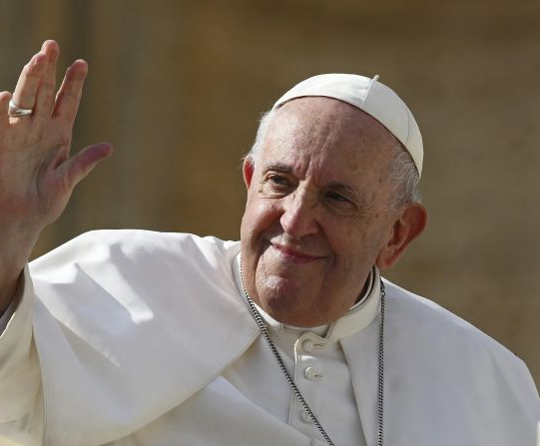


‘As stewards of God's creation, we are called to make the earth a beautiful garden for the human family. When we destroy our forests, ravage our soil and pollute our seas, we betray that noble calling.’

Slide 2
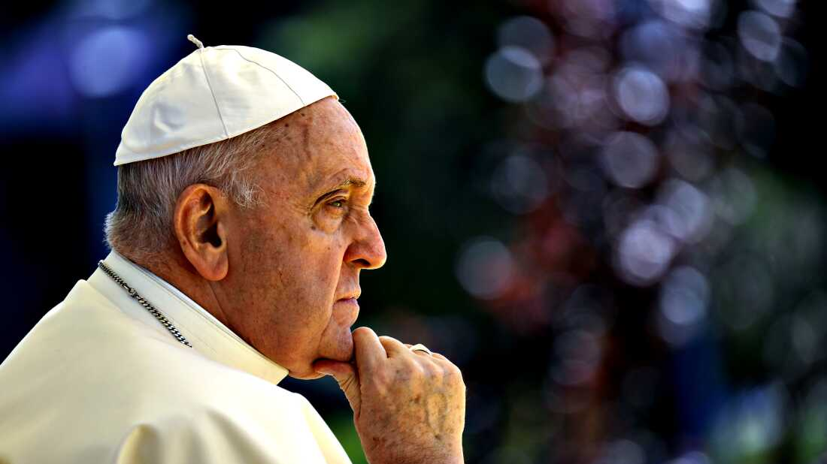
‘Dear young people, have you thought about the talents that God has given you? Have you thought of how you can put them at the service of others?
Do not bury your talents! Do not be afraid to dream of great things!’

Slide 3
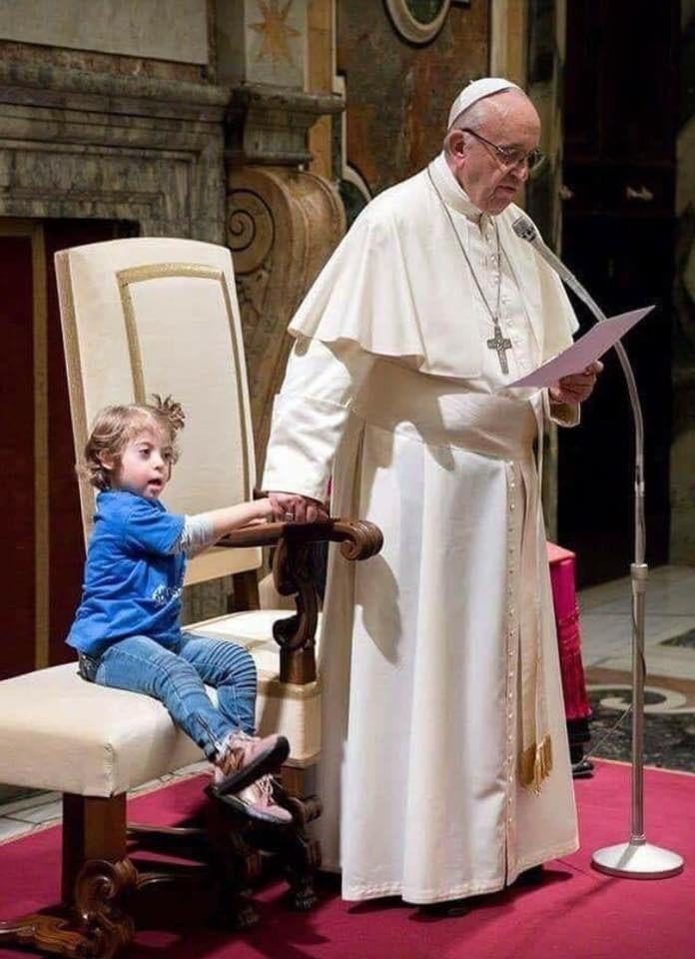
Let the risen Jesus enter your life,
welcome him as a friend,
with trust; he is life.
If up till now you have kept him
at a distance, step forward.
He will receive you with open arms.

Slide 4
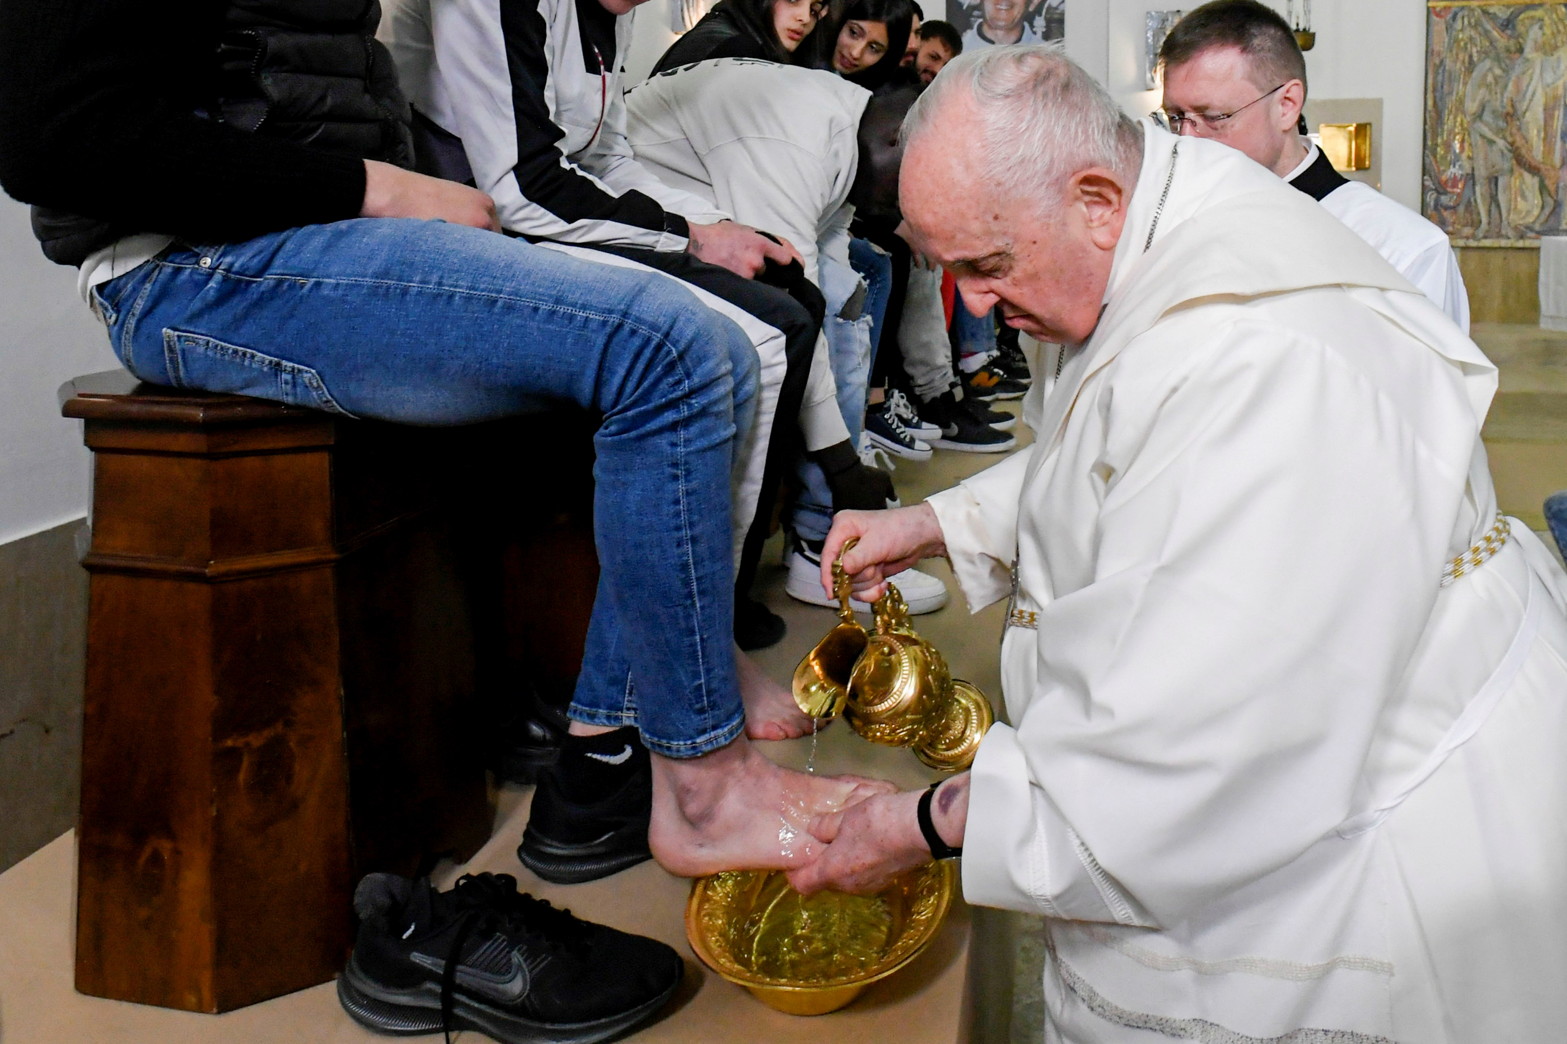
If you have been indifferent,
take a risk;
you won’t be disappointed.
If following him seems difficult
don’t be afraid, trust him.
Be confident that
He is close to you,
He is with you
and He will give you the peace
you are looking for
and the strength to live
as he would have you do.

Slide 5
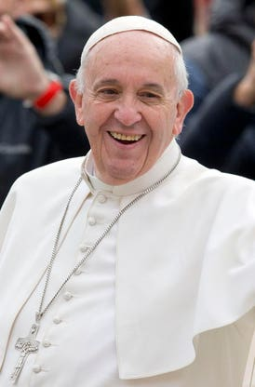
“ Kindness is firm and persevering intention to always will the good of others, even the unfriendly." "We must restore hope to young people, help the old, be open to the future, spread love. Be poor among the poor. We need to include the excluded and preach peace."

Slide 6
‘I believe in God – not in a Catholic God; there is no Catholic God. There is God and I believe in Jesus Christ, his incarnation. Jesus is my teacher and pastor, but God, the Father, Abba, is the light and Creator. This is my being.’

Slide 7
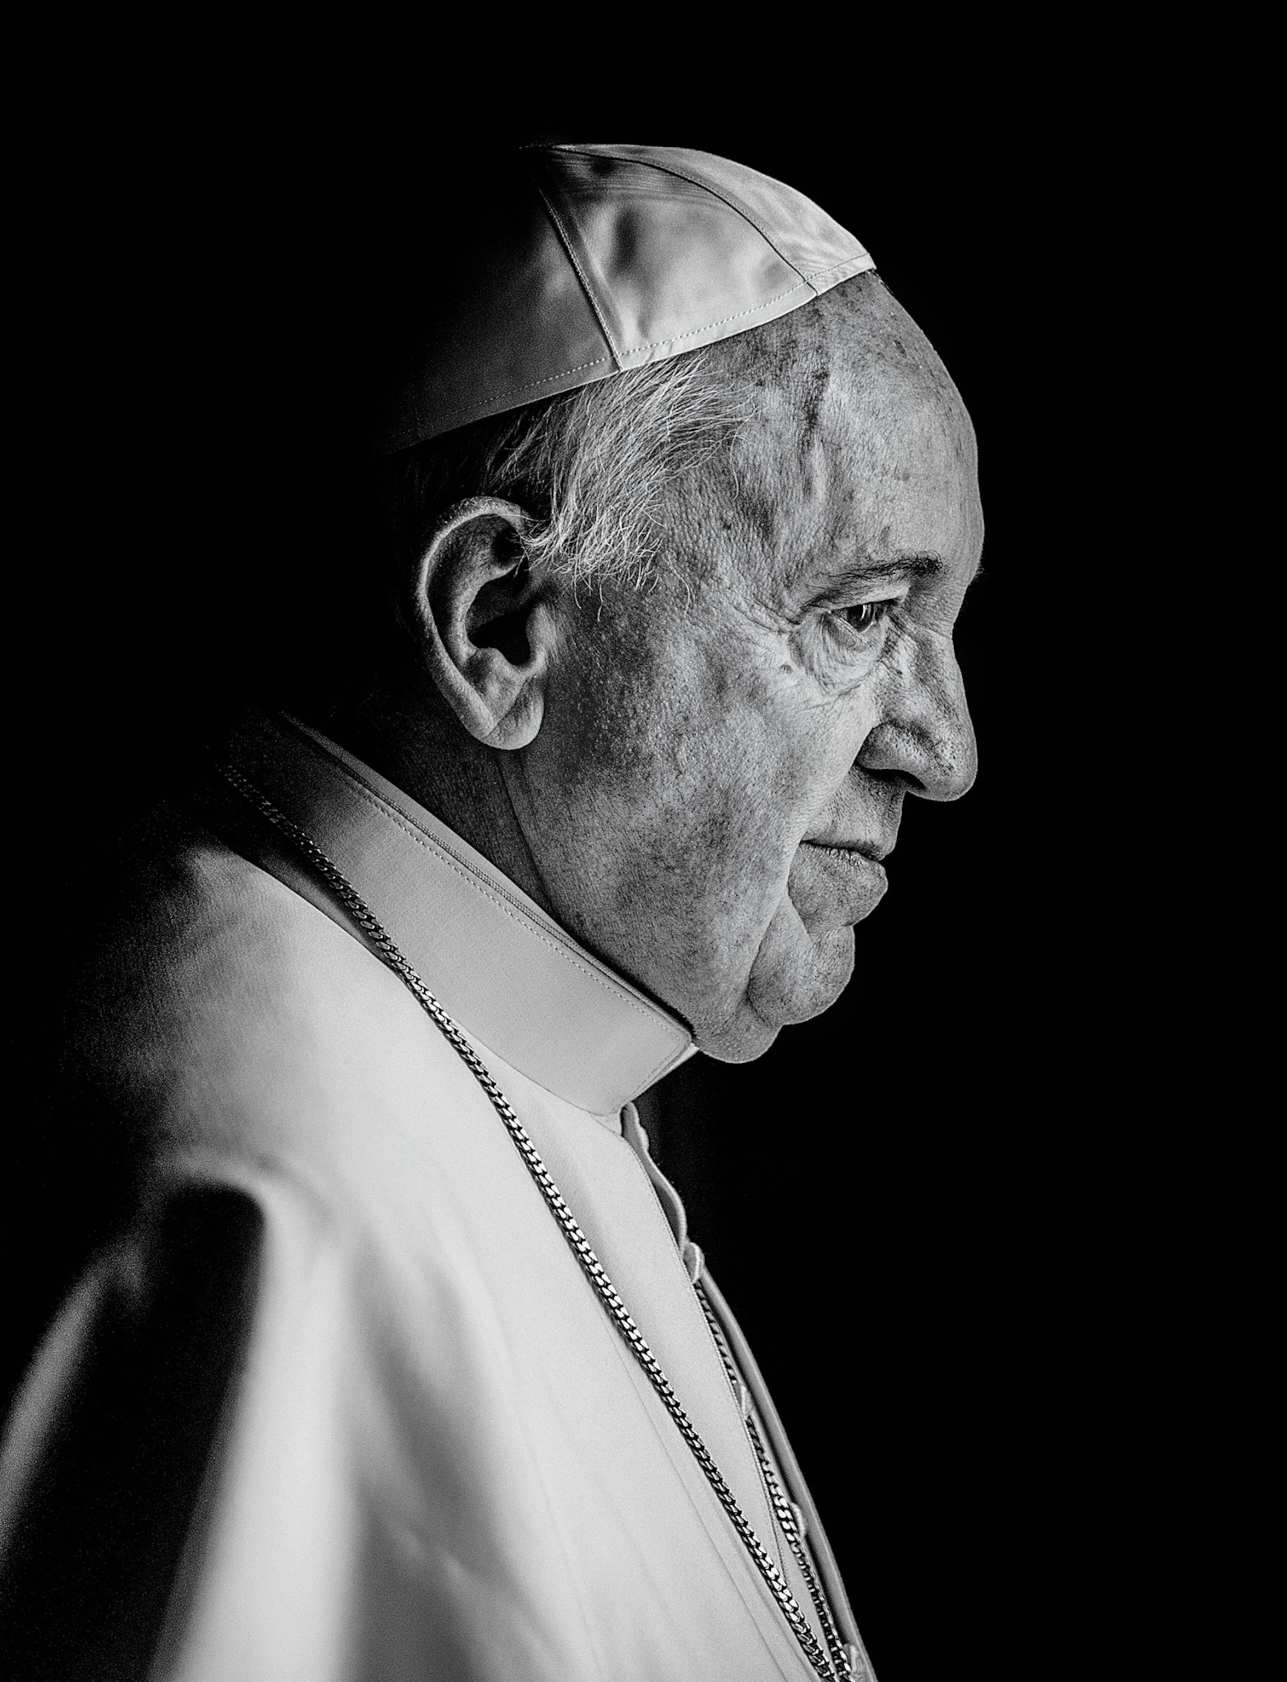
Loving God,
We give you thanks for your servant, Pope Francis.
We thank you for his inspirational example and the love he showed to all Your creation.
Notes:
After the prayer say, We will now take a moment to reflect and pray for Pope Francis as we remember some of his inspirational words.

Slide 8
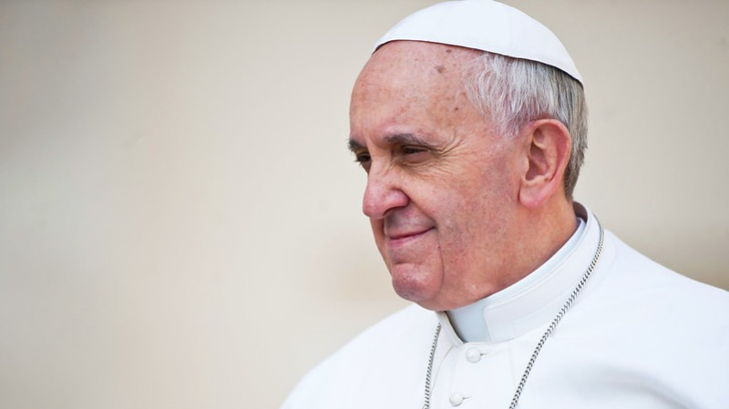
Pope Francis
1936 - 2025
Eternal rest grant unto him, O Lord,
and let perpetual light shine upon him.
May he rest in peace.
Amen.

