Slide 1

SUCCESS
Thoughts and Prayers
Monday 5th May – Friday 9th May

Slide 2
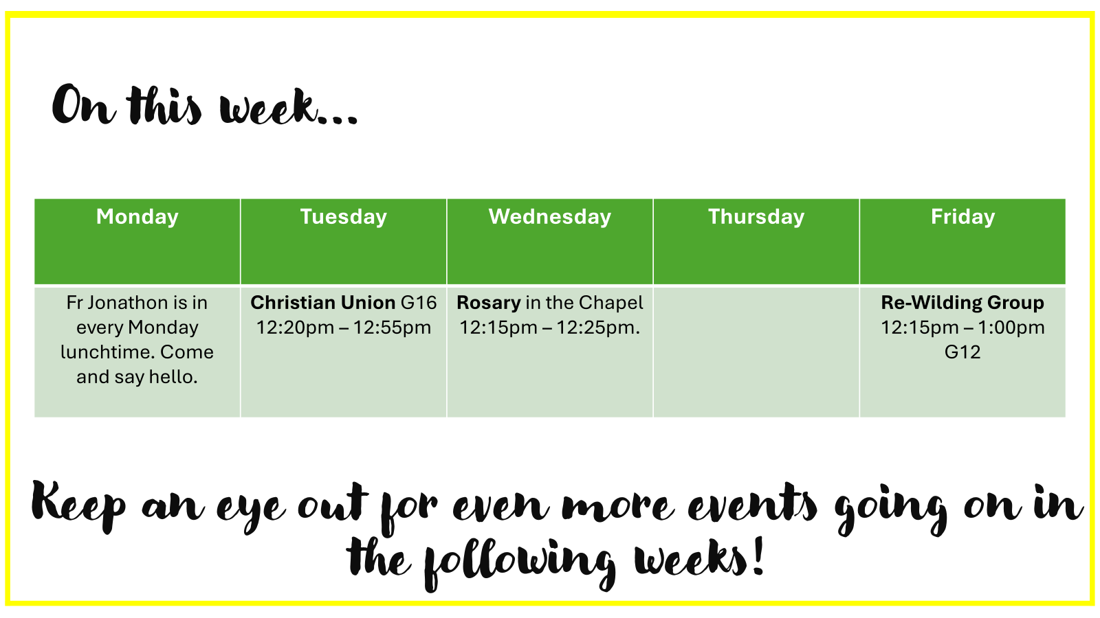

Slide 3

Every Friday Lunchtime in G16 starting at 12.30pm
Everyone is welcome!

Slide 4
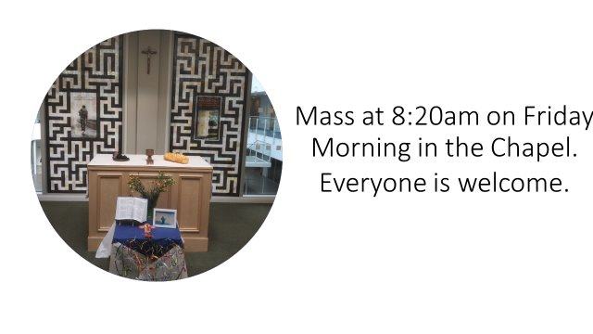

Slide 5


MORNING PRAYER IN THE CHAPEL THIS WEEK
Tuesday 6th May - 9A
Wednesday 7th May - 8Y
Thursday 8th May - 9I
Friday 9th May - 9N

Slide 6
SUCCESS
Thoughts and Prayers
Monday 5th May – Friday 9th May

Slide 7

What do YOU think it means to be successful?

Slide 8
Success
Being True To Who You Are
Financial Security
Reader 1 - Success is subjective and can vary from person to person.
Some people may define success in terms of achievements, such as high grades or gaining recognition for their work.
Reader 2 - Some find success in personal relationships and emotional well-being. They may value strong and meaningful connections with loved ones, having a supportive network of friends, or experiencing a sense of happiness and contentment in their lives.
Reader 3 - For some, achieving success means continuously learning, developing new skills, and expanding their knowledge and capabilities. It can involve overcoming challenges, setting and achieving personal goals, and becoming the best version of oneself.
Working Hard At Something You Love
Keeping Meaningful Relationships
Saying Yes and No to the right things
Self Belief
Confidence
Being Happy

Slide 9

Let's Reflect...
Take a few moments to think about your past achievements. These could be academic, personal, athletic, creative, or any other area you consider significant
Write down at least three achievements that you are proud of and briefly describe why you consider them successful.
Try to think beyond grades or awards and consider personal growth, overcoming challenges, or positive impacts you have made.

Slide 10
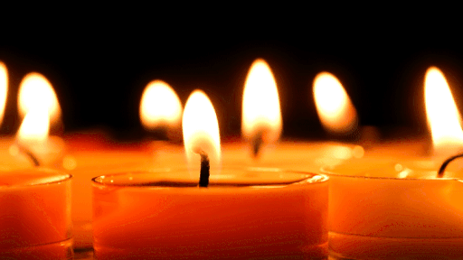
Let Us Pray
Heavenly Father,
I come before you humbly today, seeking your guidance and blessings for success in my endeavors. You are the source of all wisdom and strength, and I place my trust in you.
Grant me clarity of mind, that I may make wise decisions and take the right actions. Help me to see opportunities where others may see obstacles, and give me the courage to pursue them with determination and perseverance.
I ask for your grace to be upon me, that doors may open and paths may be made clear. May my efforts be fruitful and rewarding, bringing not only personal success but also benefit to those around me
Amen

Slide 11
SUCCESS
Thoughts and Prayers
Monday 5th May – Friday 9th May

Slide 12
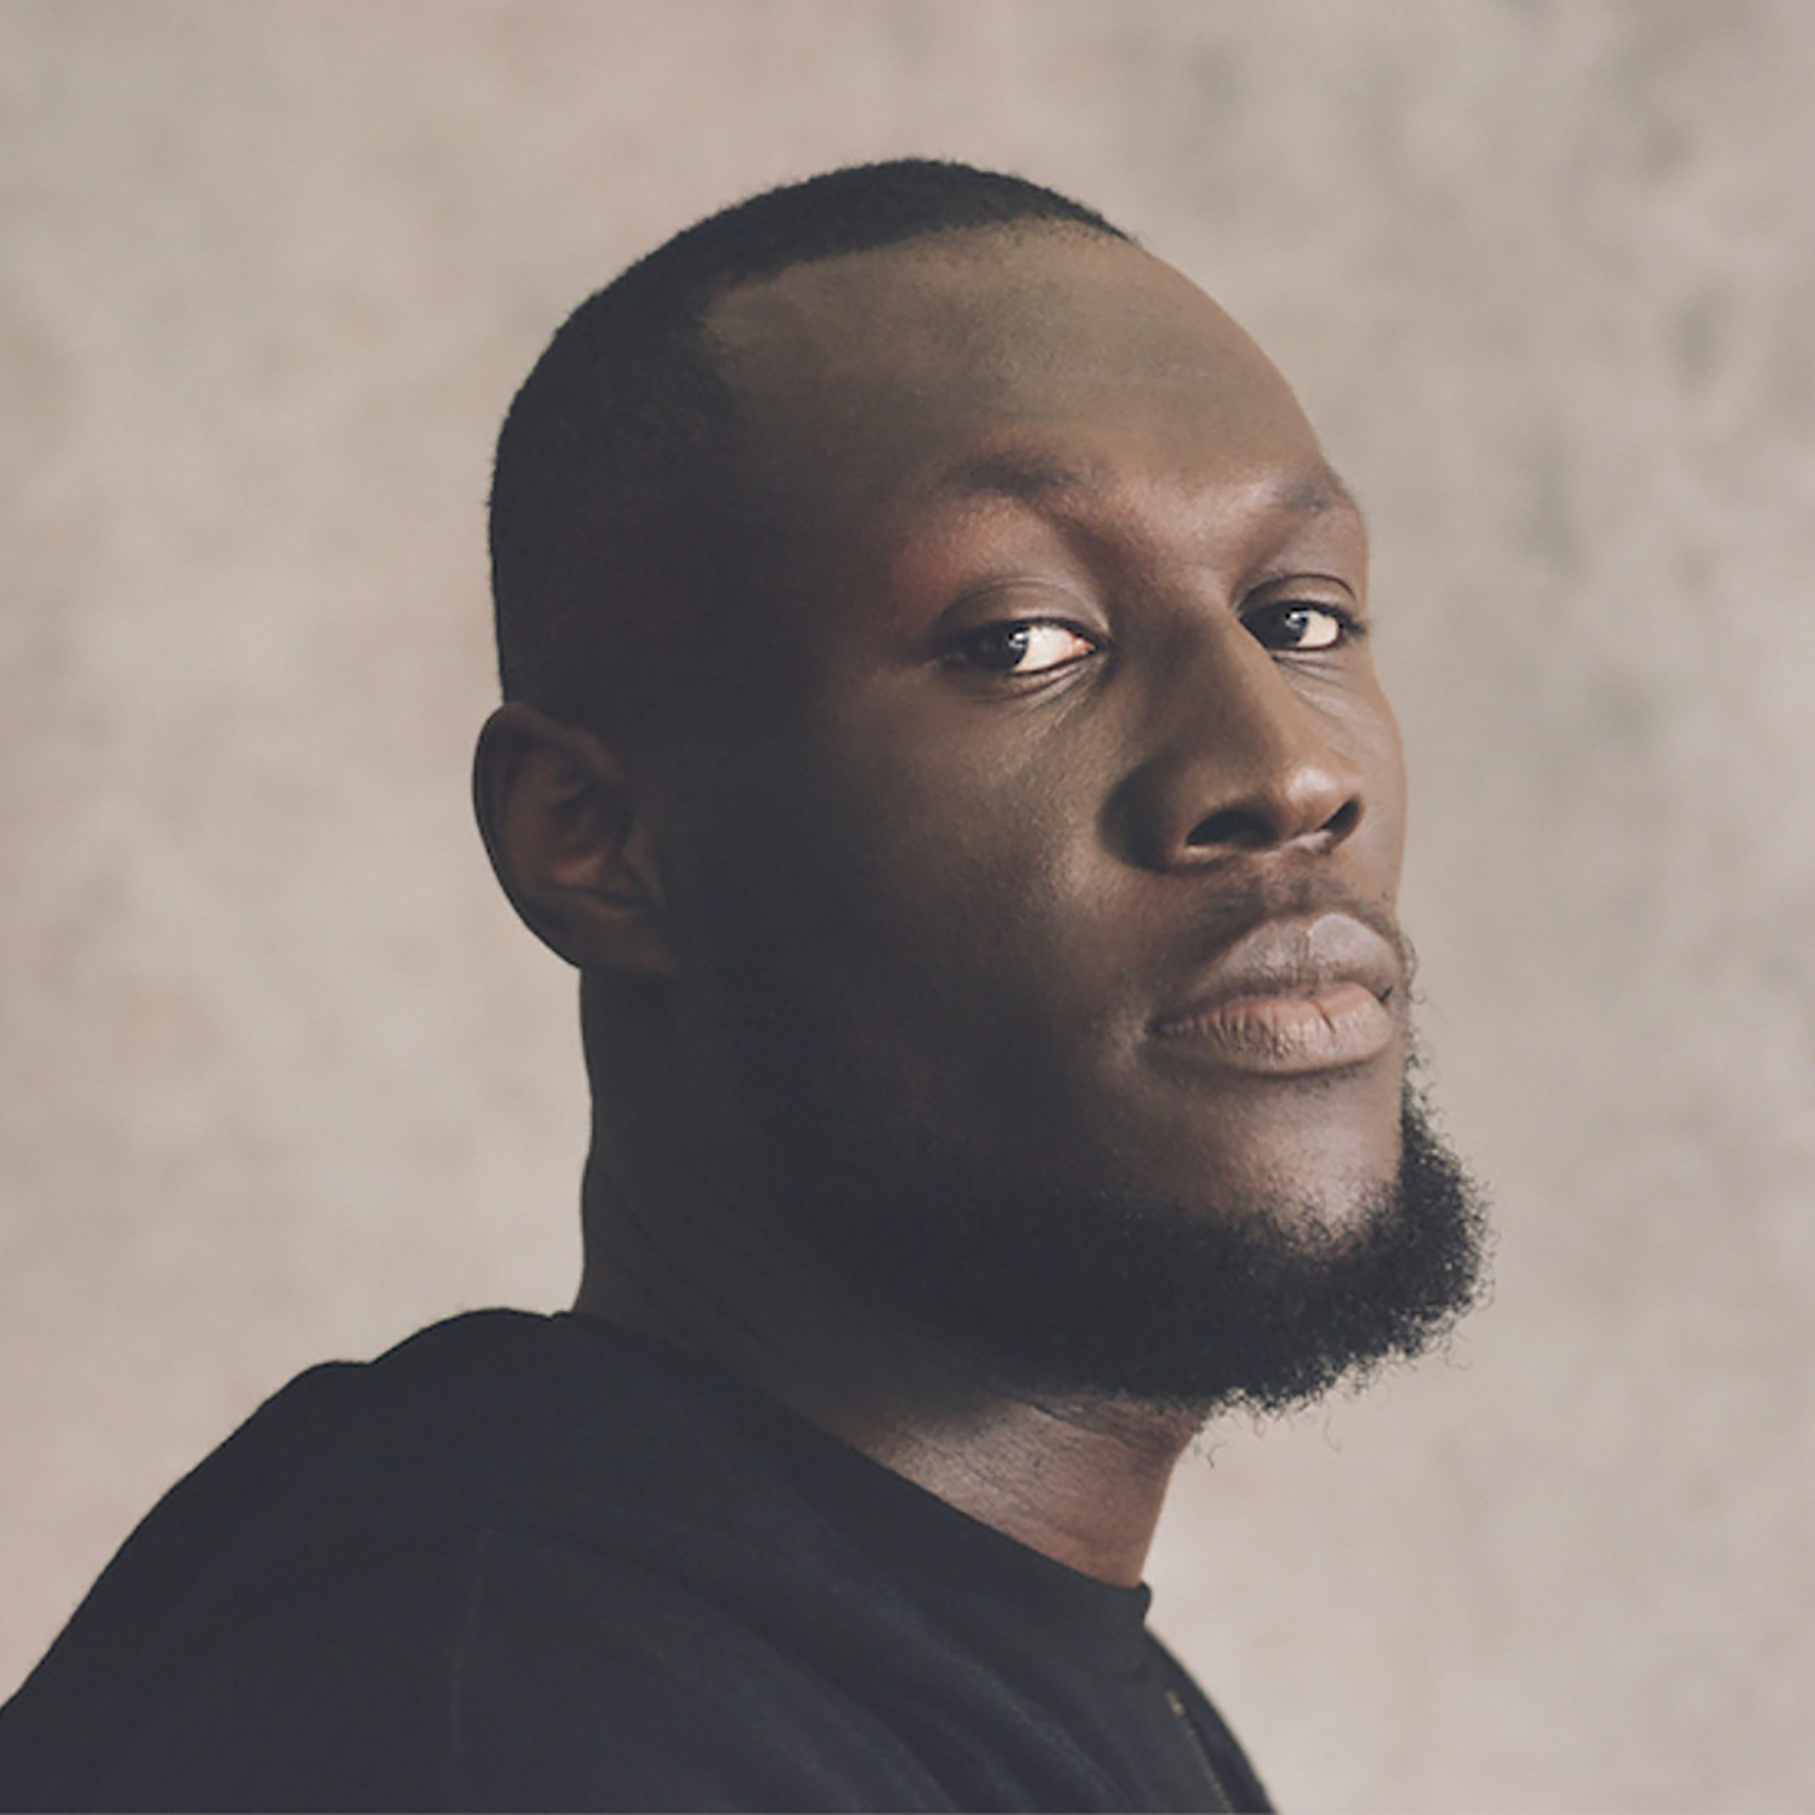
Stormzy
Stormzy is a British rapper and singer/song-writer.
In his song "Big For Your Boots," Stormzy touches on the subject of success and the challenges that come with it. The lyrics convey a sense of determination and not allowing success to change one's character or forget one's roots.
In interviews, Stormzy has talked about his journey to success and the importance of staying focused on one's goals. He has mentioned that success should not be measured solely by financial achievements but by the positive impact one can make in the world. Stormzy has also spoken about the responsibility that comes with success and using his platform to address social issues and empower others.

Slide 13
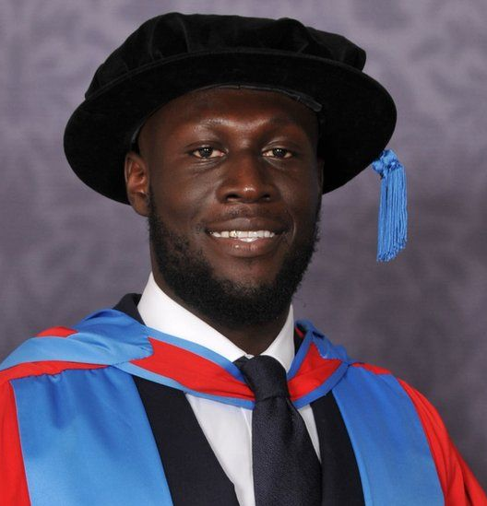
Stormzy's Journey To Success
Reader 1 - Stormzy has spoken publicly about his turbulent background. He grew up in the Croydon area of South London, which is known for its social and economic challenges. Stormzy has mentioned in interviews and his music that he faced various difficulties while growing up, including experiences with poverty, crime, and violence.
Reader 2 - Stormzy has been candid about his involvement in street activities during his teenage years, including being involved in gang culture.
Despite this, Stormzy went on to achieve success, becoming a multi award winning platinum sensation.
Reader 3 - In addition to his commercial success, Stormzy has been praised for addressing social and political issues in his music. His performances and lyrics often touch on topics such as racism, inequality, and the challenges faced by young black people in the UK.
When Stormzy graduated from Exeter University, he gave this speech highlighting the importance of trusting in God's plan to get us to where we are supposed to be
https://www.youtube.com/watch?v=VL6uakV-c3Q

Slide 14
Let Us Pray
Dear Lord,
I surrender my ambitions to you, knowing that you have plans for my life that are far greater than what I can imagine. Guide me along the right path, and may my achievements be in alignment with your divine purpose.
In your boundless love and mercy, I trust that you will bless me with success according to your perfect plan. I offer this prayer with gratitude and faith, knowing that you are always with me.
Amen

Slide 15
SUCCESS
Thoughts and Prayers
Monday 5th May – Friday 9th May

Slide 16
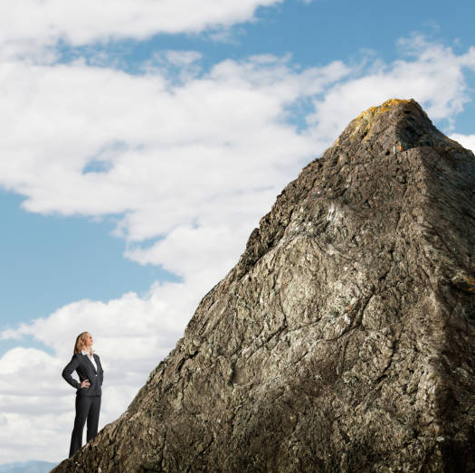
Creating and Reaching Goals
Reader 1 - As secondary school students, you are at a crucial stage of your lives where you have dreams, ambitions, and goals that you strive to achieve. Whether it's excelling academically, pursuing a passion, or working towards personal growth, breaking your goals into smaller steps can make a significant difference in your journey to success.
Reader 2 - Imagine standing at the base of a towering mountain, contemplating how to reach its summit. It may seem daunting, even impossible, to reach the top. However, if you break down your ascent into smaller steps, each one leading you higher and closer to the peak, suddenly the goal becomes much more achievable. The same principle applies to any goal you set in your life.

Slide 17
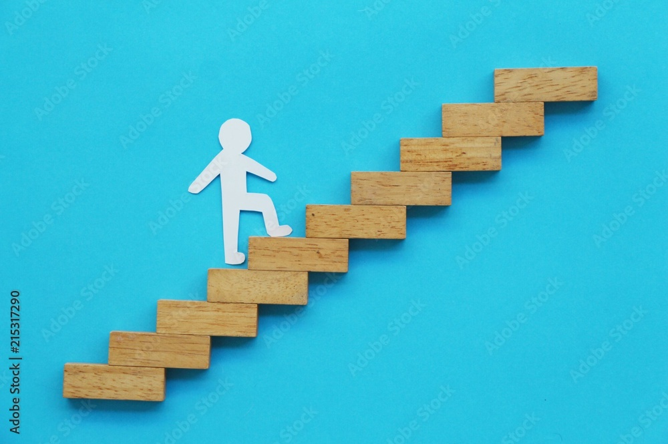
Steps to Success
FINAL GOAL
Big dreams can be very daunting.
But if we focus on those long-term goals by creating smaller goals that build up to where they want to be it can seem a lot more manageable. A student in Year 9 that dreams of becoming a doctor may see that goal as far away, intimidating, and frightening. However, if they break up that big goal into smaller short-term goals it will make that big dream of becoming a doctor seem much more achievable.
Think of one goal that you want to achieve
Draw a ladder on your paper and write your final goal at the top. Then consider the smaller steps that will help you achieve it.
Step Three
Step Two
Step One
Where you are now

Slide 18
Let Us Pray
Dear God,
Bless our journey towards our goals. Guide us with wisdom, strength, and grace. Grant us success and purpose, To make a difference in this world.
Amen.

Slide 19
SUCCESS
Thoughts and Prayers
Monday 5th May – Friday 9th May

Slide 20
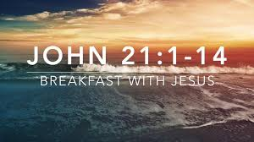
Our Scripture This Week
After Jesus' resurrection, several of His disciples — including Peter, Thomas, Nathanael, and others — went fishing on the Sea of Tiberias (Sea of Galilee). They fished all night but caught nothing. In the morning, Jesus (whom they did not at first recognise) stood on the shore and told them to cast their net on the right side of the boat.
When they obeyed, they caught so many fish they could not haul the net into the boat. Realizing it was the Lord, Peter jumped into the water to reach Him. When the others arrived with the boat and the heavy net, they found Jesus had already prepared a fire with fish and bread, and He invited them to eat.
This event showed Jesus' ongoing provision and presence, even after His resurrection, and symbolized the disciples' future success as "fishers of men" when they trusted and obeyed Him.

Slide 21
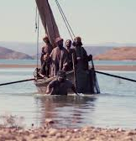
How Does It Link To Success?
True success comes not just from hard work (the disciples fished all night with no results) but through trusting and obeying God's direction.
Success is a gift when we are in partnership with God, rather than striving alone.
Recognition of Jesus in the moment of abundance reminds us to stay grounded in gratitude and relationship rather than pride.
It teaches that patience, faith, and listening lead to a deeper, more meaningful kind of success than mere material achievement.

Slide 22
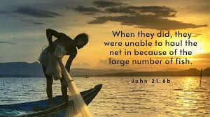
Discussion Questions
Why do you think the disciples caught nothing at first, even though they were experienced fishermen?
What made the difference when Jesus told them where to fish?
How might this story change the way we think about success in school, sports, or life?
What does it mean to "listen to Jesus" today?

Slide 23
Let Us Pray
Dear God,
Thank You for reminding us that true success comes from trusting You.
Help us to listen to Your voice, even when the way seems hard or uncertain.
Teach us to work with patience, faith, and love,
and to remember that with You, our efforts have meaning and purpose.
Bless the work of our hands and hearts today
Amen.

