Slide 1


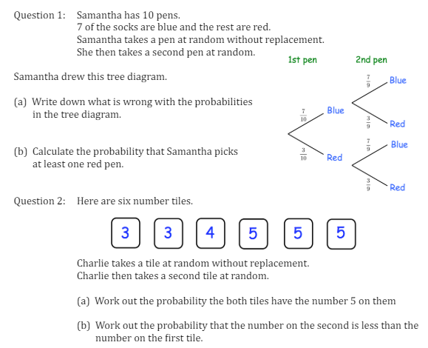
Finding the probability of combined events where the second is dependent on the first
Enter code U246, U699, U821 and U806 Into Sparx Independent Learning and/or
Follow this link to watch a video on Probability:
https://corbettmaths.com/2013/06/18/conditional-probability/
Work through the questions below to check your understanding (solutions on next page):

Slide 2
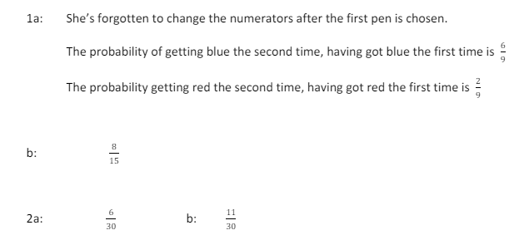
Solutions

