Slide 1


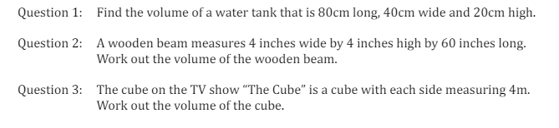
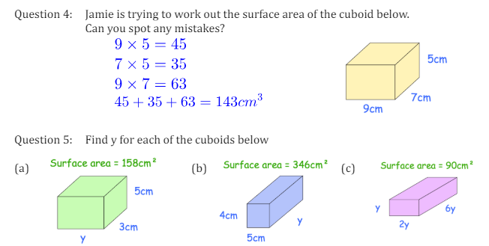
Finding the volume and surface area of cubes and cuboids
Enter code U786 and U929 Into Sparx Independent Learning and/or
Follow these links to watch videos on surface area and volume :
https://corbettmaths.com/2013/03/29/surface-area-of-a-cuboid/
https://corbettmaths.com/2012/08/09/volume-of-cuboids-and-cubes/
Work through the questions below to check your understanding (solutions on next page):

Slide 2


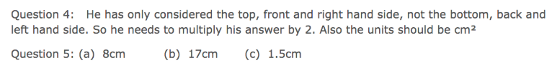
Solutions

