Slide 1


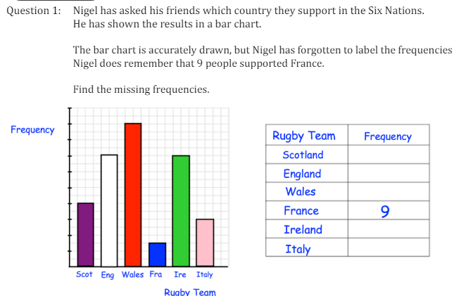
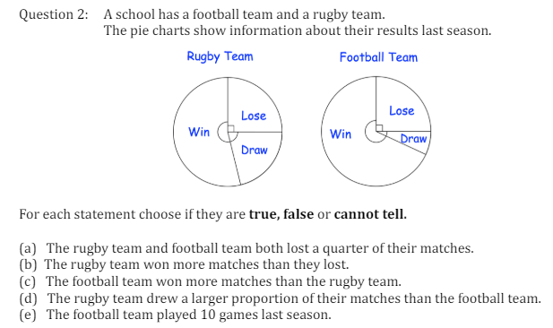
Interpreting and Constructing Pie Charts, Composite Bar Charts and Pictograms
Enter code U 506, U557, U508 and U172 into Sparx Independent Learning and/or
Follow these links to watch videos on Data representation:
https://corbettmaths.com/2012/08/10/reading-bar-charts/
https://corbettmaths.com/2012/08/09/reading-pictograms/
https://corbettmaths.com/2013/05/25/interpreting-pie-charts/
Work through the questions below to check your understanding (solutions on next page):

Slide 2
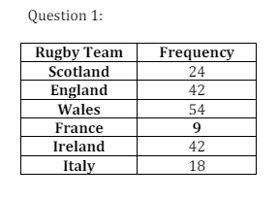
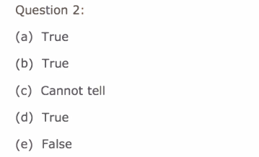
Solutions

