Slide 1


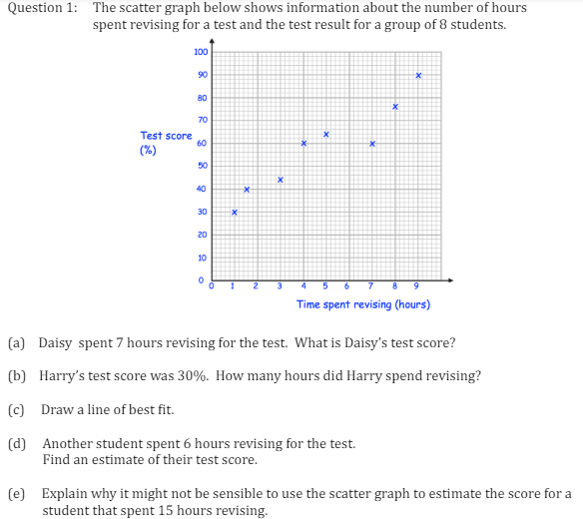
Constructing and Interpreting Scatter Diagrams
Enter code U199, U277 and U128 into Sparx Independent Learning and/or
Follow these links to watch videos on Data representation:
https://corbettmaths.com/2012/08/10/scatter-graphs/
https://corbettmaths.com/2012/08/10/scatter-graphs-correlation/
Work through the questions below to check your understanding (solutions on next page):

Slide 2
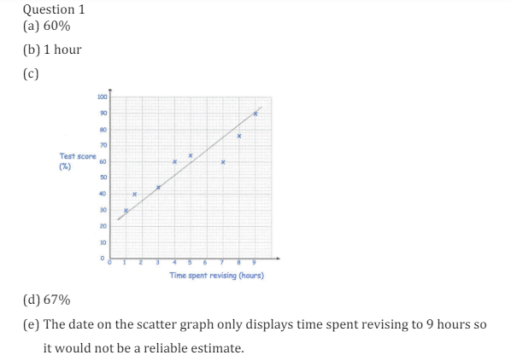
Solutions

