Slide 1


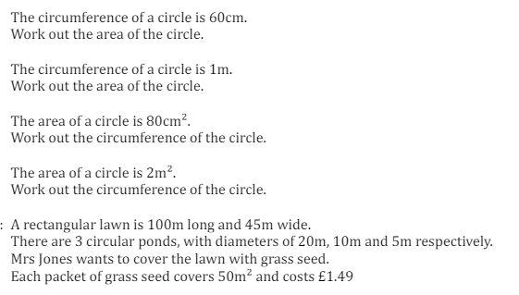
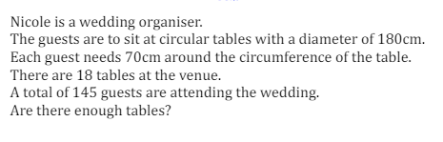
Working backwards to find the radius or diameter of a circle given the circumference or area
Enter code U604, U950, U221 and U373 Into Sparx Independent Learning and/or
Follow these links to watch videos on Circles:
https://corbettmaths.com/2013/12/22/area-of-a-circle-video-40-and-59/
https://corbettmaths.com/2013/12/21/circumference-video-60/
Work through the questions below to check your understanding (solutions on next page):

Slide 2
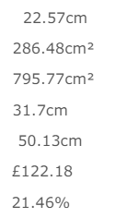
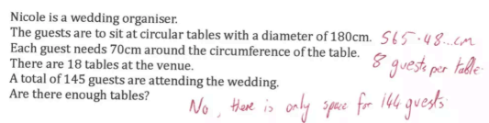
Solutions

