Slide 1


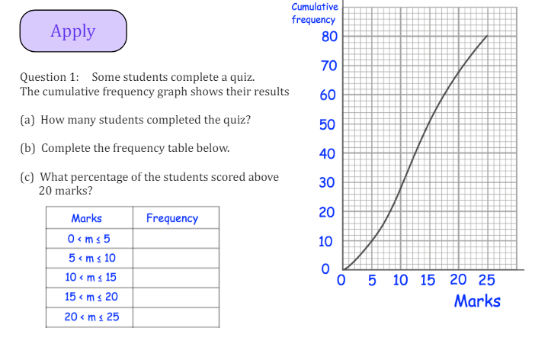
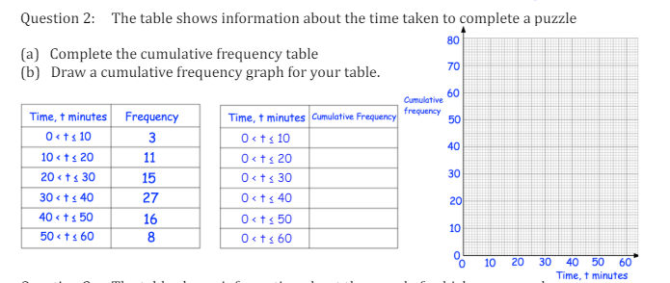
Interpreting and Constructing Cumulative Frequency Diagrams
Enter code U182 and U642 into Sparx Independent Learning and/or
Follow these links to watch videos on Data representation:
https://corbettmaths.com/2012/08/09/drawing-cumulative-frequency-graphs/
https://corbettmaths.com/2012/08/09/reading-cumulative-frequency-graphs/
Work through the questions below to check your understanding (solutions on next page):

Slide 2
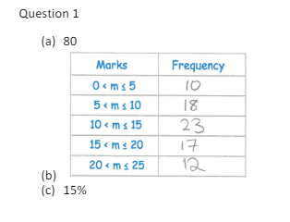
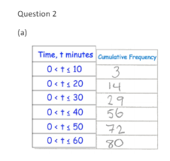
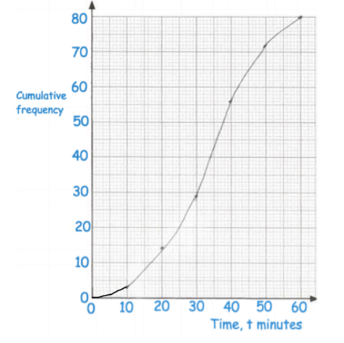
Solutions

