Slide 1


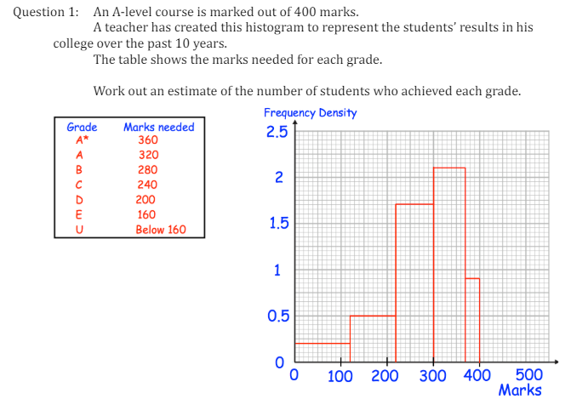
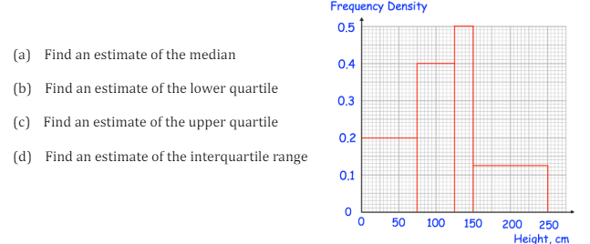
Interpreting and Constructing Histograms
Enter code U185, U814, U983 and U267 into Sparx Independent Learning and/or
Follow these links to watch videos on Data representation:
https://corbettmaths.com/2012/08/20/drawing-histograms/
https://corbettmaths.com/2012/08/19/finding-frequencies-from-histograms/
https://corbettmaths.com/2012/08/23/reading-histograms-and-a-gcse-questions/
Work through the questions below to check your understanding (solutions on next page):

Slide 2

Solutions

