Slide 1


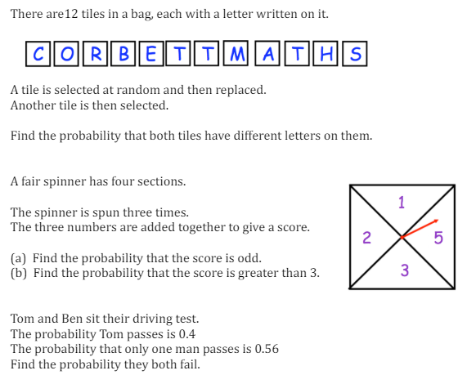
Finding the probability of combined events
Enter code U683, U104, U476 and U748 Into Sparx Independent Learning and/or
Follow these links to watch videos on Probability:
https://corbettmaths.com/2013/06/18/sample-space-diagrams/
https://corbettmaths.com/2013/06/16/independent-events/
Work through the questions below to check your understanding (solutions on next page):

Slide 2
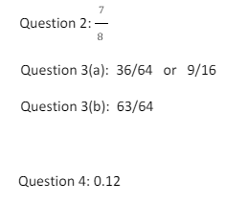
Solutions

