Slide 1


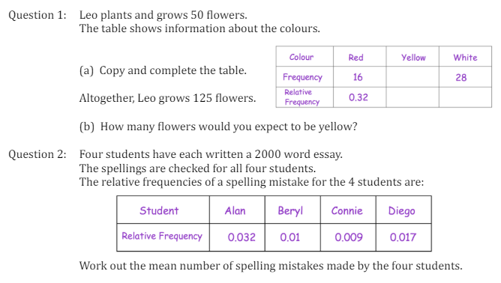
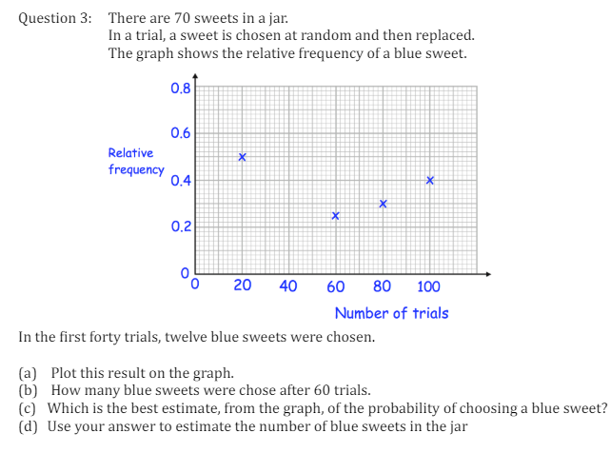
Finding the expected outcome from experiments using Relative Frequency
Enter code U580 into Sparx Independent Learning and/or
Follow this link to watch a video on Relative Frequency:
https://corbettmaths.com/2013/06/20/relative-frequency/
Work through the questions below to check your understanding (solutions on next page):

Slide 2
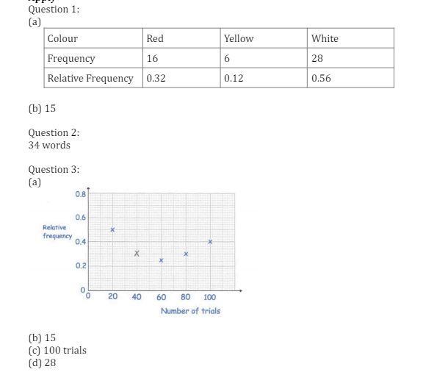
Solutions

