Slide 1


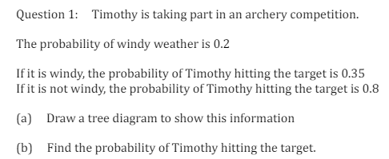
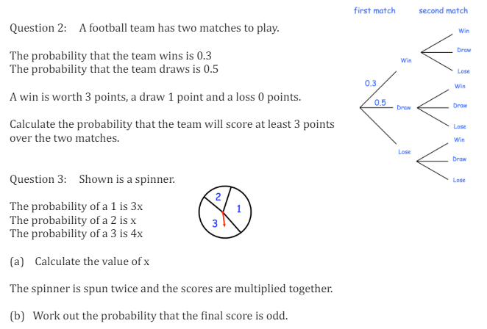
Constructing Tree Diagrams and using these to find probabilities of combined events
Enter code U558 Into Sparx Independent Learning and/or
Follow this link to watch a video on Probability:
https://corbettmaths.com/2013/05/07/tree-diagrams/
Work through the questions below to check your understanding (solutions on next page):

Slide 2
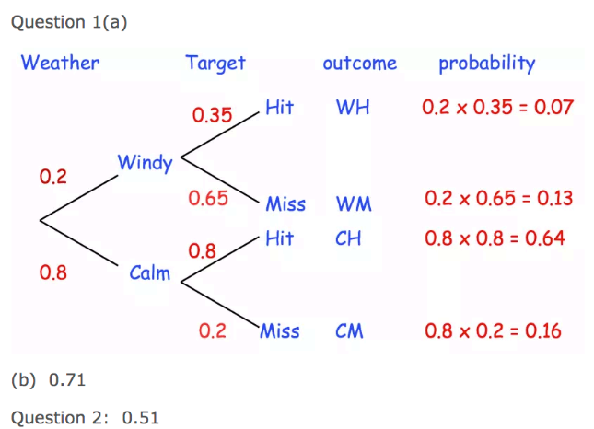

Solutions

