Slide 1
Energy Generation and Storage
Non-Renewable Energy Sources | This is when certain sources of energy will run out eventually
Fossil Fuels | Coal, Oil and Gas Burned to create steam, turned in turbines to create electricity. Burning creates C02 which adds to Global Warming
Nuclear Power | Nuclear Fission controls the reactor (that creates the electricity). This requires Uranium which is non-renewable Accidents and waste can severely damage the environment and cause radiation poisoning Radiation poisoning can be fatal and cause physical deformations Nuclear waste has to be disposed of properly and is hazardous for thousands of years.
Renewable Energy Sources | This is when certain sources of energy will not run out.
Solar | Solar panels are used to collect light and convert it into electricity There is no waste and a consistent supply However, the panels are not effective at night or in countries where there isn’t a lot of sunlight
Wind | Turbines harness wind energy Not effective on non-windy days Some people don’t like turbines as they are noisy, and not attractive to look at
Hydro-Electrical | This harnesses energy from water held behind a dam Has to be created by flooding land – damaging wildlife habitats Tidal energy comes from using energy from waves
Biomass | This is fuel from natural sources e.g. crops, scrap woods and animal waste Growing biomass crops produces oxygen and uses up C02 However, is a very expensive method
Storing Energy
Pneumatics: This is the production of energy using compressed gas or air. E.g. Pistons in an engine
Hydraulics: Like a Pneumatic system, but uses water or oil under pressure. E.g. Wheelchair lifts
Kinetic: Energy that is generated by movement. This is stored by items like springs in a “clickable” pen or balloons,
Batteries: Electrical power can be stored in batteries. Rechargeable batteries are becoming increasingly popular.

Slide 2
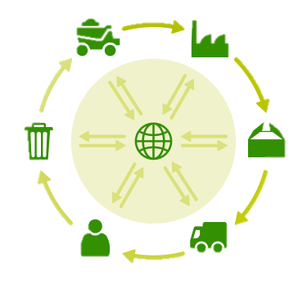
Environment
The 6Rs | Meaning
Reuse | To use a product again either for the same purpose or a different one
Reduce | To have less of material/packaging/pollution when making products by making them more efficient
Recycle | Breaking down and forming the material into another product
Refuse | Customers not buying or supporting products that make an environmental impact
Rethink | Designers and customer rethinking their decisions when making and buying products.
Repair | Fixing a product rather than throwing it away. Extending its life rather than using more resources to make another Often products are Designed for Maintenance so can easily be repaired. E.g. Using screws so even non-specialists can take a product apart, or using components that can easily be replaced like fuses or batteries
Repairing products rather than throwing them away
Reducing Product Miles buy making the product in the country it is sold in
Planting more trees to reduce deforestation
What can we do to reduce environmental impact or products and manufacture?
Reducing Pollution by using less plastics, efficient manufacture, less waste and using renewable energy (like solar and wind)
Recycling products and materials
Using less finite resources
Sustainability is maintaining our planet and its resources and making a minimal negative impact
Finite Resources Will run out of eventually | Infinite Resources Can be re-grown and re-bread. Will not run out of
Plastics | Paper
Metals | Boards
Polymers (Textiles) | Natural Timbers
 | Cotton
 | Leather
Life Cycle Assessment
This is when a designer looks at the environmental impact a product makes over its life time and how it could be reduced. Including:
Impact of materials
Impact of processes
Product Miles (how far a product has to travel to get from factory to consumer)
Impact while in use
Impact when disposed of (6Rs)
Planned Obsolescence | This is where products “die” after a certain amount of time. E.g. Disposable cups, Phones, Lightbulbs, Printer Ink, etc This can have a big environmental impact as customers are throwing away lots of products, and resources are being used to create new ones.

Slide 3

Industry and Enterprise
Automation
This is when machines and robotics help make products or make them for you.
Often this is done by CAD (Computer Aided Design) and CAM (Computer Aided Manufacture)
This helps products be made quicker, with more accuracy. Reducing errors humans make to products.
However, these machines are expensive to buy, need specialist training to use and need constant maintenance to keep them working properly
Enterprise
This is when an idea is developed into a business and produces a viable product.
Often, one of the biggest enterprises in in apps for smartphones
To make sure ideas are protected from being copied, a Patent can be applied for. This legally protects your idea on invention from being stolen.
Crowdfunding
This is where ideas are funded by large groups of ordinary people.
www.Kickstarter.com is a good example of this.
Virtual Marketing
This is when websites, social media and email are used to promote and sell products. This has become very popular in recent years, with big social media apps being funded by advertisers
Companies can also pay search engines to push their company further to the top of the results page, so customers are more likely to click it.
Fair Trade
This is an organisation that promotes fair pay, working conditions and better trade with farmers in developing countries
You can tell when something is Fairtrade
as it will often have the symbol on the
product or packaging. Common Fairtrade
items include; bananas, cotton and chocolate.
Cooperatives
A Cooperative is an Enterprise that is run by members that are part of the workforce or customers.
This means the organisation is democratic and often supports the local community. They are set-up to protect the rights of their members and ensure the same rules apply to everyone

Slide 4
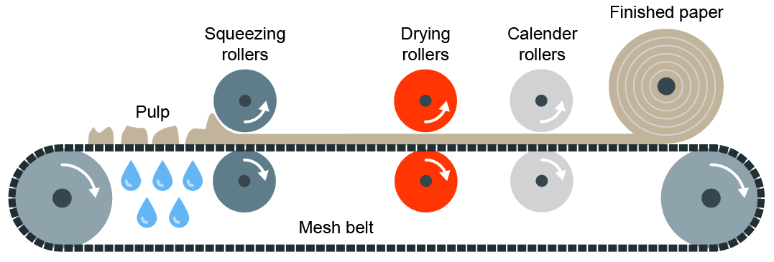
Modern and Smart Materials
Papers and Boards
Modern Materials are materials that have been developed recently
Material | Key info | Examples
Corn-starch Polymers | These are plant-based polymers that are a replacement for plastics that are biodegradable but cannot be recycled. | Plastic bottles, tubs, food containers, etc
Flexible MDF | Made in the same way as normal MDF but with grooves cut into the surface so it is flexible. Flexiply is the same but for Plywood. These can easily be shaped into curves | Modern furniture, interior walls and room dividers
Titanium | High strength to weight ratio. Doesn’t corrode or rust. Suitable for medical use as its hypo-allergneic | Prosthetics, medical applications, sports cars, etc
Kevlar | A woven polymer with a high strength to weight ratio. | Bullet-proof vests, tyres, helmets, etc
Papers and Boards come from trees. The Stock forms for papers are: rolls, sheets, A4, A3, etc
Material | Key info | Uses/ Examples
Cartridge Paper | Thick white paper, completely opaque and more expensive than photocopy paper | Sketching, ink drawings
Layout Paper | Light, semi-translucent, good for blending inks and artist markers | Sketching, drawing and some tracing
Corrugated Cardboard | Strong but light. Rigid triangles of card sandwiched between a top and bottom layer. | Outer packaging, food packaging
Duplex Board | Light card with white outside layers. Waxy coating can be added | Cheap packaging. If waxy coating is applied, can be used for food
Foil-lined Board | White card coated with a thin aluminium layer. Foil is great for insulation and water resistance | Takeaway containers
Solid White Board | High-quality white card with a smooth finish. Stiff and holds colours well | Greetings cards, packaging and advertising
Smart Materials are materials that change and react to the stimuli
Material | Key info | Examples
Thermochromic Pigments | Change colour in reaction to heat | Kettles, baby bottles, etc
Photochromic Pigments | Change colour in reaction to light | Colour changing glasses, windows, etc
Shape Memory Alloy | Returns to its original shape, in reaction to heat | Braces and glasses
Polymorph | Granules that once exposed to hot water, become a modelling material (like a dough or clay) | Modelling and repairs
Primary Processing of Papers and Boards
Paper is made by first making pulp. Pulp is a mix of tree fibres and water. This is cooked and bleached white, and adding any other additives.
The pulp is then drained and goes through Calendering where the pulp is drained and goes through rollers to convert it to its stock forms

Slide 5
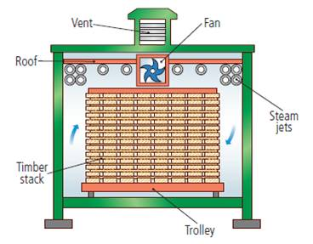
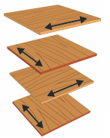
Woods and Boards
Natural Timbers
Softwoods are generally cheaper than hardwoods as they are more available, since they grow quicker.
But because man-made boards are manufactured they are cheaper than timbers.
Man-made boards also come in a better variety of sizes since they don’t depend on tree growth.
Stock forms for both include; sheets, dowel, planks, etc
Man-Made Boards
Manufactured boards are made from wood chips/dust/ layers and glue.
Material | Key info | Examples
Chipboard | Prone to chipping but good compressive strength. Not-water resistant | Flooring, low-end furniture, flat-pack
MDF | Rigid and stable. Easy to finish. Absorbs liquid easily | Flat-pack furniture and kitchen unites
Plywood | Very stable. Exterior veneer can be used from more expensive woods | Shelving, furniture, toys
Hardwoods come from Deciduous Trees. These trees loose leaves in winter and grow fruit and flowers in spring
Material | Key info | Examples
Ash | Flexible, tough and shock resistant | Sports equipment Tool Handles
Beech | Fine finish, tough and durable | Toys, furniture and veneers
Mahogany | Easily worked, durable, high quality finish | High-end furniture
Balsa | Very soft and spongy. Light | Modelling
Oak | Tough, durable and hard | Flooring, furniture and veneers
Primary Processing of Papers and Boards
Trees are cut then converted into planks by cut using saws
It is then seasoned to reduce the moisture in the wood. This is done by either:
Air-drying – Planks are stacked and air allowed to circulate; causing evaporation
Kiln-drying – Where planks are put into a kiln and dried rapidly. This process is more costly than air-drying
Softwoods come from Coniferous Trees. These have thin, needle-like leaves and grow all year round. Often have pine cones and sometimes nuts and seeds
Material | Key info | Examples
Larch | Durable, tough, good water resistance and finishes well | Furniture, flooring and used outdoors
Pine | Light, easy to work with but can split | Cheap furniture, construction and decking
Spruce | Easy to work with, high stiffness but can decay quickly | Furniture, musical instruments and construction
Manufactured boards can be either be made by lamination or compression
Lamination – Layers of woods and adhesive are layered and compressed together. Usually with a more expensive wooden veneer on the top
Compression – Wood is shredded, heated and compressed with adhesive under extreme pressure

Slide 6
Metals, Alloys and Plastics
Metals
Plastics
Metals come from ores in the ground. Stock forms are sheets, bars and rods
Plastics come from crude oil. Stock forms are sheets, powders, granules and rods
Ferrous Metals contain iron and are magnetic and rust
Material | Key info | Examples
Low Carbon Steel | Tough and ductile and easily machined and welded | Construction, screws, cars
High Carbon Steel | Hard and wears well | Tools, blades and knives
Cast Iron | Hard but brittle. Easily cast but hard to machine | Pots, pans, vices
Thermoplastics can be reheated and reshaped and infinite amount of times
Material | Key info | Examples
PET | Easily blow moulded, food safe and easily recycled | Bottles, packaging, etc
PVC | Flexible, tough, easily extruded | Pipes, tape, hard hats
HIPS | Flexible, lightweight, food safe and easily vacuum formed | Containers and yoghurt pots
Acrylic | Tough, brittle, easily scratched | Car lights, baths, displays/ signs
Non-Ferrous Metals do not contain iron, aren’t magnetic and don’t rust
Material | Key info | Examples
Aluminium | Light, high strength to weight ratio and ductile | Pots, pans, cars, cans
Copper | Ductile, malleable and good conductor | Plumbing supplies and cables
Tin | Soft, malleable and good conductor | Used as a protective coating
Thermosets once heated and set cannot be reshaped
Material | Key info | Examples
Melamine Formaldehyde | Food safe, hygienic, hard and brittle | Kitchenware and work surfaces
Urea Formalehyde | Good insulator, hard and brittle | Electrical casings, buttons and handles
Polyester Resin | Strong, heat resistant, can be transparent | Coatings, casings
Alloys
Alloys are mixtures of 2 or more metals to get the best of their properties
Material | Key info | Examples
Brass | Malleable and easy to cast | Musical instruments, plumbing
Stainless Steel | Doesn’t rust, hard and smooth | Cutlery, medical tools, etc
Primary Processing of Metals and Alloys
Primary Processing of Plastics
Crude oil is extracted from the earth and then processes into different types of fuels, etc. This is called Fractional Distillation
A process called Cracking then converts the large hydrocarbon molecules into plastics
Metals are mined from the earth and then go through an extraction process
Extraction happens by putting the ore in a blast furnace
The metal is then separated from the waste material

Slide 7
Metals, Alloys and Plastics
Metals
Plastics
Metals come from ores in the ground. Stock forms are sheets, bars and rods
Plastics come from crude oil. Stock forms are sheets, powders, granules and rods
Ferrous Metals contain iron and are magnetic and rust
Material | Key info | Examples
Low Carbon Steel | Tough and ductile and easily machined and welded | Construction, screws, cars
High Carbon Steel | Hard and wears well | Tools, blades and knives
Cast Iron | Hard but brittle. Easily cast but hard to machine | Pots, pans, vices
Thermoplastics can be reheated and reshaped and infinite amount of times
Material | Key info | Examples
PET | Easily blow moulded, food safe and easily recycled | Bottles, packaging, etc
PVC | Flexible, tough, easily extruded | Pipes, tape, hard hats
HIPS | Flexible, lightweight, food safe and easily vacuum formed | Containers and yoghurt pots
Acrylic | Tough, brittle, easily scratched | Car lights, baths, displays/ signs
Non-Ferrous Metals do not contain iron, aren’t magnetic and don’t rust
Material | Key info | Examples
Aluminium | Light, high strength to weight ratio and ductile | Pots, pans, cars, cans
Copper | Ductile, malleable and good conductor | Plumbing supplies and cables
Tin | Soft, malleable and good conductor | Used as a protective coating
Thermosets once heated and set cannot be reshaped
Material | Key info | Examples
Melamine Formaldehyde | Food safe, hygienic, hard and brittle | Kitchenware and work surfaces
Urea Formalehyde | Good insulator, hard and brittle | Electrical casings, buttons and handles
Polyester Resin | Strong, heat resistant, can be transparent | Coatings, casings
Alloys
Alloys are mixtures of 2 or more metals to get the best of their properties
Material | Key info | Examples
Brass | Malleable and easy to cast | Musical instruments, plumbing
Stainless Steel | Doesn’t rust, hard and smooth | Cutlery, medical tools, etc
Primary Processing of Metals and Alloys
Primary Processing of Plastics
Crude oil is extracted from the earth and then processes into different types of fuels, etc. This is called Fractional Distillation
A process called Cracking then converts the large hydrocarbon molecules into plastics
Metals are mined from the earth and then go through an extraction process
Extraction happens by putting the ore in a blast furnace
The metal is then separated from the waste material

Slide 8
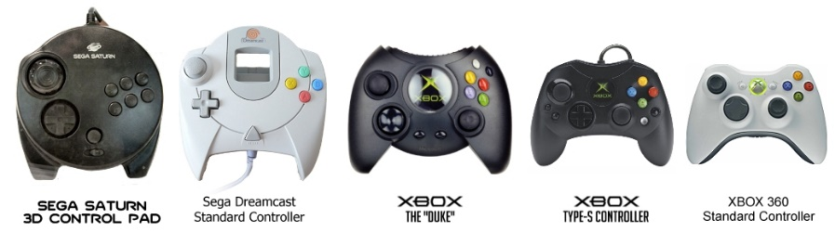
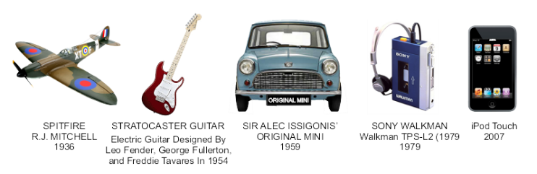
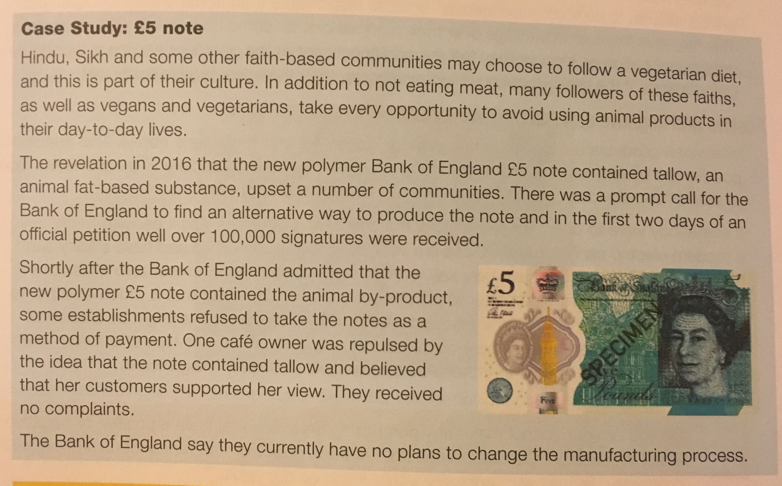
People, Society and Culture
Market Pull and Technology Push
Technology Push is the development of new technology, materials and manufacturing methods to create new products or improve old ones. Examples include; Smart Phones, Electricity, Mass Production, etc Market pull is the demand from consumers for new products and improvements in old ones; this is often found via reviews, polls, surveys, etc Examples include; Product Aesthetics, making products easier to use, etc
Fashion and Trends
Fashion and Trends will change quickly, and you can see major differences in fashions over decades. Designers have to make sure their products meet the fashion and trends of the area they are designing and selling the product to. The change of products over time is called Product Evolution. This is caused by Market Pull, Technology Push and Fashion and Trends. Some products are seen as timeless. These products are called Iconic Designs. These products are timeless because they were innovative, set a bench mark for following products, changed their industry and are often copied. Examples include; iPod, iPhone, Angle-Poise Lamp, Swiss Army Knife, Converse Shoes, Levi’s Jeans, Classic Mini Cooper
Cultures, Faith and Belief
Different groups of people have different interests and have to be catered for. Different countries and cultures also react to products differently. E.g. In India McDonalds don’t sell beef burgers as it has a large Hindu population, and cows are seen as sacred – in contrast the UK sells its most amount of fish and chips on a Friday as it is a Christian tradition to not eat meat on that day.
Inclusive vs. Exclusive Design
Inclusive Design: The aim to create a product that as many people as possible can use Examples include; Cars, Doorframes, Adjustable Products, etc Exclusive Design: The aim to create a product for a particular group and their needs Examples include; Car seats for babies, Wheelchairs, Stair Lifts

Slide 9
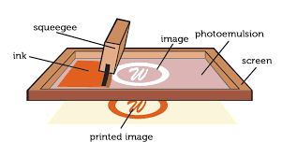
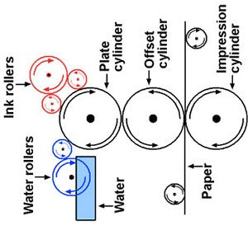
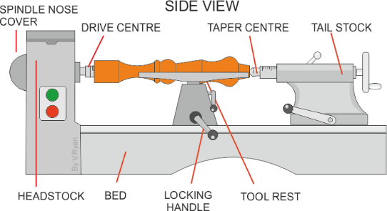
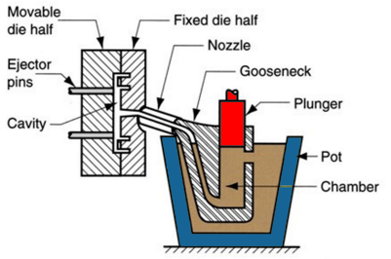
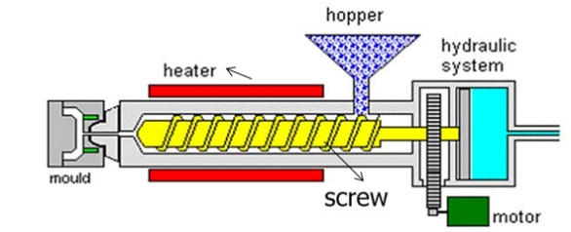
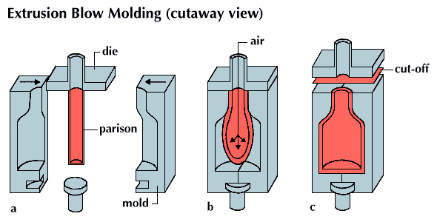
Production Processes
Name of Process | Diagram | Material | Products Made | Key info
Screen-printing |  | Papers and Textiles | Posters, signs and t-shirts | Screen printing places paint on top of a screen. The screen has a stencil embedded in it, so when the paint is passed across it the desired shape is printed underneath. Good process in one-off and batch production as often done by hand
Offset Lithography |  | Papers and card (thin, flexible plastics) | Posters, newspapers, plastics bags | Rollers containing the colours and water go onto the plate cylinder. The water stops the colours sticking to certain places, creating the shape. The shape is transferred between rollers and onto the material. Can be used at batch and mass production
Lathe Turning |  | Wood and metal | Chair legs, baseball bats )(cylindrical items) | Material is placed between the tail stock and the headstock and spun at high speed. The material is then cut using specialist tools (either by hand or my automated machinery) to the desired shape. Can be used in one-off and batch production
Die Casting |  | Metal | Car parts, engine components, etc | Molten metal is poured into a chamber and a plunger forces the metal through the nozzle into the mould. Unlike sand casting, the mould is reusable. Good process for both one-of and batch production
Injection Moulding |  | Plastics | Chairs, toys, etc | Plastic granules are poured into the hopper and onto the screw. The screw moves the material towards the heater where it turns into a liquid. The liquid is then forced into the mould, cooled and released. Great process for mass production as it makes 100s+ of products at once, to a identical standard.
Blow Moulding |  | Plastics | Plastic bottles | A Plastic parison is heated and put into the mould. The parison is then filled with air (like blowing up a balloon) and is forced to fit the mould shape. It is then cooled and then released. This is a great process for mass producing bottles.

Slide 10
Production Techniques and Systems
CAD Computer Aided Design
Examples; 2D Design, Autodesk Inventor, Fusion 360, Photoshop, etc
Advantages | Disadvantages
Easy to change designs Designs are easily saved and sent Can be worked on by multiple people simultaneously Can be used for virtual testing Can produce high-quality designs | Complex and time-consuming to learn Expensive to buy PCs can crash or be hacked – causing work to be lost Takes up PC memory
CAM Computer Aided Manufacture
Examples; 3D Printing, Laser Cutting, CNC Router, Automated Machines and Robotics, etc
Advantages | Disadvantages
Faster and more accurate than traditional tools Repetitive accuracy/ consistent outcomes Machines can run 24/7 | Expensive to buy the equipment, etc Training takes cost and time Need specialists to maintain and repair the machines Dependence on CAM can cause unemployment
Flexible Manufacturing Systems
This is where automated machines are adaptable and can produce different products if needed. If a manufacture is making a product with machines that are just dedicated to specific tasks they have to be reprogrammed and re-tooled before changing to a new task. This is time consuming and expensive. Examples include; CNC Machines, 3D Printers, Laser Cutters, Robotic arms, etc
Just-in-Time (JIT) Manufacture
This is where manufacturers only order materials, parts, etc when needed. The customer’s order triggers the production process and the resources needed for that order are the only ones bought. This can be used in any scale of production but is particularly useful for one-off production.
Advantages | Disadvantages
Saves on warehouse and storage costs Money is not tied-up in stock Little/minimal waste Customer often pays in advance so money is secure before production | All production stops if a part/ material is missing Needs to have a fast, reliable and good quality supply chain to work properly Can be time-consuming
Lean Manufacturing
This is where waste and energy is kept to a minimum. This helps manufacturers save money and resources in production, as well as helping minimise the environmental impact of producing products.

Slide 11



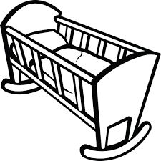
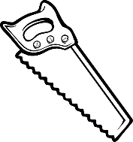

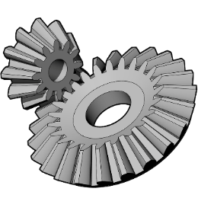
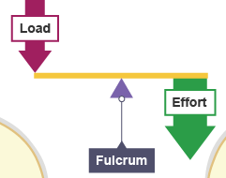
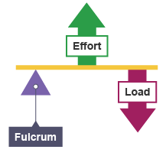
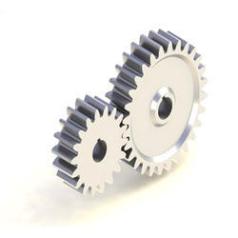
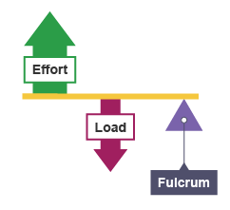
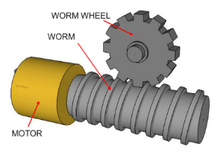
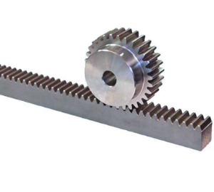
Mechanical Systems
Motion
Compression
Rotation
Ten
sion
Linear
Torsion
She
Oscill ating
ar
Recip rocating
Levers
Gears and Pulleys
Bevel Gear
Gears have teeth that mesh together with each other (like teeth on a zip)
They mainly focus on rotary motion on tools and machinery e.g. car steering and pillar drills
2nd Class Lever:
Load in the centre
E.g. wheelbarrow
Spur Gear
1st Class Lever:
Fulcrum in the centre
E.g. Scissors
3rd Class Lever:
Force in the centre
E.g. Lifting a dumbbell
A Pulley is a grooved wheel, that has a belt running through it
This uses rotary motion and is often used to help with heavy loads, and transfer force from a motor to a tool in machines like drills, etc
Worm and Wheel
Rack and Pinion

Slide 12
People. Society and Culture
Market Pull and Technology Push
Technology Push is the development of new technology, materials and manufacturing methods to create new products or improve old ones. Examples include; Smart Phones, Electricity, Mass Production, etc Market pull is the demand from consumers for new products and improvements in old ones; this is often found via reviews, polls, surveys, etc Examples include; Product Aesthetics, making products easier to use, etc
Fashion and Trends
Fashion and Trends will change quickly, and you can see major differences in fashions over decades. Designers have to make sure their products meet the fashion and trends of the area they are designing and selling the product to. The change of products over time is called Product Evolution. This is caused by Market Pull, Technology Push and Fashion and Trends. Some products are seen as timeless. These products are called Iconic Designs. These products are timeless because they were innovative, set a bench mark for following products, changed their industry and are often copied. Examples include; iPod, iPhone, Angle-Poise Lamp, Swiss Army Knife, Converse Shoes, Levi’s Jeans, Classic Mini Cooper
Cultures, Faith and Belief
Different groups of people have different interests and have to be catered for. Different countries and cultures also react to products differently. E.g. In India McDonalds don’t sell beef burgers as it has a large Hindu population, and cows are seen as sacred – in contrast the UK sells its most amount of fish and chips on a Friday as it is a Christian tradition to not eat meat on that day.
Inclusive vs. Exclusive Design
Inclusive Design: The aim to create a product that as many people as possible can use Examples include; Cars, Doorframes, Adjustable Products, etc Exclusive Design: The aim to create a product for a particular group and their needs Examples include; Car seats for babies, Wheelchairs, Stair Lifts

Slide 13
Scales of Production
Name/ Type | How many it makes | Key Info | Examples of Products
One-off Production | 1 | Also known as Bespoke or Prototype manufacture Custom-made products Specialist workers/ skills Specialist machines and materials High Quality but expensive | Towers / Bridges One-off Houses Custom made clothes
Batch | 10s-1000s | Uses a mix of workers and machinery Uses jigs, moulds and templates to help make identical products Stations of workers e.g. cutting station, painting station, etc Can have some variation e.g. colour, finish, flavour | Baked foods Limited edition car Socks Chairs
Mass | 10,000s - 100,000s | Big assembly lines (and sub-assembly lines) Heavily automated Standard and identical products Little worker input | Cars Bottles Microchips Plain shirts
Continuous | 100,00s + | 24/7 production Heavily automated Standard and identical products Little worker input | Energy Water Paper Plastic
One-off Production
Advantages | Disadvantages
Custom made High Quality Materials High Quality Craftsmanship | Time consuming Specialist training for workers Expensive to buy
Batch Production
Advantages | Disadvantages
Lower cost than one-off Jigs, moulds and templates help products look identical Can have some variety | High storage costs Jugs, moulds and templates have to be checked Workers can become bored on their station
Mass Production
Advantages | Disadvantages
Large amounts made at once All products are identical and to same standard Using automation reduced human error | Initial starting costs are high If production line stops, the product can’t be made Workers become bored monitoring machines and repetitive tasks
Continuous Production
Advantages | Disadvantages
Large amounts made at once All products are identical and to same standard Using automation reduced human error | Initial starting costs are high If production line stops, the product can’t be made Workers become bored monitoring machines and repetitive tasks

