Slide 1
All three sciences require similar skills, see the next pages for an example in each science of a skill

Slide 2
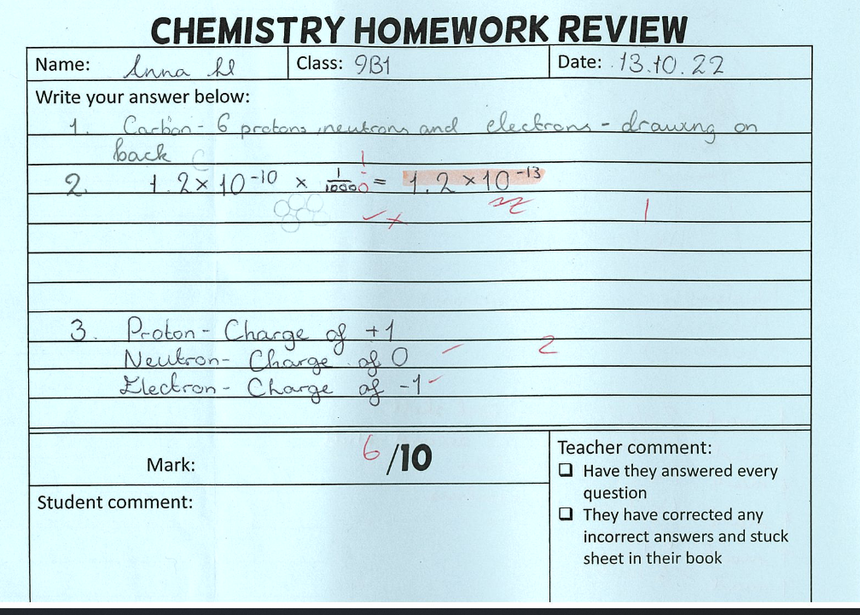
1. Homework review
Students complete a homework review for each science every 2 weeks. They are given a homework to review a section of the topic. They then test their knowledge and understanding in class. It is teacher marked and then reviewed in class.

Slide 3
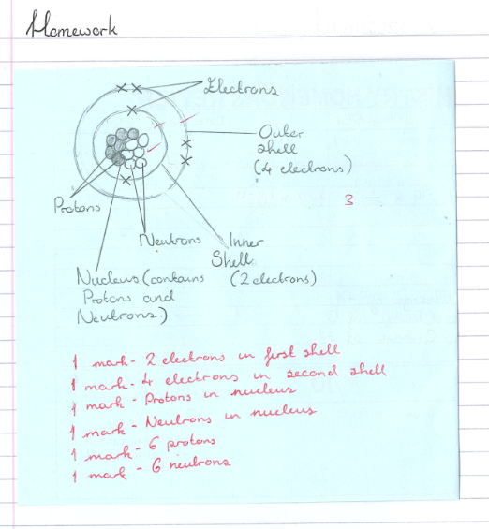
This is a great example because they have included detailed corrections that will help their learning long term! Fantastic work!

Slide 4
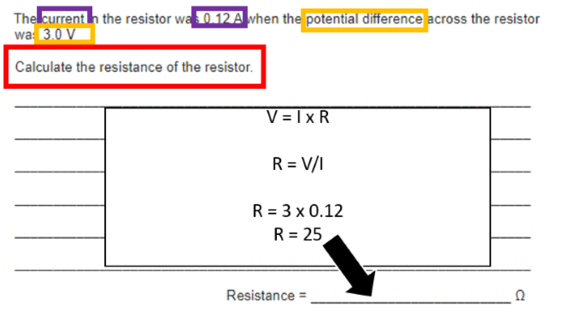
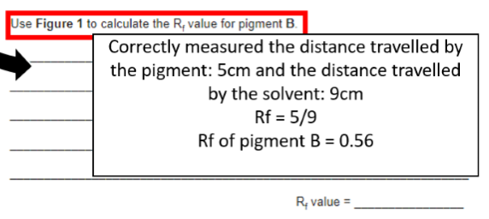
2. Equation skills
Equation questions can be between 2-6 marks. It is important that you ensure you get all those marks.
The marks come from all the working out and not just the correct answer!
Here are two examples:

Slide 5
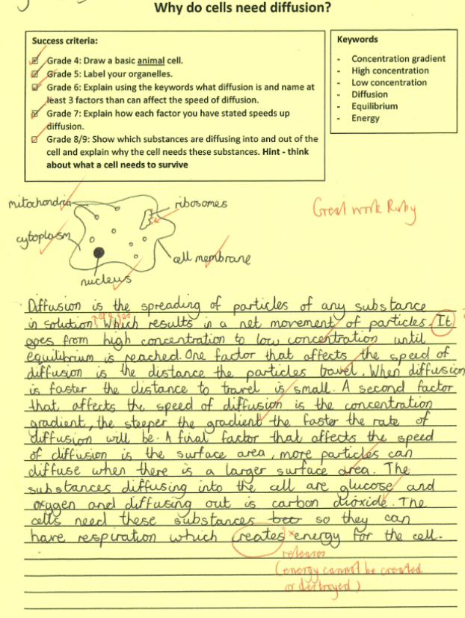
3. Longer answer/exam questions
Every science paper will have longer answer questions up to 6 marks. These next two 'Why do cells need diffusion?' Tasks are great examples.

Slide 6
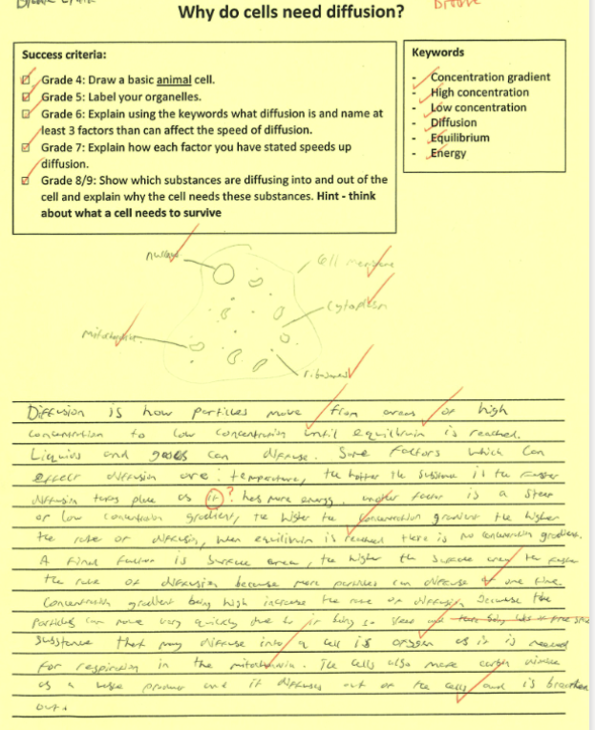
They are good examples because they are well laid out in terms of their ideas, they include the correct terminology, and they are written well.

Slide 7
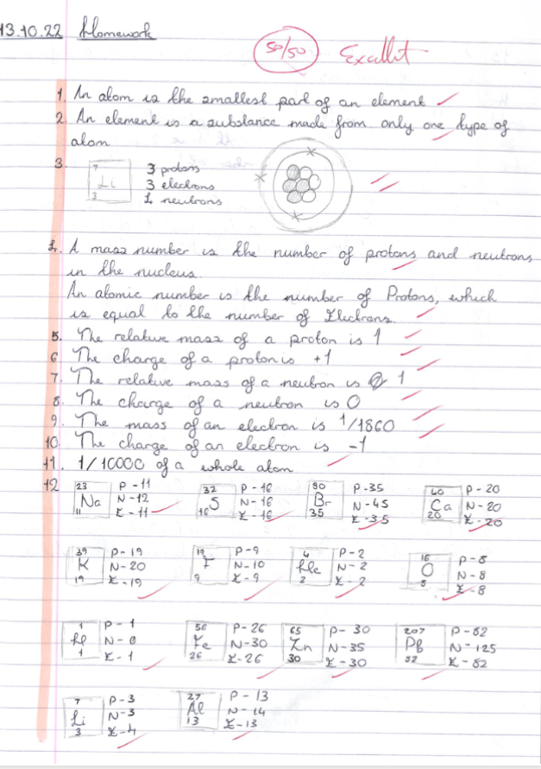
Detailed and clear notes are vital for science. They are required to ensure good understanding and so you can use your book for revision.

Slide 8
