Slide 1
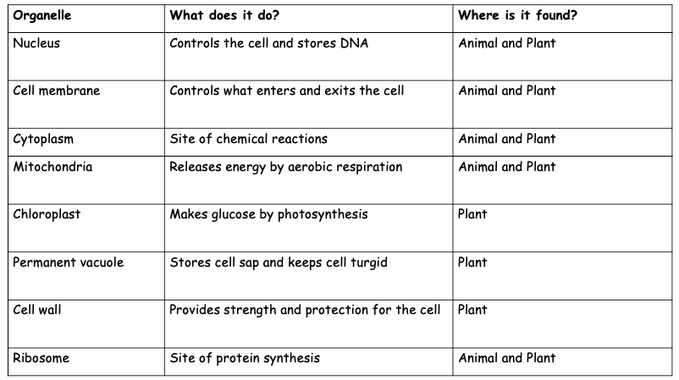
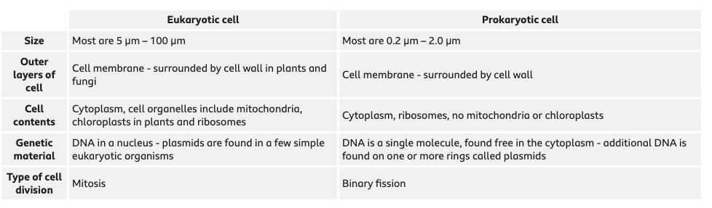
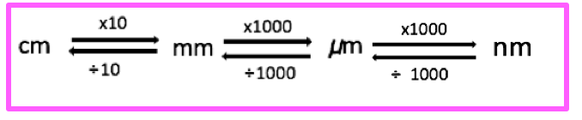
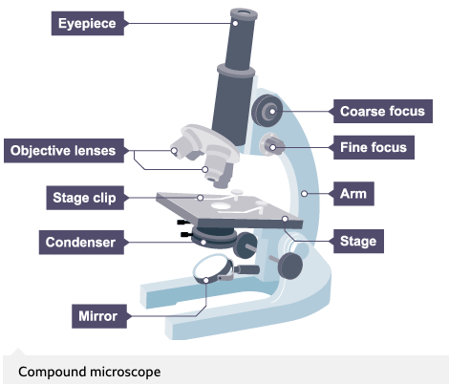
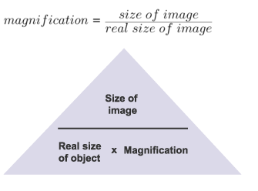
Biology: 4.1 cell biology Graphic Organiser
Organelles | Prokaryotic cells
Eukaryotes include animals, plants and fungi. Animals and plants have the following organelles. Make sure you know which are exclusive to plant cells! | Prokaryotic cells possess fewer organelles compared to eukaryotic cells. Bacteria and archaea are prokaryotes. Their structure is more simplistic compared to eukaryotes, and they do not have a membrane bound nucleus!
Magnification and microscopes | Specialsied cells
 | There are many different types of cells in animals, each is specialized for a role.
Cell | How is it adapted to its function?
Sperm cell | Long tail which whips from side to side to help move the sperm through water or the female reproductive system. Middle section is full of mitochondria which transfer the energy needed for the tail to work.
Muscle cell | Contain many mitochondria to transfer the energy needed for the chemical reactions that take place as the cells contract and relax.
Red blood cell | No nucleus to more room for oxygen and biconcave dis shape increases the surface area to volume ratio to help carry more oxygen to respiring tissues.
Leaf palisade cell | They contain specialised green structures – chloroplast – that contain chlorophyll. Chlorophyll is the green pigment in plants, that traps light energy for photosynthesis. They are usually positioned at the top of the leaf so they absorb as much light as possible.
Root hair cell | The hair like projections greatly increase the surface area available for water to move into the cell. Lots of mitochondria for the active transport of ions from soil into plant.
The image size and actual size must be in the same units!
The compound microscope uses two lenses to magnify the specimen – the eyepiece and an objective lens.
Electron microscopes can be used to view smaller organisms and have a higher magnification and resolving power.
Increasing the power of the objective lens increases the magnification.
The focus dials improve the resolution.
What do power and magnification mean?

Slide 2
Biology: 4.1 cell biology Graphic Organiser
Organelles | Prokaryotic cells
Eukaryotes include animals, plants and fungi. Animals and plants have the following organelles. Make sure you know which are exclusive to plant cells! | Prokaryotic cells possess fewer organelles compared to eukaryotic cells. Bacteria and archaea are prokaryotes. Their structure is more simplistic compared to eukaryotes, and they do not have a membrane bound nucleus!
Magnification and microscopes | Specialsied cells
 | There are many different types of cells in animals, each is specialized for a role.
Cell | How is it adapted to its function?
Sperm cell | Long tail which whips from side to side to help move the sperm through water or the female reproductive system. Middle section is full of mitochondria which transfer the energy needed for the tail to work.
Muscle cell | Contain many mitochondria to transfer the energy needed for the chemical reactions that take place as the cells contract and relax.
Red blood cell | No nucleus to more room for oxygen and biconcave dis shape increases the surface area to volume ratio to help carry more oxygen to respiring tissues.
Leaf palisade cell | They contain specialised green structures – chloroplast – that contain chlorophyll. Chlorophyll is the green pigment in plants, that traps light energy for photosynthesis. They are usually positioned at the top of the leaf so they absorb as much light as possible.
Root hair cell | The hair like projections greatly increase the surface area available for water to move into the cell. Lots of mitochondria for the active transport of ions from soil into plant.
The image size and actual size must be in the same units!
The compound microscope uses two lenses to magnify the specimen – the eyepiece and an objective lens.
Electron microscopes can be used to view smaller organisms and have a higher magnification and resolving power.
Increasing the power of the objective lens increases the magnification.
The focus dials improve the resolution.

Slide 3
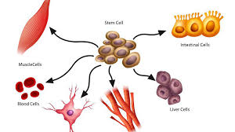
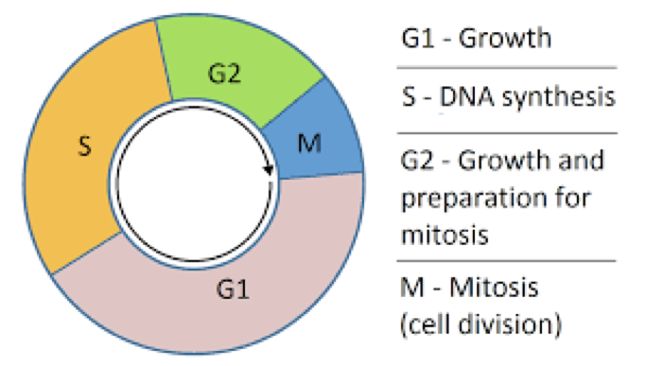
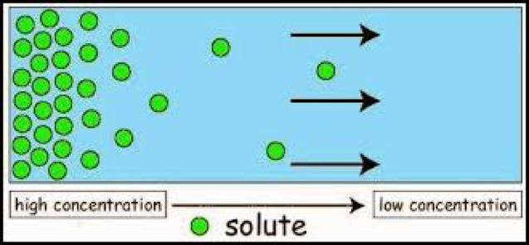
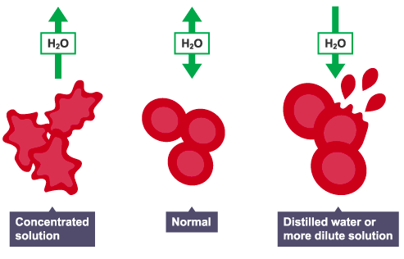
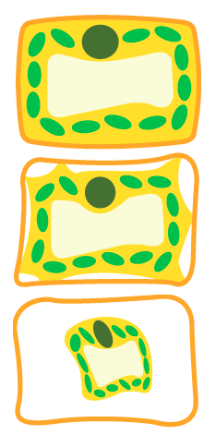
Stem cells |  | Mitosis and the cell cycle
 |  | t
Diffusion | Active transport | Osmosis
 |  | Osmosis is the diffusion of water molecules, from a region where the water molecules are in higher concentration, to a region where they are in lower concentration, through a partially permeable membrane. A dilute solution contains a high concentration of water molecules, while a concentrated solution contains a low concentration of water molecules.
Stem cells are cells that have not undergone differentiation. A cell which has not yet become specialised is called undifferentiated.
An embryo develops from a fertilised egg. Cells at the early stages in the development of the embryo are stem cells.
Some stem cells remain in the bodies of adults – adult stem cells. Adult stem cells are found in limited numbers at certain locations in the body. Adult stem cells will differentiate into a narrower range of cell types. Embryonic stem cells can differentiate into a wider range of cell types, but are difficult to obtain and their use raises ethical challenges.
at any time during the life of the plant.
Therapeutic cloning
Adult stem cell transplants use a patient's own stem cells.
They are therefore genetically identical and will not be rejected by the patient's immune system
Cells divide when:
an organism grows
an organism becomes damaged and needs to produce new cells
It is essential that any new cells produced contain genetic information that is identical to the parent cell
What are stem cells and why are they important?
How many daughter cells are made? | 2
What are the daughter cells like compared to the parent cells? | Genetically identical/ clones
Why does mitosis happen? | For growth, repair, and to replace worn out cells
PLANTS.
Cell division in plants occurs in regions called meristems, near the tip of the roots and shoots.
Cells of the meristem can differentiate to produce all types of plant cells
What are meristems?
qEach cell goes through a series of stages while it is dividing.
qIt is really important that DNA replicates itself before Mitosis (M) can happen.
The net movement of particles from a high to low concentration. It is a passive process.
Osmosis is:
Diffusion is:
Active transport is:
It requires:
Active transport is the movement of particles from a low to high concentration.
This is against the concentration gradient.
It requires energy, released from the mitochondria.
Animals:
Glucose is moved from the lumen of the small inestine into the blood by active transport
LOW --> HIGH CONCENTRATION
Plants:
Most mineral ions are moved from the soil into the root hair cells by active transport
LOW --> HIGH CONCETRATION
Factor | How it affects diffusion
Temperature | The higher the temperature, the more kinetic energy the particles will have, so they will move and mix more quickly.
Concentration gradient | The greater the difference in concentration, the quicker the rate of diffusion.
Surface area | The greater the surface area, the faster the rate of diffusion.
1
Difference in plant cells:
Plant cells have a cell wall so will not burst.
1.Turgid
2. Flaccid
3. Plasmolysed
2
Solution is hypertonic. Water leaves the cell by osmosis and it shrinks
Solution is isotonic. No net movement of water.
Solution is hypotonic. Water enters cell by osmosis and cell bursts.
3.

Slide 4
Stem cells |  | Mitosis and the cell cycle
 |  | t
Diffusion | Active transport | Osmosis
 |  | Osmosis is the diffusion of water molecules, from a region where the water molecules are in higher concentration, to a region where they are in lower concentration, through a partially permeable membrane. A dilute solution contains a high concentration of water molecules, while a concentrated solution contains a low concentration of water molecules.
Stem cells are cells that have not undergone differentiation. A cell which has not yet become specialised is called undifferentiated.
An embryo develops from a fertilised egg. Cells at the early stages in the development of the embryo are stem cells.
Some stem cells remain in the bodies of adults – adult stem cells. Adult stem cells are found in limited numbers at certain locations in the body. Adult stem cells will differentiate into a narrower range of cell types. Embryonic stem cells can differentiate into a wider range of cell types, but are difficult to obtain and their use raises ethical challenges.
at any time during the life of the plant.
Therapeutic cloning
Adult stem cell transplants use a patient's own stem cells.
They are therefore genetically identical and will not be rejected by the patient's immune system
Cells divide when:
an organism grows
an organism becomes damaged and needs to produce new cells
It is essential that any new cells produced contain genetic information that is identical to the parent cell
How many daughter cells are made? | 2
What are the daughter cells like compared to the parent cells? | Genetically identical/ clones
Why does mitosis happen? | For growth, repair, and to replace worn out cells
PLANTS.
Cell division in plants occurs in regions called meristems, near the tip of the roots and shoots.
Cells of the meristem can differentiate to produce all types of plant cells
qEach cell goes through a series of stages while it is dividing.
qIt is really important that DNA replicates itself before Mitosis (M) can happen.
The net movement of particles from a high to low concentration. It is a passive process.
Active transport is the movement of particles from a low to high concentration.
This is against the concentration gradient.
It requires energy, released from the mitochondria.
Animals:
Glucose is moved from the lumen of the small inestine into the blood by active transport
LOW --> HIGH CONCENTRATION
Plants:
Most mineral ions are moved from the soil into the root hair cells by active transport
LOW --> HIGH CONCETRATION
Factor | How it affects diffusion
Temperature | The higher the temperature, the more kinetic energy the particles will have, so they will move and mix more quickly.
Concentration gradient | The greater the difference in concentration, the quicker the rate of diffusion.
Surface area | The greater the surface area, the faster the rate of diffusion.
1
Difference in plant cells:
Plant cells have a cell wall so will not burst.
1.Turgid
2. Flaccid
3. Plasmolysed
2
Solution is hypertonic. Water leaves the cell by osmosis and it shrinks
Solution is isotonic. No net movement of water.
Solution is hypotonic. Water enters cell by osmosis and cell bursts.
3.

Slide 5
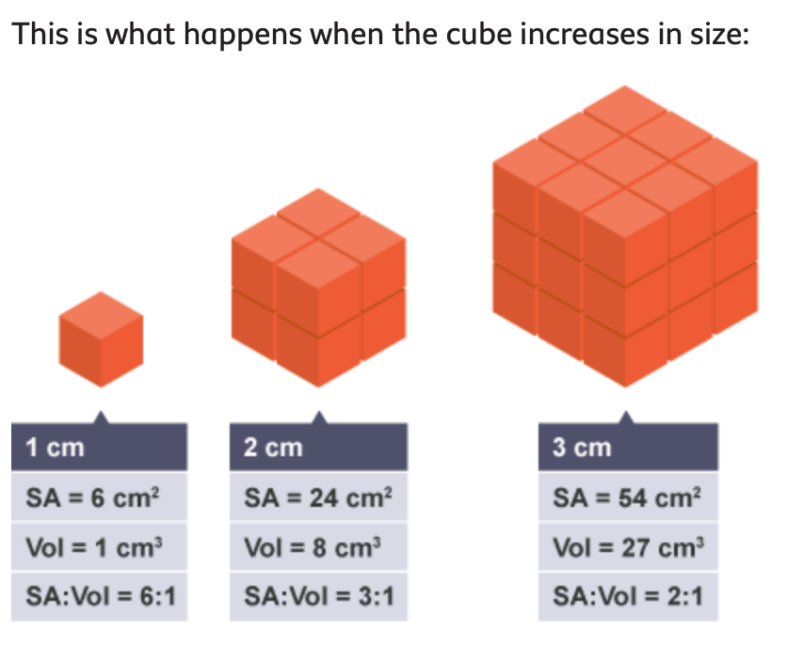
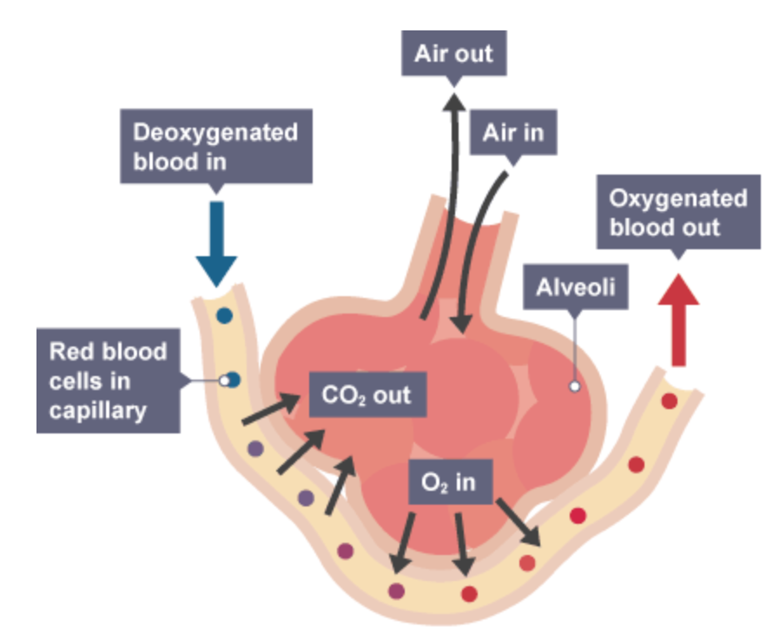
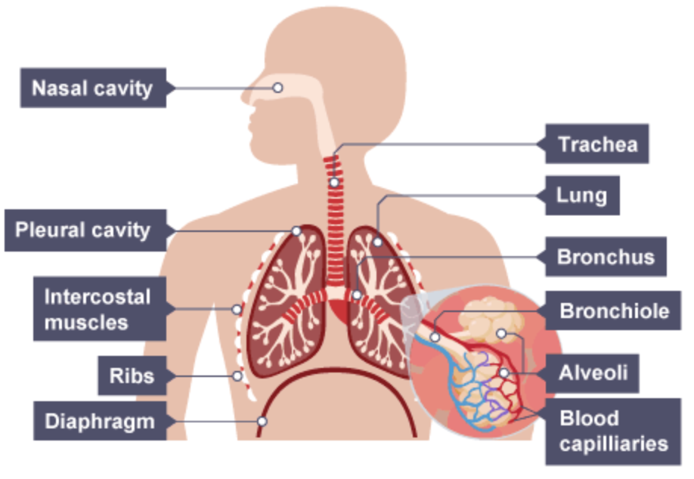
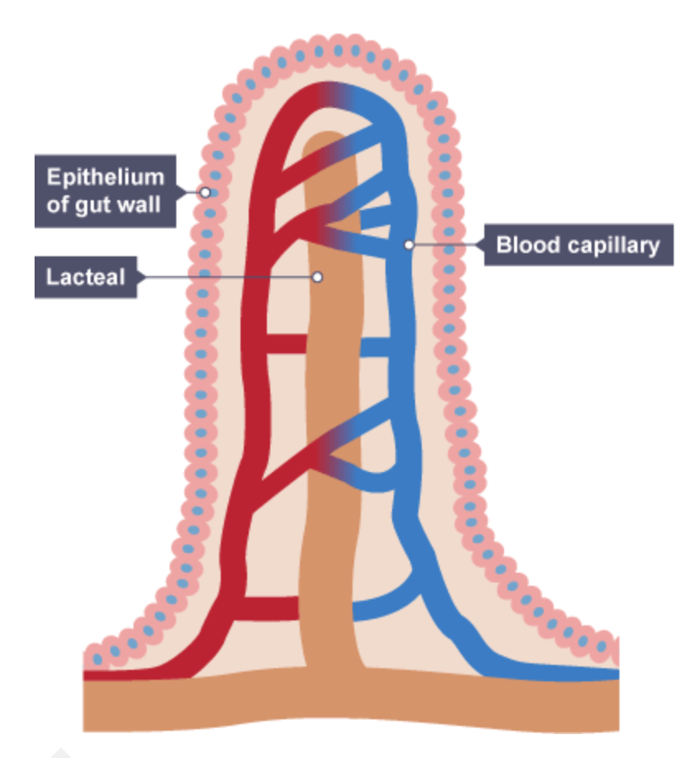
Aqa trilogy Gcse Biology: 4.2.1 ORGANISATION IN ANIMALS
Levels of organisation | Gas Exchange
 | Surface area to volume ratio
Exchange Surfaces | Respiratory System | Respiratory Adaptations
Organelle ->
Organisms must take in
The size of their surface, or surface area, defines
A large surface area:
A short distance required for diffusion:
The human lungs provide an exchange surface adapted for:
The alveoli are adapted to provide a very large surface area for gaseous exchange:

Slide 6
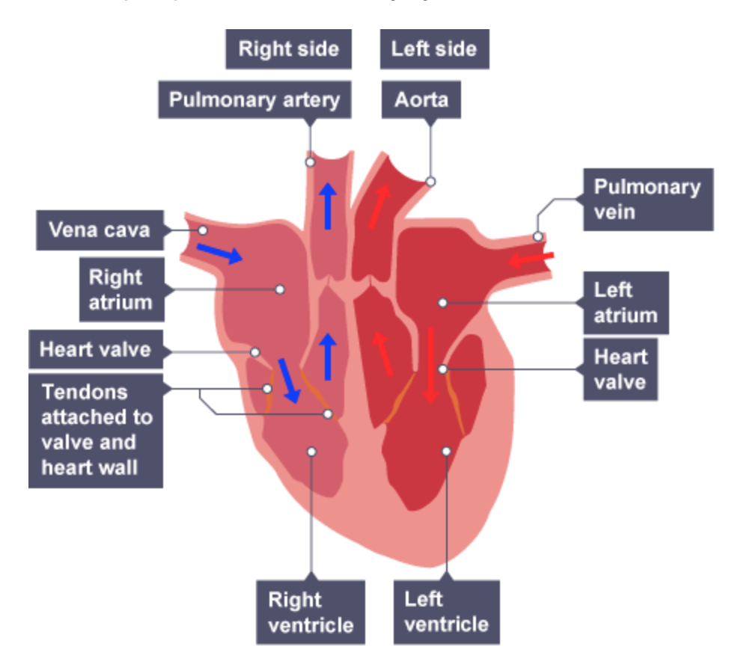
Transport Systems and Disease
Name of macromolecule | Breaks down into | Food test | Use | Use | Found in | Heart Disease
 |  |  |  |  |  | Blood must flow one way only through the circulatory system. Faulty heart valves Coronary Heart Disease Artificial Pacemaker Heart Transplant
 |  |  | Energy
 |  |  | Growth and repair
 |  |  | Energy and insulation
 |  |  | Energy
Mouth ->
Structure of the Heart |  |  | Blood Vessels
 |  |  |  |  |  | Cancer
 |  |  | Components of blood |  |  | Risk factors linked with disease
Arteries –
Veins –
Capillaries –
Tumour –
Benign –
Malignant –
Risk factors –
Red blood cells –
White blood cells –
Platelets –
Plasma –
Smoking
Alcohol
Obesity
Systemic circulation
Pulmonary circulation

Slide 7
Aqa trilogy Gcse Biology: 4.2.1 ORGANISATION IN ANIMALS
Levels of organisation | Gas Exchange
 | Surface area to volume ratio
Exchange Surfaces | Respiratory System | Respiratory Adaptations
Organelle -> Cell -> Tissue -> Organ -> Organism
Organisms must take in food, oxygen and water, and other essential substances, from the environment. Organisms also need to remove waste substances.
The size of their surface, or surface area, defines how quickly they can absorb substances. The size of their volume defines how much of these substances they need.
A large surface area:
the flattened shape of structures such as leaves
the alveoli in the respiratory system
the villi in the digestive system
A short distance required for diffusion:
the membranes of cells
the flattened shape of structures such as leaves
the walls of blood capillaries are one cell thick
the epithelia of alveoli in the respiratory system and the villi in the small intestine are only one cell thick
The human lungs provide an exchange surface adapted for:
absorbing oxygen – needed for respiration – into the blood from the air
transferring carbon dioxide – produced by respiration – from the blood into the lungs then the air
The alveoli are adapted to provide a very large surface area for gaseous exchange:
small size - each alveolus is a small sphere about 300 μm in diameter
number - there are around 700 million alveoli
There is also a short diffusion path - the walls of blood capillaries and alveoli are just one cell thick.

Slide 8
Transport Systems and Disease
Name of macromolecule | Breaks down into | Food test | Use | Use | Found in | Heart Disease
 |  |  |  |  |  | Blood must flow one way only through the circulatory system. Faulty heart valves Heart valves may become faulty. Faulty heart valves can be replaced: with a biological valve with a mechanical valve made from strong, durable material Coronary Heart Disease Coronary arteries supply the heart with oxygen. Sometimes, these can become blocked. There are two ways to treat this Statins – medication that lowers cholesterol levels Stent – tube that helps widen the arteries so more blood can flow Artificial Pacemaker The right atrium has a natural pacemaker – this controls the heart beat by controlling when the heart contracts An artificial pacemaker can help by sending out regular electrical impulses Heart Transplant If Coronary Heart Disease causes heart failure, this can be an option. Artificial hearts can help keep patients alive while they are waiting
Carbohydrates | Glucose (by Carbohydrase) | Benedict’s – brick red | Energy | Energy | Stomach
Protein | Amino acids (by Protease) | Biuret - purple | Growth and repair | Growth and repair | Stomach
Lipids | Fatty acids and glycerol (by Lipase) | Ethanol – cloudy white | Energy and insulation | Energy and insulation | Small intestine
Starch | Glucose (by Amylase) | Iodine – blue black | Energy | Energy | Salivary glands
Mouth -> Stomach -> Small Intestine -> Large Intestine -> Rectum Bile – Emulsifies fat. Produced in the liver and stored in the gall bladder Pancreatic juice – contains carbohydrase, protease and lipase Peristalsis – contractions in the oesophagus that lead to food being pushed down
Structure of the Heart |  |  | Blood Vessels
 |  |  |  |  |  | Cancer
 |  |  | Components of blood |  |  | Risk factors linked with disease
Arteries – thick walls to withstand pressure, narrow lumen, no valves
Veins – thin walls, large lumen, valves
Capillaries – one cell thick, used in gas exchange
Tumour – a group of cancerous cells that divide uncontrollably (think mitosis)
Benign – grows slowly, does not invade other parts of the body
Malignant – grows quickly, invades neighbourign tissues, can cause secondary tumours (metastasis)
Risk factors – carcinogens, UV, alcohol, diet, ionising radiation, linked viruses
Red blood cells – transport oxygen around the body. This helps with respiration.
White blood cells – fights infection (see module 4.3)
Platelets – help clot blood if there is a cut so that you don’t bleed out
Plasma – carries all of the different components of the blood
Smoking
Cardiovascular disease
Nicotine – increases heart rate
Carbon monoxide – decreases oxygen supply
Damages lining of the arteries
Alcohol
Liver and brain function
Liver becomes scarred and loses the ability to make new cells
Can cause slower reaction times and less consciousness
Obesity
High blood pressure
Cardiovascular disease due to fatty deposits
Type 2 diabetes when your body loses the sensitivity for insulin
Systemic circulation transports:
oxygen and nutrients to the body
carbon dioxide and other wastes away from cells
Pulmonary circulation transports: blood to the lungs and back to the heart

Slide 9
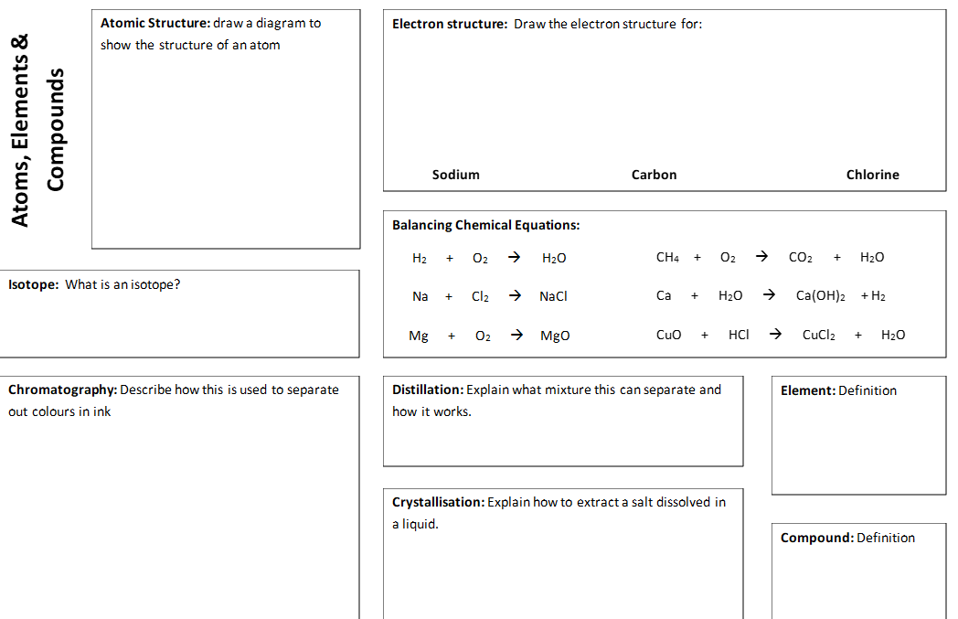

Slide 10
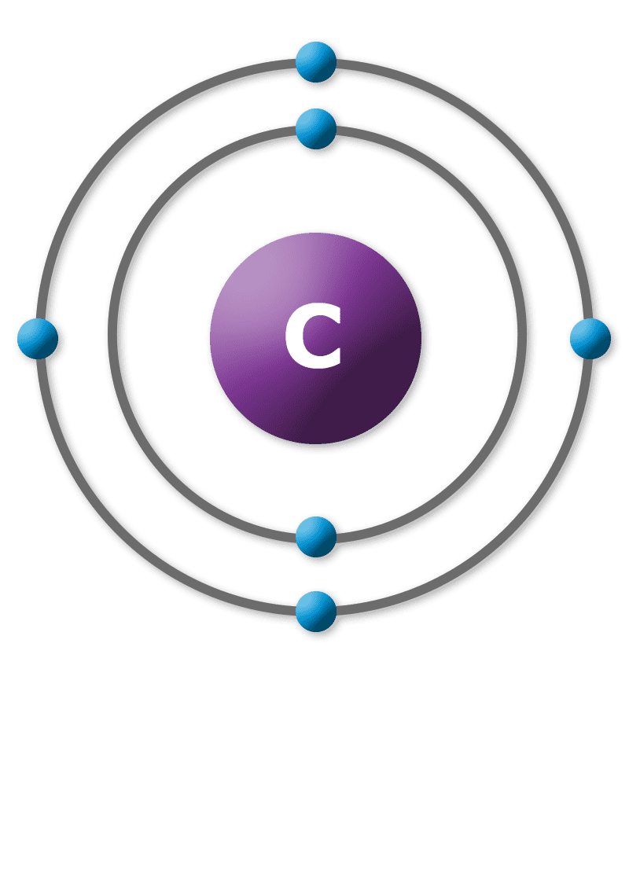
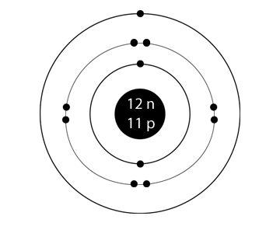
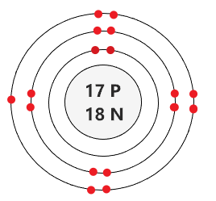
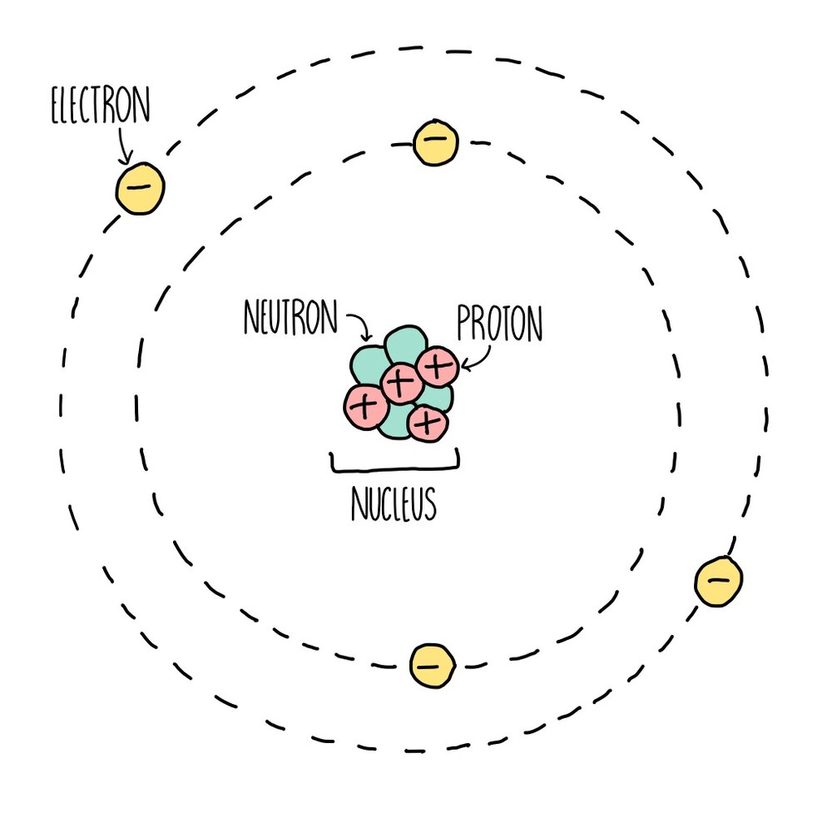
2
2
2
2
Isotope =each of two or more forms of the same element that contain equal numbers of protons but different numbers of neutrons in their nuclei, and hence differ in relative atomic mass but not in chemical properties; in particular, a radioactive form of an element.
2
2
2
2
2
2
Chromatography can be used to separate mixtures of coloured compounds. Mixtures that are suitable for separation by chromatography include inks, dyes and colouring agents in food. Simple chromatography is carried out on paper. A spot of the mixture is placed on a pencil line near the bottom of a piece of chromatography paper – the line must be in pencil because pencil is insoluble in water and so will not move as the chromatography progresses. The paper is then placed upright in a suitable solvent, such as water.
As the solvent soaks up the paper, it carries the mixtures with it. Different components of the mixture will move at different rates. This separates the mixture out.
Distillation separates a liquid from a solution. For example, water can be separated from salty water by simple distillation. This method works because the water evaporates from the solution, but is then cooled and condensed in a condenser and collected in a separate container. The salt does not evaporate and so it stays behind.
An element is a substance that cannot be broken down into any other substance. Every element is made up of its own type of atom
One way to separate a soluble solid from its solution is to make crystals. This involves evaporating the solution to a much smaller volume and then leaving it to cool. As the solution cools, crystals form, and these can be obtained by filtration.
A compound is a substance that contains two or more elements that are chemically combined

Slide 11
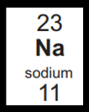
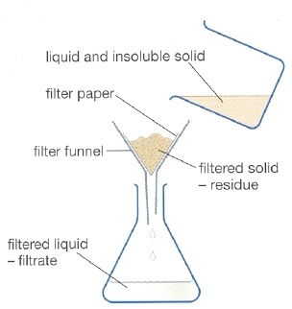
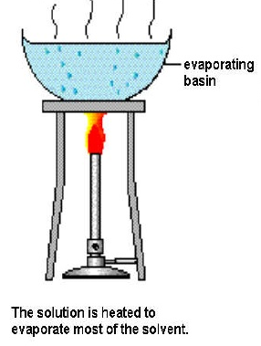
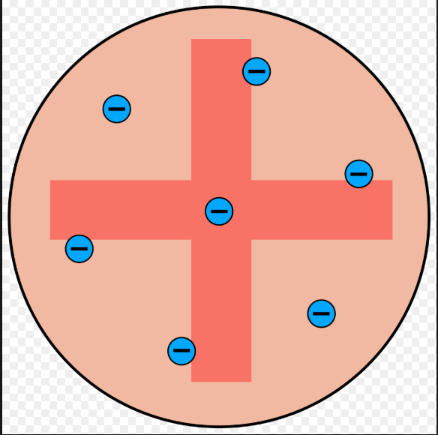
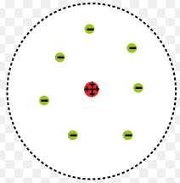
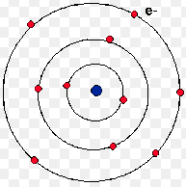
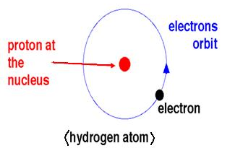
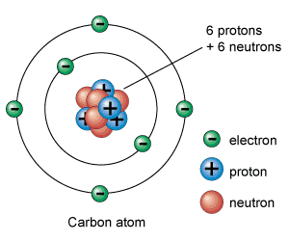
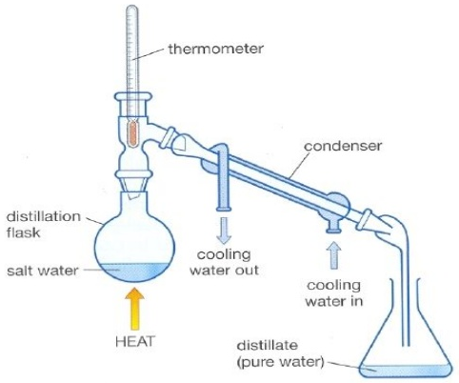
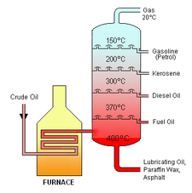
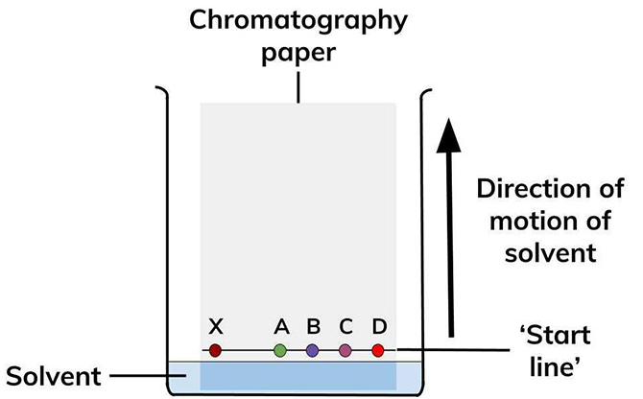
Particle | Mass
Proton
Neutron
Electron
Particle | Relative charge
Proton
Neutron
Electron
H
tier
 | A substance made of one type of atom only.
 | Two are more different types of atoms chemically bonded together
 | Elements and/or compounds combined together but not bonded. Can easily be separated
________________ = ________ + _________
Steps in the development of the periodic table
Before the discovery of protons, neutrons and electrons, scientists attempted to classify the elements by arranging them in order of their _____________ _____________.
The early periodic tables were _____________ and some _____________ were placed in inappropriate groups if the strict order of atomic weights was followed.
Mendeleev overcame some of the problems by _________ ______ for elements that he thought had not been _____________ and in some places changed the _____________ based on atomic weights.
Elements with ___________ predicted by Mendeleev were ___________ and filled the gaps. Knowledge of _____________ made it possible to explain why the order based on atomic weights was not always correct.
_____________ = ____________________
1. Atoms have the same number of _____________ and _____________
2. Atoms of the same element can have different numbers of _____________; these atoms are called _____________ of that element.
3. Isotopes of the same element have the same number of _____________ and _____________
4. To calculate the _____________ _____________ _____________ of an element taking into consideration isotopes then you need the following equation:
(percentage of isotope 1 x mass of isotope 1) + (percentage of isotope 2 x mass of isotope 2)
100
Separation techniques
1. ________________ 2. ________________ 3. ________________ 4. ________________ 5. ________________
Development of the atomic model
 | JJ Thomson | Ernest Rutherford | Niels Bohr |  | James Chadwick
2
1
3
4
5

Slide 12
Particle | Mass
Proton | 1
Neutron | 1
Electron | Very small
Particle | Relative charge
Proton | +1
Neutron | 0
Electron | -1
H
tier
Element | A substance made of one type of atom only.
Compound | Two are more different types of atoms chemically bonded together
Mixture | Elements and/or compounds combined together but not bonded. Can easily be separated
Relative atomic mass = protons + neutrons
Steps in the development of the periodic table
Before the discovery of protons, neutrons and electrons, scientists attempted to classify the elements by arranging them in order of their atomic weights.
The early periodic tables were incomplete and some elements were placed in inappropriate groups if the strict order of atomic weights was followed.
Mendeleev overcame some of the problems by leaving gaps for elements that he thought had not been discovered and in some places changed the order based on atomic weights.
Elements with properties predicted by Mendeleev were discovered and filled the gaps. Knowledge of isotopes made it possible to explain why the order based on atomic weights was not always correct.
Atomic number = number of protons
1. Atoms have the same number of protons and electrons
2. Atoms of the same element can have different numbers of neutrons; these atoms are called isotopes of that element.
3. Isotopes of the same element have the same number of protons and electrons
4. To calculate the relative atomic mass of an element taking into consideration isotopes then you need the following equation:
(percentage of isotope 1 x mass of isotope 1) + (percentage of isotope 2 x mass of isotope 2)
100
Separation techniques
1. Filtration 2. Crystallisation 3. Simple distillation 4. Fractional distillation 5. Chromatography
Development of the atomic model
 | JJ Thomson | Ernest Rutherford | Niels Bohr |  | James Chadwick
Solid spheres | Plum pudding model | Nuclear model | Electrons in shells | Protons | Neutrons

Slide 13
Atomic structure and the periodic Table
Atoms Atomic number = Mass number = + Number of neutrons = + | Isotopes | History of the Atom
Electron Structure | Metals and Non-metals | Development of the periodic table

Slide 14
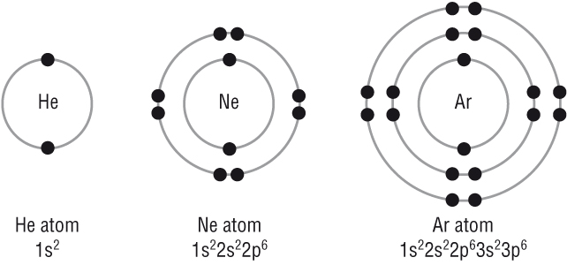
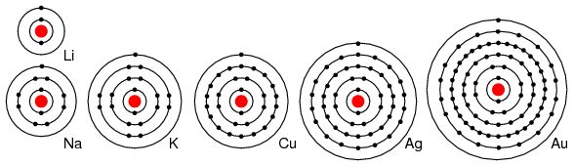
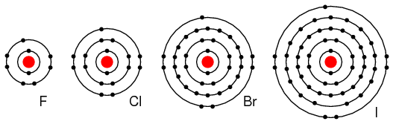
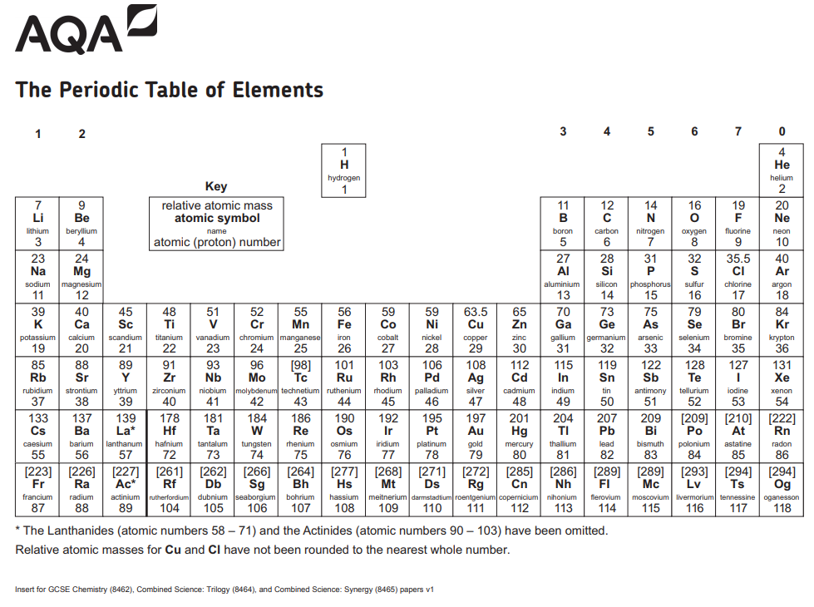
Group 0: The noble gases | Group 1: The alkali metals | Group 7: The halogens
All have full outer ________, which means __ electrons in their outer shell apart from Helium which only has __.
Full outer shell means they are ________ and do not easily form ________.
The ________ points of the noble gases ________ with increasing relative atomic mass (as you go ________ the group)
________ reactive
All of the elements in group 1 have __ electron in their outer shell this means they have ________ properties.
The reactivity of the elements ________ going down the group because the atoms get ________ and their outer electrons are ________ from the positive nucleus so they are more easily lost
________ reactive
All of the elements in group 7 have __ electrons in their outer shell this means they have similar ________.
The reactivity ________ going down the group because the atoms get bigger and it is ________ for them to gain an electron to fill their outer shell because the outer shell is further from the ________
________ reactive
Reaction with oxygen Example word equation: ________ + oxygen → lithium oxide Example symbol equation: 4Li + O₂ → 2Li₂O Observations: Freshly cut metal tarnishes/ goes from ________ to ________.
Reaction with water Example word equation: Sodium + water → ________ hydroxide + ________ Example symbol equation: 2Na + 2H₂O → 2NaOH + H₂ Observations: All ________/ bubble and move around the ________ of the water. All produce an ________ solution with the water. Potassium catches fire and has a ________ flame
Reaction with chlorine Example word equation: ________ + chlorine → potassium chloride Example symbol equation: 2K + Cl₂ → 2KCl
________ reactive
Non-metals
All exist as ________ ________ molecules eg) Cl₂
As you go down the group the relative molecular mass, ________ point and ________ point increase
Colour in the correct group
A more reactive halogen can ________ a less reactive halogen from an ________ solution of its salt.
Eg) Chlorine + sodium bromide → bromine + sodium chloride
But …Iodine + sodium bromide = no reaction
Colour in the correct group
Colour in the correct group

Slide 15
Group 0: The noble gases | Group 1: The alkali metals | Group 7: The halogens
All have full outer shells, which means 8 electrons in their outer shell apart from Helium which only has 2.
Full outer shell means they are unreactive and do not easily form molecules
The boiling points of the noble gases increase with increasing relative atomic mass (as you go down the group)
Least reactive
All of the elements in group 1 have 1 electron in their outer shell this means they have similar properties.
The reactivity of the elements increases going down the group because the atoms get bigger and their outer electrons are further from the positive nucleus so they are more easily lost
Most reactive
All of the elements in group 7 have 7 electrons in their outer shell this means they have similar reactions.
The reactivity decreases going down the group because the atoms get bigger and it is harder for them to gain an electron to fill their outer shell because the outer shell is further from the nucleus
Most reactive
Reaction with oxygen Example word equation: Lithium + oxygen → lithium oxide Example symbol equation: 4Li + O₂ → 2Li₂O Observations: Freshly cut metal tarnishes/ goes from shiny to dull
Reaction with water Example word equation: Sodium + water → sodium hydroxide + hydrogen Example symbol equation: 2Na + 2H₂O → 2NaOH + H₂ Observations: All fizz/ bubble and move around the surface of the water. All produce an alkaline solution with the water. Potassium catches fire and has a purple flame
Reaction with chlorine Example word equation: potassium + chlorine → potassium chloride Example symbol equation: 2K + Cl₂ → 2KCl
Least reactive
Non-metals
All exist as diatomic covalent molecules eg) Cl₂
As you go down the group the relative molecular mass, boiling point and melting point increase
A more reactive halogen can displace a less reactive halogen from an aqueous solution of its salt.
Eg) Chlorine + sodium bromide → bromine + sodium chloride
But …Iodine + sodium bromide = no reaction

Slide 16
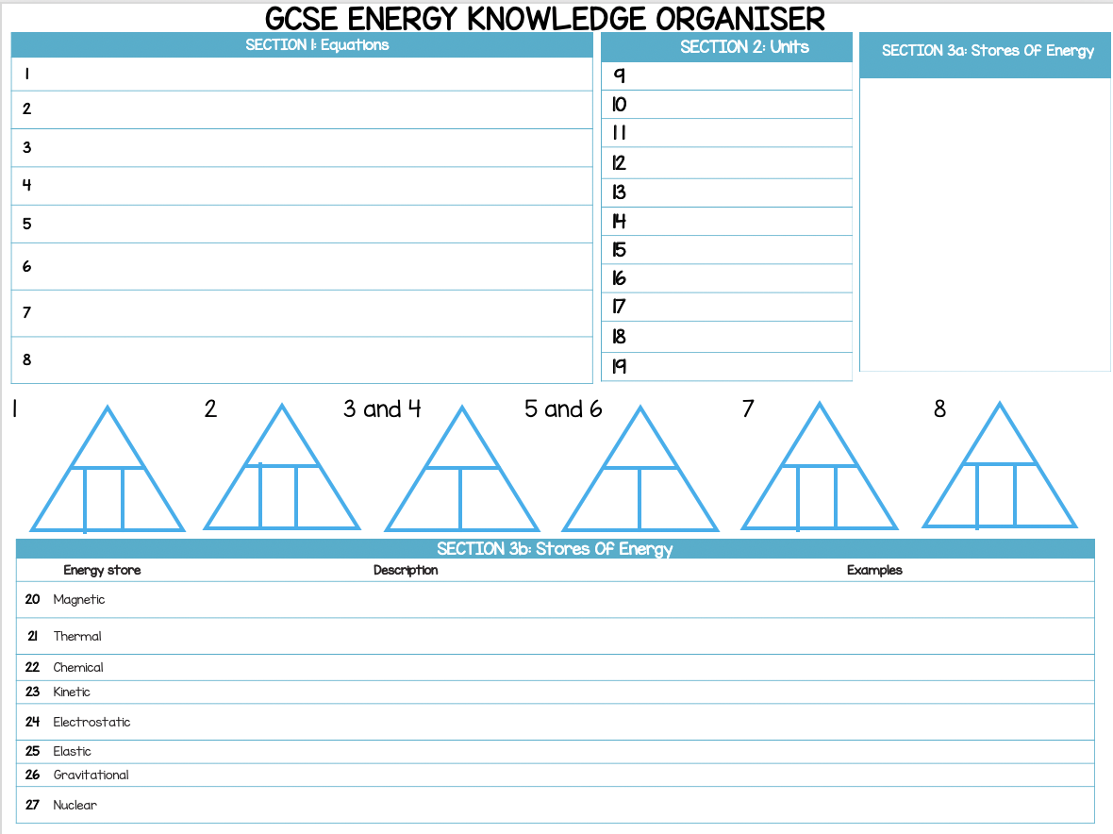
Physics energy knowledge organiser

Slide 17
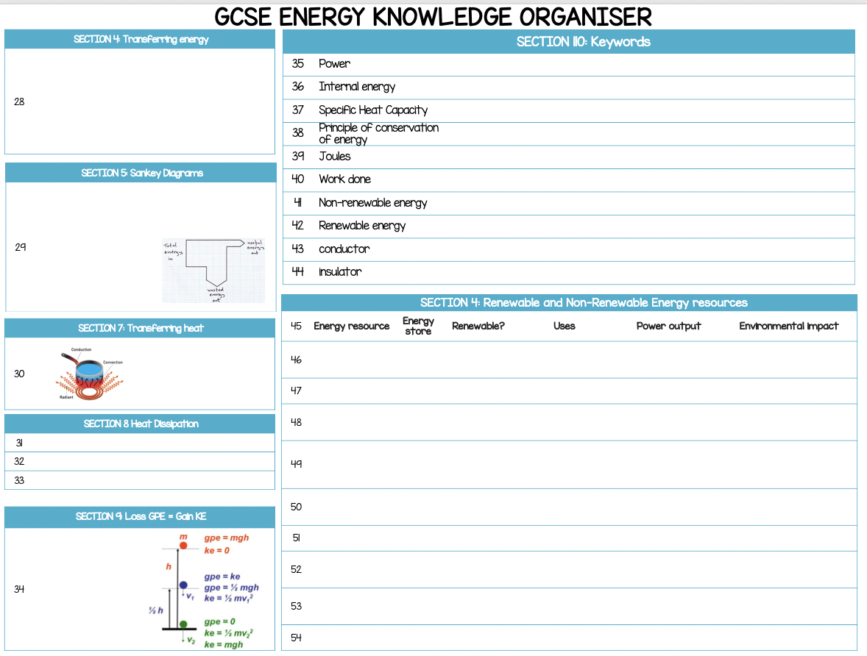
Physics energy knowledge organiser

Slide 18
Physics energy knowledge organiser

Slide 19
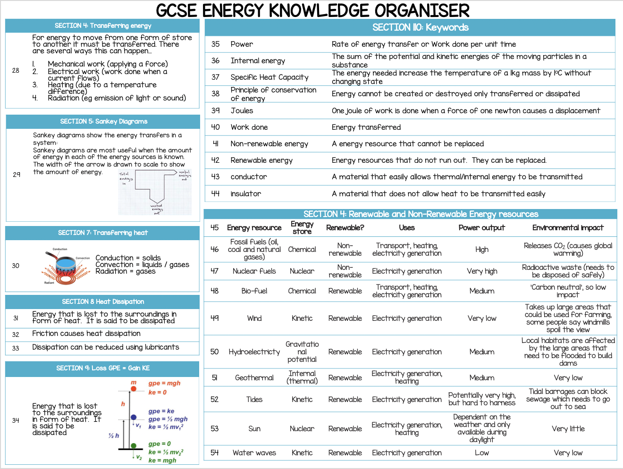
Physics energy knowledge organiser

Slide 20
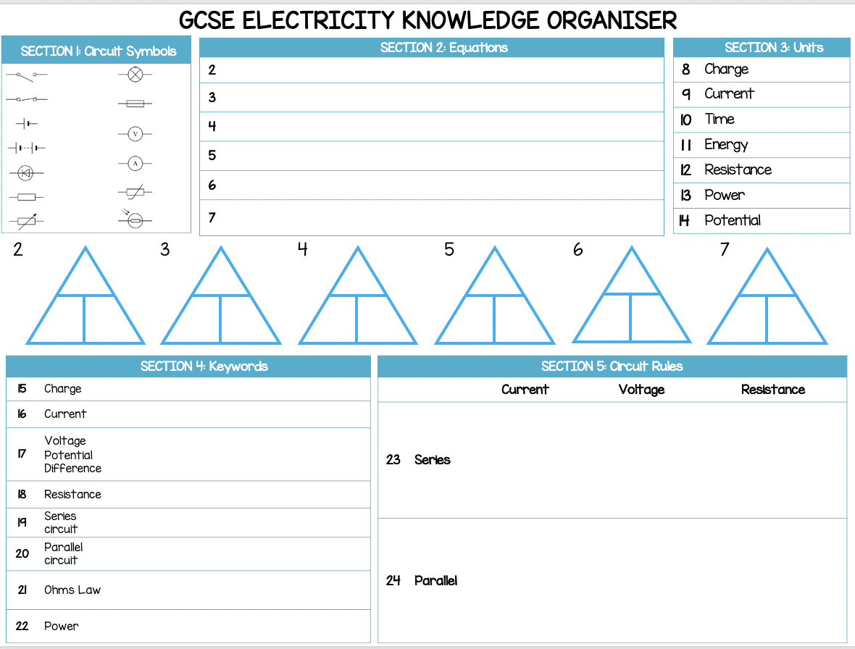
Physics electricity knowledge organiser

Slide 21
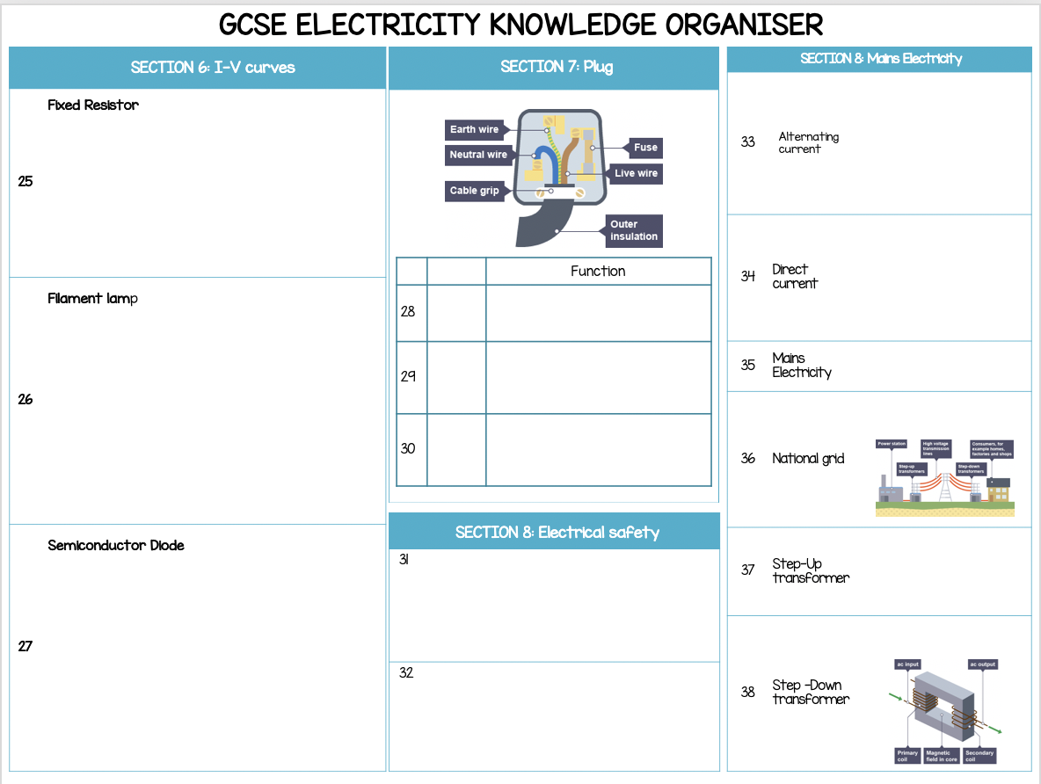

Slide 22
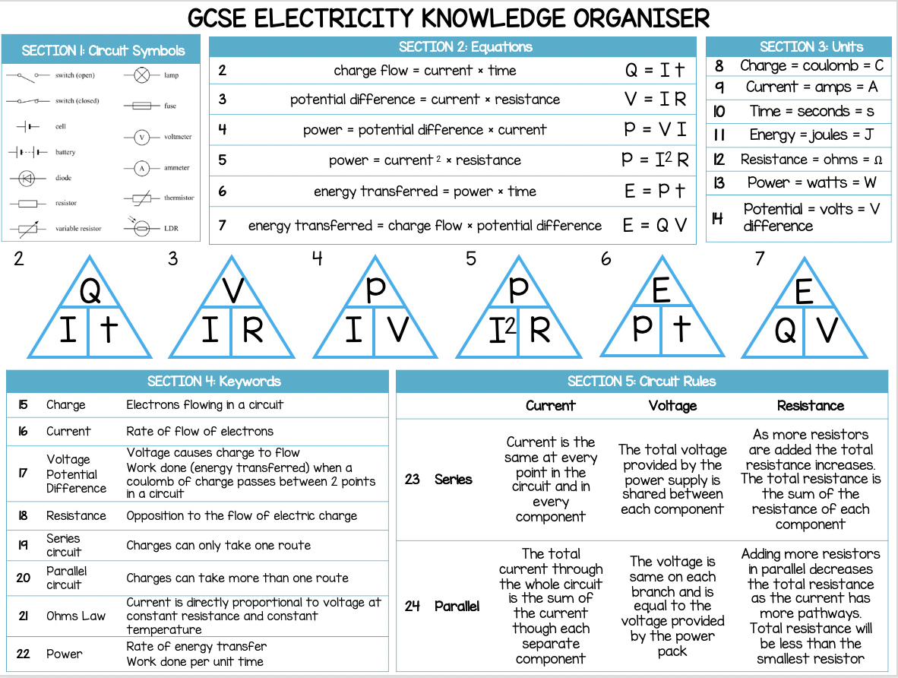
Physics electricity knowledge organiser

Slide 23
