Slide 1


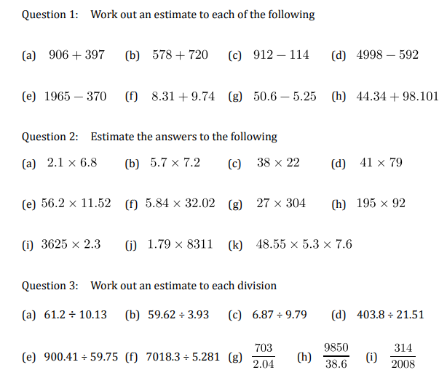
Estimating or checking, without a calculator
Follow this link to watch a video on “Approximation to calculations”
https://corbettmaths.com/2012/08/21/approximation-to-calculations/
Work through the questions below to check your understanding (solutions on next page):

Slide 2
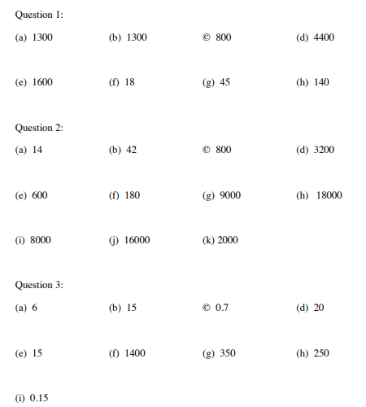
Solutions

