Slide 1


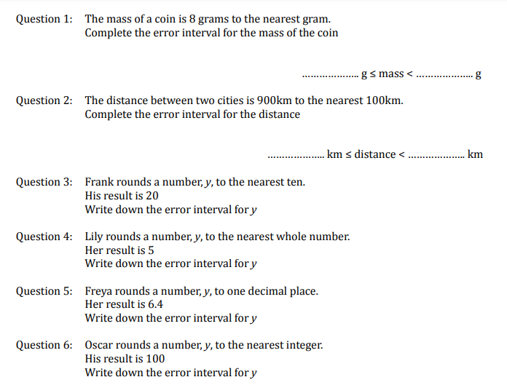
Using inequality notation to write an error interval
Follow this link to watch a video on “Error intervals”
https://corbettmaths.com/2017/12/16/error-intervals/
Work through the questions below to check your understanding (solutions on next page):

Slide 2
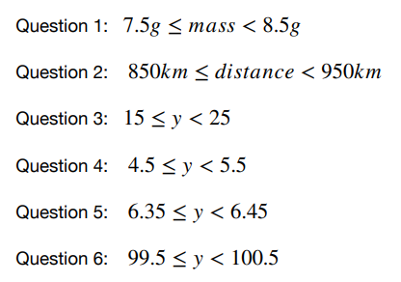
Solutions

