Slide 1


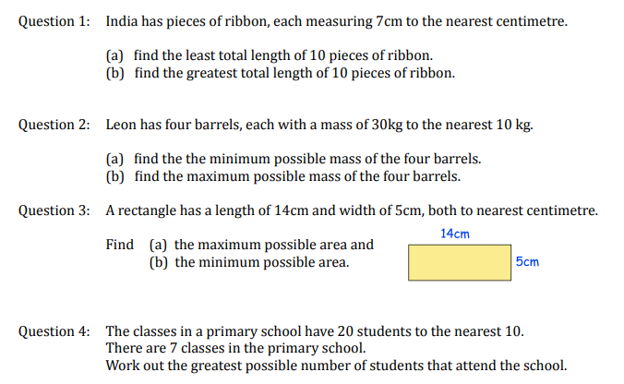
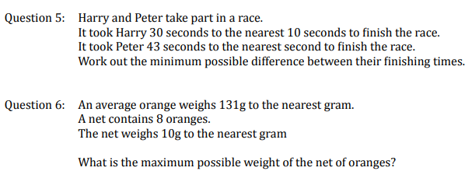
Calculating the upper and lower bounds of a calculation using numbers rounded to a known degree accuracy
Follow this link to watch a video on “Upper and lower bounds”
https://corbettmaths.com/2013/05/29/limits-of-accuracy-solving-problems/
Work through the questions below to check your understanding (solutions on next page):

Slide 2
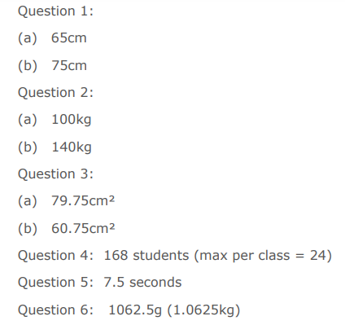
Solutions

