Slide 1


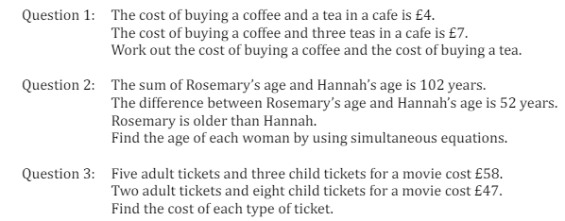
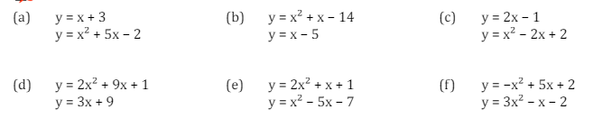
Deriving and solving increasingly complex simultaneous equations, including those involving quadratic expressions or those with three unknowns
Enter code U137 and U269 in the Sparx independent learning section and/or
Follow these links to watch videos on Simultaneous Equations
https://corbettmaths.com/2013/03/05/simultaneous-equations-elimination-method/
https://corbettmaths.com/2013/05/07/simultaneous-equations-linear-and-quadratic/
Work through the questions below to check your understanding (solutions on next page):
Question 4

Slide 2
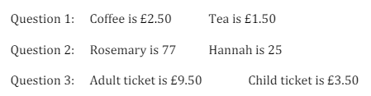
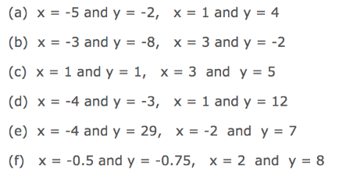
Solutions

