Slide 1
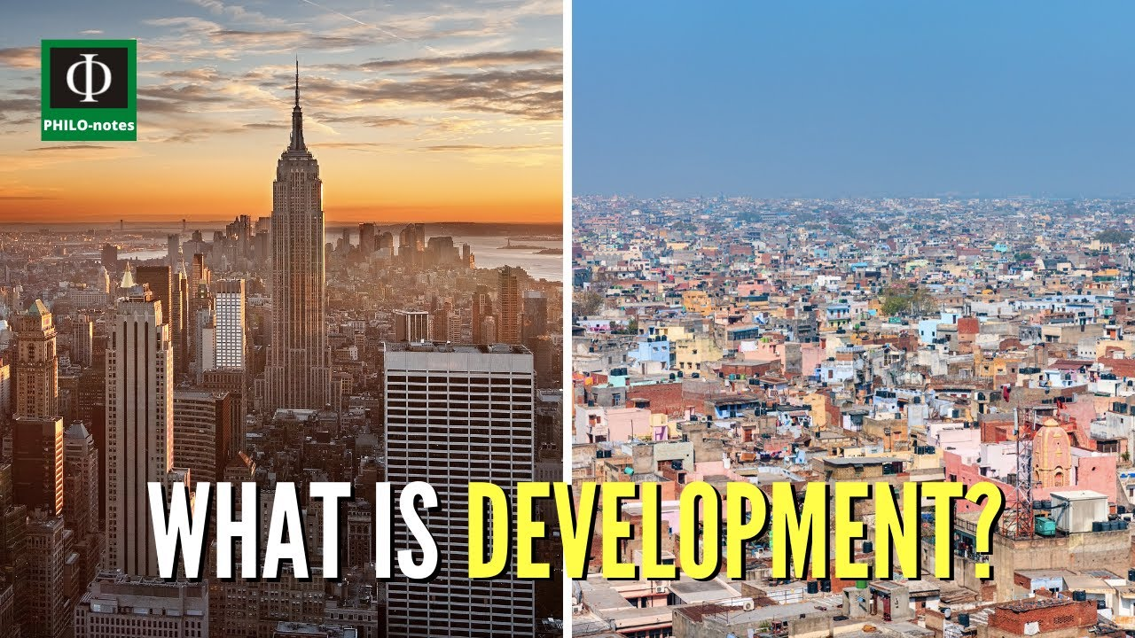
Y9 The Geography of Development

Slide 2
Key Development terms
Development - A branch of geography which refers to the standard of living and quality of life of its human inhabitants.
Highly Income Country - These are richer countries that have lots of industry and service jobs such as the UK and Japan
Low Income Country - These are poorer countries that have mainly primary jobs such as farming and mining. Countries include Bangladesh and Mali.
Newly Emerging Economy - These are Countries who are developing and becoming richer by industrialising.

Slide 3




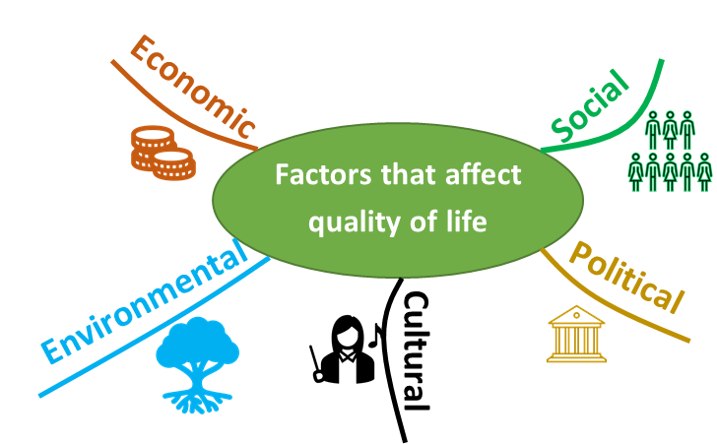

The Geography of Development
Some tasks:
Contrast the terms standard of living and quality of life – what is the major difference between the two terms?
How much money do you think you need to have a good standard of living in the UK? Write down a sum of money. Now check this website and change the answers each time.
Having used the website, what things affect standard of living in the UK? Make a list
Produce a spider diagram on the factors that could impact someone's quality of life. Try to think about people globally. There is a template below:
Two more key terms:
Standard of living refers to the level of wealth, comfort, material goods, and necessities available to a certain group of people or geographic area.
Quality of life refers to the wellbeing of individuals or groups of people. Instead of measuring the amount of money that people have, it refers to where people live and whether they are healthy and happy.

Slide 4
Some Common Development Indicators
Adult Literacy Rate - % of people aged 15 and over who can read and write.
Daily Calorie Consumption – average number of calories consumed per person
Gross Domestic Product (GDP) – total value of all the goods and services produced in a country in a year. Wealth.
GDP per Capita – GDP divided
by the population: gives you
an idea of how wealthy the
people are, on average.
Gross National Income - the sum of the money earned WITHIN the country (gross domestic product) plus income from ABROAD.
Life Expectancy – how many years a new baby can expect to live, on average.
Human Development Index (HDI) – score of 0 to 1 to indicate how developed a country is; it combines GDP per capita with some social indicators.
Infant Mortality Rate – number of babies out of every 1,000 born alive, who die before their first birthday.
Daily Calorie Consumption – the amount of energy consumed from food on a daily basis measured in calories. The NHS recommend a minimum of 2,000 calories a day for women and 2,500 for men.
Number of Doctors per 1,000 - How many doctors there are for every thousand people in a population.
Task: Read this article and decide which indicator you think is best and why? https://www.rgs.org/CMSPages/GetFile.aspx?nodeguid=0e147402-c274-4fdd-8bcb-fd614d85f0eb&lang=en-GB

Slide 5
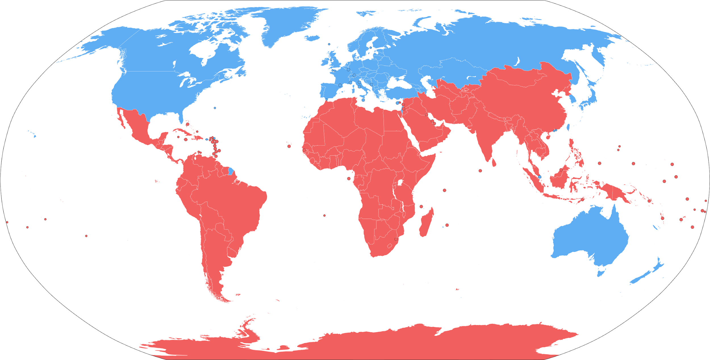
The development gap
Measuring and mapping development
In the past in Development Geography the term Global North-South divide was coined. In the 1980s, this so called Brandt Line was developed as a way of showing the how the world was geographically split into relatively richer and poorer nations. According to this model:
Richer countries are almost all located in the Northern Hemisphere, with the exception of Australia and New Zealand.
Poorer countries are mostly located in tropical regions and in the Southern Hemisphere
North South divide
DEVELOPED NORTH
Map By Kingj123 - Own work based on: BlankMap-World6.svg, Public Domain, https://commons.wikimedia.org/w/index.php?curid=6603483
DEVELOPING SOUTH
Consider:
Are all of the countries above the line High Income countries?
Are all countries below the line Low Income Countries?
Is this the best way to show if a place is developed or not?

Slide 6
The North South divide line of Development - CRITICISMS
It is very old – it featured in the Brandt Report on World Development in the late 1970s/early 1980s
Used wealth via GNP as the only indicator
The terminology used implies superiority and denigrates the south as “developing”
It is too simple, it clumps countries into two basic groups
Many countries have changed since, for example the huge economic growth witnessed in places like Brazil, China and India
We must therefore look at a RANGE of indicators to evaluate levels of development around the world. We must also use UP TO DATE data and consider the DANGERS of using a country AVERAGE
The following maps show how some of the development indicators vary globally and shows inequality. For each map consider what the pattern is. Be aware thought that this data is out of date.

Slide 7
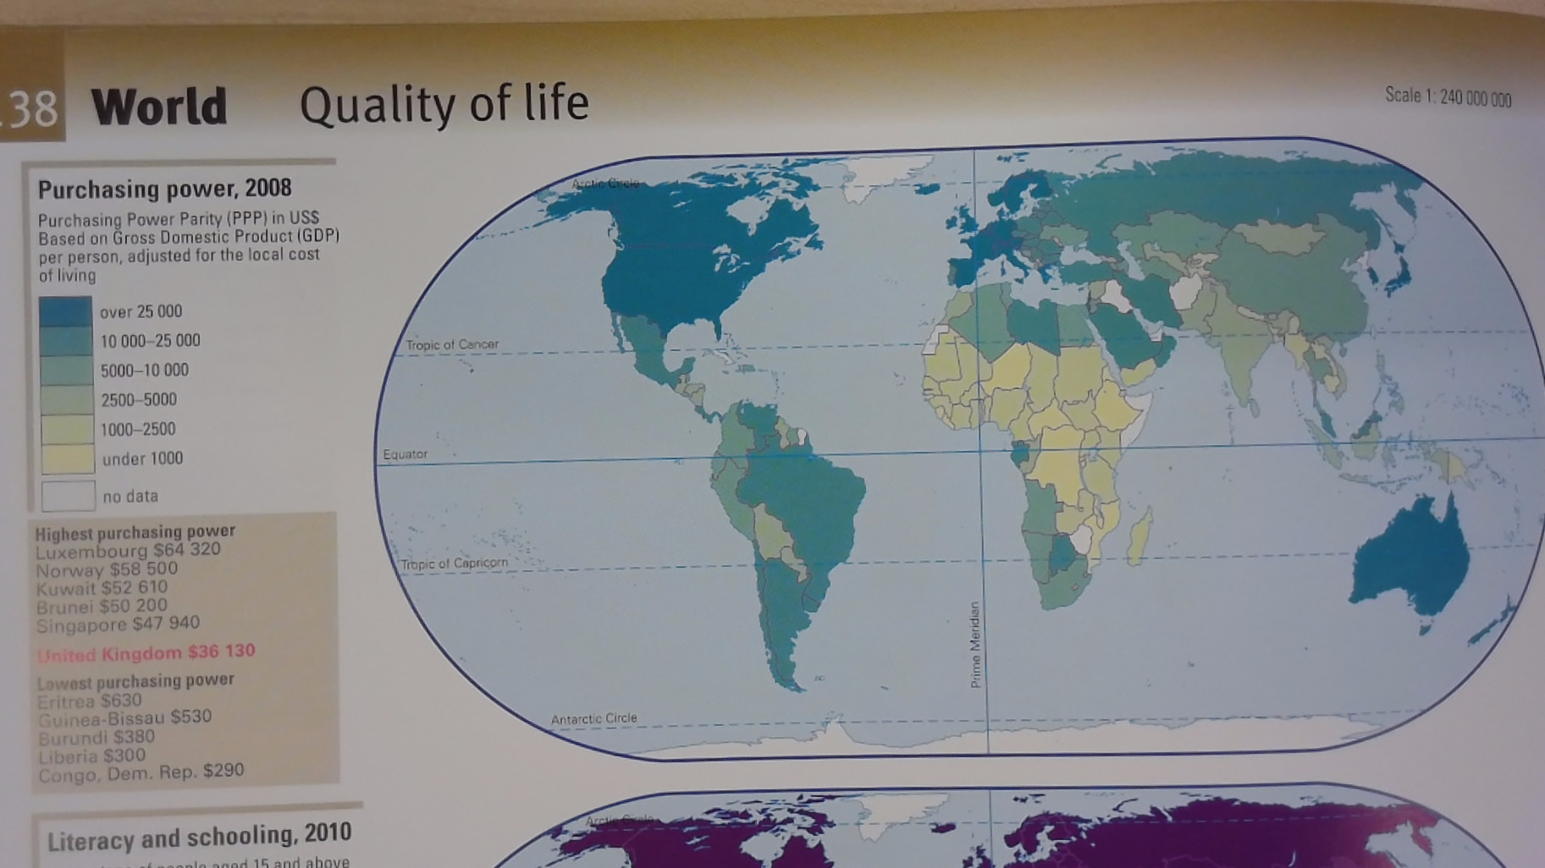

Slide 8
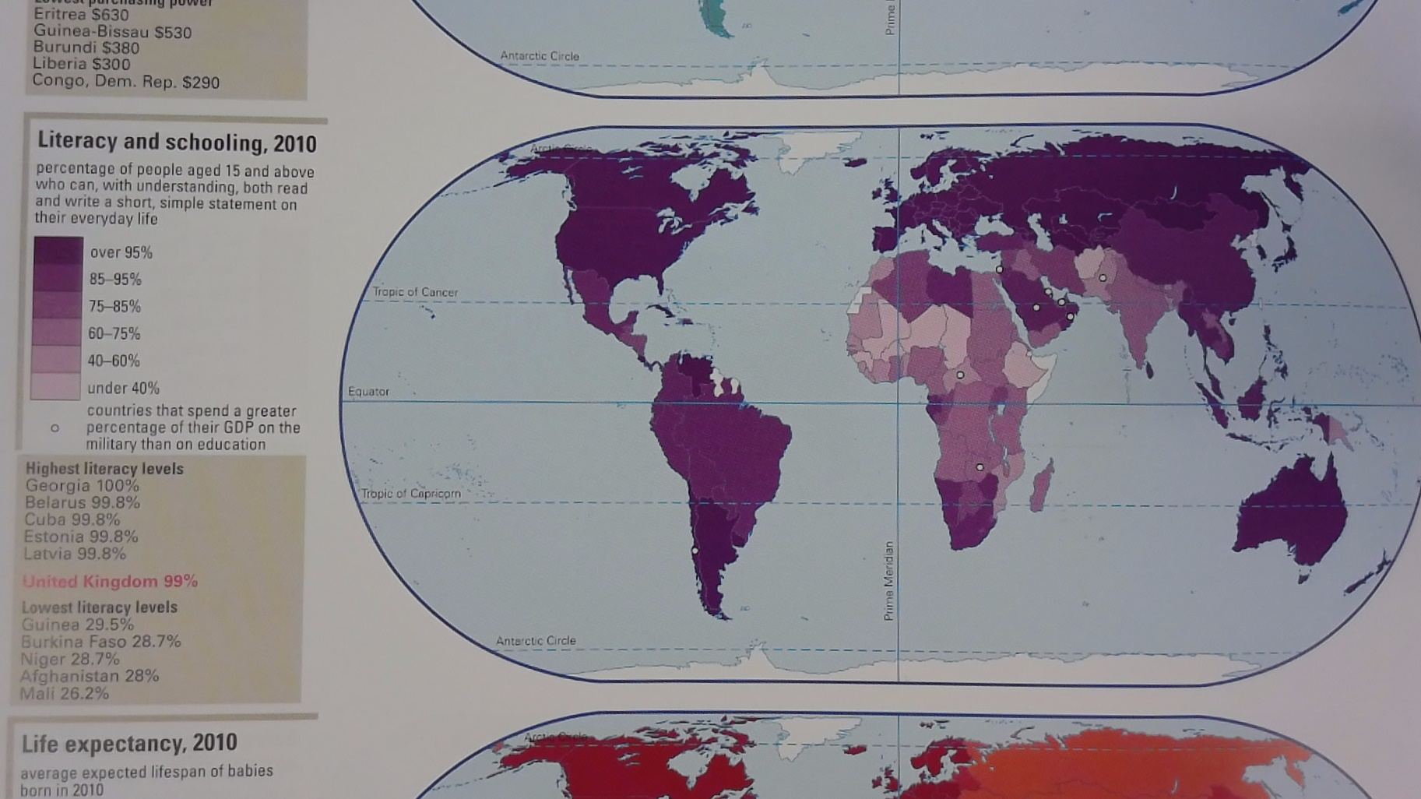

Slide 9
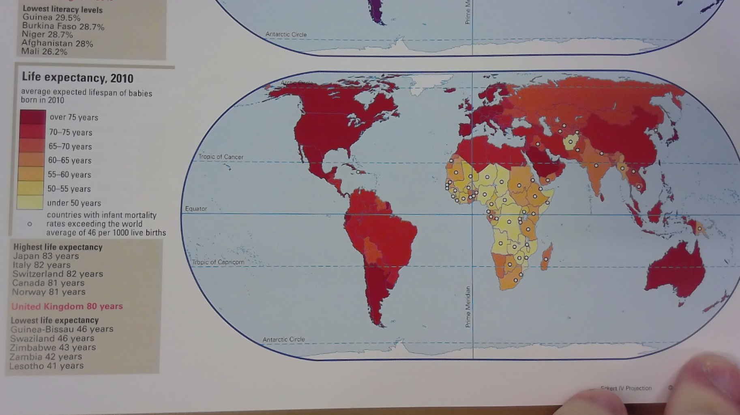

Slide 10
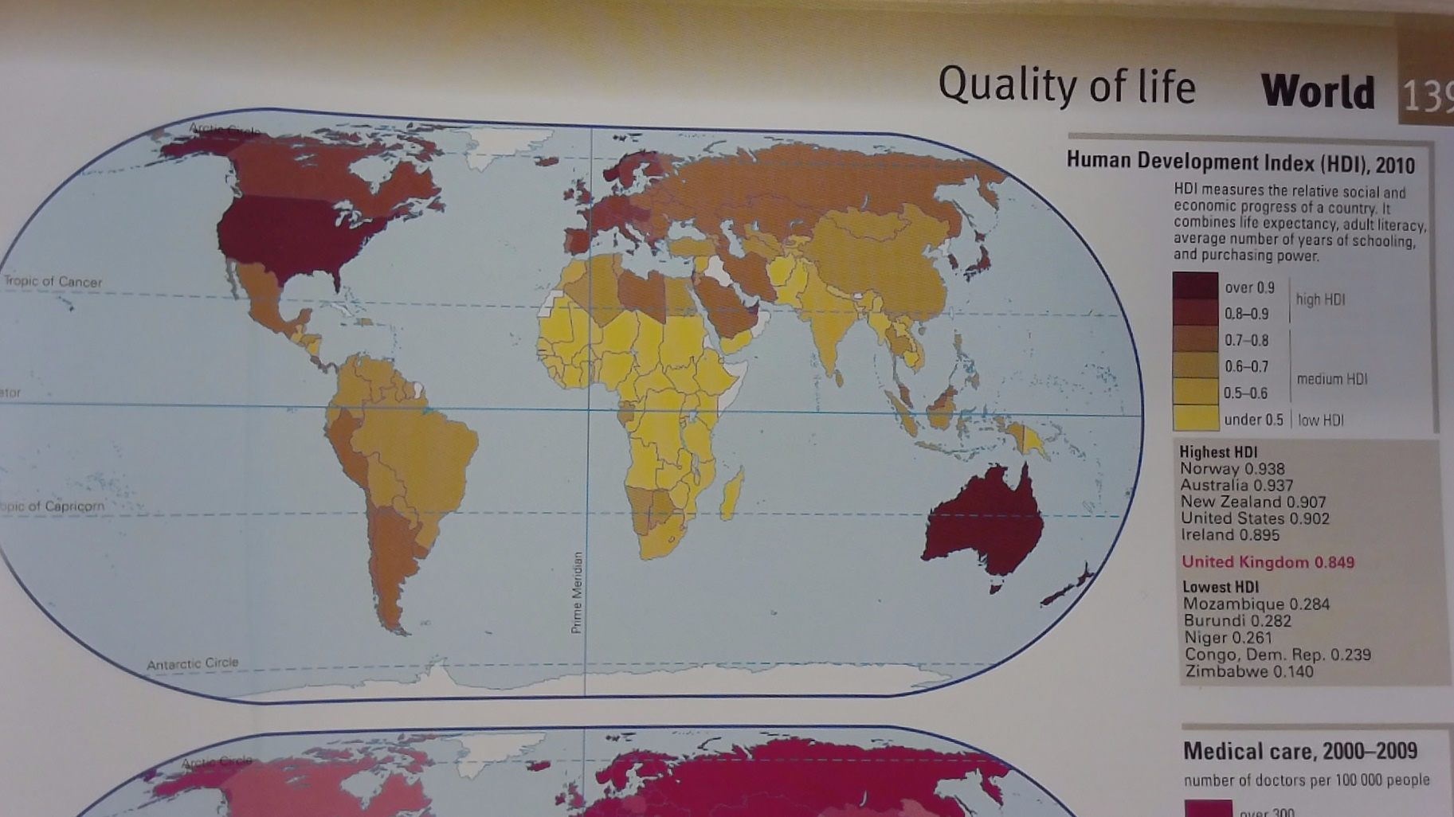

Slide 11
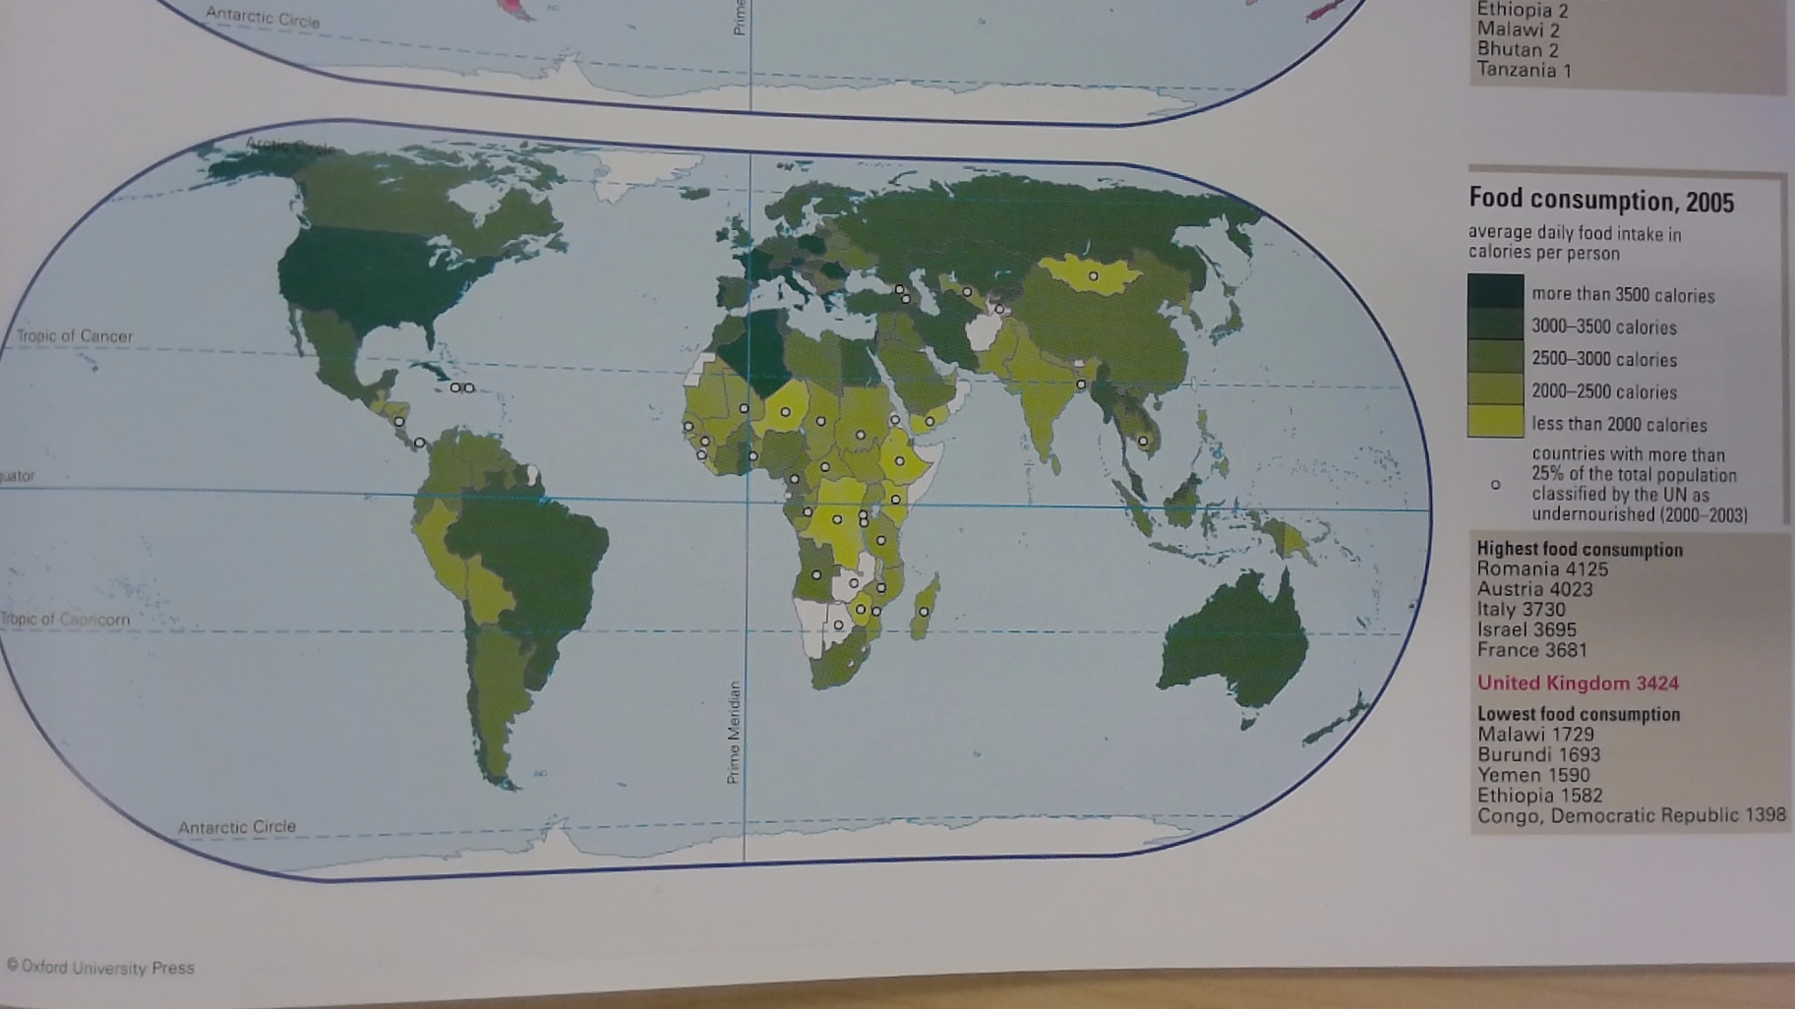

Slide 12
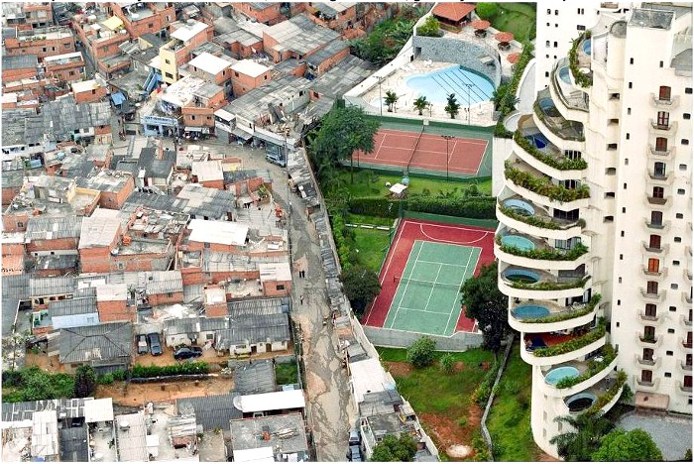
How can levels of development VARY?
The image is from 2004 and was taken by Tuca Vieira from a helicopter. Paraisópolis (Paradise City), and is the largest favela in Sao Paulo, with over 70,000 inhabitants. There is no proper street lighting or sewerage system.
There is a clear inequality between Paraisópolis favela, and the wealth of the adjacent gated communities in the Morumbi district of Sao Paulo, Brazil.

Slide 13
Some key definitions about inequalities in development
Income Inequality - is how unevenly income is distributed throughout a population. It often contrasts the very rich with the very poor.
Poverty is the state of having few material possessions or little income.
Absolute poverty is when household income is below a level that make it impossible for the person or family to meet basic needs of life including food, shelter, safe drinking water, education, healthcare, etc.
Relative poverty is when households receive less than average household incomes in the country. They have some money but not enough to afford anything above the basics. People in Relative poverty do not enjoy the same standard of life as everyone else in the country.

Slide 14
Inequality around the World
Task 1: Draw out the table below. Calculate the ratios.
The bigger the ratio, the larger the gap between the richest people in a country and the poorest.
This table shows how wealth is not evenly spread within countries and how in some it is worse than others.
Consider how this would affect people?
Country Name | A - Income share held by highest 20% in 2018 | B - Income share held by lowest 20% in 2018 | Ratio of wealth between richest and poorest
Brazil | 58.3 | 3.1 | :1
Angola | 55.6 | 3.8 | :1
India | 43.5 | 8.1 | :1
China | 45.4 | 6.5 | :1
Norway | 36.6 | 8.9 | :1
Slovenia | 34.9 | 10.1 | :1
19
15
5
7
4
3.5
Data Source World Bank

Slide 15
What are the impacts of these inequalities and poverty?
Read the article below. Highlight all of the ways in which absolute poverty affect the lives of the people in the article. Use this and your own knowledge to explain how inequality impacts people?
South Sudan's Hunger Crisis: Impact on Women and Children's Nutrition Status
The grass around Awel Atem’s house is soaked. On the roof of the family home a large tarpaulin is spread, along with wet clothes. The walls of the home have cracked, exposing the poles keeping the structure together. Inside, Awel sits on a wet mattress beside two naked children.
The children are famished, Awel says. The roads that Awel’s husband travels to his job are impassable because of the flooding. “My husband sold all our valuables like bedsheets and phones to feed us but our situation got worse every day,” Awel says. Without income, there is no food. Awel’s one-year-old daughter is malnourished. The child’s health has been a concern for months. “She has relapsed three times and is still in the nutrition programme,” Awel says. Because of ongoing heavy rains in Awel’s corner of South Sudan, her house is on the verge of collapsing. Awel is not sure what the family will do if that happens.
Sadly, Awel’s situation is not unique. The ongoing food crisis, compounded by the effects of flooding impacted 800,000 people in 2021. Eleven-month-old Abuk Theresa has been treated for malnutrition twice over her short lifetime. The child is currently in hospital where she is undergoing treatment. Her mother, Adhel Mabek, says her family doesn’t have any food and she has no breast milk. “We are only surviving because of God’s mercy. I do not want to think of losing another baby due to hunger,” Adhel says.
Adhel’s other daughter died in 2021 when the child was a year and a half old. “She got sick and when I took her to the hospital, the test showed she was anaemic. She died that day. I knew it all happened because of poor feeding,” Adhel says.
More than 40,000 children under age five have been identified with acute malnutrition in the areas affected.
In the meantime, World Vision is working with its partners at the United Nations Children’s Fund (UNICEF) and World Food Programme (WFP) at 64 nutrition centres, providing nutrition support to caregivers and children to stabilize their health.
Source: Relief Web

Slide 16
Solutions to Inequality and poverty
Trade
This is the exchange of goods and money between countries and companies but it has positives and negatives for helping development.
Using the table below explain how trade can help reduce inequalities and then evaluate how successful you think it can be.
Positives | Negatives
Countries that are open to international trade tend to grow their economies faster and provide higher income and more opportunities to their people. Trade can help to global poverty by linking areas with the world economy - this helps drive economic growth and reduce poverty. Trade transfers technology between countries. Trade can be used to help even out the gaps in development. Internal trade ideas can help - in Nigeria, Hello Tractor, a technology start-up, is a quickly expanding Uber-like programme that gives farmers temporary access to tractors on demand. Trading internationally brings in money that governments can use to help their citizens Open trade benefits lower-income households by offering consumers more affordable goods and services. Trade can help with border issues as trade across borders is made easier with logistics services more reliable. The African union has a 2018 free trade agreement. | Countries open to trade could see local firms/companies outcompeted by larger international rivals Trade via large companies can mean local workers in poorer countries getting poor wages or working in poor conditions. LICs tend to export one single high value product (70% of Burkina Faso exports are gold!), this makes them vulnerable to price changes Trade can often result in the misuse of the environment by large companies, this has been witnessed by oil companies in the Niger delta Large companies can shift their business from place to place driving down wages and encouraging a “Race to the Bottom” Some countries can block trade using import taxes. This can disadvantage countries with smaller economies
Read this website on Fair trade and explain how this reduces inequalities and if its better than trade - https://sellmerch.org/how-does-fair-trade-work-the-pros-and-cons-of-fair-trade/

Slide 17
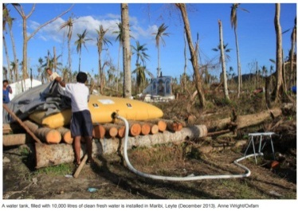
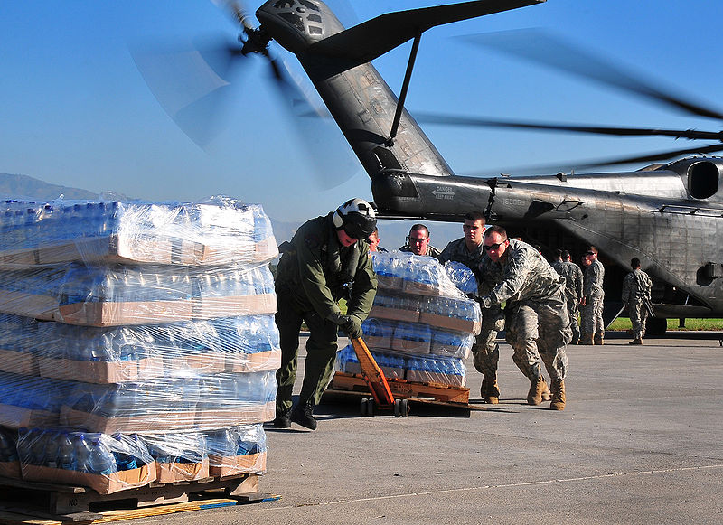
Solutions to Inequality and poverty: Aid
Aid is basically a form of help given from one country to another; or one person to another, or from a charity (often called Non-Government Organisations or NGOs) to a country or region.
Short term aid is for emergencies, like during the 2004 Boxing Day Tsunami, when money poured into South East Asia to help the victims and the sick.
Development aid is longer term, and seeks to help people in poorer countries raise their standard of living.
Aid can also be tied or untied.
Tied aid is when the country giving the aid expects something in return for the aid - the host country may have to trade more with the donor country for example.
Untied aid is where the receiving country does not have to give anything in return.
Typhoon Haiyan water aid
Recovery efforts after the Haiti Earthquake
By Daniel Barker, U.S. Navy

Slide 18
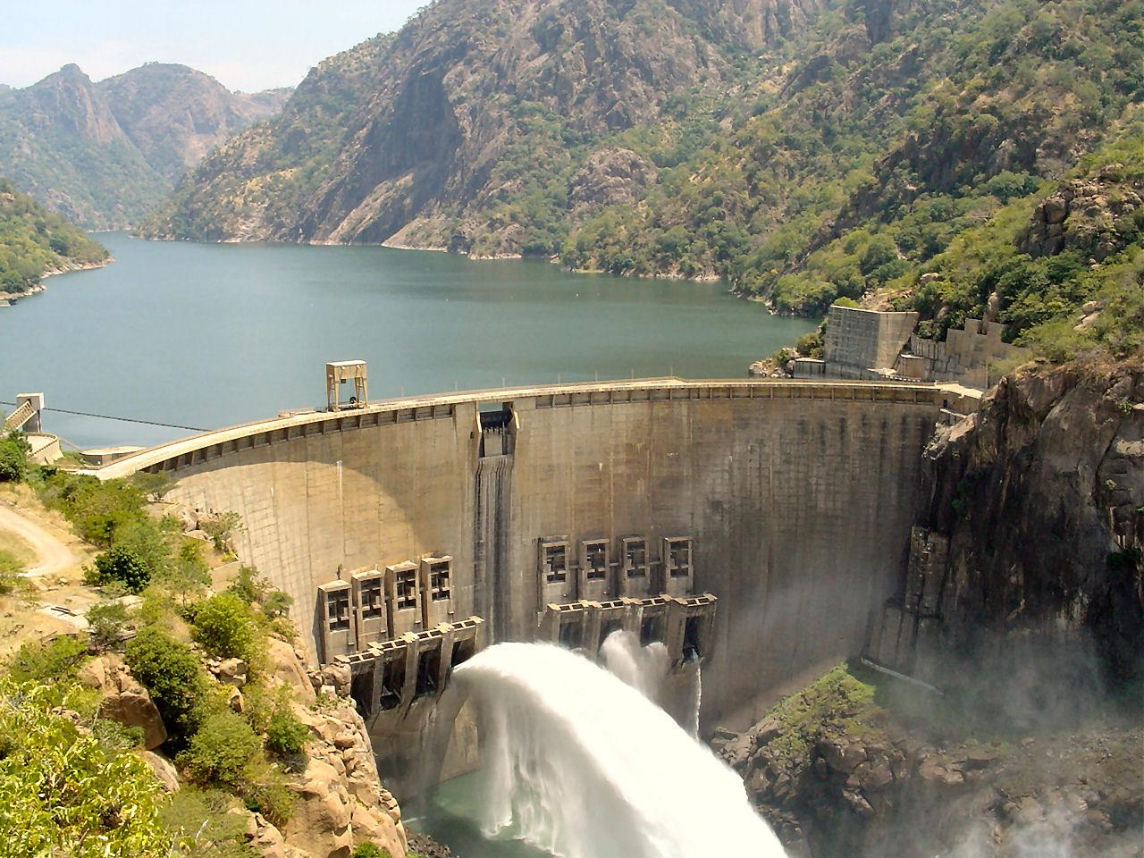
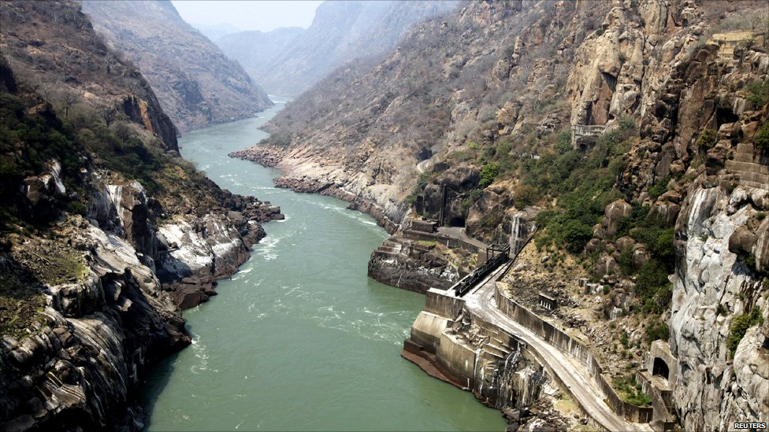
Historical Large scale Development Aid
Many development projects in the past were LARGE SCALE and often partnered poorer countries with ex-colonial powers. Dams were often seen by countries as a great way of raising the development level of a country. They offer energy for other industries, the energy they produce is environmentally “clean” and the construction of such large structures generates instant employment in construction and its associated industries.
For example, Mozambique built the Cahora Bassa Dam. This is a good example of bilateral aid, as the Portuguese government in the 1960s initially started construction of the dam with Portugal having an 82% stake in the dam. Mozambique now fully owns the dam .
The dam blocks the 4th largest artificial lake in Africa, and is one of 3 major dams along the mighty Zambezi River which passes through Congo, Angola, Zimbabwe and finally Mozambique. It has created a lake that is 292km long, up to 32km wide and a maximum of 157m deep.
The dam provides an important power import facility to the South African grid. It transmits 1920 MW of power and one megawatt can power a thousand US homes on average, which is enough to provide most of Mozambique’s energy needs. Locals could use this electricity to power electrical items in their houses helping to improve their quality of life. It could also be used by local business, creating more jobs providing a boost to economy. However, only 8% of homes in RURAL Mozambique have a direct electricity supply according to the World Bank in 2021. So locals have not benefitted from the energy produced by the dam. This is because most of the power is sold to South Africa, which boosts the national economy but does not benefit the local population.
The dam could produce even more electricity, but other dams further up the river have decreased the amount of water flowing downstream to the Cahora Bassa dam. Other impacts include that whilst the local shrimp industry has been destroyed a Kapenta fishery industry has developed, harvesting 140,000 tonnes in 2021. The dam has also failed to prevent flooding, with floods downstream of the dam in 1978. The risk of flooding limits an areas development. However the build-up of water behind the dam helps to prevent water shortages in the local area.
Read the text opposite
What are the characteristics of this as an aid scheme?
What type of aid project is this?
What have been the positive and negative impacts of the Dam?
Are these large aid projects the solution to bridging the Development Gap?
Finished – watch this background video https://www.youtube.com/watch?v=ZVnOEx54b_w

Slide 19
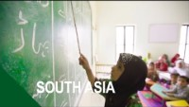
Large scale Development Aid
https://youtu.be/rofaZ477S7g
What work are the World Bank doing in countries like Pakistan?
What successes have they had?
Are these large aid projects the solution to bridging the Development Gap?

Slide 20
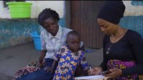
Smaller scale aid
https://youtu.be/e6DCpPzYcrw
Using the video - what energy issues do many people in rural areas in Sub Saharan Africa have?
What is Solar Aids solution and how does it work/help?
Can you think of any drawbacks to the scheme? (perhaps compare it to our use of energy in the UK)
Visit Solar Aid’s website section on Malawi
Take some notes on the problems the country has and what solar aid is doing to help.
Read some of the stories and consider the impact of Solar Aid’s work
Are these smaller aid projects the solution to bridging the Development Gap?

Slide 21
Solutions to Inequality and Poverty
In summary both trade and different types of aid can help nations develop and improve the lives of poor people.
Overall, which of the following do you prefer?
Trade
Fair Trade
Large scale aid
Small scale aid
Explain your choice
Trade can help countries bring in extra income to help their populations but is not without its issues.
Aid can be helpful to country development, especially in more marginal rural areas. Aid needs to be targeted and is often better when it is smaller scale and works from the bottom up.
Aid should be conducted in a dignified way that does not damage the DIGNITY of the people being helped.

Slide 22

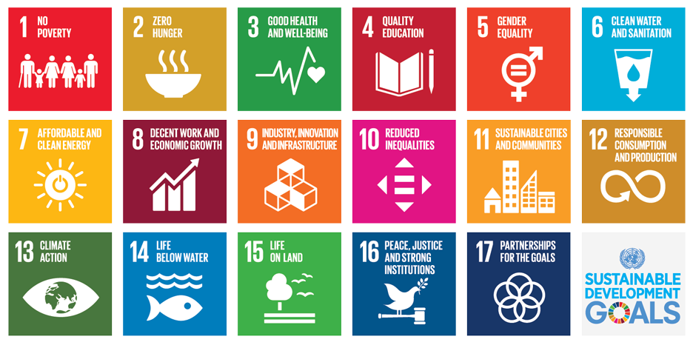
Sustainable Development
Sustainable development is “development that meets the needs of the present, without compromising the ability of future generations to meet their own needs”
The 2030 Agenda for Sustainable Development is a plan of action for people, planet and prosperity by the United Nations.
It aims to eradicate (get rid of) poverty in all its forms and dimensions, including extreme poverty, is the greatest global challenge
The 17 Sustainable Development Goals and 169 targets show the size of the goals. They seek to build on the Millennium Development Goals and complete what these did not achieve.
Explore the 17 goals here https://sdgs.un.org/goals
Which do you think will be achievable?

Slide 23
Extra resources to recap and test your knowledge
Development BBC bitesize https://www.bbc.co.uk/bitesize/topics/zvwtsbk/articles/zbcqjsg
Sustainable solutions to unequal development https://www.bbc.co.uk/bitesize/guides/zcr2w6f/revision/1 (look at all the pages following this link) and then test yourself https://www.bbc.co.uk/bitesize/guides/zcr2w6f/test

