Slide 1
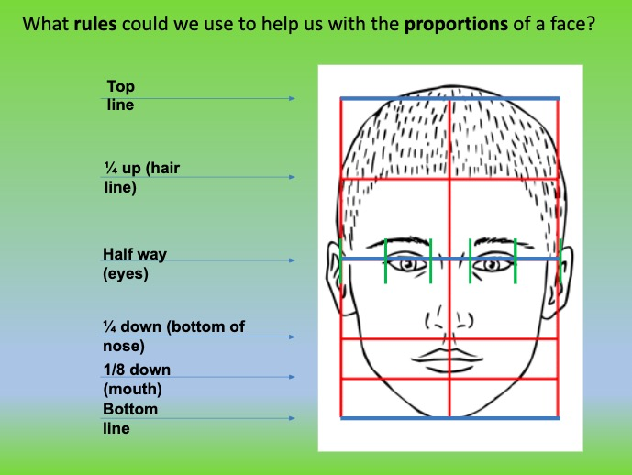
https://youtu.be/sri-B-Xh9P4
Watch the video to show you how to draw a portrait in proportion
Aim: Building depth in portraiture work and illustrations by combining materials and creating areas of shadow and highlight with more consistent control.

Slide 2
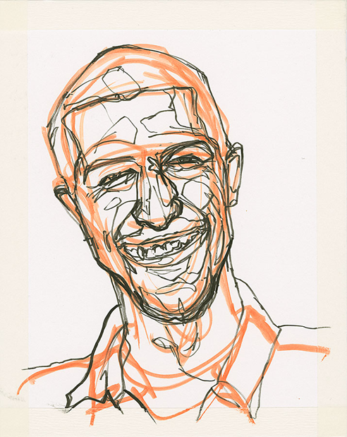
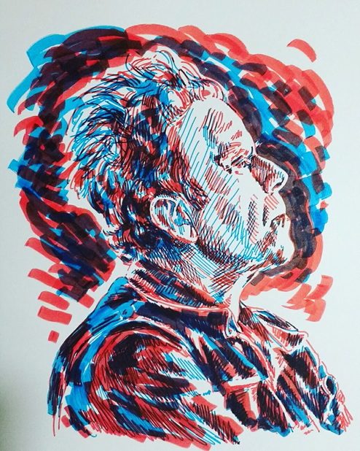
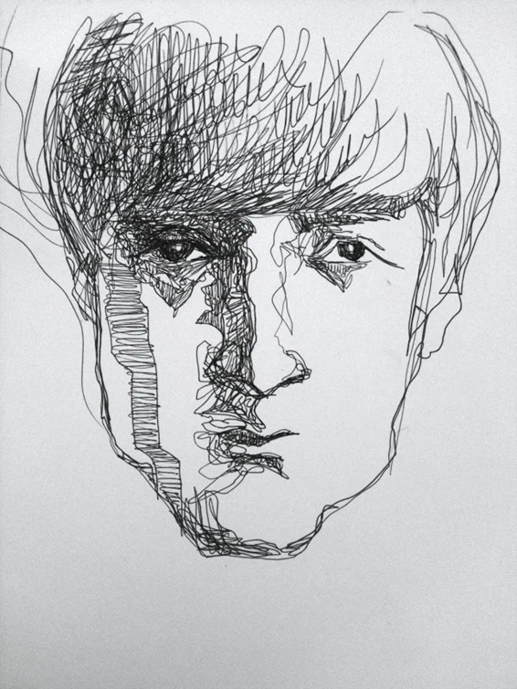
To learn how to apply different mark making techniques to your portraits to give them greater depth and likeness.
Try layering lines to add depth. Suggested:
Highlighters
Coloured pencil
Sharpies
Layering 3 different colours on top of each other.
Apply heavy lines into the darkest areas of the face

