Slide 1
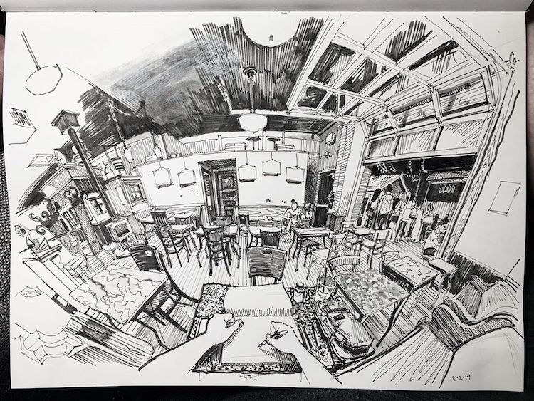
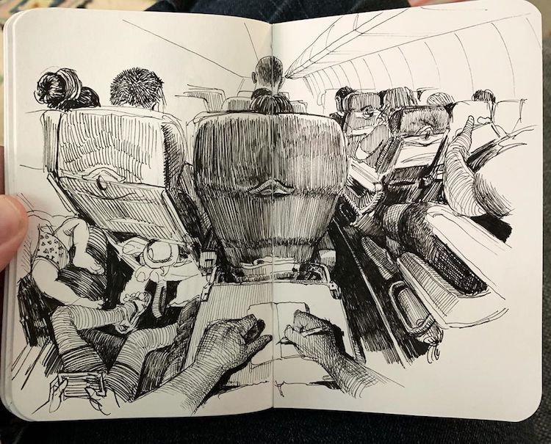
Aim: Composing more complex composition ideas and perspectives in pencil work.
Take paper/sketchbook out on a journey with you. Create rough sketches from the rooms/areas in front of you.
Practising drawing from life is always useful and helps you improve your observational drawing.
https://mymodernmet.com/perspective-drawings-paul-heaston/
Denver-based artist Paul Heaston's impressive perspective drawings reveal moments from his daily life. Visit the website to see more of Paul Heaston’s daily sketches.

Slide 2
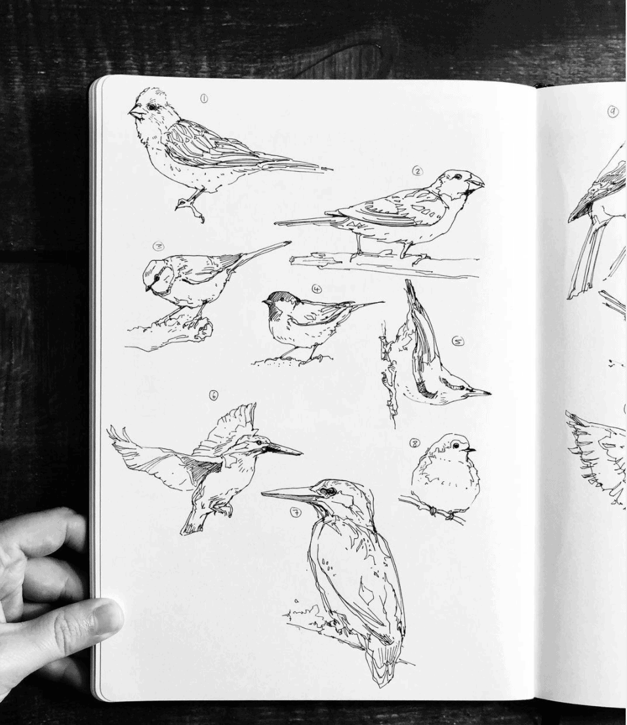
Daily Drawing Exercises to challenge you
Technical Skill/Skill Development • Draw all the contents of your junk drawer with one continuous line. • Make a detailed drawing of a rock. • Draw a dark object in a light environment. • Draw a light object in a dark environment. • Make a detailed drawing of five square inches of grass. • Draw a transparent object. • Draw a translucent object. • Do several studies of eyes, noses, and mouths in a variety of poses. • Draw an interesting object from three different angles. • Value Studies–Draw three eggs and part of the carton with a strong light source. • Draw three metallic objects that reflect light. Focus on highlights and reflections. • Refraction–Create two drawings of separate objects partially submerged in water. • Make three drawings (your choice of subject) using materials with which you are not familiar. • Draw a piece of patterned fabric with folds. • Draw a bridge and all of its details.
Visit this website for more drawing exercise prompts
https://theartofeducation.edu/2015/11/100-sketchbook-prompts-your-students-will-love/

Slide 3
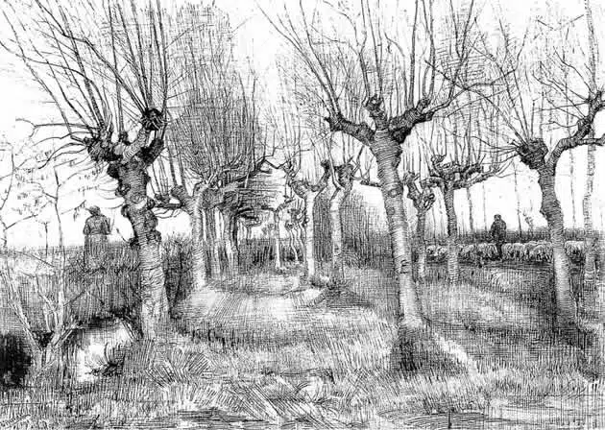
Perspective and Viewpoint
https://www.studentartguide.com/articles/one-point-perspective-drawing
Student Art Guide shows you how to draw from different perspectives.
Choose and activity, watch the demonstration and give it a go.
Landscapes and perspective scenery abide by the same rules of perspective. In this ink landscape by Vincent van Gogh, the trunk heights disappear towards the vanishing point on the horizon.

