Slide 1
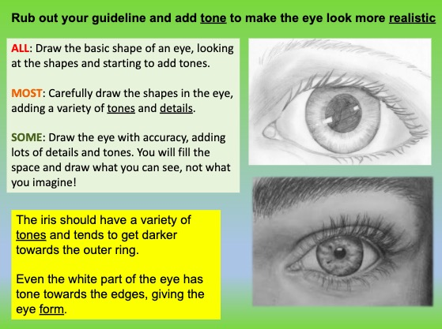
Aim Capturing a high level of accuracy in portraiture work, including fine intricate details and creating tones using varied mark making techniques.
Watch the how to videos. Try drawing along with the video by pausing it as regular stages.
https://youtu.be/PHD3Xvgaqcg
Drawing eyes with detail and tone
https://youtu.be/SB7el6aFTKY
How to draw lips with line detail and shadow

Slide 2
