Slide 2
. | A02 /A03: Experimenting and Quality of recording ideas. AIM: ADDING TO YOUR DEVELOPMENT PAGES FOR YOUR EXAM TOPIC OR COURSEWORK Look at the examples on the next slides for ideas Apply extra depth: Vary surface/paper Vary the size Vary the material Vary the colour palette
 | Annotate your experiments Which ones have potential to be developed further?
 | first one, print images and begin written analysis

Slide 3
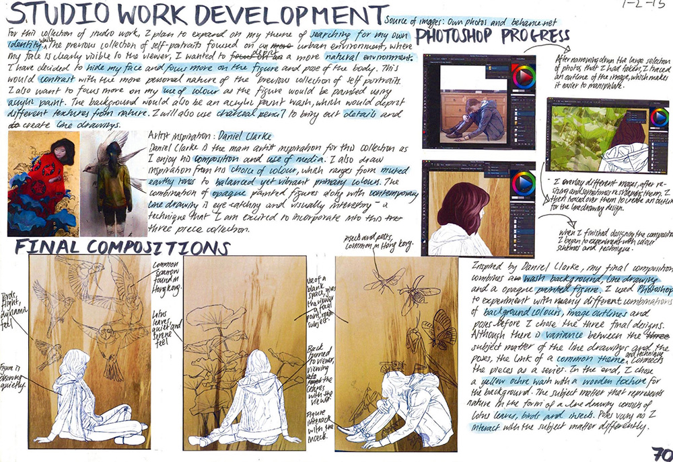
IDEAS SKETCHES DEVLOPED FROM THE PHOTO EDITS AND DIGITAL ART

Slide 4
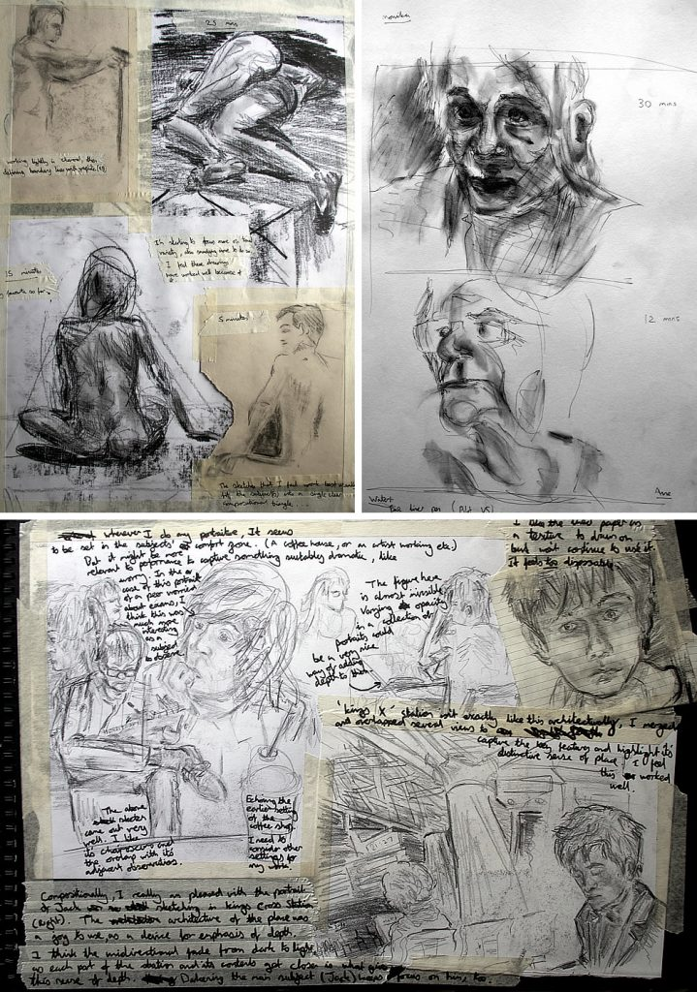
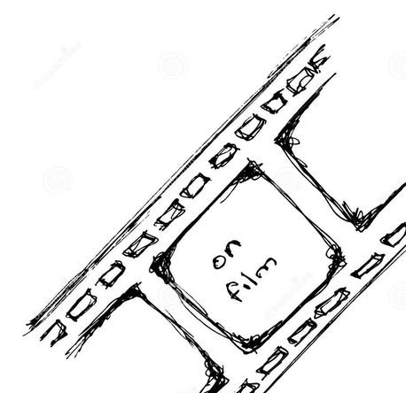
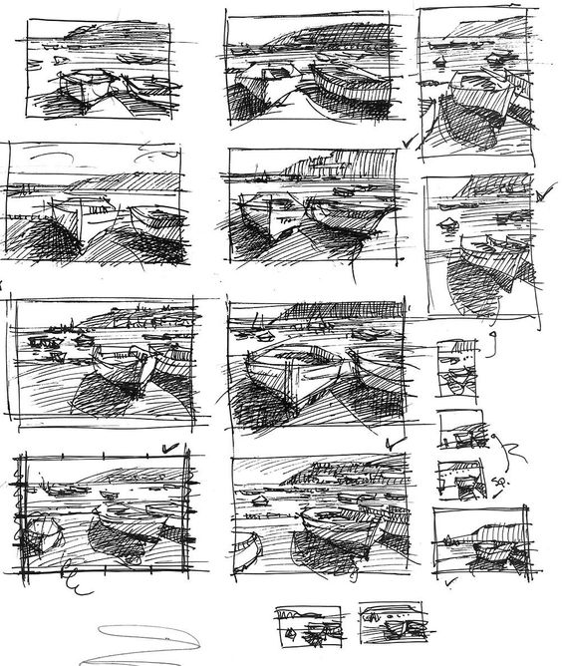
ROUGH SKETCHES IN A FRAME LAYOUT

Slide 5
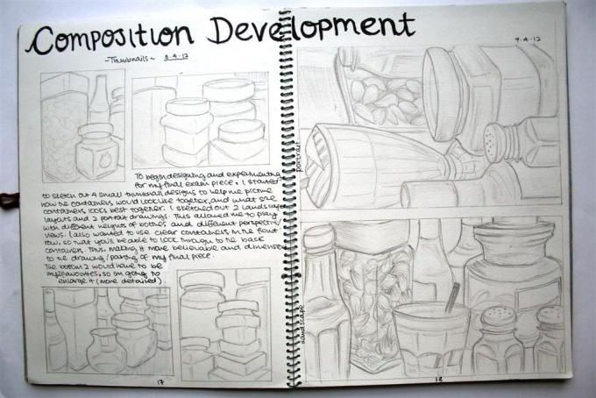
EXPLORING DIFFERENT LAYOUTS OF OBJECTS
Overlapping objects

Slide 6
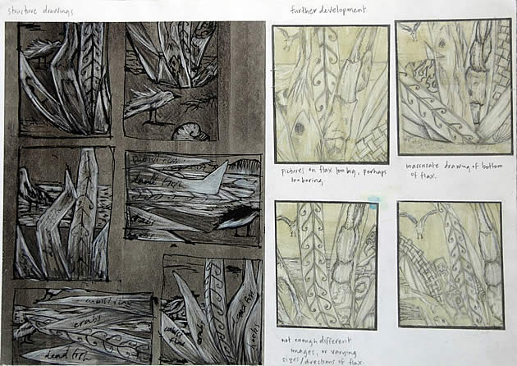
OVERLAPPING OBJECTS

Slide 7
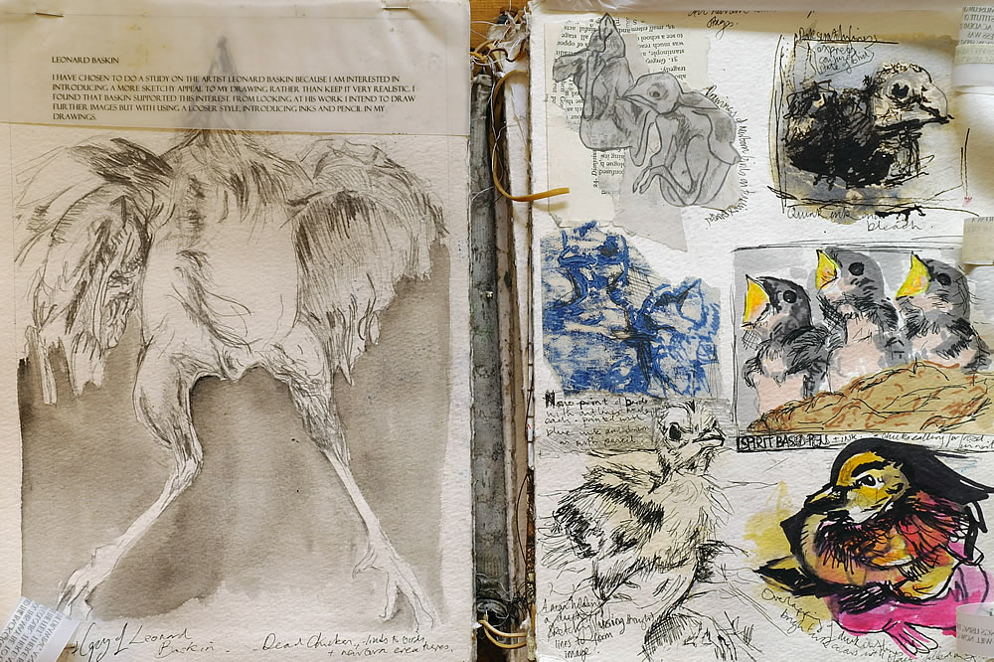
Apply depth to your most successful compositional ideas

Slide 8
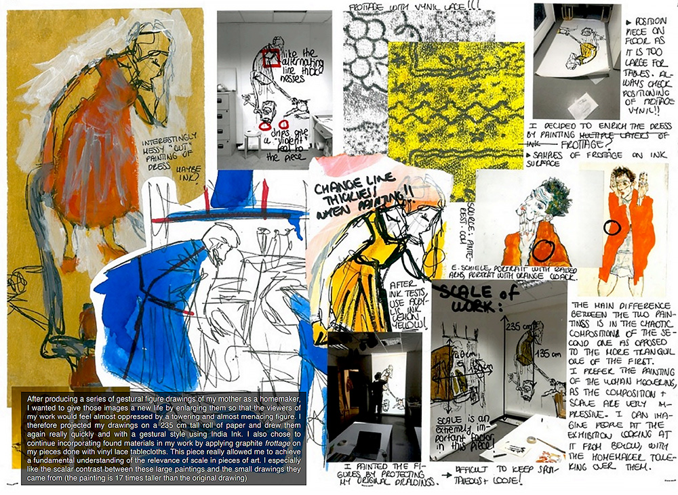
Colour
Line thickness
Pen
Paint

