Slide 1
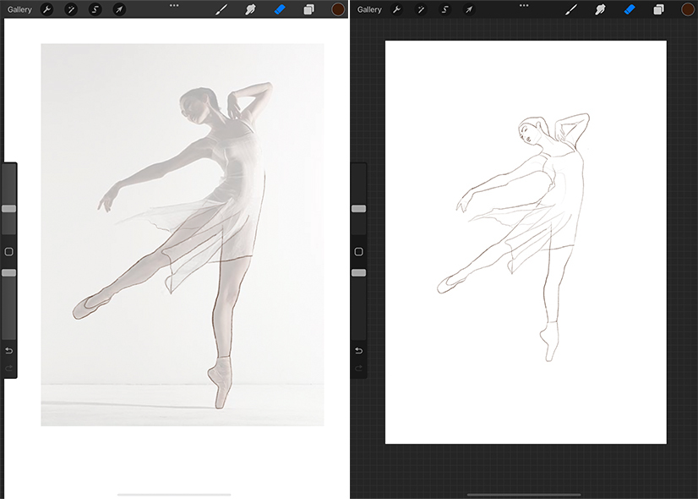
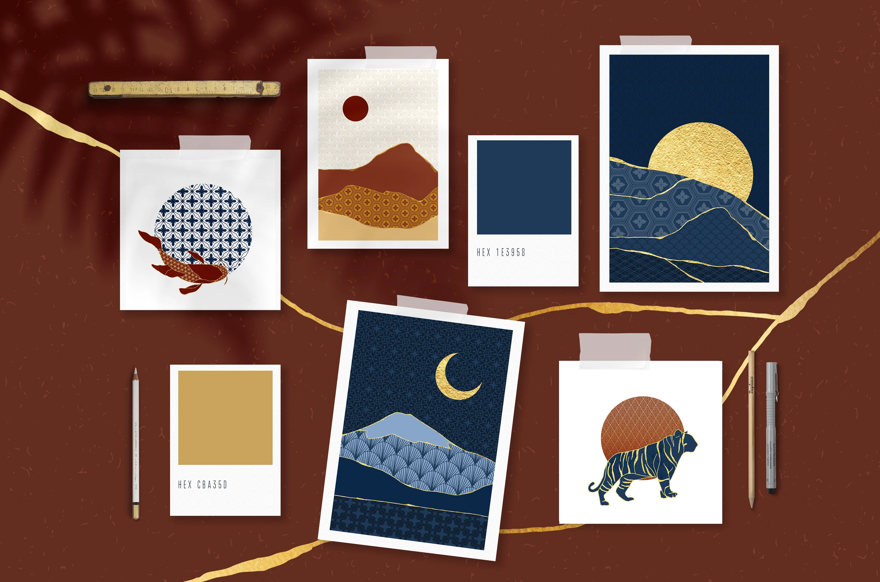
DIGITAL DRAWING EXPERIMENTS
Import an image from teams or take a photo of a drawing or image directly from your book.
Open Procreate and selected image
Create a new layer on top so the photo becomes a guide
Click on the photo layer and change opacity
Click on the new layer and select your tool.
Screen shot the drawing as you make progress
Objective: To create a digital drawing as part of your development from one of your new images.
You could take a photo of one of your existing drawing and rework it digitally.
Examples on the next slide

Slide 2
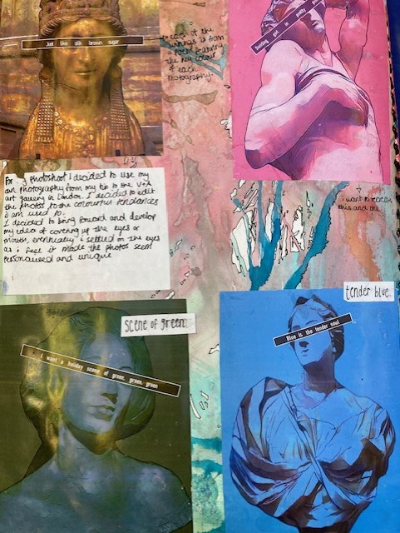
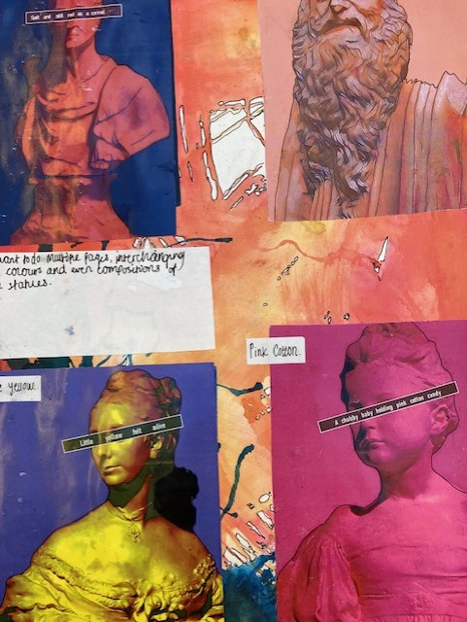
Year 13 Examples of Artist Responses
Digital Outcomes

Slide 3
Procreate Support
https://www.21-draw.com/how-to-trace-on-procreate/
Trace on Procreate
Ideas
https://creativemarket.com/blog/cool-things-to-draw-on-procreate

