Slide 1
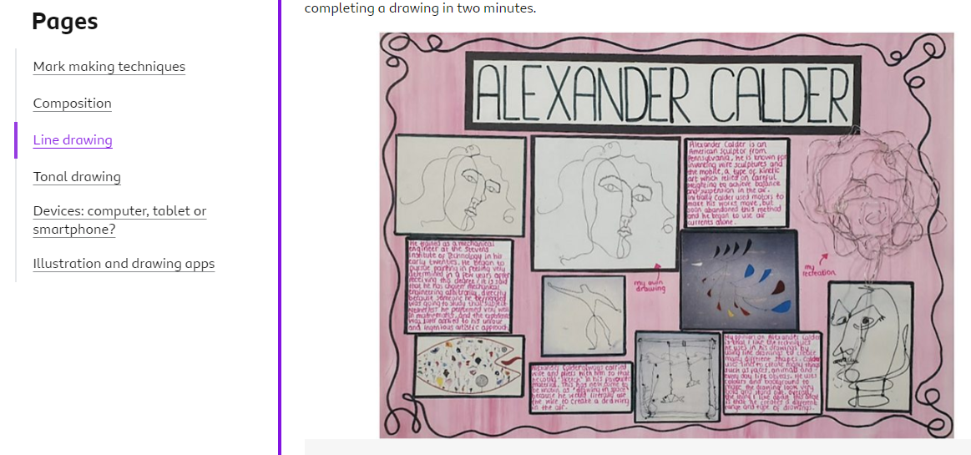
Drawing Techniques
https://www.bbc.co.uk/bitesize/guides/zkn9jfr/revision/2
BBC BITESIZE GCSE
Click on the link and explore different drawing techniques.
Create extra drawing using your preferred techniques and present them in your Coursework or Exam book

