Slide 1
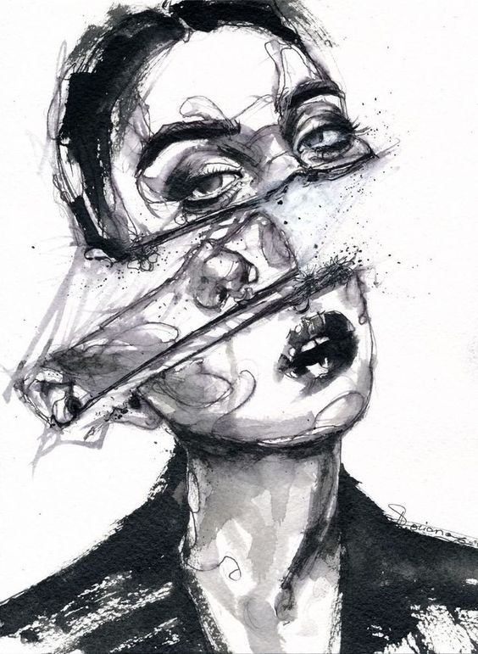
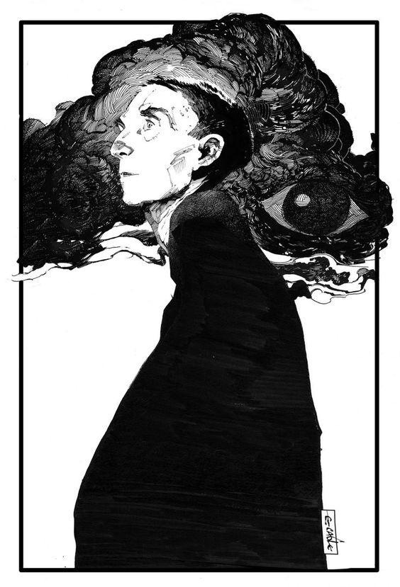

Experimenting with Wet Materials
What effect does the material have on this piece?
What does the ink add?
What is the mood?

Slide 2
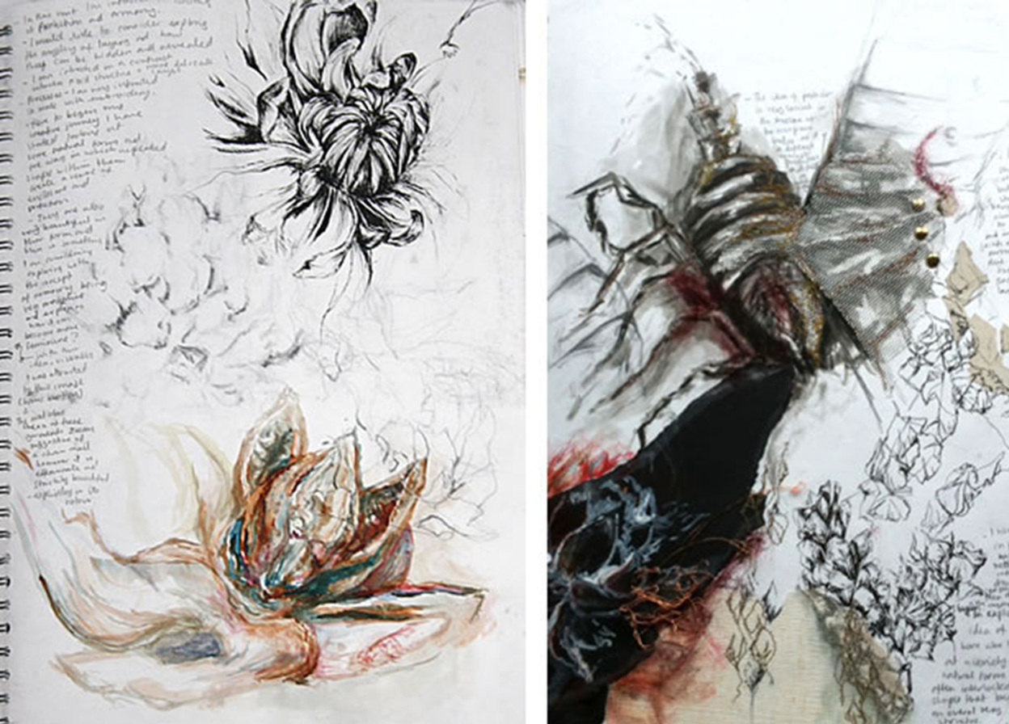
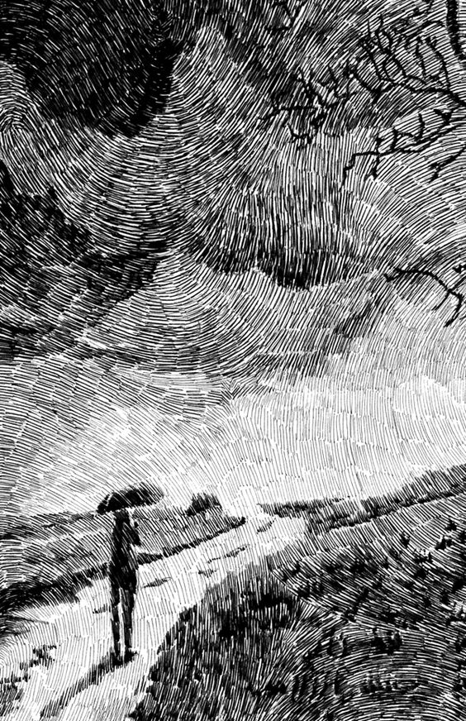
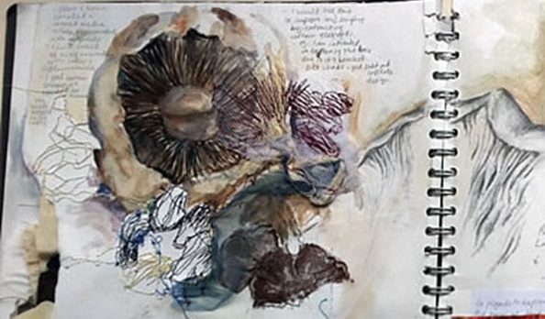
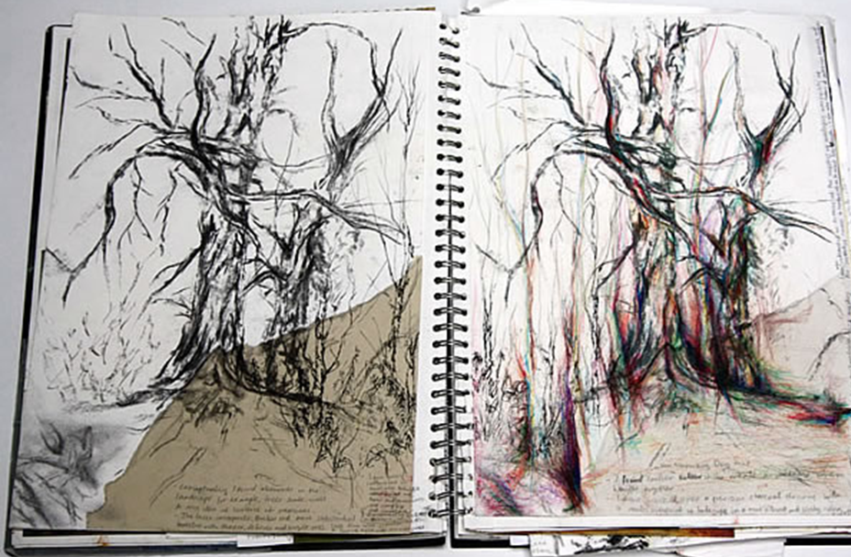
Experimental Drawing Suggestions for ink /paint/coffee
Intricate line
Building up different layers
Light, dry, next layer
Short strokes
Drips
Line
Scratches
Tissue paper/fabric
Ink

Slide 3
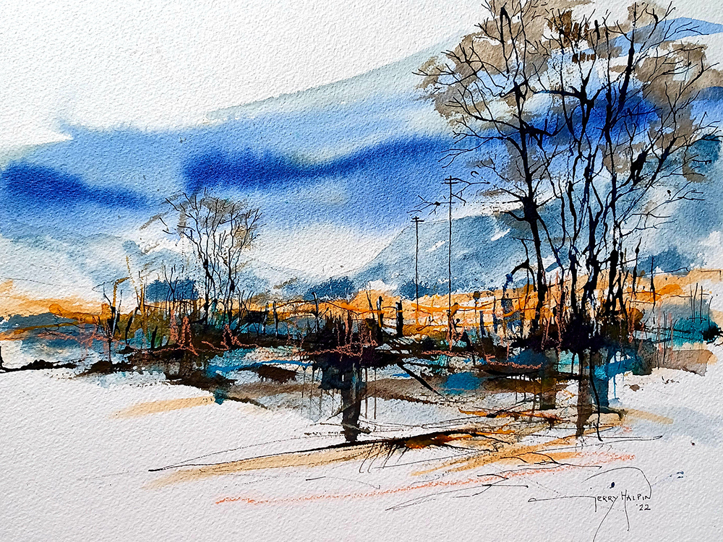
Combining techniques:
Washes
Different dilutes
Strong colour palette
Bleeding
Layers
Scratches

Slide 4
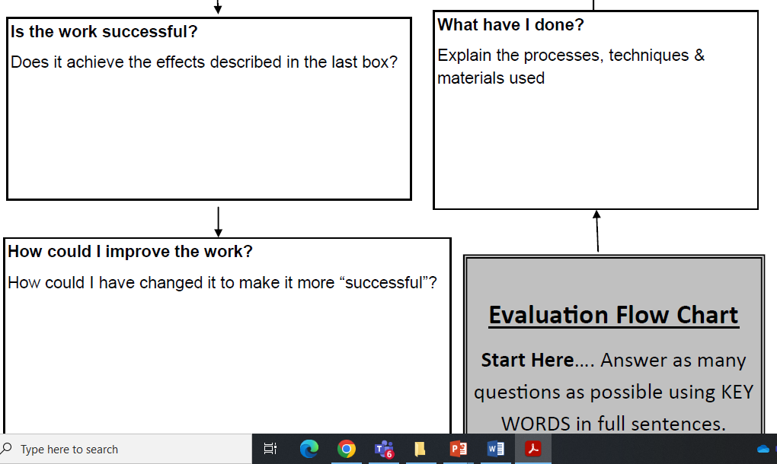
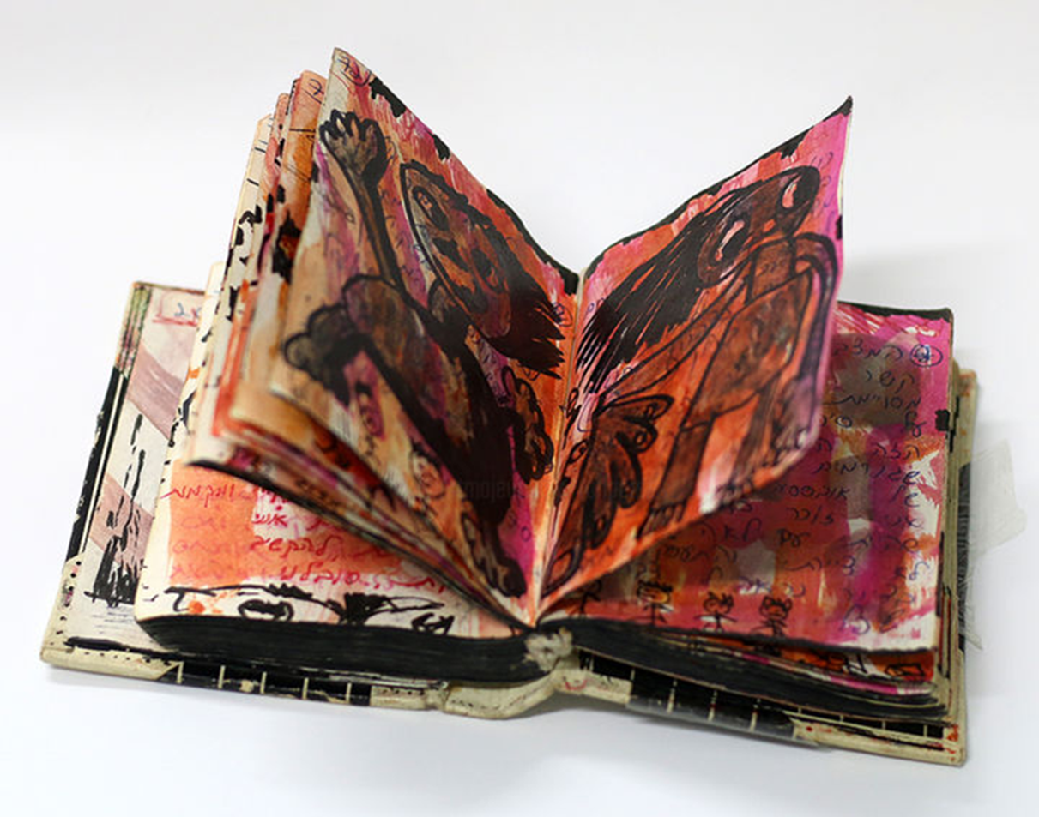
Extra:
Presenting your work and adding reviews.
1/ Present in a clear way.
2/ Give your work enough space
3/ Keep annotations neat and clear.

