Slide 1
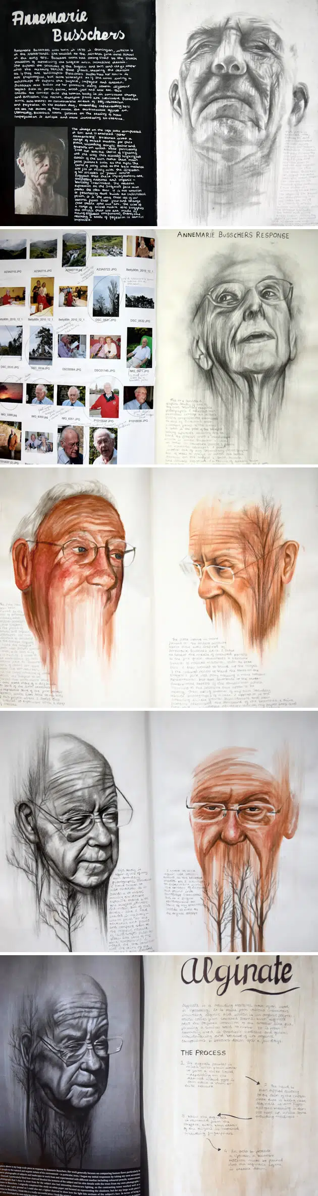
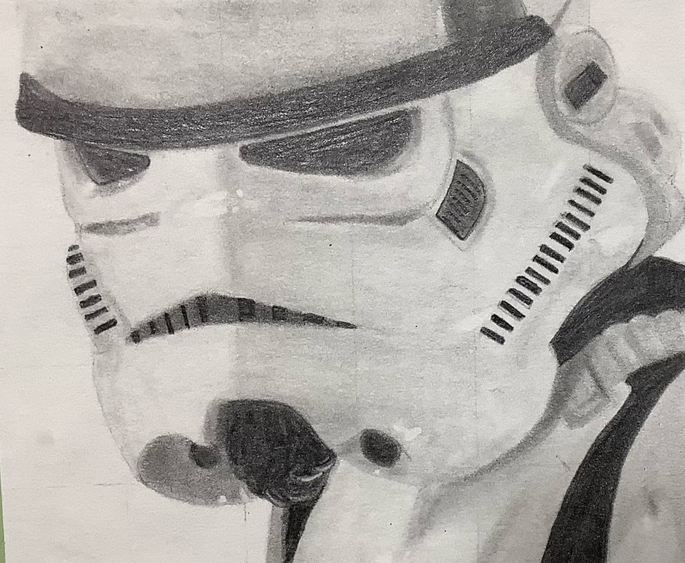
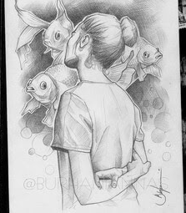

What makes a quality drawing?
Can you spot any good examples

Slide 2
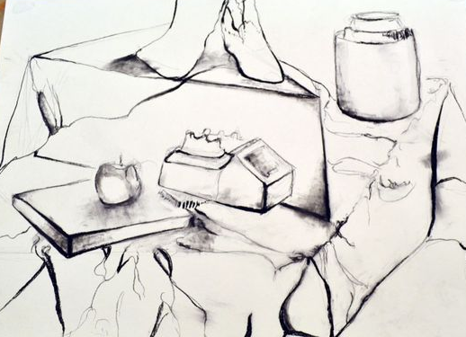
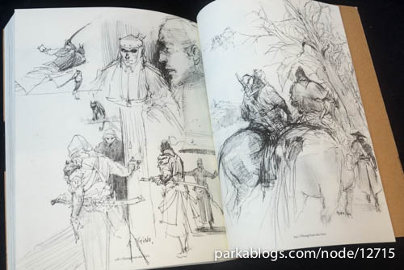
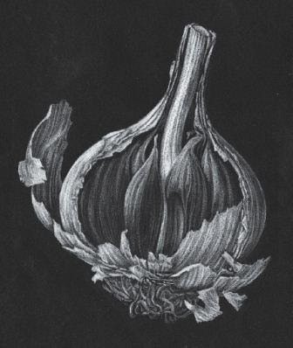
FOCUS ON QUALITY IN PENCIL
Weight of line
Parts of sketches
Delicate areas
Shadow behind the subject
Don’t reply on a heavy outline .
Line and dot sketches
Intricate details
Applying different pressures
Creating a variety of tonal shades

Slide 3
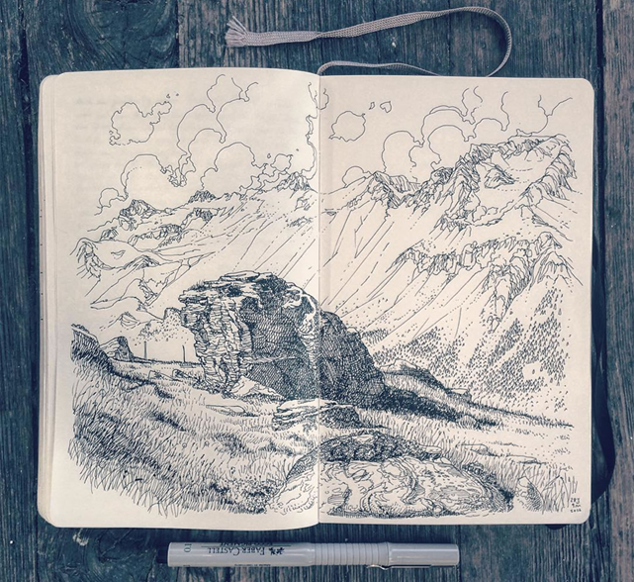

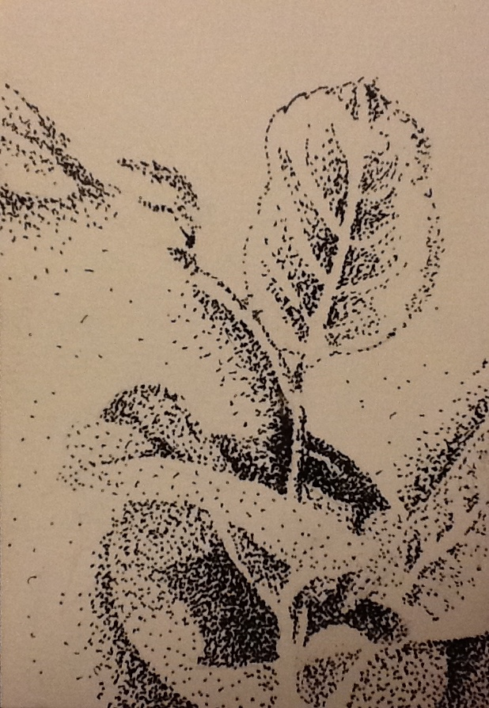
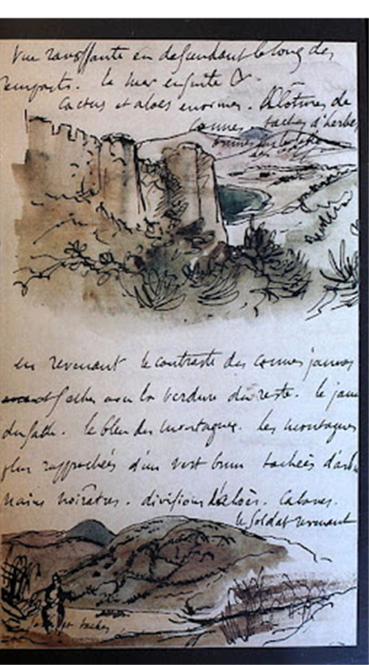
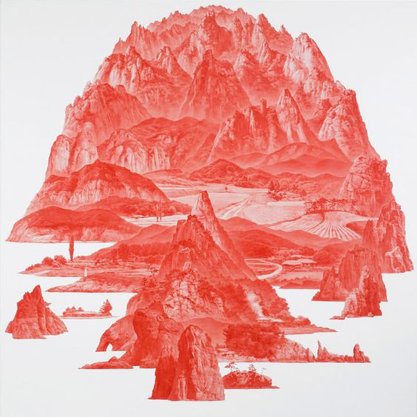
Delicate line and tone
Line and dot sketches
Creating 2 smaller pieces
1/ A different type of pencil/pen drawing you the one you created in the lesson. Look at the options for help.
2/Limited monochromatic colour palette drawing
Looser sketches
Line
Pointillism

Slide 4
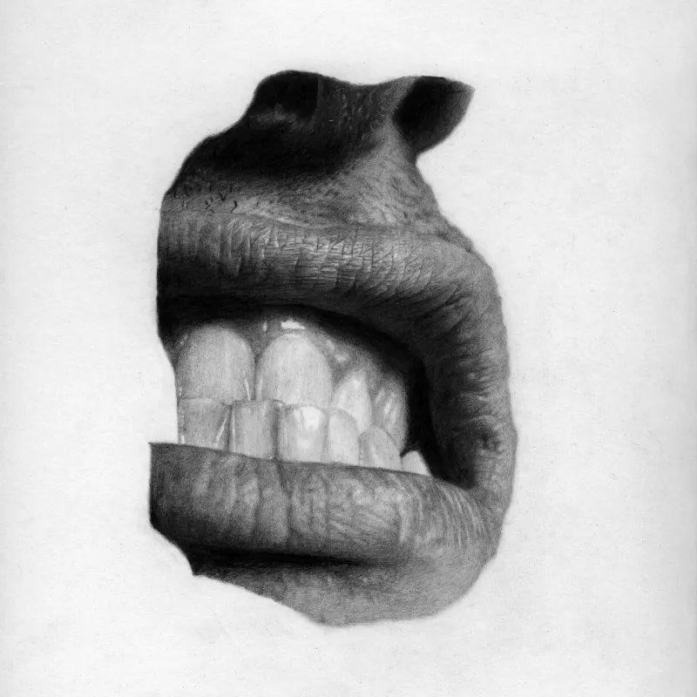
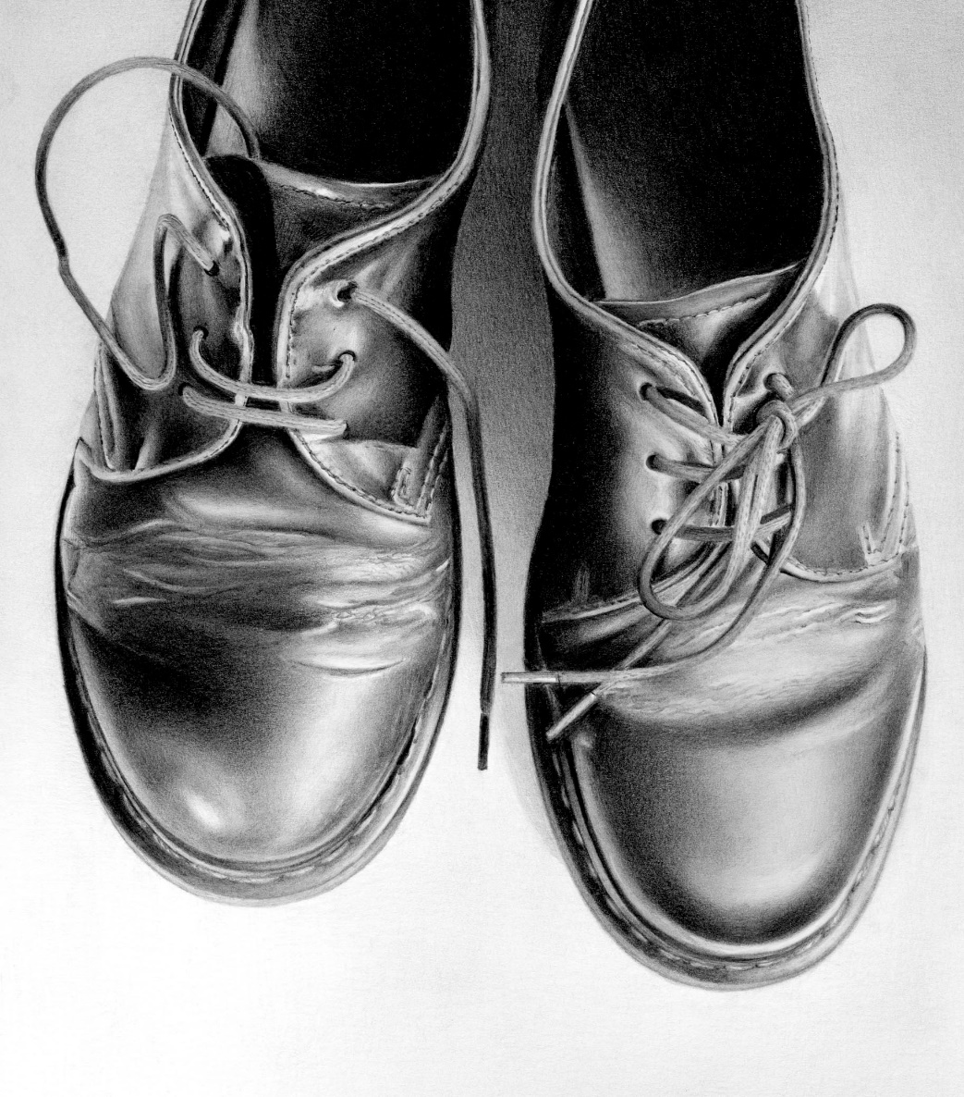
Hyper realism READING
https://www.kooness.com/posts/magazine/21-famous-pencil-drawing-artists-leading-hyperrealist-movement-nowadays
Read this article on pencil drawing
Cath Riley
Jonny Shaw, Lip, 2010, Courtesy of the artist.

