Slide 1
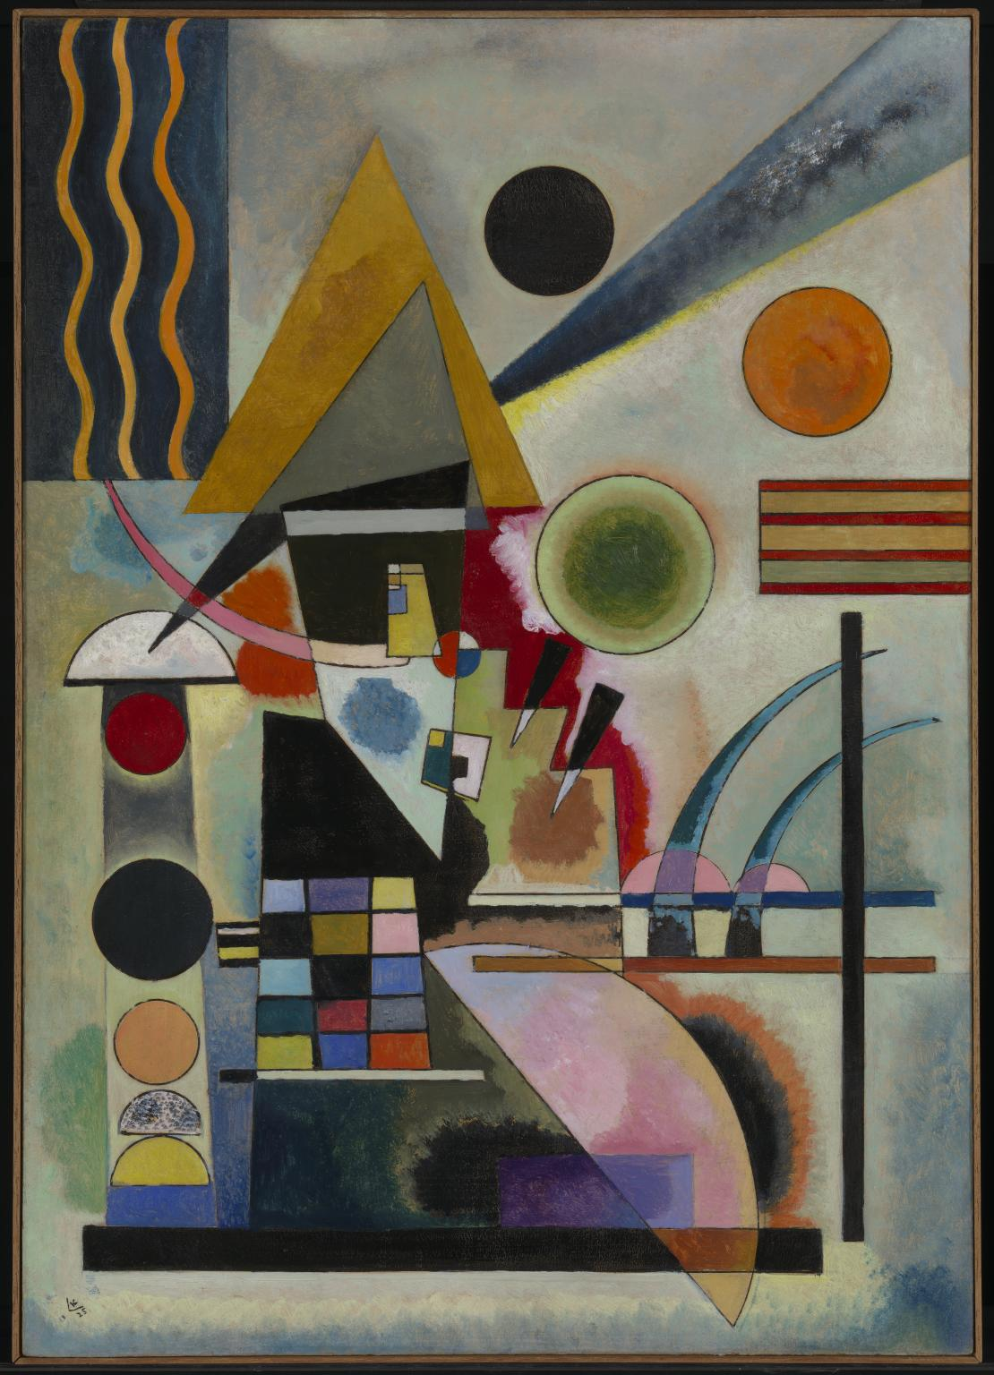
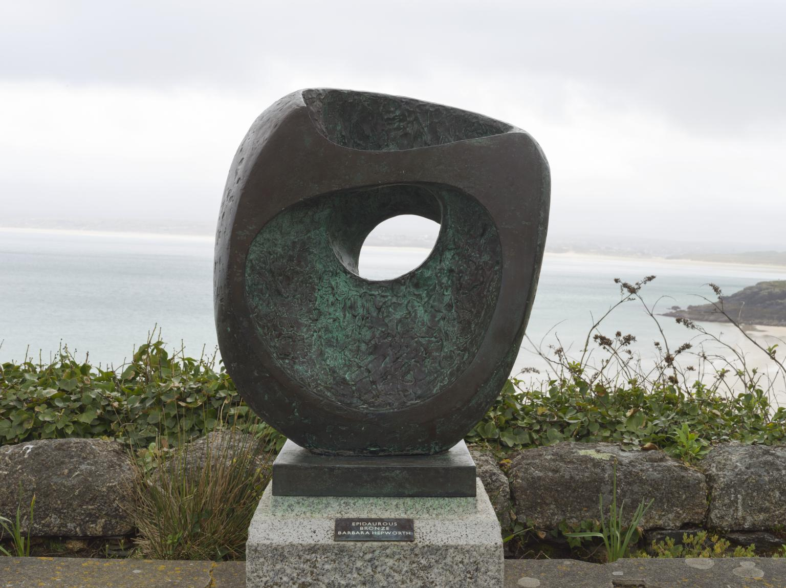
ABSTRACTION
What does Abstraction Art mean?
Abstract art is art that does not attempt to represent an accurate depiction of a visual reality but instead use shapes, colours, forms and gestural marks to achieve its effect.
Since the early 1900s, abstract art has formed a central stream of modern art.
Dame Barbara Hepworth abstract 3D sculpture 1961
Wassily Kandinsky is generally credited as one of the pioneers of abstraction in western art.
Swinging 1925
Abstract painting

Slide 2
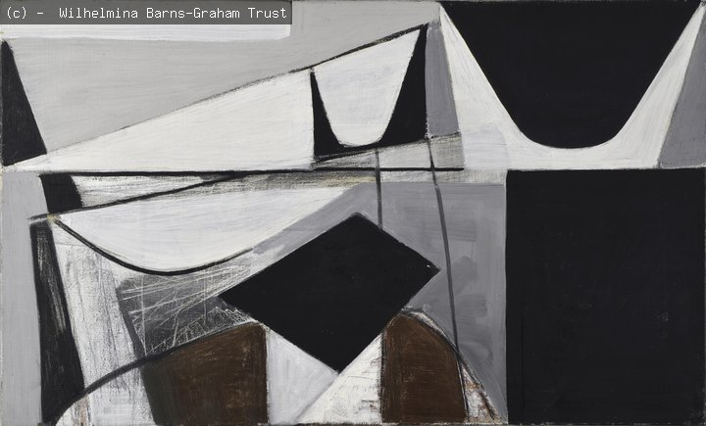
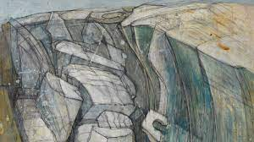
Meet Wilhelmina Barns-Graham: Paths to Abstraction
https://www.youtube.com/watch?v=ftigfoCqX80
3 MINUTES BASED ON HER CURRENT SHOW AT THE HATTON GALLERY, NEWCASTLE

Slide 3
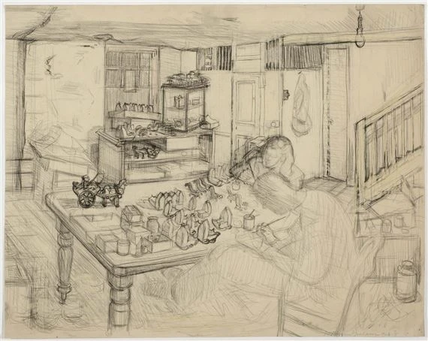
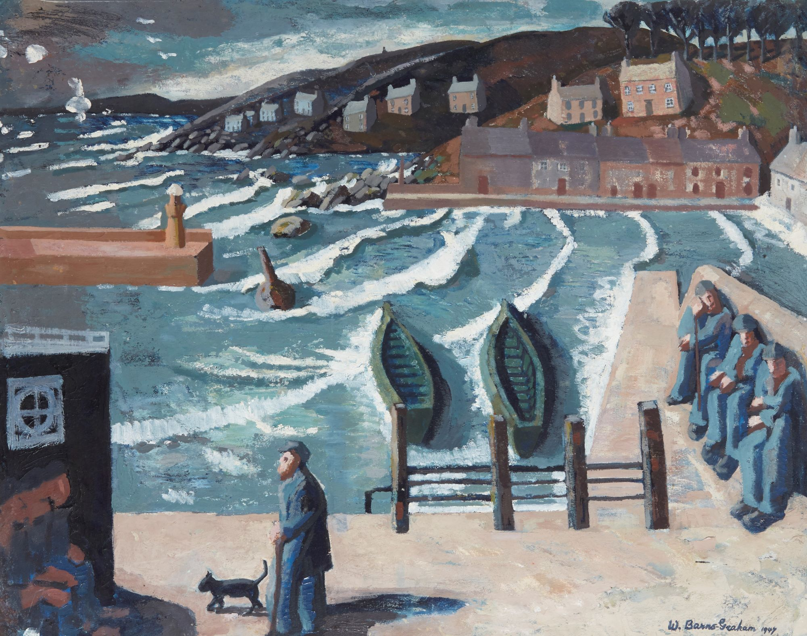
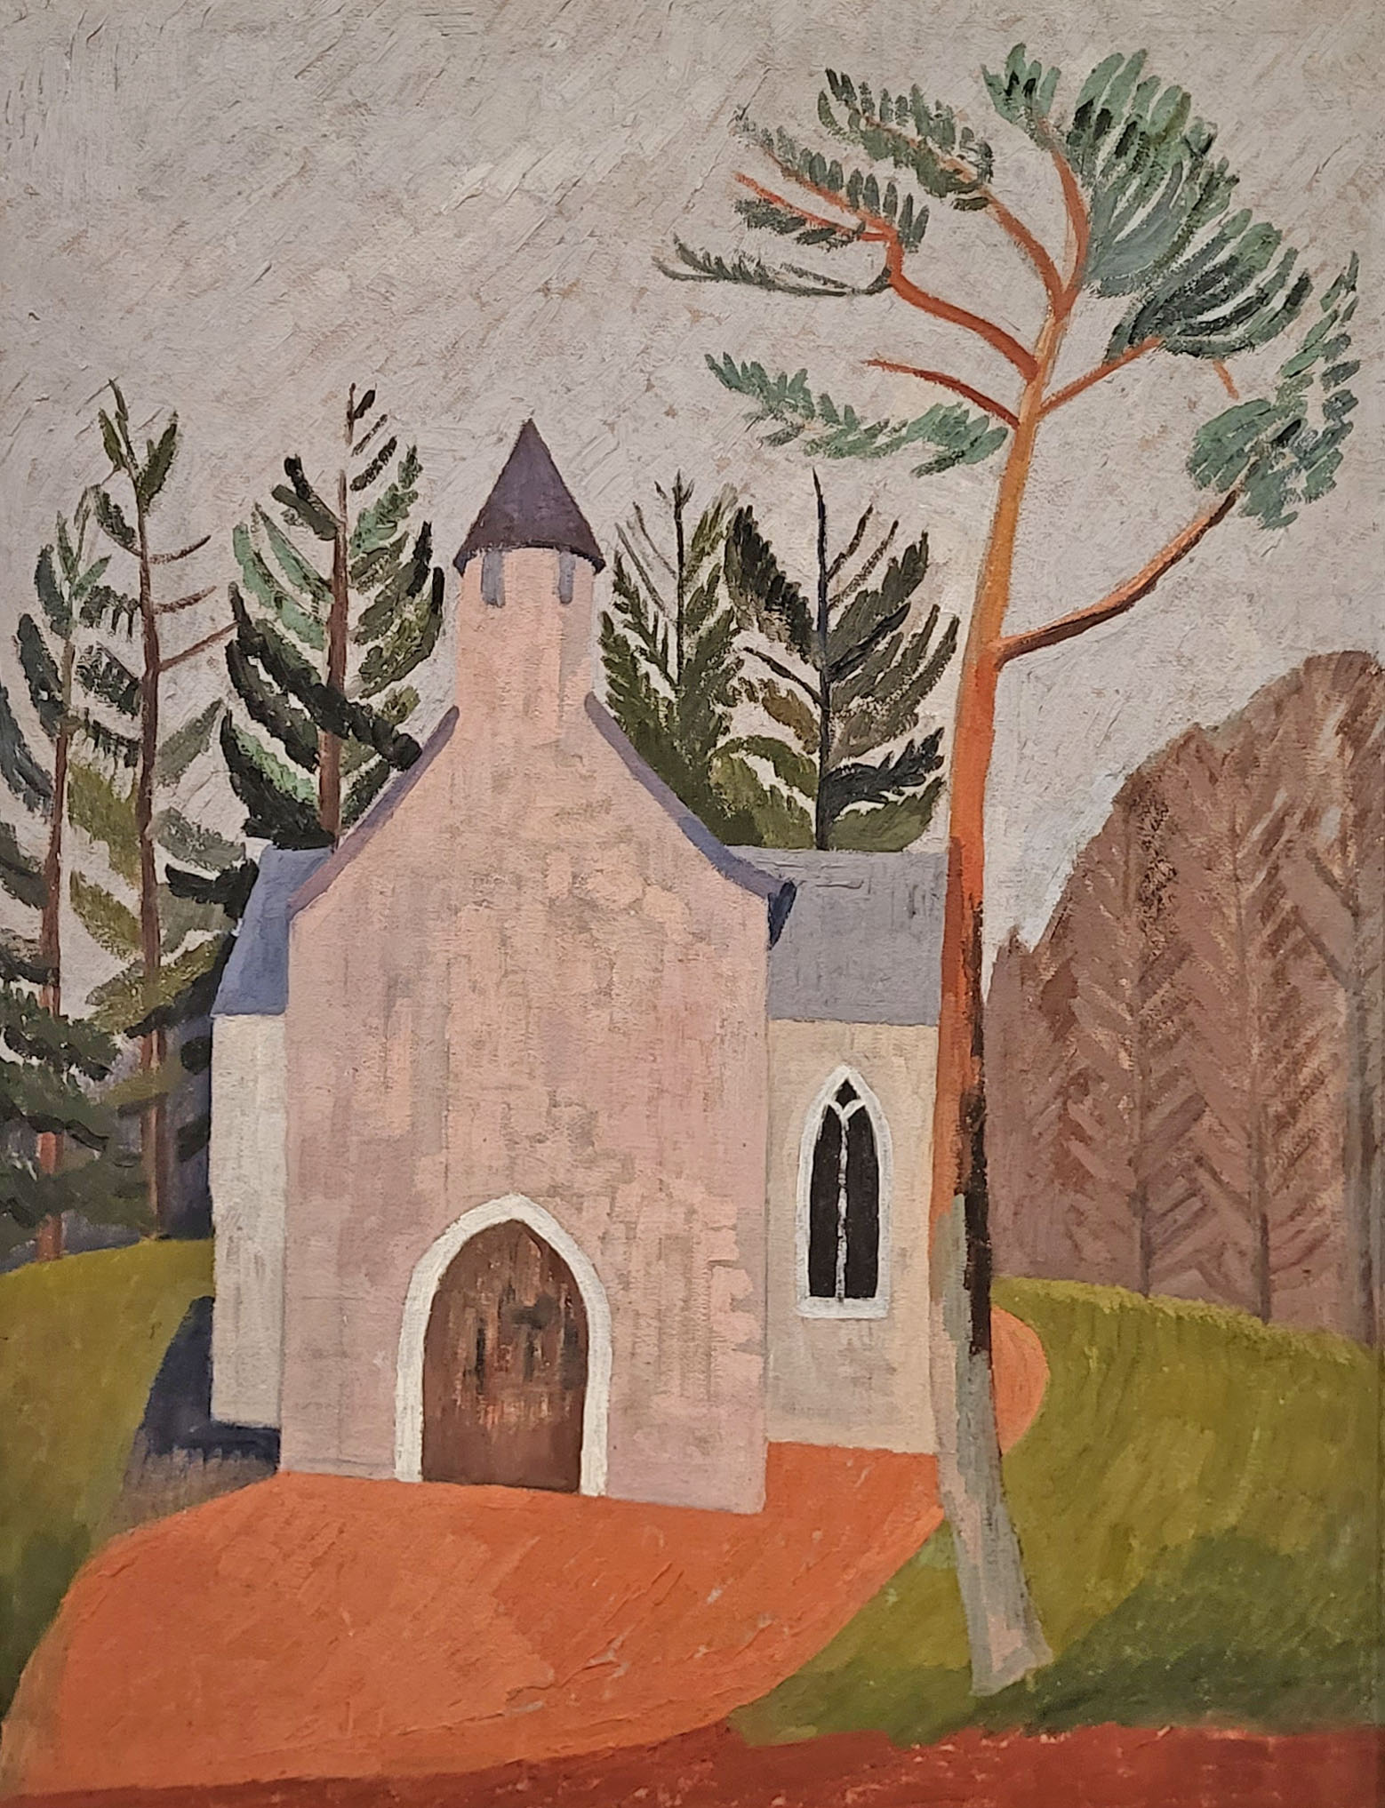
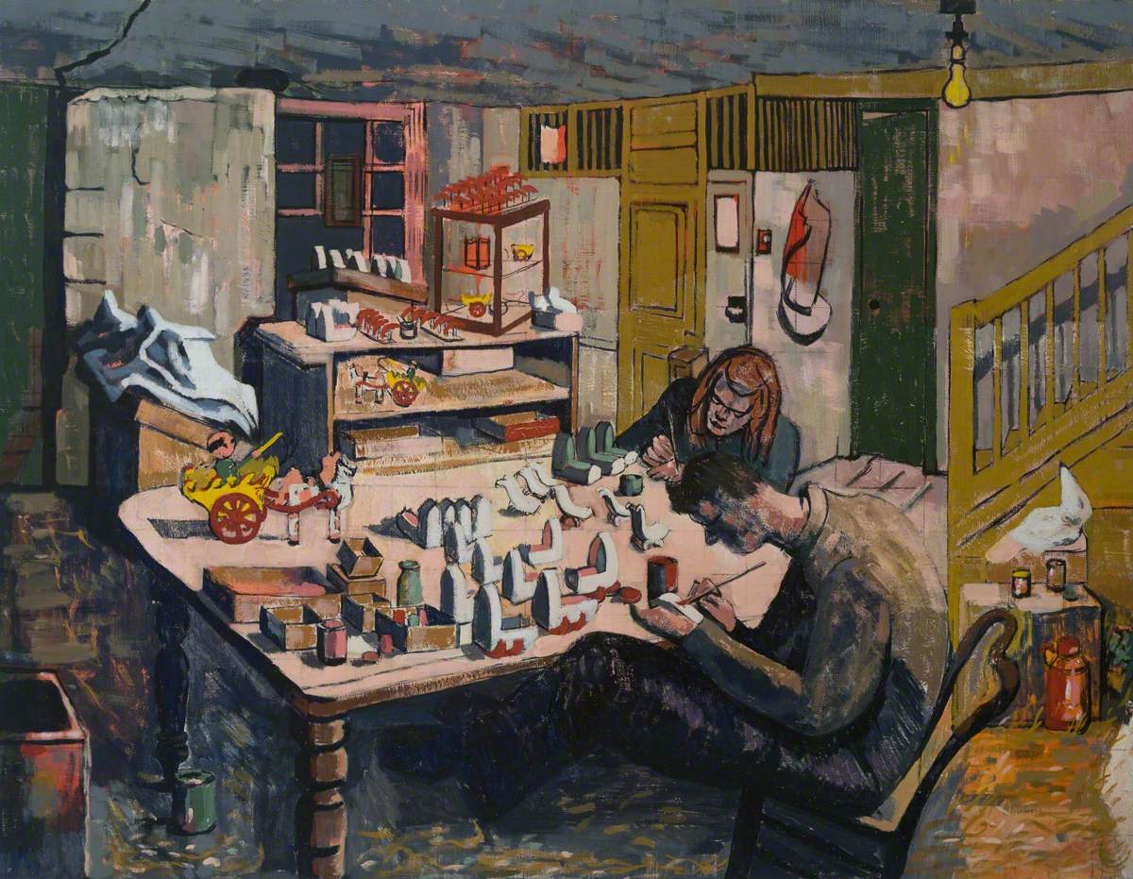

Barn’s work changed over time. Her detailed drawings and paintings of scenes around her moved into flatter paintings. Later, she recorded landscapes with pure shapes and forms.

Slide 4
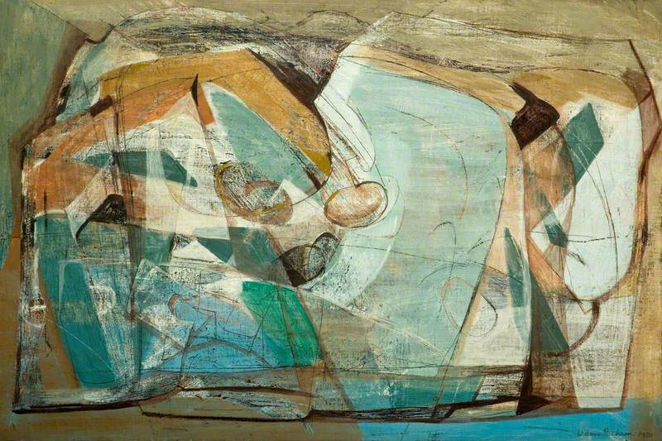
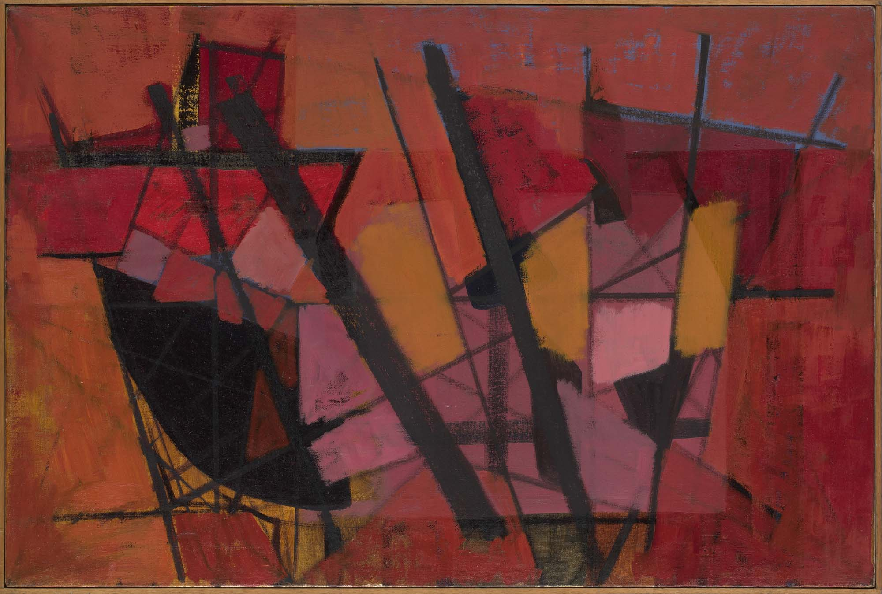
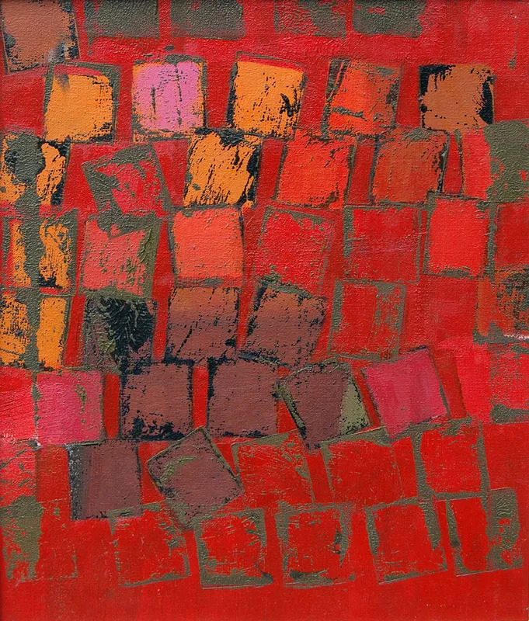

Slide 5
Barn’s rock formations
Task:
1/ Using the landscape image you have been given. Break the scene into the main shapes.
Cutting the main shapes out with scissors can help deconstruct the scene.
2/ Use a pencil to record these basic shape on your large paper.
3/ Use the brushes/card/tools to apply colour to your abstract drawing.
Do you want to limit your colour palette?

Slide 6
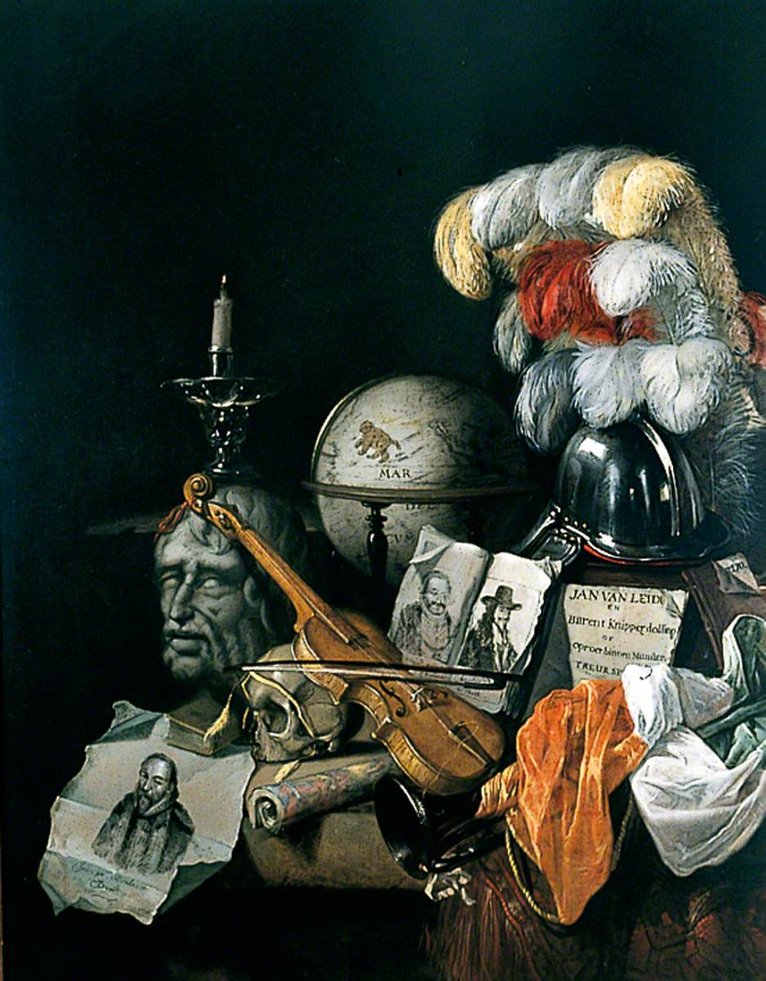
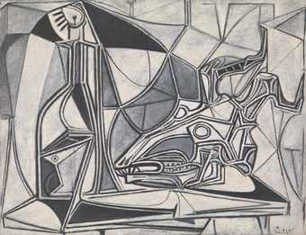

FINISHED EARLY?
Vanitas are closely related to memento mori still lifes which are artworks that remind the viewer of the shortness and fragility of life (memento mori is a Latin phrase meaning ‘remember you must die’) and include symbols such as skulls and extinguished candles. However vanitas still-lifes also include other symbols such as musical instruments, wine and books to remind us explicitly of the vanity (in the sense of worthlessness) of worldly pleasures and goods.
VANITAS
A still life artwork which includes various symbolic objects designed to remind the viewer of their mortality and of the worthlessness of worldly goods and pleasures
Task: Creating exciting still life drawings on a larger scale.
Suggested: Graphite, watered down paint.

