Slide 1
ART APPRECIATION Links

Slide 2
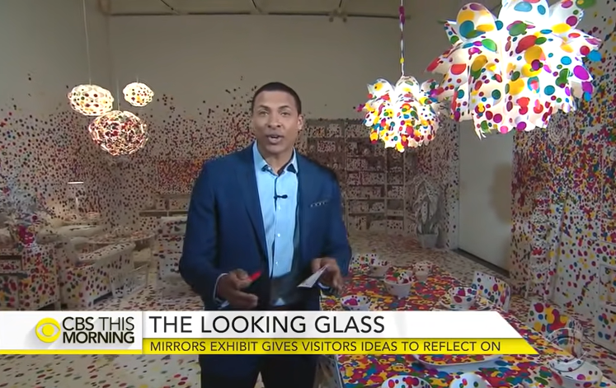
Art Appreciation
Watch the report on Experience Yayoi Kusama's limitless "Infinity Mirrors" exhibit
https://www.youtube.com/watch?v=mmFBlE4cg3w
More
https://www.youtube.com/watch?v=rRZR3nsiIeA

Slide 3
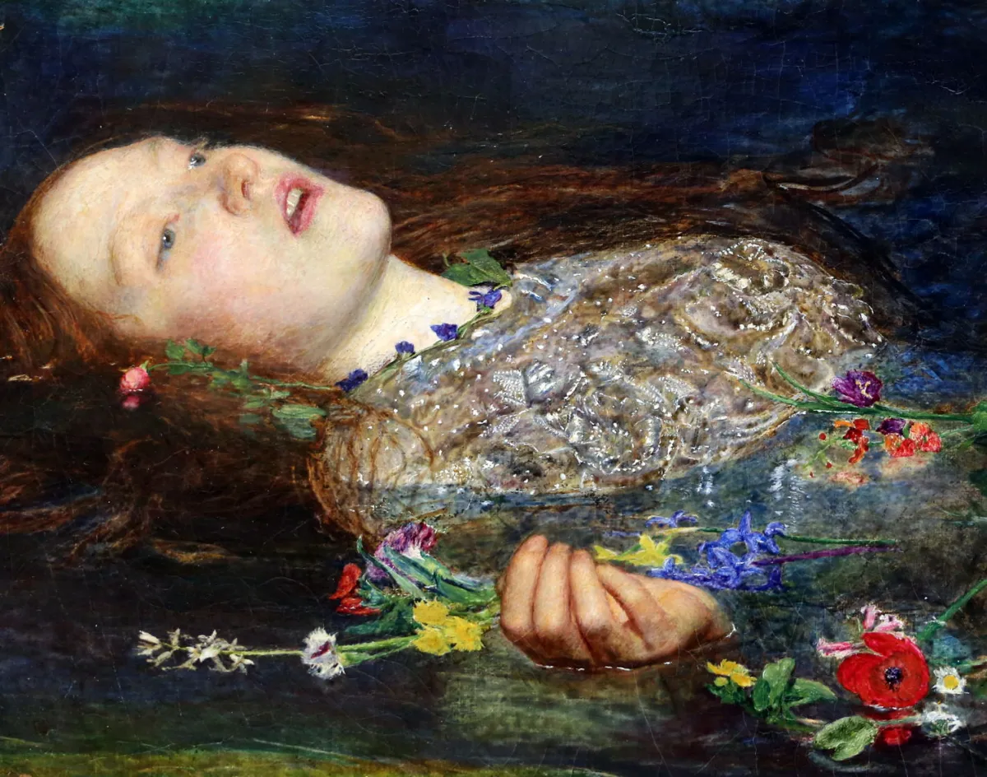
The Real Ophelia
Homework
Art Appreciation
Artists telling stories
https://www.youtube.com/watch?v=6DH-d3s74Ak

Slide 4
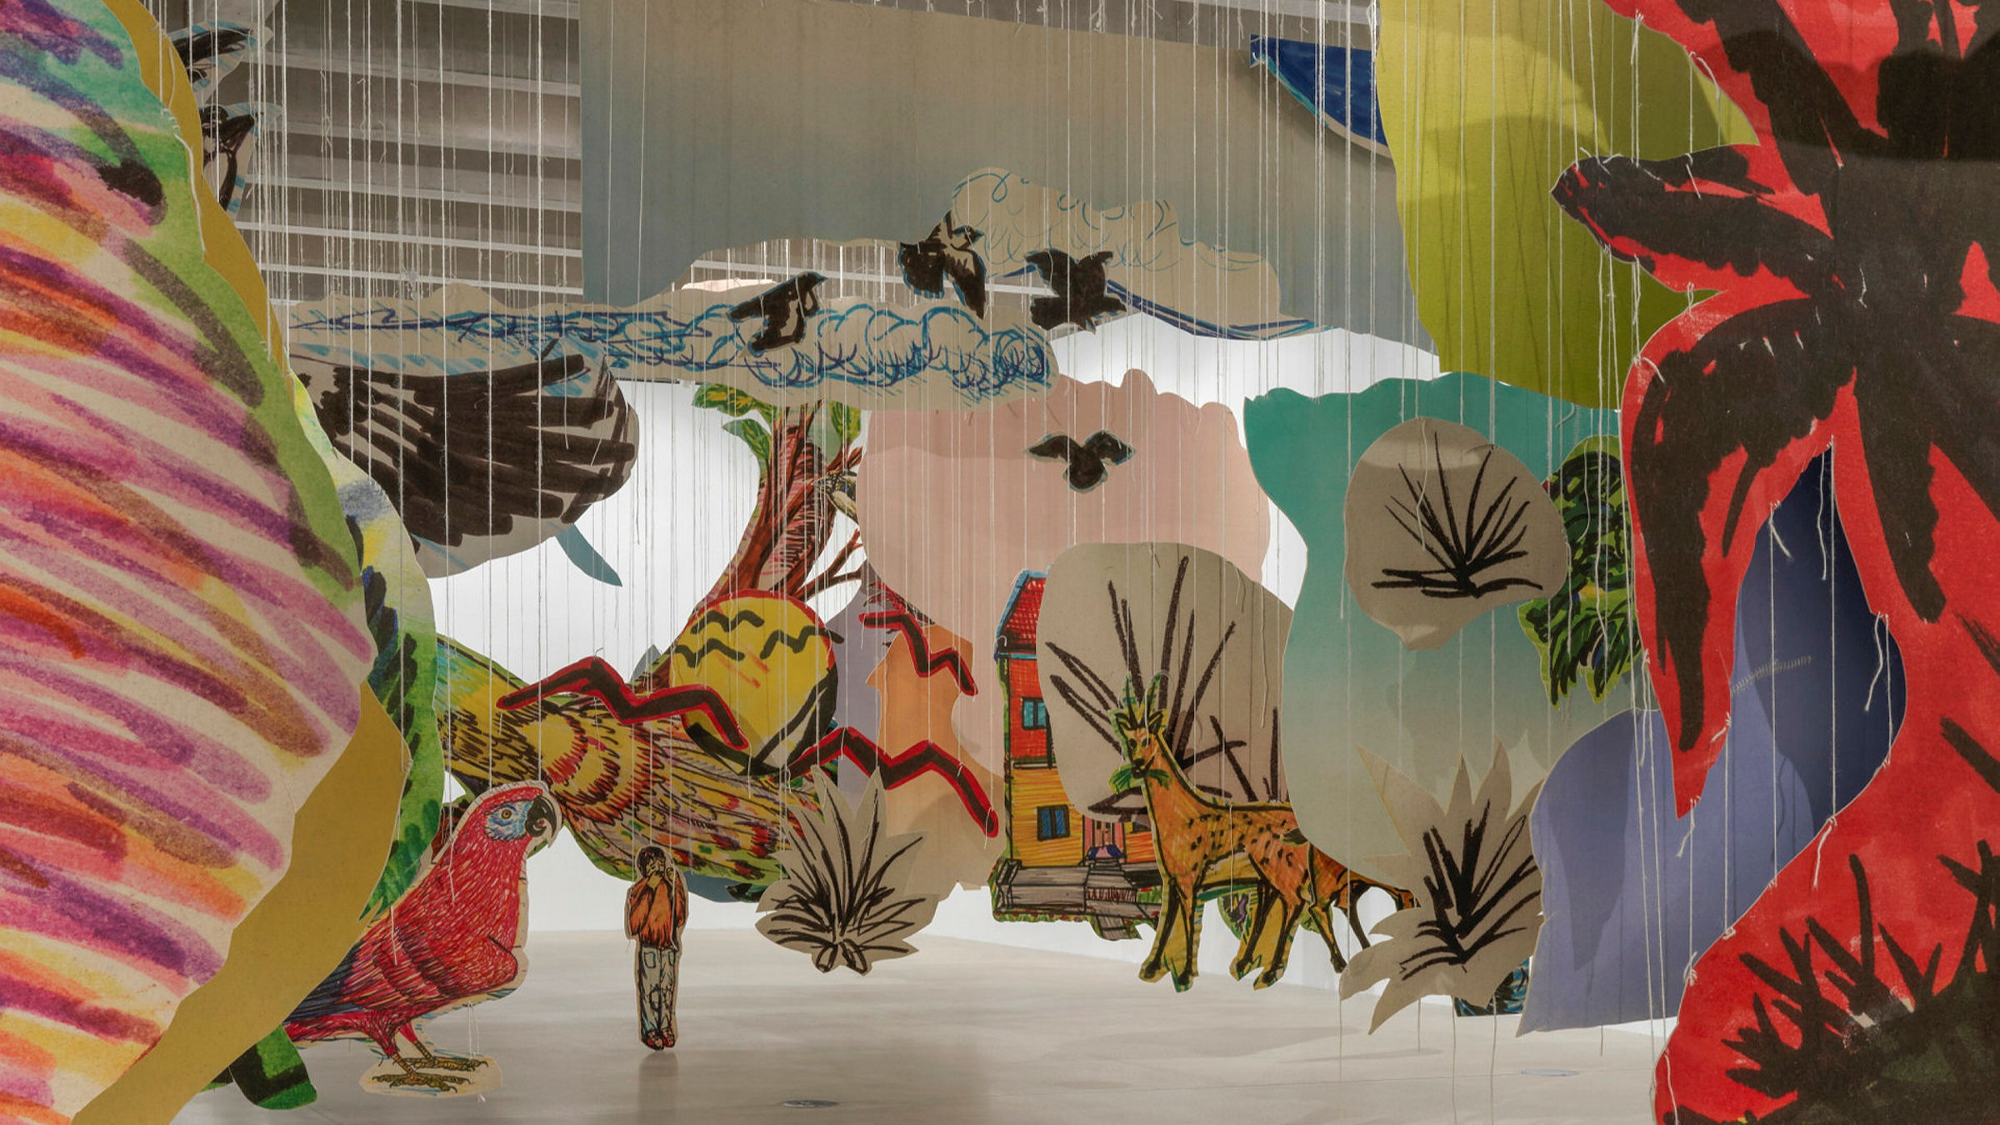
Childhood drawings Homework
ART APPRECIATION
Artist Petrit Halilaj’s childhood drawings from the Kosovan War | Tate
https://www.youtube.com/watch?v=agUTqlyOH_k
https://www.youtube.com/watch?v=K8vPOPw9gjs
Dream landscape based on war space ‘Dream’
Task: Create your own dream landscape based on a place you know

Slide 5
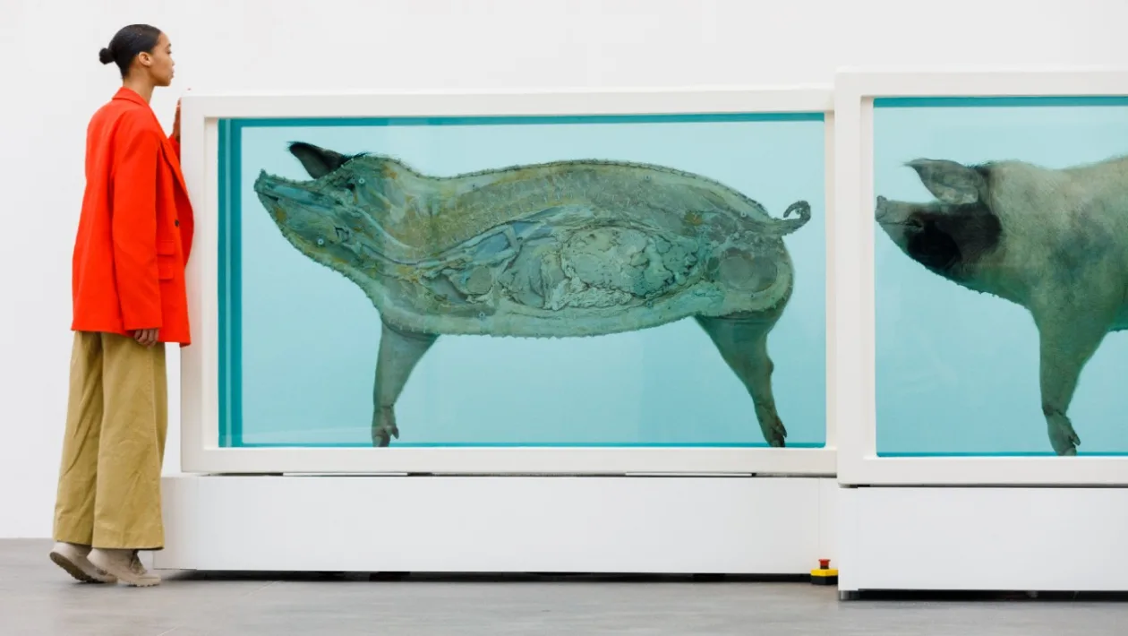
Damien Hurst
For the love of God
https://www.youtube.com/watch?v=3tXIYBFbUjs
Spin Paintings Beautiful Paintings
https://www.youtube.com/watch?v=ltDVSLkKxlg

