Slide 1
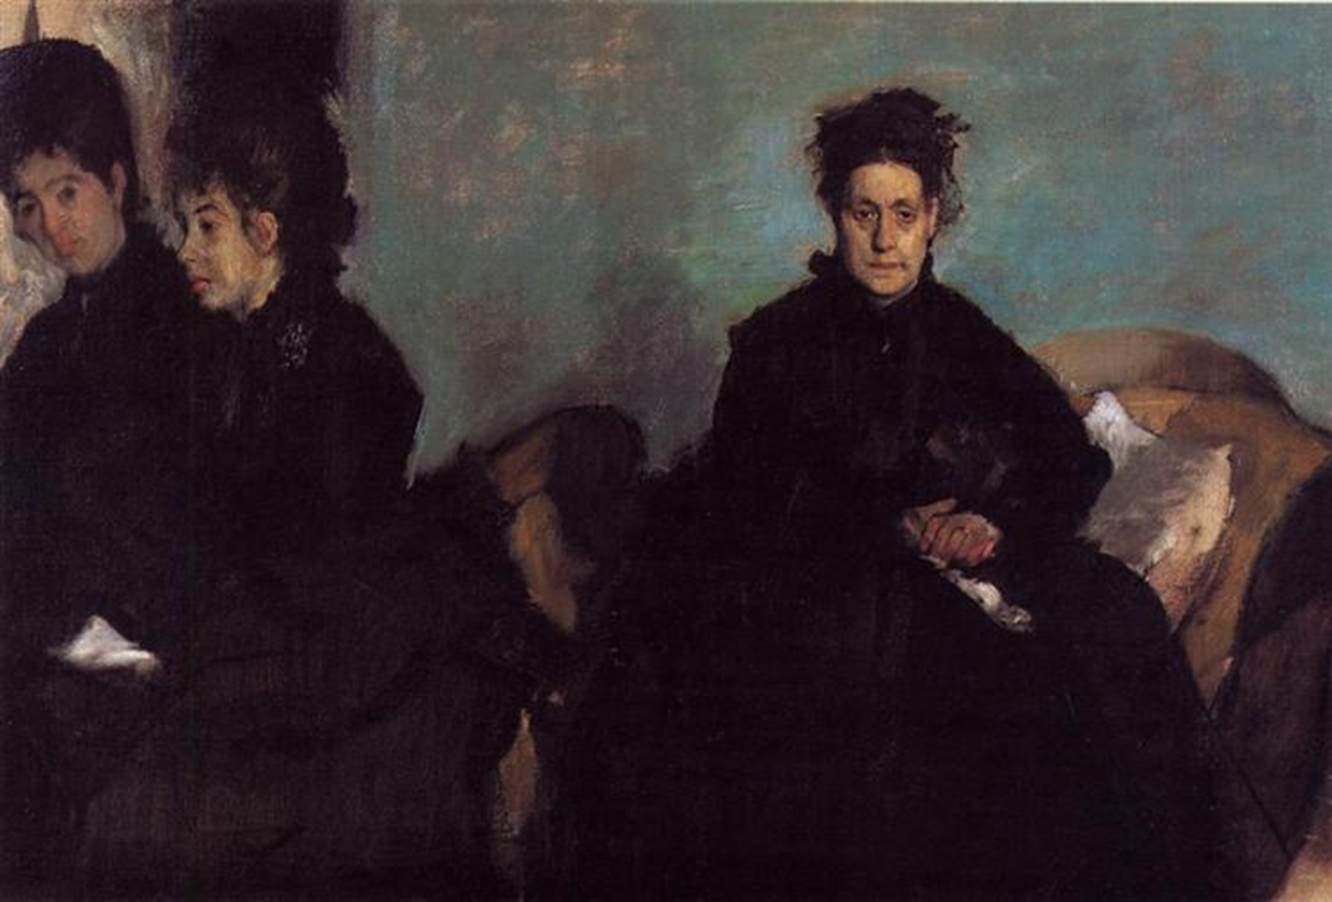
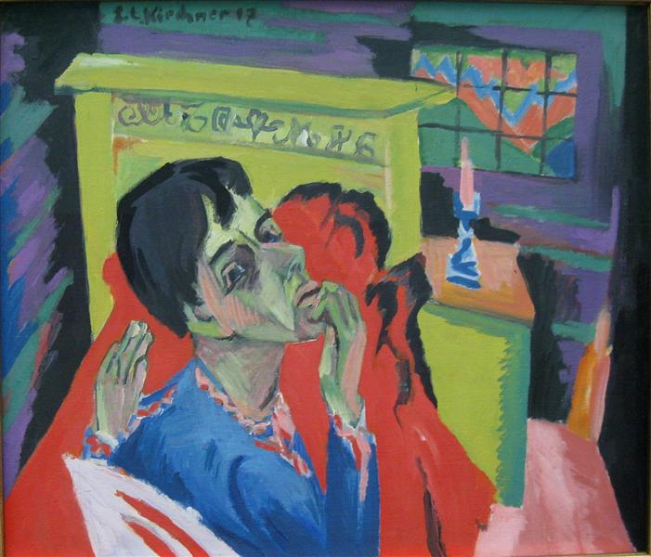
ART COMPOSITION
BOOKLET

Slide 2
What do you notice?
Where is your attention drawn?
Can you spot any decisions the artist has made?
Selft portrait as an Invalid, Ernst Ludwig Kircher 1917-20

Slide 3
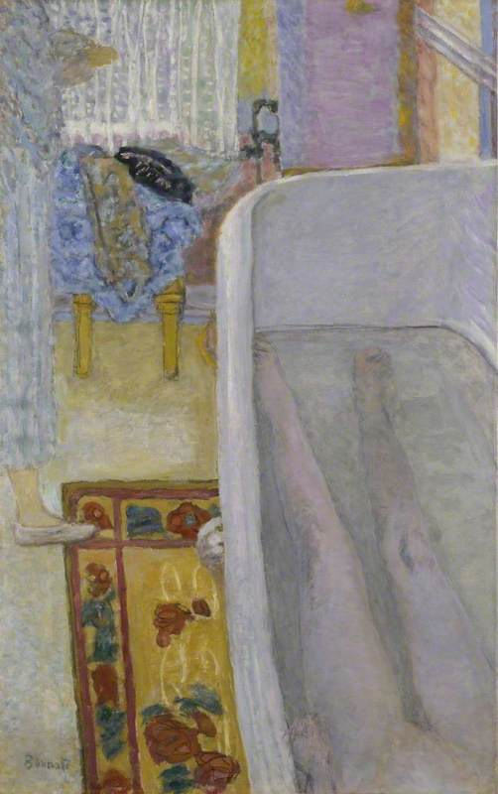
Nude in Bath, Pierre Bonnard, 1925.

Slide 4
Looking down on himself
Vulnerability
Face is close up (intimate space between the viewer and the subject)
Emphasis on his fragile state
Exaggerated perspective which makes the bedstead look large in relation to the window.
Perspective heightens the effect
Selft portrait as an Invalid, Ernst Ludwig Kircher 1917-20

Slide 5
Nude in Bath, Pierre Bonnard, 1925.
Artists is visible in the top left
Painted his wife in the bath
Cropping both figures adds to the idea of uncomfortable voyeurism or ‘disturbingly voyeuristic’’

Slide 6

Edgar Degas 1876
The Duchess de Montejasi and her daughters Eleana and Camilla
What is Degas capturing in this family portrait?
What decisions has he made?

Slide 7
Edgar Degas 1876
The Duchess de Montejasi and her daughters Eleana and Camilla
What is Degas capturing in this family portrait?
The sharp division between space and form signals a rift between sitters.
What decisions has he made?
Space between the mother and daughters
Contrast between the duchess frontal pose and the daughters half out of the frame accentuates the split

Slide 8
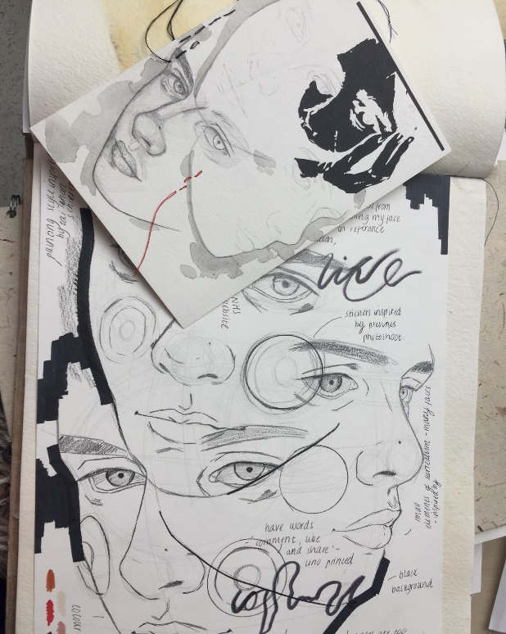
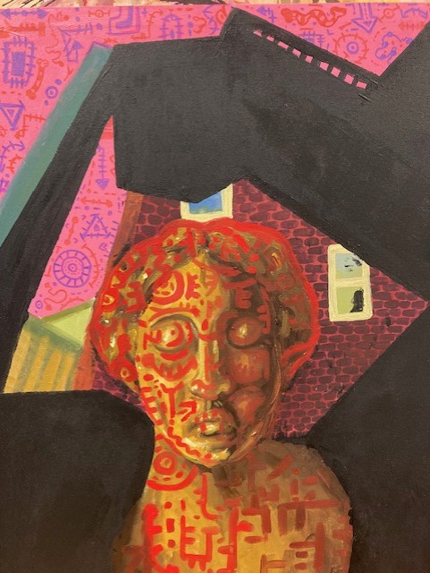
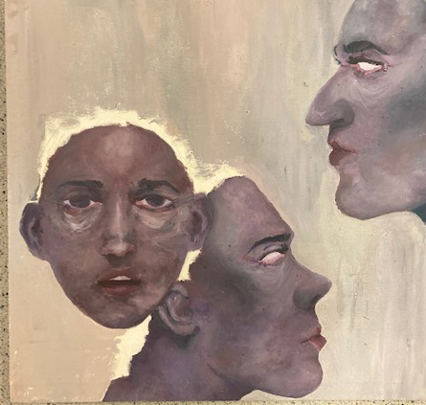
Week 3 Composition Theory
Year 13 examples
Overlapping
FINE ART
Create a strong, experimental 2 compositional from your own images focusing on the following:
Alternative Composition than you’ve worked with before (see next slides for inspiration)
Example: If you’ve never thought about framing you could give it a go! ☺
Use the booklet to help you decide.
Framing
Negative space
Light and dark
ODD NUMBER CROPPING AND OVERLAPPING
SPACE

Slide 9
If the visual elements are the building blocks, the principles of art are the glue holding it all together. They are:
Rhythm: The visual tempo of your work created through repetition and pattern.
Balance: The visual weighting of elements.
Emphasis: The arrangement of elements to place emphasis on certain areas. Otherwise known as a focal point.
Gradation: A gradual change in a certain element to help connect the composition (long lines to short lines, large shapes to small shapes, dark to light tones, etc.).
Harmony: The way distinct parts work together towards a similar vision or idea.
Variety: The use of different elements to create interest and contrast.
Movement: The illusion of movement through clever placement of the visual elements (think of Vincent van Gogh’s energetic brushwork).
Proportion: The relative size of one element in comparison to another.
Composition is the way in which different elements of an artwork are combined or arranged.

Slide 10
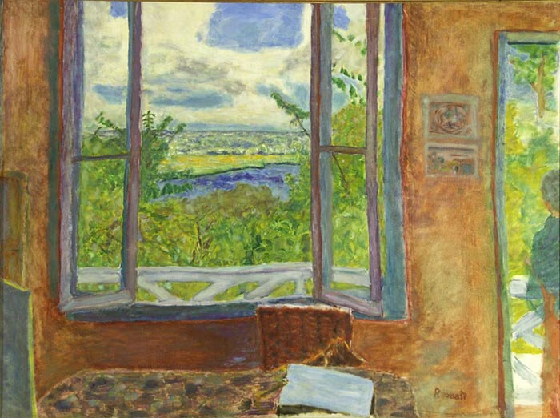
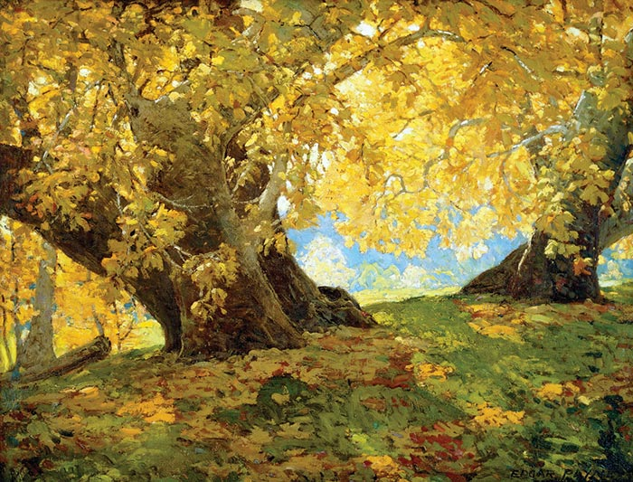
Framing
Pierre Bonnard, Open Window Towards the Seine (Vernon), 1912
Tip: You don’t need to try and artificially create frames in your subject. Instead, consider how you can arrange and depict what is already there to frame important features. For example, a prominent tree could be used to frame the left side of your painting.
COMPOSITION IDEAS

Slide 11
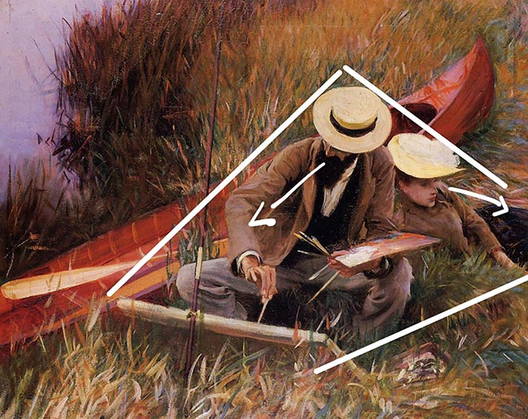
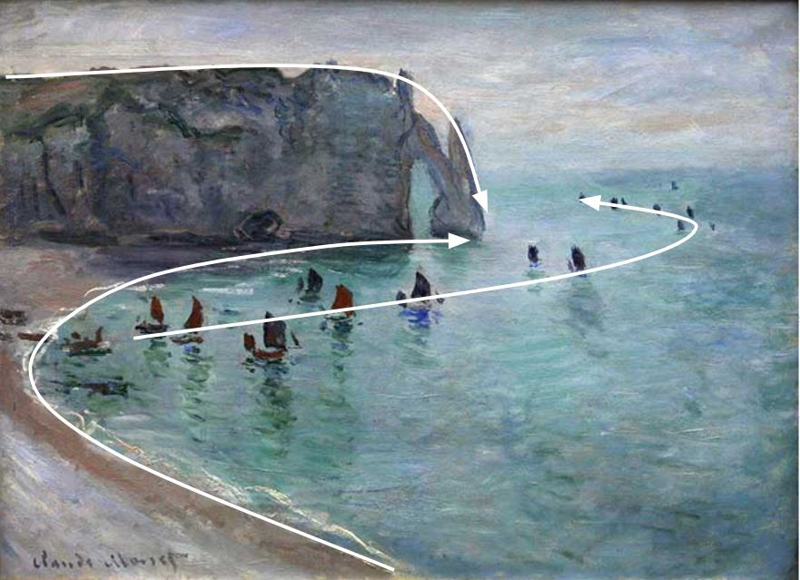
Leading Lines
Lines are powerful. Our eyes like to follow them. Be careful not to lead people out of your painting.
John Singer Sargent, Paul Helleu Sketching His Wife, 1889

Slide 12
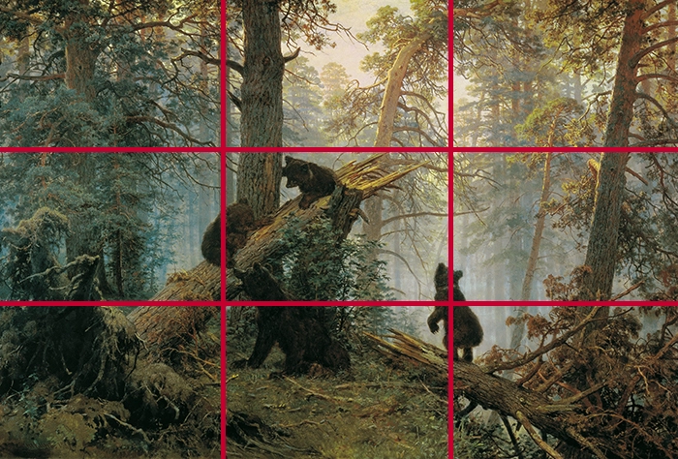
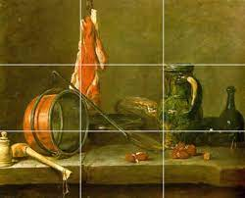
Rule of thirds
The rule of thirds involves placing a three-by-three grid over the subject and using it to assist in the composition design. The gridlines and intersections are “safe” spots to position key features. For example, you could position your focal point at one of the intersections, or the horizon line along the top horizontal.

Slide 13
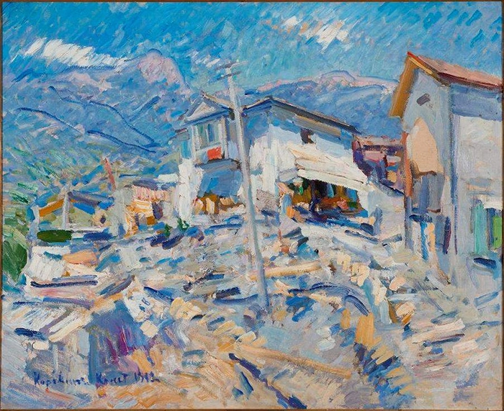
Simplification
Simplification is perhaps the most important composition concept. It involves taking all the “noise” and detail and simplifying it into something more coherent. By simplifying the unimportant, you focus attention on the important.
Below are some of the different ways you can simplify your composition:
Use a limited color palette (simplification of color).
Compress the value range (simplification of value).
Use larger brushes (simplification of tools).
Use less refined strokes for unimportant areas (simplification of detail).
Konstantin Korovin, Crimean Landscape, 1912

Slide 14
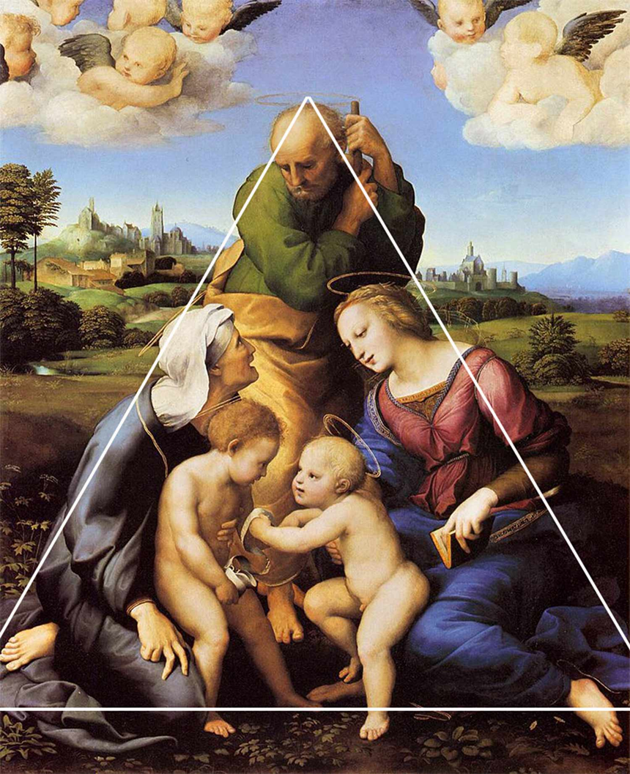
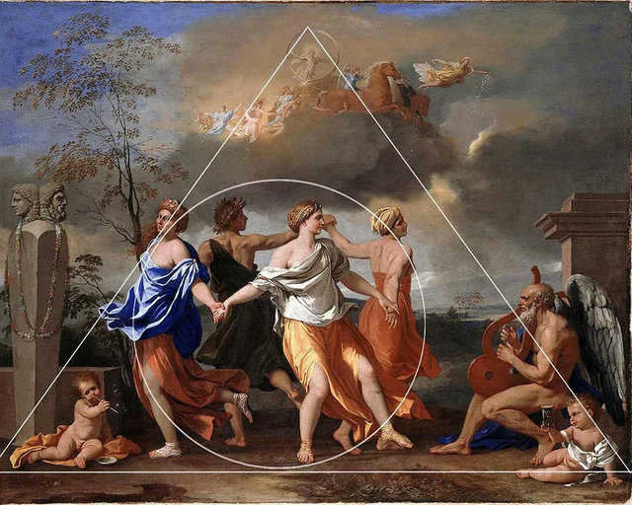
Triangle

Slide 15
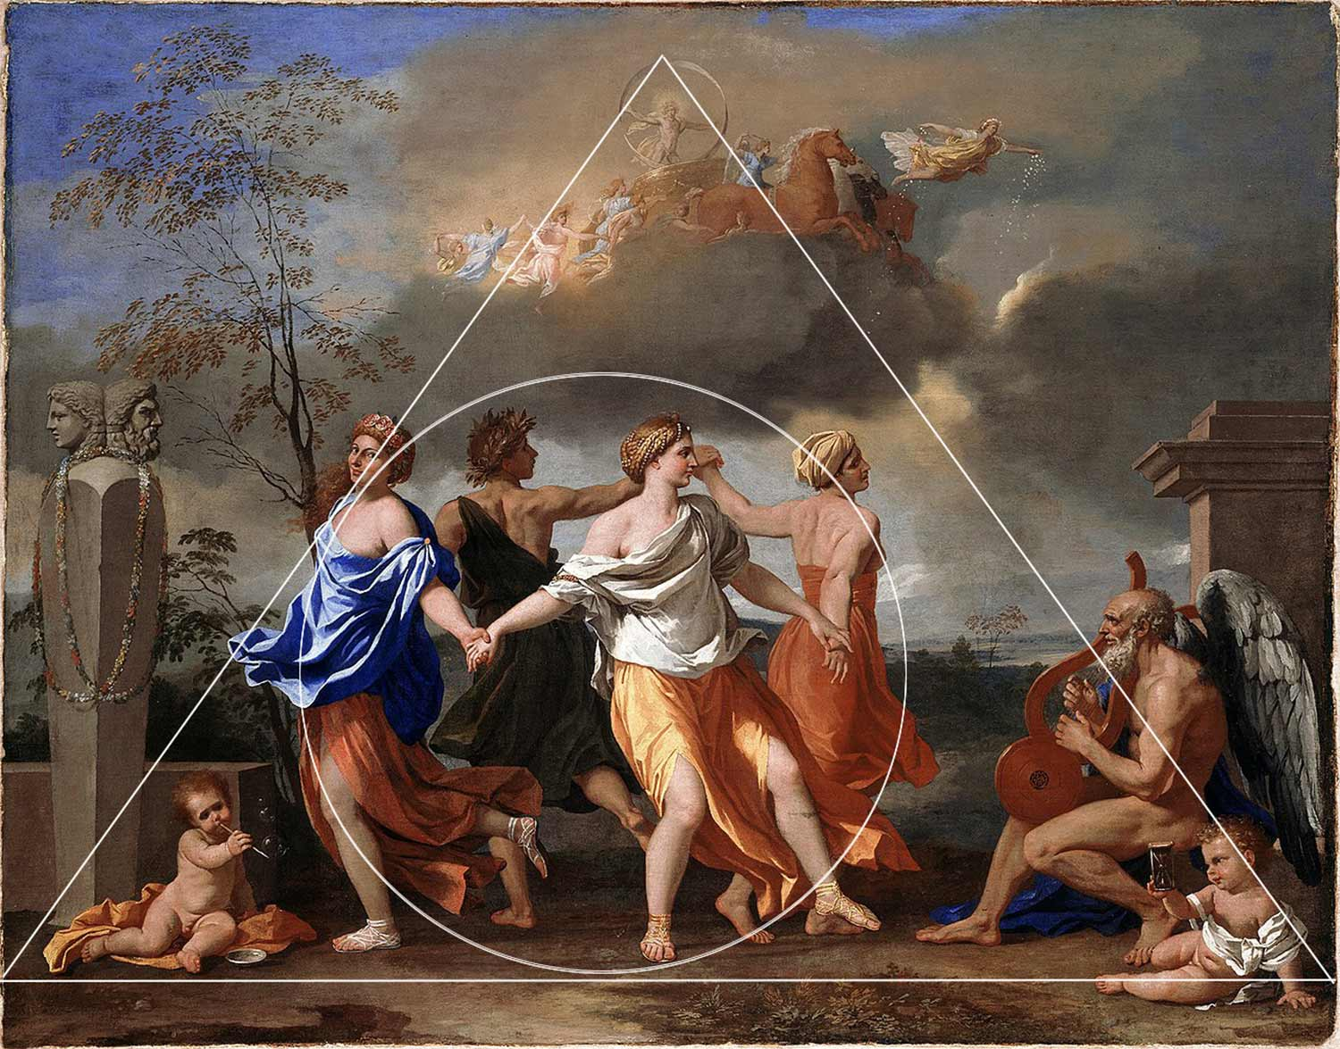
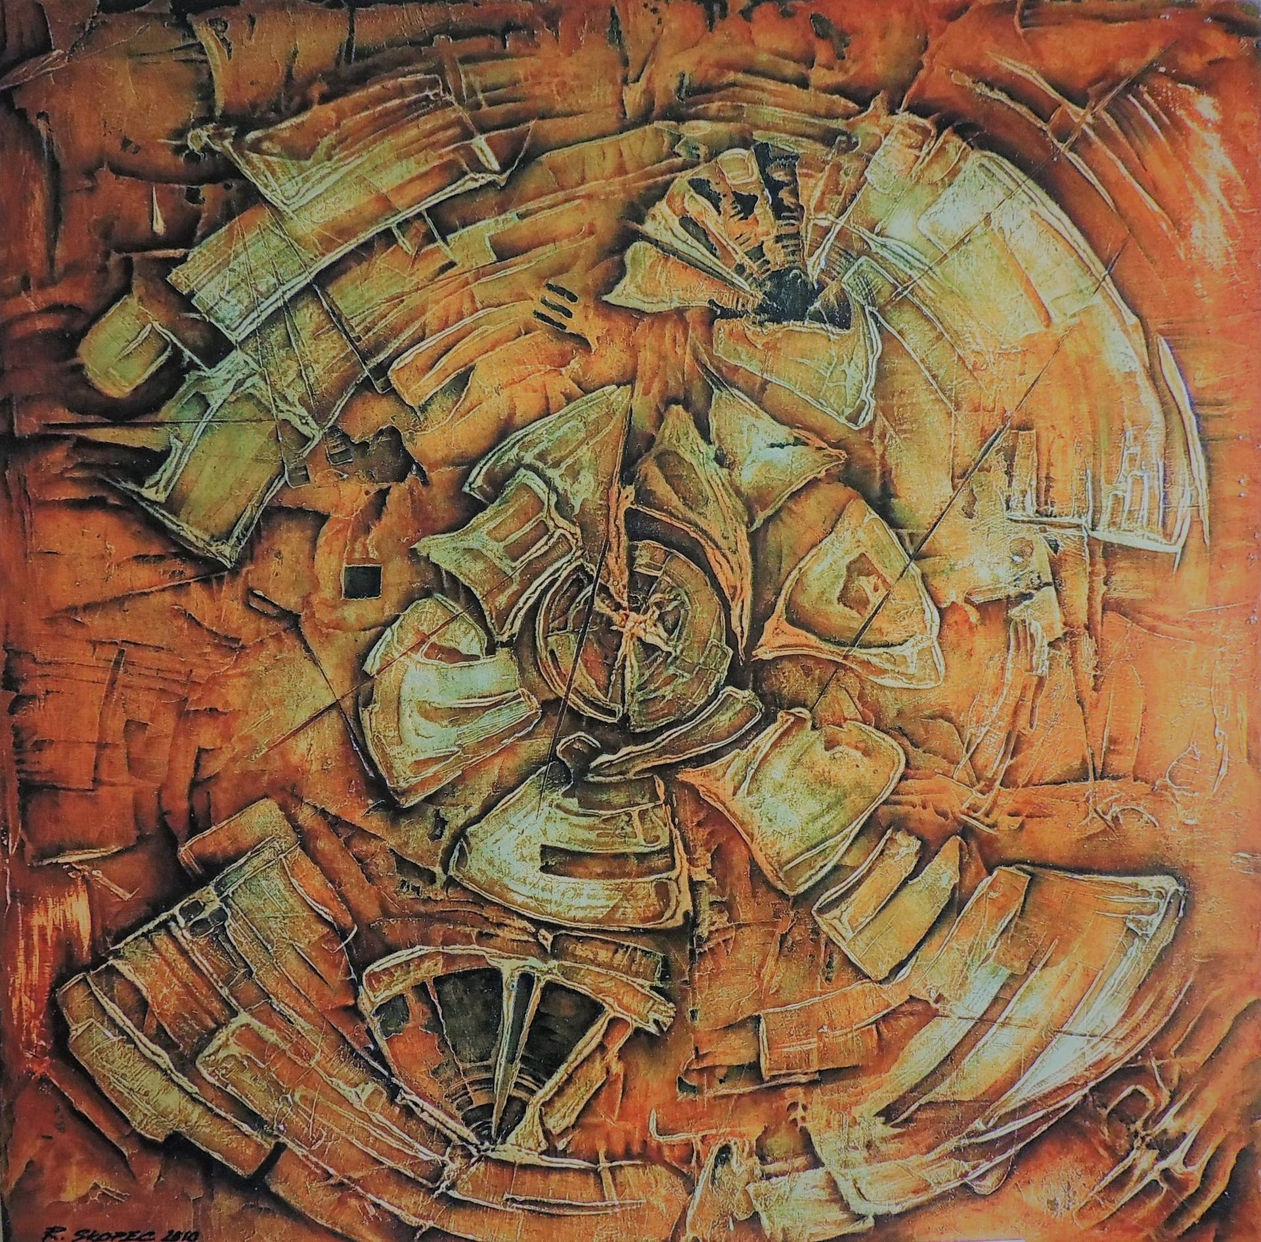
Magic Circle

Slide 16
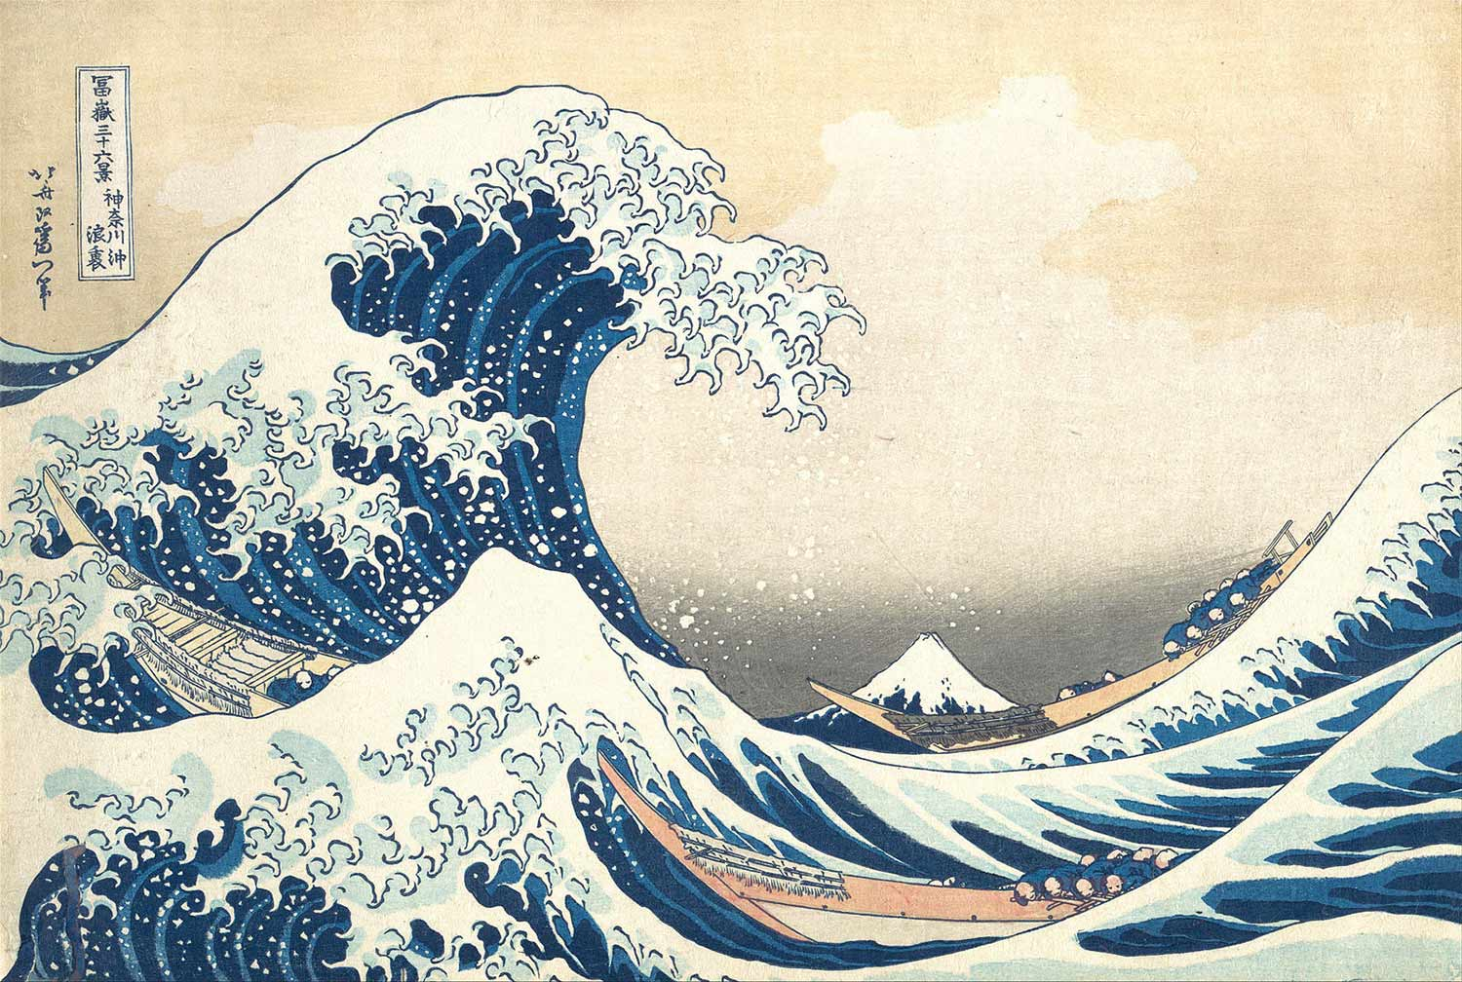
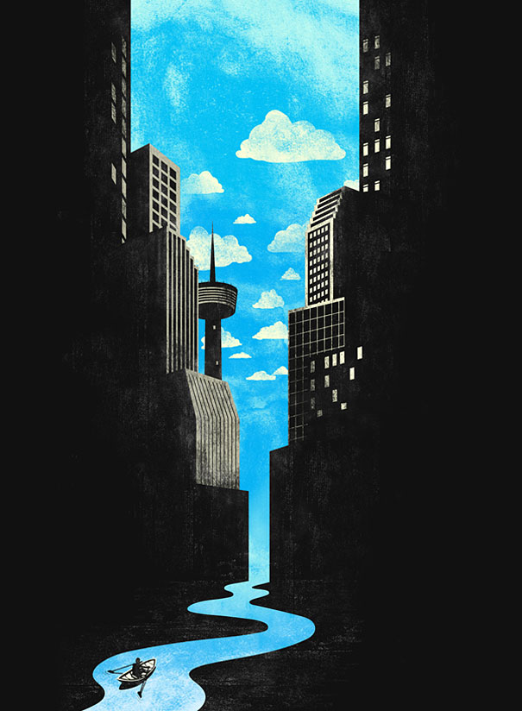
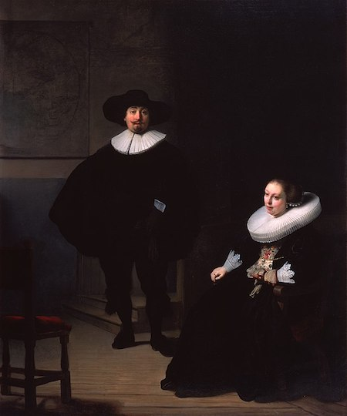
Negative Space
In art, negative space is the space around and between the subject of the image. The positive space is the subject or object of the image.

Slide 17
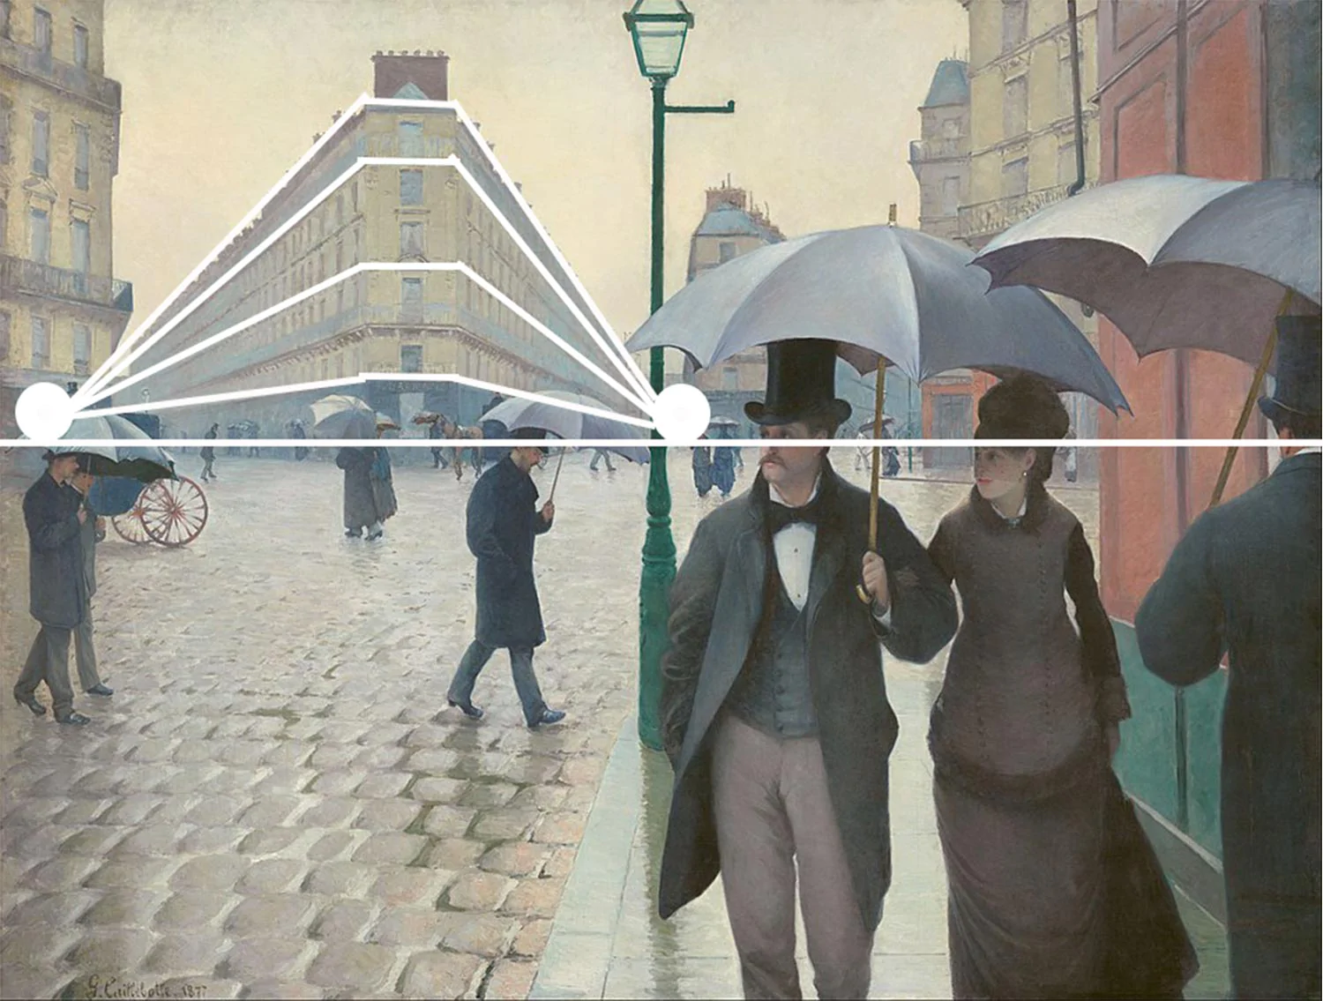
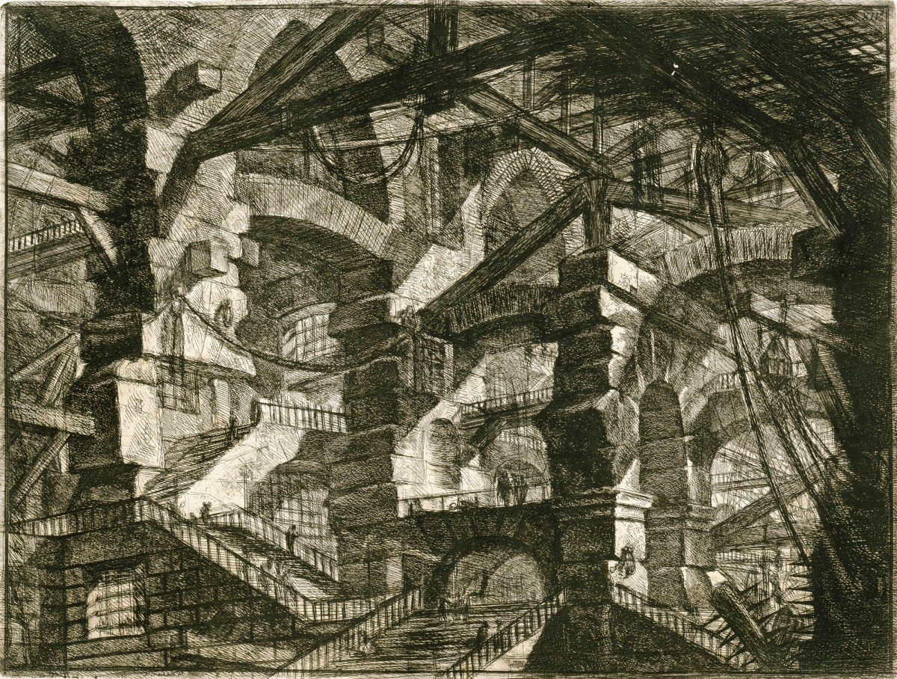
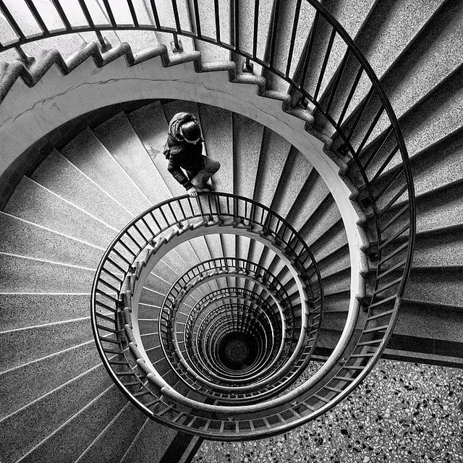
Perspective
Gustave Caillebotte's "Paris Street; Rainy Day" illustrates the use of a two-point perspective at a Parisian intersection with great accuracy as shown above.

Slide 18
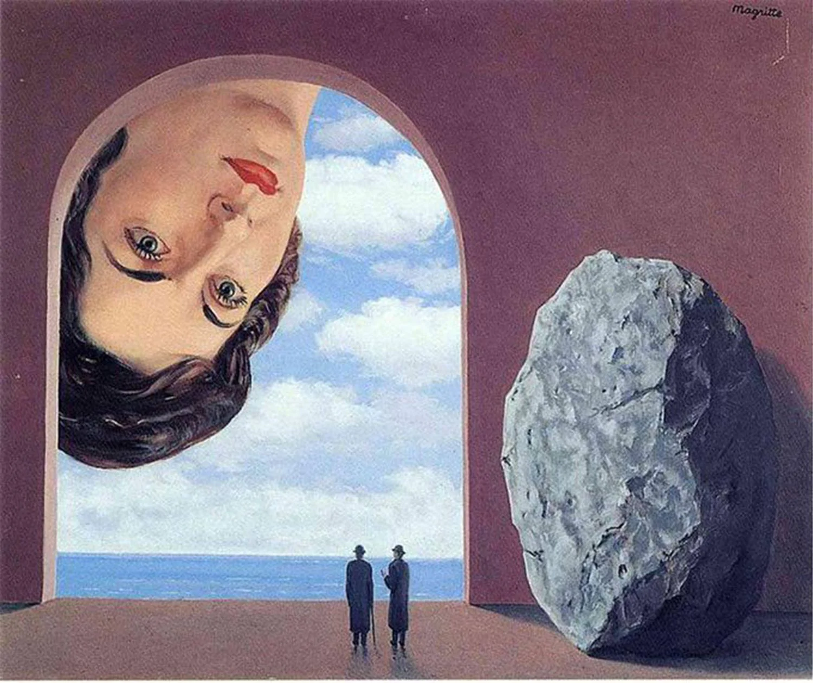
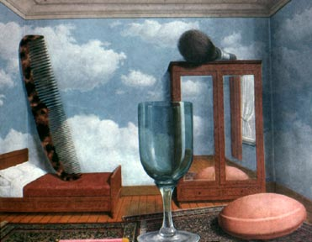
Playing with Scale
Rene Magritte's "The Portrait of Stephy Langui" tells a very surreal story through the use of larger than life objects. Stephy is peering in the cavern while the two men seem to be oblivious to her and the enormous rock beside them.

Slide 19
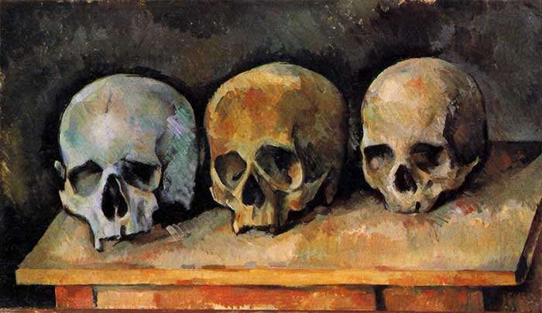
Rule of odds
The rule of odds is an idea that objects in odd numbers appear more interesting and natural than objects in even numbers.
Paul Cézanne, The Three Skulls, 1900

Slide 20
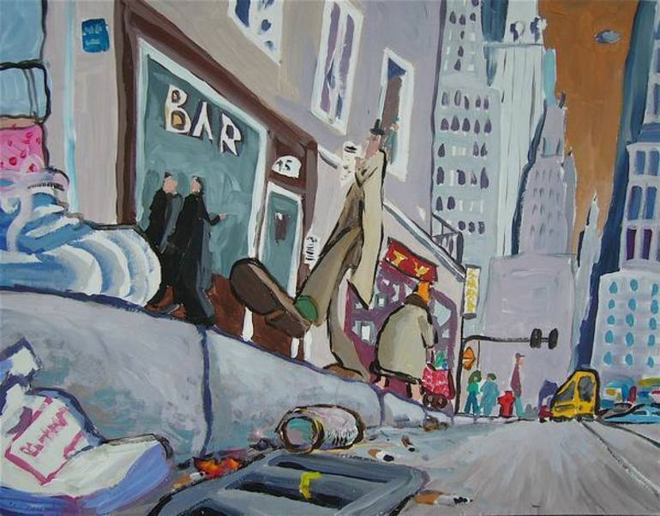
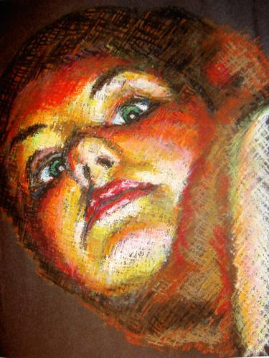
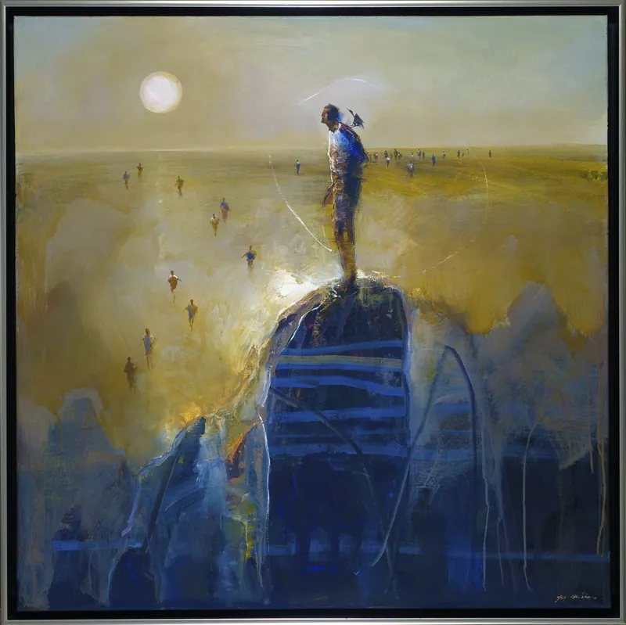
Viewpoint
Rat’s Viewpoint by Eric Le Henand
Viewpoint, 2018
Mel Briggs

Slide 21
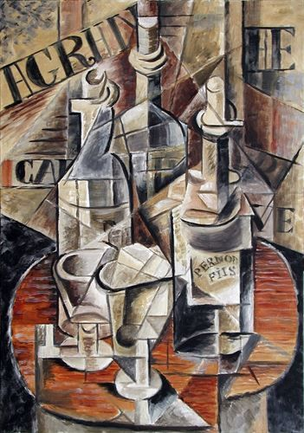
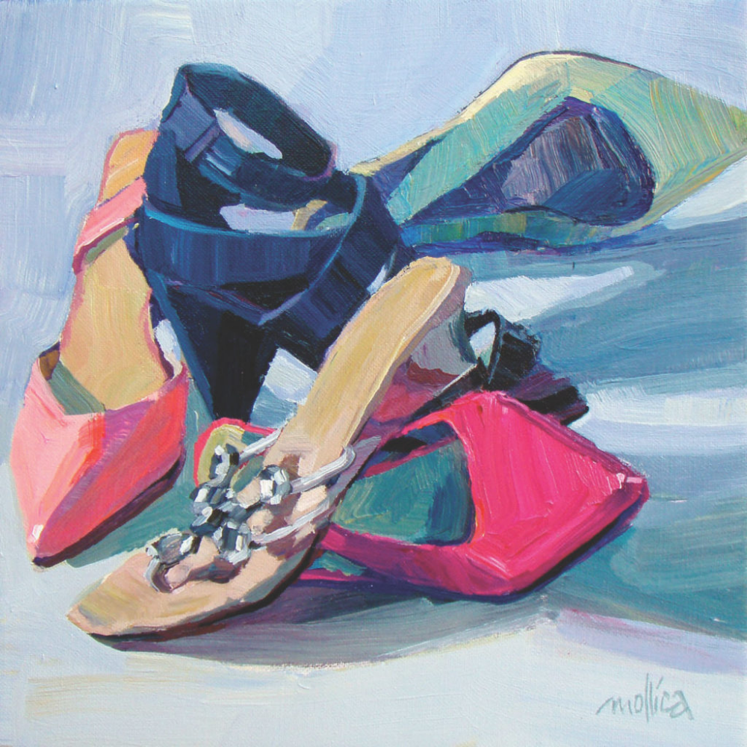
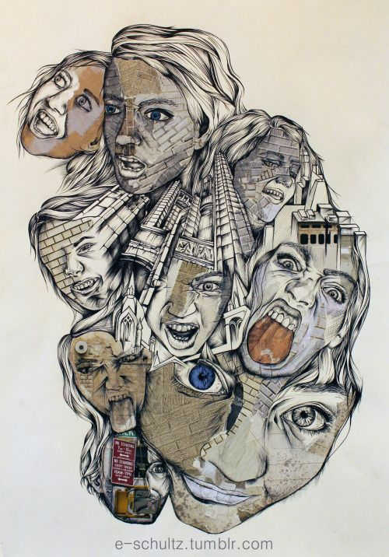
Layering & Overlapping

Slide 22
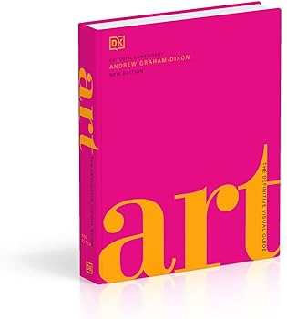
Reading related to composition in Art
Andrew Graham-Dixon Art The Definitive Visual Guide
Copy in Mrs. Tait’s office
Online
https://www.riseart.com/guide/2412/what-is-composition-in-art#:~:text=Composition%20is%20the%20way%20in,the%20corners%20of%20the%20piece.
Rise Art. Com have an article on composition theory

