Slide 1


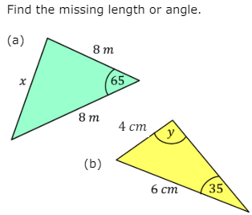
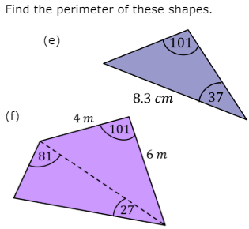
Knowing and applying the sine and cosine rules to find missing lengths and angles in non-right angled triangles.
Enter code U2952 and U951 in the Sparx independent learning section and/or
Follow these links to watch videos on “non-right angled triangles”
https://corbettmaths.com/2013/05/03/sine-rule-missing-sides/
https://corbettmaths.com/2019/04/24/sine-rule-angles/
https://corbettmaths.com/2013/04/04/cosine-rule-missing-sides/
https://corbettmaths.com/2013/04/04/cosine-rule-missing-angles/
Work through the questions below to check your understanding (solutions on next page):

Slide 2
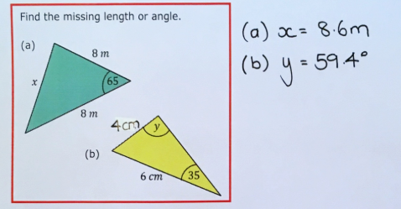
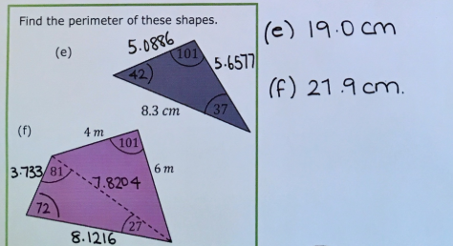
Solutions

