Slide 1



Setting up and solving two simultaneous equations (one linear and one quadratic) algebraically.
Enter code U269 in the Sparx independent learning section and/or
Follow this link to watch a video on “Simultaneous equations”
https://corbettmaths.com/2013/05/07/simultaneous-equations-linear-and-quadratic/
Work through the questions below to check your understanding (solutions on next page):
Solve these simultaneous equations.
(a) $x^{2}+y^{2}=25$
$x+y=7$
(b) $x^{2}+y^{2}=9$
$y=x+3$
(c) $x^{2}+y^{2}=5$
$y=3x+5$
A netball court has an area of 224 m². If the length were decreased by 1 m and the width increased by 1 m, the area would be increased by 1 m². Find the dimensions of the court.

Slide 2
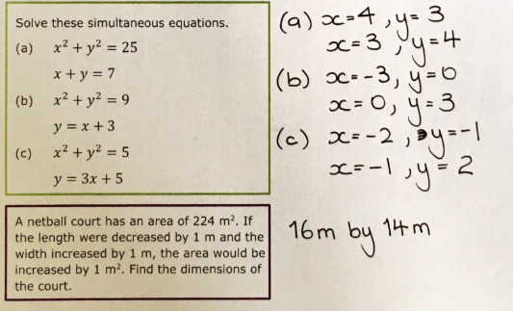
Solutions

