Slide 1


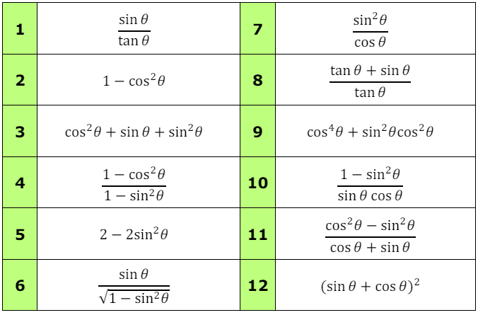
Knowing important trigonometric identities and applying them to solve equations.
Follow this link to watch a video on “Trigonometric Identities”
https://corbettmaths.com/2013/01/19/proof-of-trigonometric-identities/
Work through the questions below to check your understanding (solutions on next page):
Simplify the following:

Slide 2
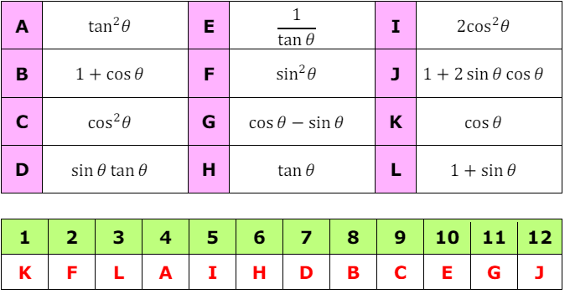
Solutions

