Slide 1




Understanding the process of differentiation as a method to find the gradient of a tangent to a curve.
Follow this link to watch a video on “Differentiation of a curve”
https://corbettmaths.com/2019/12/31/gradient-of-a-curve-video/
Work through the questions below to check your understanding (solutions on next page):
1. (a) Find the equation of the tangent to the curve $y=x^{2}+2x−3$at the point $(1, 0)$.
(b) Find the equation of the tangent to the curve $y=x^{2}+4x−5$ at the point $(−1, −7)$.
(c) Find the equation of the tangent to the curve $y=x^{3}+x$at the point $(2, 10)$.
2. (a) Find the equation of the normal to the curve $y=x^{2}−4$at the point $(1, −3)$.
(b) Find the equation of the normal to the curve $y=x^{2}−5x−6$ at the point $(3, −12)$.
(c) Find the equation of the normal to the curve $y={2x}^{3}−3x+1$at the point $(1, 0)$.

Slide 2
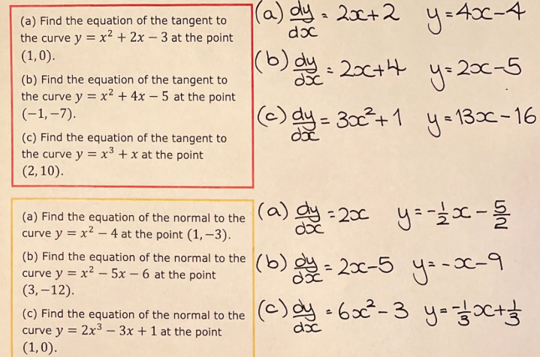
Solutions

