Slide 1




Mulltiplying matrices by a scalar quantity and by another matrix.
Follow these links to watch videos on “Matrices”
https://corbettmaths.com/2019/06/25/multiplying-by-a-scalar/
https://corbettmaths.com/2019/04/24/multiplying-matrices-2x2-by-2x1/
https://corbettmaths.com/2019/04/24/multiplying-matrices-2x2-by-2x2/
Work through the questions below to check your understanding (solutions on next page):
Work out:
(a) $\left(\begin{matrix}4 \\ 2\end{matrix}\right)×\left(\begin{matrix}−2 & 5\end{matrix}\right)$
(b) $\left(\begin{matrix}0 & 3 \\ 2 & 5\end{matrix}\right)×\left(\begin{matrix}−1 & 3 \\ 0 & 6\end{matrix}\right)$
(c) $\left(\begin{matrix}4 & 7 & −2\end{matrix}\right)×\left(\begin{matrix}0 \\ 1 \\ 5\end{matrix}\right)$
(d) $\left(\begin{matrix}1 & −2 \\ 3 & 7\end{matrix}\right)×\left(\begin{matrix}−1 & 4 \\ 0 & −2\end{matrix}\right)$
(e) $\left(\begin{matrix}0 & 2 \\ −5 & 3\end{matrix}\right)×\left(\begin{matrix}1 & 6 \\ −3 & 0\end{matrix}\right)$
(f) $\left(\begin{matrix}−2 & 1 \\ 8 & 0\end{matrix}\right)×\left(\begin{matrix}−3 & 5 \\ 1 & 2\end{matrix}\right)$
(a) Given that
$\left(\begin{matrix}−2 & a \\ −4 & 3\end{matrix}\right)\left(\begin{matrix}3 \\ 7\end{matrix}\right)=\left(\begin{matrix}22 \\ 9\end{matrix}\right)$
work out the value of $a$.
(b) Matrix P = $\left(\begin{matrix}2 & 3 \\ a & b\end{matrix}\right)$
Matrix Q = $\left(\begin{matrix}1 & 1 \\ 0 & 1\end{matrix}\right)$
You are given that PQ = QP. Work out the values of $a$ and $b$.

Slide 2
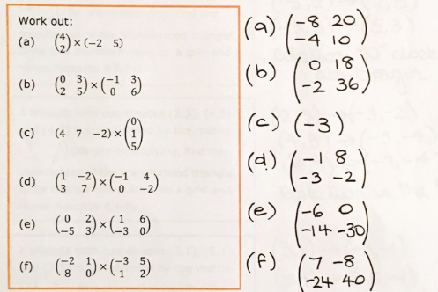
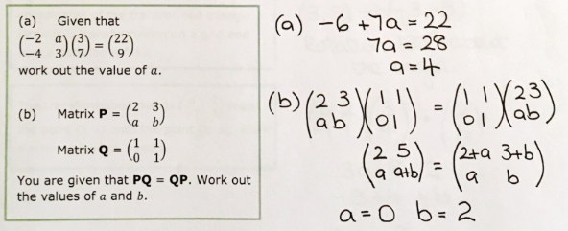
Solutions

