Slide 1


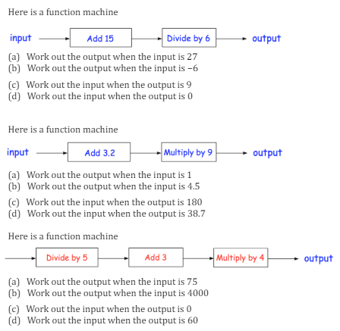
Interpreting simple expressions a functions with input and outputs through diagrammatic function machines
Enter code Q605, Q878, Q184 and Q344 in the Sparx independent learning section and/or
Follow this link to watch a video on “Function machines”
https://corbettmaths.com/2017/09/25/function-machines/
Work through the questions below to check your understanding (solutions on next page):

Slide 2
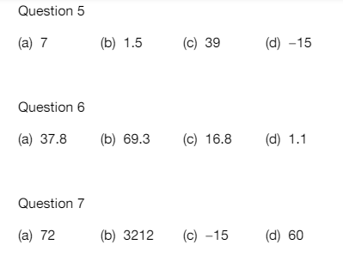
Solutions

