Slide 1


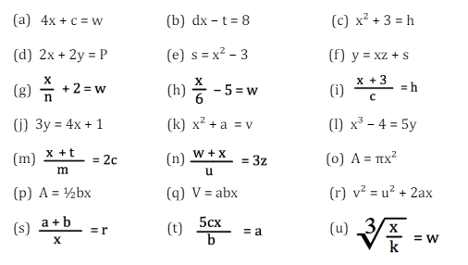
Changing the subject of a formula involving multiple steps, including fractions
Enter code U556 in the Sparx independent learning section and/or
Follow this link to watch a video on “Rearranging formula”
https://corbettmaths.com/2013/12/23/changing-the-subject-video-7/
Work through the questions below to check your understanding (solutions on next page):

Slide 2
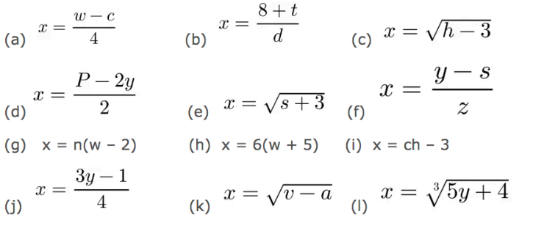
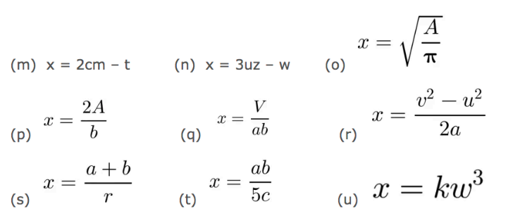
Solutions

