Slide 1


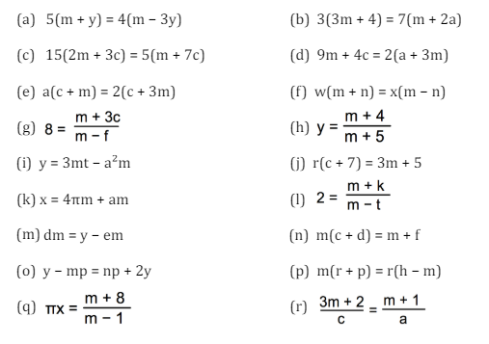
Changing the subject of a formula where x appears twice
Enter code U556 in the Sparx independent learning section and/or
Follow this link to watch a video on “Rearranging formula”
https://corbettmaths.com/2013/12/28/changing-the-subject-advanced-video-8/
Work through the questions below to check your understanding (solutions on next page):

Slide 2
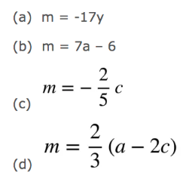
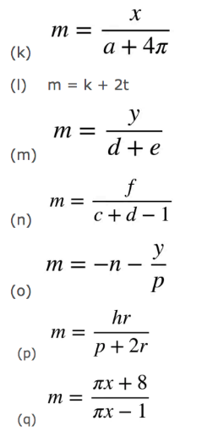
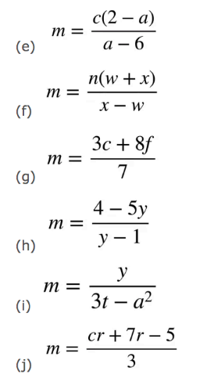

Solutions

