Slide 1


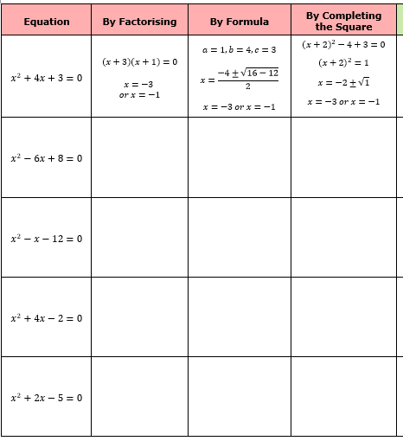
Solving quadratic equations using a range of methods.
Enter code U228, U960, U589 and U665 in the Sparx independent learning section and/or
Follow these links to watch a videos on “solving quadratics”
https://corbettmaths.com/2013/05/03/solving-quadratics-by-factorising/
https://corbettmaths.com/2013/04/24/quadratic-formula/
https://corbettmaths.com/2013/12/29/completing-the-square-video-10/
Work through the questions below to check your understanding (solutions on next page):

Slide 2
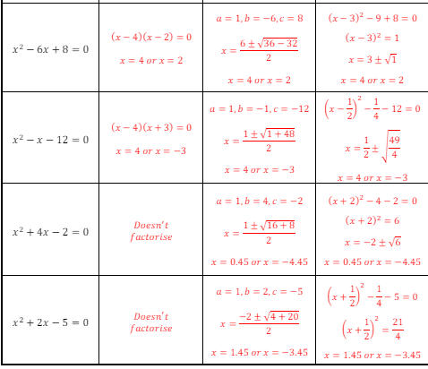
Solutions

