Slide 1






FRENCH GCSE STUDENT HANDBOOK
Nom: ___________________________________
KNOW THE BASICS
The alphabet |  | 2
Numbers |  | 3
Dates, months, days, seasons, colours |  | 4
Little but tricky words – a, the, to the, from the, my, your, this, that etc. |  | 5
Grammar terms and tenses explained |  | 6
VERBS & TENSES
Regular present tense verbs | 7
Irregular present tense | 8
Reflexive verbs in the present tense | 9
Perfect tense | 10 -11
Imperfect tense | 12
Future tense | 13
Conditional tense | 14
Additional future structures (…+ inf) | 15
Compound structures to impress examiners | 16
Useful table of regular verb endings for all tenses | 17
SPEAKING & WRITING FRENCH
Common errors to avoid including spelling/pronunciation | 18 – 19
Linking words, giving structure, intensifiers, time phrases | 20
Opinions, adjectives, negatives | 21
Developing answers LOVE IT | 22
FRENCH FANCIES | 23
10 essential must learn verbs in 3 tenses | 24
Infinitive structures | 25
The subjunctive mood | 26
GCSE FOUNDATION & HIGHER SPEAKING
Key to success in the role play | 27-28
Example role plays | 29
Key to success in read aloud task | 30
Example read aloud tasks | 31-32
Key to success in photo card | 33
Photo card chatty mat | 34
Key to success in unprepared conversation | 35
WRITING EXAM PREPARATION
FQ1:Write 5 sentences |  | 36
FQ2 Foundation: 50 word task |  | 37
FQ3 – Foundation grammar gap fill task |  | 38
FQ4: Translate into French example & advice |  | 39
The key to success in translating |  | 40-41
FQ5 & HQ2: 90 word task |  | 42
10 word bullet point strategy & 10 French fancies for grade 5+ |  | 43
HQ2: 150 word task |  | 44
LISTENING & READING EXAM PREPARATION
Listening & Reading exam advice |  | 45-46
Synonyms & vocab learning strategies |  | 47
Common features of the translation into English question |  | 48
VOCAB LISTS & STRUCTURES IN THEMES
THEME 1 – People and lifestyle |  | 49-52
THEME 2 – Popular Culture |  | 53-56
THEME 3 – Communication and the world around us |  | 57-60
Exam revision checklist by skill |  | 61
Useful websites for learning & revising French |  | 62
GCSE course content & grammar corrections checklist |  | 63

Slide 2
L’alphabet français
 | pronunciation guide
a | ah
b | bay
c | say
d | day
e | eugh
f | ef
g | jhay
h | ash
i | ee
j | ghee
k | ka
l | el
m | em
n | enn
o | oh
p | pay
q | Koo
r | air
s | ess
t | tay
u | ooo
v | vay
w | doo bla vay
x | eeks
y | ee grek
z | zed

Slide 3
Les nombres
1 un | 20 vingt | 100 cent
2 deux | 21 vingt et un | 101 cent-un
3 trois | 22 vingt-deux | 102 cent-deux
4 quatre | 23 vingt-trois | 110 cent-dix
5 cinq | 24 vingt-quatre | 151 cent-cinquante et un
6 six | 25 vingt-cinq | 162 cent-soixante deux
7 sept | 26 vingt-six | 190 cent-quatre-vingt-dix
8 huit | 27 vingt-sept | 200 deux-cents
9 neuf | 28 vingt-huit | 300 trois-cents
10 dix | 29 vingt-neuf | 400 quatre-cents
11 onze | 30 trente | 500 cinq-cents
12 douze | 31 trente et un | 600 six-cents
13 treize | 32 trente-deux | 700 sept-cents
14 quatorze | 40 quarante | 800 huit-cents
15 quinze | 50 cinquante | 900 neuf-cents
16 seize | 60 soixante | 1 000 mille
17 dix-sept | 70 soixante-dix | 2 000 deux-mille
18 dix-huit | 80 quatre-vingts | 1 000 000 un-million
19 dix-neuf | 90 quatre-vingt-dix | 2 000 000 deux-millions
Follow the link to help you pronounce the numbers correctly:
https://frenchtogether.com/french-numbers/

Slide 4
La date: The date
Quelle est la date (d’)aujourd’hui? What’s the date (today)?
Aujourd’hui c’est lundi (le) trois septembre
Les mois The Months Les jours The days
janvier January lundi Monday
février February mardi Tuesday
mars March mercredi Wednesday
avril April jeudi Thursday
mai May vendredi Friday
juin June samedi Saturday
juillet July dimanche Sunday
août August
septembre September
octobre October
novembre November
décembre December
Les saisons The seasons
printemps spring
été summer
automne autumn
hiver winter
mille neuf-cents quatre-vingt-dix-huit:
1998
deux-milles douze:
2012
Les couleurs The colours
rouge red rose pink
jaune yellow marron brown
vert green orange orange
bleu blue gris grey
blanc white violet purple
noir black bleu clair light blue
bleu foncé dark blue bleu marine navy blue

Slide 5
Little but tricky words *These words AGREE with the NOUN they describe
 | masc (s) | fem (s) | masc (p) | fem (p)
*a/ some | un | une | des
any | des
*none | aucun | aucune | aucuns | aucunes
*the | le | la | les
*to the | au | à la | aux
*of/ from the | du | de la | des
too much/many | trop de
another/other | autre
few/little | peu
lots of | beaucoup de
so much/many | tant de/tellement de
*this/ these | ce | cette | ces
*that one/ those ones | celui-ci | celle-ci | ceux- ci | celles-ci
*that/ those (over there) | celui-là | celle-là | ceux-là | celles-à
*my | mon | ma | mes
*your | ton | ta | tes
*his/ her | son | sa | ses
*our | notre |  | nos
*your | votre |  | vos
*their | leur |  | leurs
*mine | le mien | la mienne | les miens | les miennes
*yours | le tien | la tienne | les tiens | les tiennes
*his/ hers | le sien | le sienne | les siens | les siennes
*ours | le nôtre | la nôtre | les nôtres
*yours | le vôtre | la vôtre | les vôtres
theirs | le leur | la leur | les leurs

Slide 6
Grammar terms and tenses explained
Term | Its job | Example
Noun (n) | names a person, place, animal, thing | Pierre, La France, un chat, un cahier
Nm/nf | masculine noun feminine noun | un stylo, une gomme
definite articles | the (singular noun) the (plural noun) | le, la les
indefinite articles | a some | un, une des
Adjective (adj) | describes a noun, usually placed after noun | bleu un stylo bleu
Verb (vt) | describes an action | je m’appelle, j’ai,
Adverb (adv) | describes a verb | très, trop, doucement
subject pronouns | word used in place of a noun You: Tu = singular Vous = plural or polite | Je Tu Il/Elle/On Nous Vous Ils Elles | I You He/She We We You They They
Tense | Meaning | Example with the verb to sing (Chanter)
Conditional (Le conditionnel) | would | I would sing Je chanterais
Future ( le futur) | will/ shall | I will sing Je chanterai
Present (Le présent) | is | I sing/ I do sing Je chante
Imperfect (L’imparfait) | was/ used to | I was singing/ used to sing Je chantais
Perfect with avoir (Le passé composé) | has/ have | I have sung J’ai chanté
Perfect with être (Le passé composé) | has/have | I have arrived Je suis arrivé(e)
Pluperfect (le plus-que-parfait) | had | I had sung J’avais chanté

Slide 7
Regular present tense verbs
To talk about actions in the present, you need to change the infinitive verb by taking off the last 2 letters (either – -ER, –IR or -RE) and adding different endings.
The subject pronoun and the endings tell you who is doing the action of the verb. E.g. je parle = I speak, ils dansent = they dance.
Look at the table below to see which endings you need to add to the regular – -ER, –IR and RE verbs to make the present tense.
NB: Use the tu form of ‘you’ when talking to a friend, relation or children. Use the vous form when talking to an adult who you would not call by their first name.
Regular present tense verbs
 | (ER) jouer – to play | (IR) finir – to finish | (RE) vendre – to sell
je (I) | joue | finis | vends
tu (you, 1 pers fam) | joues | finis | vends
il/elle (he, she) on (we/people in general) | joue | finit | vend
nous (we) | jouons | finissons | vendons
vous (you, pl, or polite) | jouez | finissez | vendez
ils/elles (they) | jouent | finissent | vendent
NB: the ‘nt’ in the ils/elles form in silent when spoken.
SOME IIREGULAR “I” FORMS TO LEARN | Avoir | J’ai | I have
 | Etre | Je suis | I am
 | Aller | Je vais | I go
 | Faire | Je fais | I do/make
 | Vouloir | Je veux | I want
 | Pouvoir | Je peux | I can
 | Venir | Je viens | I come
 | Voir | Je vois | I see
 | Savoir | Je sais | I know
 | Sortir | Je sors | I go out

Slide 8
Irregular present tense verbs
Some verbs do not follow the regular pattern and you need to learn these by heart.
NB: Il y a = there is / there are
Il n’y a pas de = there isn’t/aren’t
‘To be’
 | ETRE
je (I) | suis
tu (you, 1 pers fam) | es
il/elle (he, she) on (we/people in general) | est
nous (we) | sommes
vous (you, pl, or polite) | êtes
ils/elles (they) | sont
3 more Irregular present tense verbs
 | FAIRE – to make/do | ALLER – to go | AVOIR – to have
je (I) | fais | vais | ai
tu (you, 1 pers fam) | fais | vas | as
il/elle (he, she) on (we/people in general) | fait | va | a
nous (we) | faisons | allons | avons
vous (you, pl, or polite) | faites | allez | avez
ils/elles (they) | font | vont | ont

Slide 9
REFLEXIVE VERBS
Some verbs need an extra part because they are reflexive, (when the action is being done to your self, like waking up, having a wash.)
AN EXAMPLE OF A REFLEXIVE VERB
Se lever-To get up
Because it is an ER verb, it takes the ER endings.
Because it is reflexive, it needs the reflexive pronoun (me, te, se, nous, vous, se)
Reflexive verbs have infinitives that end in “se”.
SE LEVER | TO GET UP
Je me lève | I get up
Tu te lèves | You get up
Il/elle/on se lève | He, she,gets up, we get up
Nous nous levons | We get up
Vous vous levez | You get up
Ils/elles se lèvent | They get up
Some common reflexive verbs:
Se réveiller-to wake up
Se laver-to get washed
Se doucher-to have a shower
Se baigner-to have a bath
Se détendre-to relax
S’habiller-to get dressed

Slide 10
The perfect tense
Step 1 : What type of verb is it?
être
avoir
Step 2 : Conjugate the auxiliary
verb
Je suis
Tu es
Il/elle/on est
Nous sommes
Vous êtes
Ils/elles sont
J’ai
Tu as
Il/elle/on a
Nous avons
Vous avez
Ils/elles ont
Step 3 : Add the past participle
-er é
-re u
-ir i
Past participle needs to agree?
Female – add ‘e’
Plural – add ‘s’
Female and plural – add es
IRREGULAR past participle ? Eg.
Boire – bu
Prendre – pris
Avoir – eu
Lire – lu
Voir – vu etc.

Slide 11
Perfect tense: verbs which take être
MONTER – to go up | VENIR – to come | DESCENDRE – to go down | TOMBER – to fall
RENTRER – to return | ALLER – to go | ENTRER – to enter | RESTER – to stay
SORTIR – to go out | NAÎTRE – to be born | RETOURNER – to return | ARRIVER – to arrive
 |  |  | MOURIR – to die
 |  |  | PARTIR – to leave
Perfect tense: irregular past participles
Some verbs have irregular past participles which need to be learnt – below are just some of the key ones
Avoir – to have | eu | Mourir – to die | mort
Boire – to drink | bu | Naître – to be born | né
Devoir – to have to | du | Pouvoir – to be able | pu
Dire – to say | dit | Prendre – to take | pris
Être – to be | été | Venir – to come | venu
Faire – to do | fait | Voir – to see | vu
Lire – to read | lu | Vouloir – to want | voulu

Slide 12
The imperfect tense (was, were doing/ used to do)
The imperfect is used to describe things we did regularly in the past and where we do not know the beginning and end of the action. It also sets the scene in a narrative, describing places, objects, people, time and the weather in the past.
The imperfect is formed by taking the nous form of the verb, removing the ‘ons’ and adding these endings
Regular imperfect tense endings
je (I) | ais
tu (you, 1 pers fam) | ais
il/elle (he, she) on (we/people in general) | ait
nous (we) | ions
vous (you, pl, or polite) | iez
ils/elles (they) | aient
Eg. To play – JOUER
Je jouais
Tu jouais
Il/elle/on jouait
Nous jouions
Vous jouiez
Ils/elles jouaient
Irregulars | etre – to be (irregular) | Être is the only verb which is fully irregular but there are a number of verbs which have an irregular present tense so this should be checked before taking the nous form
je (I) | étais
tu (you, 1 pers fam) | étais
il/elle (he, she) on (we/people in general) | était
nous (we) | étions
vous (you, pl, or polite) | étiez
ils/elles (they) | étaient
Il y avait -There was/ were

Slide 13
Future tense (will do…)
FORMATION
To form the future tense add the following endings to the infinitive.
There are some irregular stems but the endings are regular.
A very useful verb: Il y aura = There will be
je (I) | jouerai | I will play
tu (you, 1 pers fam) | joueras | You will play
il/elle (he, she) on (we/people in general) | jouera | He/she/we will play
nous (we) | jouerons | We will play
vous (you, pl, or polite) | jouerez | You will play
ils/elles (they) | joueront | They/you will play
Irregular future stems |  |  | Après mes examens, j’irai en France. After my exams, I will go to Spain. Nous mangerons à 8H. We will eat at 8. La soirée sera géniale. The party will be great. A l’avenir ils achèteront une maison en Espagne. In the future they will buy a house in Spain.
Infinitive | Future | Meaning
Être | Je serai | I will be
Avoir | J’aurai | I will have
Faire | Je ferai | I will do
Aller | J’irai | I will go
Voir | Je verrai | I will see
Pouvoir | Je pourrai | I will be able to
Vouloir | Je voudrai | I will want
Savoir | Je saurai | I will know
Venir | Je viendrai | I will come

Slide 14
Conditional Tense (would do…)
FORMATION (same as for future tense but with different endings)
You add the ending to the infinitive.
There are some irregular stems but the endings are regular.
A very useful verbs: Il y aurait= There would be
je (I) | Jouerais | I would play
tu (you, 1 pers fam) | Jouerais | You would play
il/elle (he, she) on (we/people in general) | Jouerait | He/she/you would play
nous (we) | Jouerions | We would play
vous (you, pl, or polite) | Joueriez | You would play
ils/elles (they) | Joueraient | They/you would play
Irregular stems (same as future tense) |  |  | Je voyagerais plus mais je n’ai pas d’argent. I would travel more but I don’t have any money. Je chanterais mais je ne peux pas. I would sing but I can’t.
Infinitive | Conditional | Meaning
Être | Je serais | I would be
Avoir | J’aurais | I would have
Faire | Je ferais | I would do
Aller | J’irais | I would go
Voir | Je verrais | I would see
Pouvoir | Je pourrais | I would be able to
Vouloir | Je voudrais | I would want
Savoir | Je saurais | I would know
Venir | Je viendrais | I would come

Slide 15
Talking about future plans
You can express future plans with a variety of phrases followed by the infinitive:
J’espère | I hope to
Je veux | I want to
J’ai l’intention de | I intend to
J’ai envie de | I feel like …ing
Je pense | I’m thinking of …ing
Je vais | I am going to
Je voudrais | I would like to
J’aimerais | I would like to
Quand j’aurai fini mes études je vais | When I finish studying I am going to
Quand je serai plus âgé je vais | When I’m older I’m going to
Examples:
J’ai l’intention de voyager avant de trouver un emploi | I intend to travel before looking for a job.
J’espère aller à l’université et étudier les langues. | I hope to go to university and study languages.
Quand je serai plus âgé je vais aller à l’étranger. | When I’m older I’m going to go abroad.
You can also use the future tense.
Je voyagerai avant de trouver un emploi. | I will travel before looking for a job.
J’étudierai les langues à l’université. | I will study languages at University.

Slide 16
USING MORE THAN ONE VERB IN A STRUCTURE
APRÈS AVOIR/ÊTRE… (AFTER HAVING…)
Après avoir/etre can be followed by a past participle to mean after having
done something. Ensure you use MRS VAN DER TRAMP verbs with etre and
make sure you past participle agrees.
Eg. Après avoir étudié… – after having studied…
Après être allé(e)… - after having arrived…
These structures can be used to add complexity to your language and it
would be good practice to follow them with a future structure.
Eg. J’ai l’intention d’aller à l’université
J’espère trouver un appartement
AVANT DE + INF… (BEFORE …ING)
Avant de can be followed by an infinitive to mean before …ing
Eg. Avant d’étudier… - Before studying…
Avant d’aller… - Before going…
THE PLUPERFECT TENSE (HAD DONE)
FORMATION
Imperfect tense of avoir + past participle
J’avais mangé | I had eaten
Tu avais mangé | You had eaten
Il/elle/on avait mangé | He. She, we had eaten
Nous avions mangé | We had eaten
Vous aviez mangé | You had eaten
Ils/elles avaient mangé | They had eaten
REMEMBER THAT SOME PAST PARTICIPLES ARE IRREGULAR

Slide 17
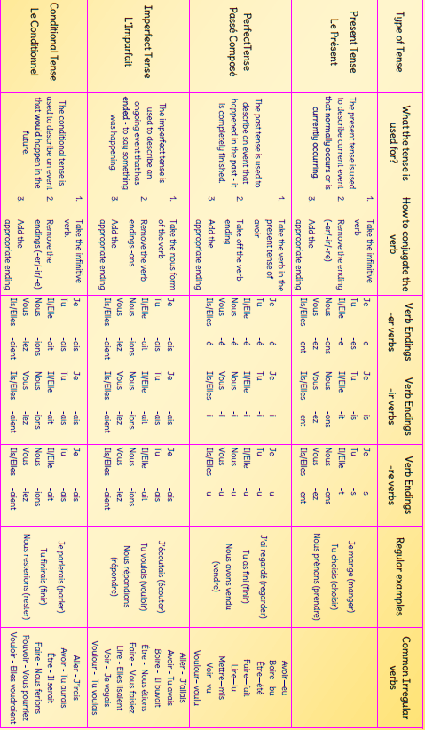
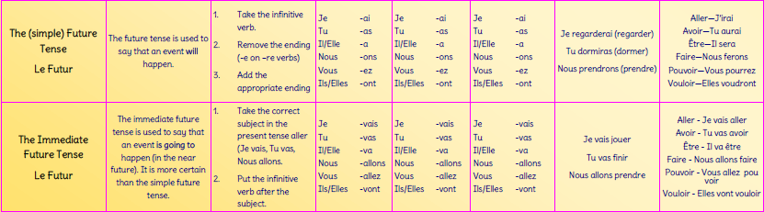
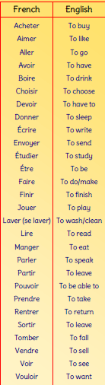


Slide 18
Common errors (to avoid!)
1. On + days of the week
On Saturday |  | Le samedi
On Tuesdays (i.e. every Tuesday) |  | Les mardis
2. In the morning / in the evening
in the morning |  | Le matin
in the afternoon / evening |  | L’après-midi
at 5 o’clock in the morning |  | À cinq heures du matin
at 8 o’clock in the evening |  | À huit heures de l’après-midi
3. In French the adjective usually comes after the noun.
the brown dog |  | Le chien marron
4. In French the adjective changes its ending to match the noun it describes.
the black dog |  | Le chien noir
the black house |  | La maison noire
the black dogs |  | Les chiens noirs
the black houses |  | Les maisons noires
5. Saying your age – use AVOIR not ÊTRE (I have 15 years)
I am 15 years old |  | J’ai 15 ans
My mum is 40 years old |  | Ma mère a 40 ans
6. ‘Is’ or ‘are’? Forgetting to make your verb match your subject.
I like comedies because they are funny. | J’aime les comédies car ils sont rigolos
7. I like going to the cinema – J’aime + infinitive NOT j’aime je vais= I like I go
J’aime aller au cinéma | I like going/ to go to the cinema.
8. Using ‘un/une’ with jobs – Don’t do it!
Je suis médicin | I’m a doctor
9. Using ‘’your’ or ‘my’ with parts of the body or clothing – Don’t do it! In French just use ‘le’, ‘la’, ‘les’
J’ai mal à la tête. | My head hurts

Slide 19
Common misspellings | Common mispronunciations
ennuyeux beaucoup intéressant je m’appelle sœur parce que Angleterre pourquoi je préfère l’anniversaire meilleur passionnant paresseux juillet août les cheveux aujourd’hui maintenant malheureusement quelquefois par exemple | C’est = ‘say’ Est = ‘eh’ Parce que = ‘parse quh’ Je = ‘juh’ J’ai = jhay’ Je suis = ‘juh swee’ Beaucoup = ‘boh coh’ Élève = ‘eh – lev’ Qu’est-ce que = ‘qess quh’ Qui = ‘key’ Trop = ‘troh’ é/est/er/ez/ais/ait = ‘eh’ Au/aux/eau/eaux/aud/ aut/os = ‘oh’ As a general rule do not pronounce the s on the end of a word unless the next word begins with a vowel

Slide 20
CRIB SHEET FOR SPEAKING & WRITING FRENCH
LINKING WORDS |  |  | GIVING STRUCTURE/ ORDER
et aussi de plus donc par conséquent mais ou lorsque cependant pourtant néanmoins bien que parce que car puisque étant donné que à cause de en raison de surtout | and also furthermore therefore therefore but or while however however however although because because since given that because of due to above all |  | d’abord/premièrement deuxièmement troisièmement puis après finalement D’une part... D’autre part |  |  |  | Firstly Secondly Thirdly Then/ next After Finally On the one hand ... On the other hand
 |  |  | INTENSIFIERS
 |  |  | assez presque trop très vraiment quasiment tellement |  |  | quite almost too very really practically so
TIME PHRASES
maintenant tout de suite aujourd’hui de nos jours le matin/l’après-midi/la nuit le week-end tous les jours/chaque jour toutes les semaines une fois par semaine cinq fois par mois tous les mois chaque année dès que possible les lundis /les mardis / les mercredis /les jeudis /les vendredis /les samedis /les dimanches toujours normalement souvent dans beaucoup de cas de temps en temps quelquefois quasiment jamais ne…jamais bientôt tôt tard | now straight away today nowadays in the morning/ afternoon/ at night at the weekend every day every week once a week five times a month every month every year as soon as possible on Mondays/Tuesdays/ Wednesdays/Thursdays /Fridays /Saturdays /Sundays always usually often many times from time to time sometimes hardly ever never soon early late |  |  | hier avant-hier hier le matin/ l’après-midi/ la nuit la semaine dernière le week-end dernier le mois dernier l’année dernière l’été dernier le lundi dernier il y a une semaine en 2010 (deux-milles-dix) quand j’étais plus jeune quand j’étais enfant ce matin/cet après-midi ce soir cette semaine/ cette année demain le lendemain demain matin/ après-midi/ soir la semaine prochaine le mois prochain l’année prochaine le lundi prochain dans une semaine/ un mois à l’avenir de ... à... Déjà |  | yesterday the day before yesterday yesterday morning/ afternoon, evening/ night last week last weekend last month last year last summer last Monday a week ago en 2010 when I was little as a child this morning/ afternoon tonight this week/ this year tomorrow the day after tomorrow tomorrow morning/ afternoon, evening/ night next week next month next year next Monday in a week’s/ month’s time in the future from… to… already

Slide 21
POSITIVE OPINIONS |  |  |  |  | NEGATIVE OPINIONS
J’adore J’aime beaucoup J’aime assez …… m’intéresse Je préfère/ J’aime plus Ce qui est bien c’est que Ce que j’aime le plus c’est que Le mieux c’est que |  | I love I like a lot I quite like I’m interested in I prefer The good thing is that What I like most is that The best thing is that |  |  | Je n’aime pas Je n’aime pas du tout Je déteste … m’énerve ce qui est mauvais c’est que Ce que j’aime le moins c’est que Le pire c’est que Je ne supporte pas C’est pénible C’est une perte de temps Je suis accro à |  |  |  |  |  | I don’t like I don’t like ... at all I hate It annoys me The bad thing is that What I like least is The worst thing is that I can’t stand It’s a pain It’s a waste of time I’m hooked on
POSITIVE ADJECTIVES |  |  |  |  |  |  |  |  | NEGATIVE ADJECTIVES
intéressant cool/branché parfait Idéale génial impressionant immense Inoubliables super/top pratique actif | interesting cool perfect ideal great impressive tremendous unforgettable awesome practical active |  | utile divertissant rigolo sociable formidable incroyable amusant passionnant Informatif beau/belle | useful fun funny sociable great incredible entertaining exciting informative beautiful |  |  |  |  | ennuyeux/barbant casse-pieds affreux pas pratique inutile addictif dangereux peu intéressant peu intelligent agaçant décevant Désagréable |  |  |  | boring annoying awful impractical useless addictive dangerous boring stupid irritating disappointing unpleasant
INFINITIVE EXPRESSIONS (J’aime JOUER au tennis- I like TO PLAY tennis)
J’aime J’adore Je suis intéressé(e) par… Je voudrais/j’aimerais On peut J’ai l’habitude de Je préfère Je peux Je vais Il est interdit de J’espère J’ai l’intention de Je rêve de |  | I like to I love to I am interested in …ing I would like to You can I usually I want to/ I prefer to I can I am going to It is forbidden to I hope to I intend to I dream of |  | Je veux J’en ai marre de J’ai peur de J’allais… mais j’ai décidé Il faut Il faut que je + subj On doit Il est nécessaire/essential Pour Il est + adjective de Après Avant de Ainsi que |  |  |  |  |  | I feel like …ing I am sick of …ing I’m scared of …ing I was going to … but I decided to You have to I have to We should It is necessary/ essential to To (in order to) It is + adjective to After …ing Before …ing As well as …ing
OPINIONS IN GENERAL |  |  |  |  |  |  | NEGATIVES
Je crois que/je pense que A mon avis J’ai l’impression que |  | I think that In my opinion I get the impression that |  |  |  |  | Ne…jamais Ne…rien Ne… personne Ne… ni … ni… |  |  |  |  | never nothing No one neither … nor …

Slide 22
Developing answers in writing and speaking
LOVE IT!
LINKS (pg 20) et, aussi, mais, ou, de plus, cependant, donc, par conséquent, néanmoins, d’abord, puis, après, finalement, souvent, la dernière fois que…, malheureusement, surtout, y compris, contrairement à, à cause de, grâce à , malgré, puisque, pourvu que
OPINIONS AND REASONS (pg 21) Je crois que/Je pense que / il me semble que / A mon avis / D’après moi/ Selon moi / je trouve que/quant à moi Verbs of opinions referring to others: Ma mère aime… Verbs of opinion in the past: j’ai aimé/ je l’ai aimé… Ce que j’aime le plus/le moins c’est que/c’était que… pour + infinitive – to explain something you do/did un peu, peu, assez, très, trop Exclamations: Quel désastre! Quelle horreur!
VARIETY OF STRUCTURES Vary your links – see above Vary because: parce que = car, puisque, étant donné que, vu que Vary your opinions Use intensifiers with adjectives: très grand, assez bruyant, trop ennuyeux Use adjectives/adverbs with nouns: beaucoup de pollution, un film amusant, une maison tellement… Use negatives: ne…jamais/rien/personne/que/ni…ni… Use Comparisons:– plus/moins que, aussi…que, tellement noun + comme Use superlatives: – le/la moins…/plus, le mieux/pire Use infinitive structures (pg 25) Use FRENCH FANCIES (pg 24) Use different verbs & adjectives (pg 21, 25,25) Use a variety of ways to express future actions: Je vais, je veux, je pense… (pg 15)
EXTENDED SENTENCES 1. Sentences with more than one tense (e.g. avant..mais maintenant…) 2. Comparing/referring to self and others 3. Contrasting two points of view – d’une part…d’autre part, un avantage…autre avantage 4. Complex sentences with: parce que, car, puisque, étant donné que, quand, où, que, si (& some that need the subjunctive: bienque, il faut que) 5. Phrases which introduce the subjunctive, e.g. il est dommage que … (It is a shame that …) J’ai peur que… (I’m afraid that …) Je souhaite que… (I wish that …) Je veux que… (I want …) Je ne crois pas que … (I don’t believe that …), Je doute que (pg 26) 6. Après avoir/être + past participle,… (pg 16)
INTERESTING VOCABULARY (pg 24, 46-51) A range of more unusual verbs and adjectives, and idioms
TENSES & TIME FRAMES (pg 7 – 17) Present, present continuous, perfect, near future, future, imperfect, pluperfect, subjunctive in set phrases (il faut que je fasse/je ne crois que ce soit…)

Slide 23
FRENCH FANCIES! COMPLEX FRENCH STRUCTURES THAT EXAMINERS LOVE!
Étant donné que/puisque/car … Given that/since – use instead of parce que Eg. J’aime le foot puisque c’est ma passion – I like football because it’s my passion | plus /moins … que … - more/less… than Eg. L’anglais est plus facile que l’espagnol – English is easier than Spanish
Avant de … + inf. - Before Eg. Avant d’aller au cinéma… - Before going to the cinema | aussi…que - as … as Eg. L’anglais est aussi facile que le français – English is as easy as French
Après avoir/être+ pp. – After having… Eg. Après avoir vu… - after having seen Après être arrivé – after having arrived | Superlative - The most/best/worst Eg. Le mieux/pire – the best/worst Le(s)… le(s) plus…/le(s) moins… - the most/least… Ce que j’aime le plus/moins – What I like most/least
Pour + inf. - In order to Eg. Je vais au cinéma pour voir un film – I go to the cinema in order to watch a film | Negative phrase(s) Eg. Je n’étudie ni l’anglais ni les maths –I study neither Engish nor maths Je ne vais jamais au cinéma – I never go to the cinema Personne ne pense que… – No one thinks that…
Je voudrais/j’aimerais + inf. - I would like to Eg. Je voudrais/j’aimerais joué au foot – I would like to play football | D’une part/ d’autre part … - On the one hand... on the other hand Eg. D’une part c’est intéressant, d’autre part je le/la trouve difficile – On the one hand it’s interesting, on the other hand I find it difficult
J’allais + inf, mais j’ai décidé + inf - I was going to ... but I decided to + inf Eg. J’allais regarder un film chez moi, mais j’ai décidé d’ aller au cinéma avec mes amis.– I was going to watch a film at home, but I decided to go to the cinema with my friends. | Bien que + subjunctive … - Although Eg. Bien que ce soit…– Although it’s
 | Il faut que + subjunctive … - it’s necessary that… Eg. il faut que je fasse/j’aille…– It’s necessary that I do/go
On peut + inf. - You can Eg. A Newcastle on peut aller au stade pour voir un match – In Newcastle you can go to the stadium to watch a match | Donc …/ par conséquent… - Therefore
Si/quand … (+ present tense) - If/when… Eg. Normalement si/quand il pleut je reste chez moi – Normally if/when it rains I stay at home
 | Quel(le) + noun - How…! Quelle horreur – How awful Quel dommage – What a pity
Ce qui est + adjective - The …. thing Eg. Ce qui est important/ intéressant/ difficile/ bon/ mauvais c’est que – The important/ interesting/ difficult/ good/bad thing is that

Slide 24
Les 10 verbes essentiels
Récemment |  | Normalement |  | A l’avenir
There was | Il y avait | There is | Il y a | There will be | Il y aura
 |  |  |  | There would be | Il y aurait
It was | C’était | It is | C’est | It will be | Ce sera
 |  |  |  | It would be | Ce serait
It had We had | …avait On avait | It has We have | …a On a | It is going to have We are going to have | …va avoir On va avoir
I went | Je suis allé(e) | I go | Je vais | I’m going to go | Je vais aller
We went | On est allé(e)(s) | We go | On va | We are going to go | On va aller
I saw | J’ai vu | I see | Je vois | I’m going to see | Je vais voir
We saw | On a vu | We see | On voit | We are going to see | On va voir
I went out | Je suis sorti(e) | I go out | Je sors | I’m going to go out | Je vais sortir
We went out | On est sorti(e)(s) | We go out | On sort | We are going to go out | On va sortir
I played | J’ai joué | I play | Je joue | I’m going to play | Je vais jouer
We played | On a joué | We play | On joue | We are going to play | On va jouer
I ate | J’ai mangé | I eat | Je mange | I’m going to eat | Je vais manger
We ate | On a mangé | We eat | On mange | We are going to eat | On va manger
I had a great time | Je me suis amusé(e) | I have a great time | Je m’amuse | I am going to have a great time | Je vais m’amuser
We had a great time | On s’est amusé(e) (s) | We have a great time | On s’amuse | We are going to have a great time | On va s’amuser
I liked (it) because it was | Je l’ai aimé car c’était | I like (it) | Je l’aime | I’m going to like (it) We are going to like (it) | Je vais l’aimer On va l’aimer
We liked (it) because it was | On l’a aimé car c’était | We like (it) | On l’aime | I would like We would like | Je voudrais On voudrait
Notes:
Must learn verbs, especially I form. Studenst could self-audit the ones they already know and learn rest for homework. Could do MWB translation/retrieval tasks.

Slide 25
INFINITIVES THE FOLLOWING STRUCTURES ARE USED WITH THE INFINITIVE |  |  |  |  | SOME COMMON INFINITIVES
 |  |  |  |  | AVOIR ÊTRE ALLER VOIR FAIRE PRATIQUER JOUER VISITER PRENDRE MANGER DÎNER LIRE SORTIR HABITER DANSER BOIRE COMMENCER FINIR ACHETER TRAVAILLER ÉTUDIER COURIR MARCHER SURFER TÉLÉCHARGER METTRE PARTAGER ÉCOUTER AIDER GAGNER DÉPENSER PASSER |  | TO HAVE TO BE TO GO TO SEE TO DO TO DO TO PLAY TO VISIT TO TAKE/HAVE TO EAT TO DINE TO READ TO GO OUT TO LIVE TO DANCE TO DRINK TO START TO END TO BUY TO WORK TO STUDY TO RUN TO WALK TO SURF TO DOWNLOAD TO PUT TO SHARE TO LISTEN TO TO HELP TO EARN/ WIN TO SPEND (MONEY) TO SPEND (TIME)
OPINIONS
J’aime … J’adore … Je préfère … …m’intéresse Je voudrais/J’aimerais … Ce que j’aime le plus c’est… Ce que je préfère c’est… Le mieux c’est… Je déteste … .. m’énerve Ce que j’aime le moins… Ce que je déteste c’est… Le pire c’est |  |  | I like to … I love to … I prefer to … I’m interested in … I would like to … What I like most is to … What I prefer is to ... The best thing is to ... I hate to ... It annoys me to ... What I least like is to ... What I hate is to ... The worst thing is to ...
TALKING ABOUT FUTURE PLANS
J’espère … Je veux … J’ai l’intention de … J’ai envie de … Je pense … Je vais … Je voudrais … J’aimerais … Quand j’aurai fini mes études je vais Quand je serai plus âgé(e) je vais |  | I hope to ... I want to ... I intend to ... I feel like …ing I’m thinking of …ing I am going to ... I would like to ... I would like to ... When I finish studying I am going to ... When I’m older I’m going to ...
OTHER VERBS
Je peux/ on peut… Je dois/ nous devons/ on doit … Je devrais/on devrait … Il faut … Il est interdit de/on n’a pas le droit de … J’allais … mais j’ai décidé de… Je viens de …/Je venais de … |  | I can/ You can … I must/ we must/ you must … We should … I have to/ we have to … You have to ... It is forbidden to ... I was going to .. but I decided to ... I have just .../ I had just (done)
AFTER A PREPOSITION |  |  |  | IL EST + ADJECTIVE DE…
J’en ai marre de … Avant de … Pour | I am fed up with … After/ before … In order to … |  |  | Il est important de … Il est essentiel de … Il est nécessaire de … Il n’est pas pratique de |  | It’s important to … It’s essential to … It’s necessary to … It’s impractical to …

Slide 26
THE SUBJUNCTIVE MOOD
When using the certain structures in French you have to use a form of the verb called the subjunctive. Il faut que j’aille à l’université. I must go to university. Bien que ce soit difficile, je voudrais étudier les maths. Although it’s difficult, I would like to study maths. Je veux que tu voyages avec moi l’année prochaine I want you to travel with me next year. To form the present subjunctive, start with the “ils/elles” form of the present tense, remove the “ent” and add these endings:
 |  | JOUER
Je |  | Joue
Tu |  | Joues
Il, elle, on |  | Joue
Nous |  | Jouions
Vous |  | Jouiez
Ils, elles |  | jouent
Verbs which are irregular in the present subjunctive include:
Être (to be) = je sois (I am) Ce soit (it is) | Aller (to go) = J’aille (I go) On aille (we go) |  | Il y a (there is/ are) = il y ait
Pouvoir (to be able to) = Avoir (to have) = Je puisse (I can) J’aie (I have) On puisse (you can) on ait (you have)

Slide 27






THE KEY TO SUCCESS IN THE ROLE PLAY CARD (10 MARKS)
QUESTIONS
QUESTION WORDS |  | ? ASKING A QUESTION |  | ASKING FOR SOMETHING
Qui est? – Who is? Qu’est—ce que? – What? Où est (sont)? – Where is(are)? Où est-ce que tu vas? – Where are you going? C’est quand…? – When is…? Pourquoi? – Why? Comment? – How/What? Quel(le)(s)? – Which? Combien? – How many? A quelle heure? – At what time? |  | Que penses-tu de…? – What do you think of? Quelle est ton opinion de…? – What is your opinion of? Aimes-tu/Aimez vous? – Do you like? As-tu/Avez-vous? – Do you have? Peut-on…? – Can you? Veux-tu/voulez-vous…? – Do you want? C’est comment…? What is…like? Doit-on + inf? – Should you? Qu’est-ce que tu vas + inf? – What are you going to….? |  | Je veux - I want Je voudrais- I would like J’aimerais- I would like Est-ce qu’il y a? - Is there/are there? As-tu?/Avez-vous? - Do you have?
TIME EXPRESSIONS |  | REMEMBER! |  | OPINIONS
Hier - Yesterday Il y a + period of time - ….ago La semaine dernière – last week L’année dernière – last year La dernière fois- The last time |  | Make a statement about the information given. (This will be a response to a question asked by the teacher) ? You will have to ask a question Aim to use a verb in each response. |  | J’aime/je n’aime pas- I like/don’t like Ce qui est bien/mauvais– The good/bad thing Le mieux/le pire- The best/worst Je préfère - I prefer Parce que/car/étant donné que/ puisque- Because/ since C’était- iI was C’est/ce sont - It is/they are Ce sera - it will be Ce serait - It would be
Aujourd’hui - today Chaque jour – each day Toujours- always Ne… jamais – never
L’année prochaine– next year La semaine prochaine – next week Demain – tomorrow
Pour + period of time = for…
KEY VERBS
PAST | PRESENT |  | FUTURE | ADJECTIVES
J’ai joué – I played Je suis allé(e) – I went J’ai fait – I did J’ai pratiqué – I did J’ai mangé– I ate J’ai travaillé – I worked J’ai étudié – I studied J’ai utilisé – I used J’ai habité - I lived J’ai acheté – I bought | Je joue – I play Je vais - I go Je fais – I do Je pratique – I do Je mange- I eat Je travaille – I work J’étudie – I study J’utilise – I use J’habite –I live J’achète – I buy |  | Je vais- I am going to Je vais jouer - …play Je vais aller- …go Je vais faire - …do Je vais pratiquer - …do Je vais manger- …eat Je vais travailler - …work Je vais étudier - …study Je vais utiliser - …use Je vais habiter - …live Je vais acheter - …buy NB. Je vais = I’m going to and will always be followed by infinitive Je voudrais/j’aimerais + Infinitive - I would like to | passionnant - exciting rigolo - funny vite - fast délicieux - delicious Casse-pieds - annoying Ennuyeux/barbant- boring difficile - difficult inutile - useless

Slide 28
LEARN YOUR QUESTION WORDS! BRIEF & RELEVANT ANSWERS! ONLY GIVE THE INFORMATION THAT YOU ARE ASKED TO! THINK OF SUITABLE RESPONSES/QUESTIONS FOCUS ON WHAT YOU CAN SAY, RATHER THAN WHAT YOU WANT TO SAY
EXAMPLES OF POSSIBLE QUESTIONS
? Meilleur ami ? Le concert -à quelle heure ? La pause déjeuner ?Le concert-quand ? Matière préférée ?Opinion de l’hôtel ?Le prix ?Manger-où ?Le chômage en France ?sites touristiques ?Le futur - quoi | Qui est ton meilleur ami? C’est à quelle heure le concert? C’est à quelle heure la pause déj? C’est quand le concert? As-tu/avez-vous une matière préférée? Que penses-tu de l’hôtel? ça coute combien? Où est-ce que tu voudrais manger? Est-ce qu’il y a du chômage en France? Est-ce qu’il y a des sites touristiques près d’ici? Qu’est-ce que tu vas faire dans le futur? |  |  | Who is …? What time is …? When is …? Have you …? Which/ What is …? What do you think of? How much is it? Where would you like …? (+ INF) Is there …? Are there …? What are you going to …?
WHICH TENSE? |  | OPINIONS/REASONS
PRESENT TENSE maintenant-now normalement-usually PAST TENSE La dernière fois-last time la semaine dernière-last week hier-yesterday dernier/e-last Dans le passé-in the past Recente/récemment-recent/recently FUTURE TENSE Tes projets pour-your plans for Dans le futur/à l’avenir-in the future L’année prochaine-next year Le week-end prochain-next weekend |  | Que penses-tu de-What do you think about? Quel type de … est-ce que tu préfères?-What type of … do you prefer? Quel(le) est ton/ta… préféré(e)?-What is your preferred…? Qu’est-ce que tu veux…?-What do you want…? Pourquoi veux-tu faire ça?-Why do you want to do that? Est-ce que tu crois que..?-Do you think that…? Comment veux-tu…? How do you want…? Qu’est-ce que tu aimes faire…?-What do you like to do…? Favori(te)-favourite Préféré(e)-preferred
 |  | AVOID STARTING YOUR ANSWERS WITH THESE WORDS!
 |  | Un inconvénient | Instead give a disadvantage Les portables sont chers-Mobiles are dear.
 |  | Un avantage | Instead give an advantage Faire du sport, c’est sain-It’s healthy to do sport.
 |  | Une raison | Instead give a reason. Start with PARCE QUE Parce que c’est amusant-because it’s fun

Slide 29
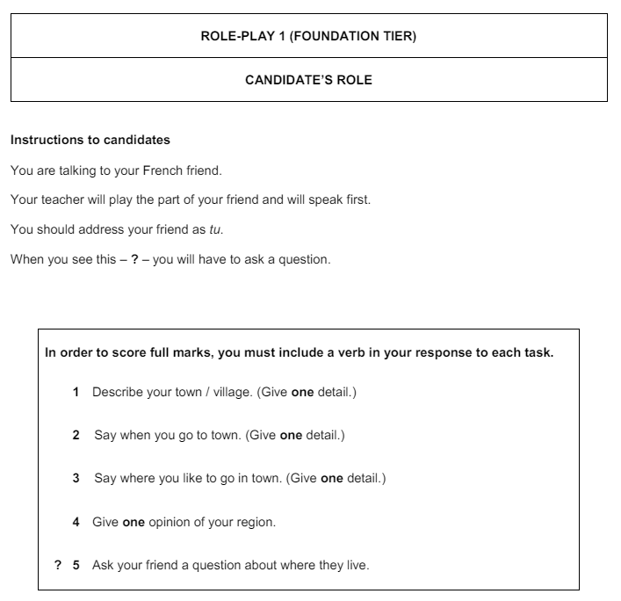
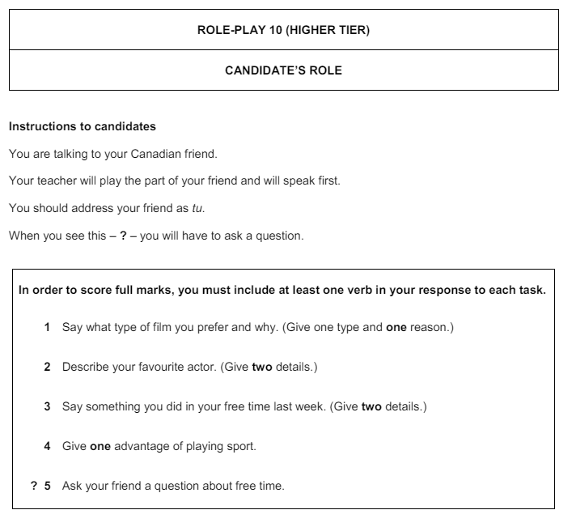
Role play examples
Ma ville est grande
Je vais en ville le week-end
J’aime aller au cinéma
Ma région est intéressante
Tu aimes ta ville?
Je préfère les comédies car j’aime rire
Mon acteur préféré est amusant et beau
J’ai joué au tennis et j’ai mangé au café
Le sport, c’est bon pour la santé
Que fais-tu le week-end?

Slide 30
THE KEY TO SUCCESS IN THE READ ALOUD TASK (15 MARKS)
PART 1
During your preparation time (15 minutes) you can write out your text phonetically to help you
When asked by your teacher, read the text out loud.
You will be given up to 5 marks for your pronunciation
PART 2
You will then be asked 4 compulsory questions about the same topic as the read aloud task. You will be given up to 10 marks for your response
For full marks you should answer each question clearly, give an extended response in at least two answers and at least one other answer should be developed well

Slide 31
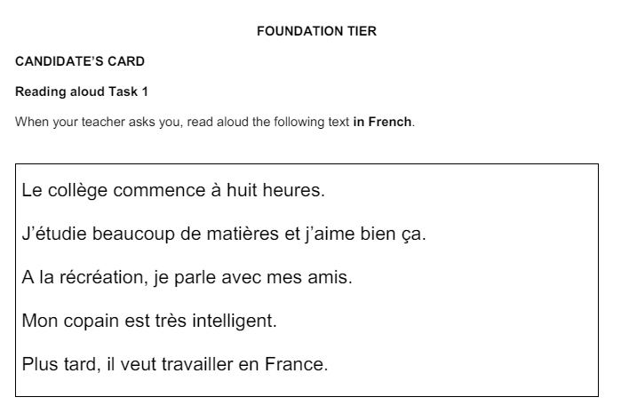
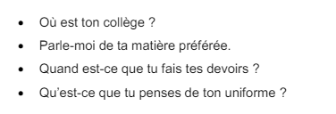
Read aloud example
Foundation
Follow up questions

Slide 32
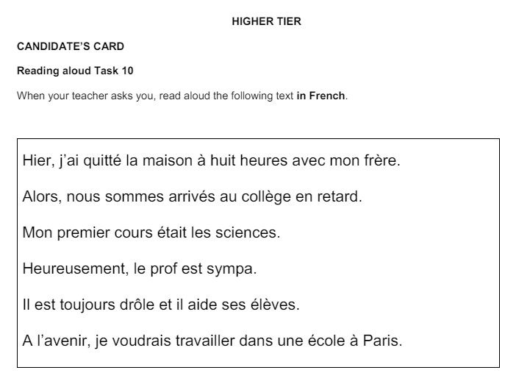
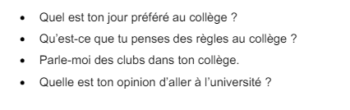
Read aloud examples
Higher
Follow up questions

Slide 33
KEY TO SUCCESS IN THE PHOTO CARD (25 MARKS)
FOUNDATION (between 4 and 5 minutes) HIGHER (between 6 and 7 minutes) You will have time to prepare an answer to describe the content of two photos. You can read this answer out to your teacher (5 marks) You will then have an unprepared conversation on any or all of the topics which are within this particular theme. (20 marks) The first question is always: Parle-moi des photos Try to develop your answers, give opinions and reasons
CLUES TO TENSES FROM THE VERBS IN THE QUESTION
PAST TENSE
-..tu as + pp? | Qu’est-ce que tu as fait? - What did you do? Hier Récemment Le week-end dernier Pendant les vacances |  |  | J’ai + pp – I… Je suis + pp
FUTURE TENSE
Est-ce que tu voudrais+ infinitive?-Would you like to… Qu’est-ce que tu veux+ infinitive-What do you want to… Qu’est-ce que tu vas + infinitive?…-What are you going to… Comment serait…?…-What would … be like? Si tu étais…, tu voudrais….? Qu’est-ce que tu penses de… |  |  | Je voudrais+ inf Je veux + infin Je vais+ infin Serait Je voudrais Give your opinion
OPINION QUESTIONS
Qu’est que tu penses de… Est-ce que tu préfères passer du temps avec ta famille ou tes amis? Pourquoi? C’est mieux visiter la plage ou aller à la piscine Aimes-tu + inf? C’est une bonne idée + infinitive Quel type de film préfères-tu? C’est bon + infinitive… Pour toi… est important… Quels sont les aspects positifs/négatifs de + infin Quel est l’avantage/l’inconvénient de… Quel est l’aspect le plus important… |  | Give an opinion. J’aime… ou=or (A choice) Je préfère… car… ou=or (A choice) … est mieux car… Give an opinion J’aime/ je n’aime pas… Je préfère Oui/Non c’est bon/n’est pas bon… Oui/Non … est important/n’est pas important… Give examples of positive & negative aspects of…
THE RULE OF 3

Slide 34

PHOTO CARD CHATTY MAT
Q1. Qu’est-ce qu’il y a sur la photo? (PAWS)
To start off! |  |  |  | What’s there?
Sur l’image Sur la photo Il y a Je vois On peut voir La photo montre | In the image In the photo There is/are I see You can see The photo shows |  |  | un homme/une femme Quelques personnes Beaucoup de personnes Des bâtiments Des arbres Une scène de |  |  |  | a man/woman some people lots of people some buildings some trees a scene of
Be specific! |  |  |  | Where are they?
Au premier plan En arrière-plan A gauche A droite Près de Devant | In the foreground In the background To the left To the right Close to In front of |  |  | Il/elle est/ ils sont À l’intérieur À l’extérieur À la maison À la campagne À l’école |  |  | He, She is/They are inside outside at home in the countryside in school
What are they doing? |  |  |  | Describing people
Ils/elles sont en train de parler sourire rire travailler utiliser manger |  | They are in the middle of Talking Smiling Laughing Working Using Eating |  | Il/elle est/ ils sont Ils semblent Heureux/euse(e) Content(e)(s) Triste(s) Fatigué(e)(s) Fâché(e)(s) |  | He, She is/They are They seem happy happy sad tired angry
Weather |  |  |  | Opinion phrases
Il fait du soleil Il fait beau Il fait mauvais Il pleut Il y a des nuages |  | It’s sunny It’s nice weather It’s bad weather It’s raining It’s cloudy |  | Je crois que Je pense que J’imagine Je suppose Je dirais que Il me semble … me fait penser à… |  |  | I think that I think that I imagine that I presume that I would say that It seems to me that It reminds me of
Do you like it?
J’aime/je n’aime pas la photo Parce que Puisque Étant donné que |  |  | I (don’t ) like the photo because since given that |  | C’est beau C’est animé |  |  |  | it is pretty it is lively

Slide 35


THE KEY TO SUCCESS IN THE UNPREPARED CONVERSATION
MAKING THE CONVERSATION SEEM REAL! Repeat some of the words from the question: Est-ce que tu regardes la télé tous les jours? Tous les jours? Use hesitation: alors, euh, hein, eh bien, c’est une bonne question Ask questions: et toi/vous? Use intonation & emotion to sound like you really mean what you’re saying REMEMBER IT IS A CONVERSATION, NOT AN INTERROGATION! INCLUDE MORE THAN ONE TIME FRAME IN SOME OF YOUR ANSWERS! Par exemple: -Parle-moi de ta journée scolaire. (Tell me about your school routine.) -Alors, j’ai cinq cours par jour et chaque cours dure une heure. Par exemple, hier j’ai eu un cours d’anglais le matin et un cours de maths l’après-midi. (Well, I have 5 lessons per day and each lesson lasts an hour. For example, yesterday I had English in the morning and maths in the afternoon. Use what you know how to say rather than exactly what you want to say Back up your opinion using parce que/ car/ puisque/ étant donné que Use frequency & time phrases Use FRENCH FANCIES Use LOVE IT! LISTEN TO YOUR TEACHER: BE PREPARED TO RESPOND TO QUESTIONS THAT ADD TO THE SPONTANEITY OF THE CONVERSATION IF POSSIBLE!
SUCCESS CRITERIA (H) A lot of information is conveyed Consistent good development with regular extended responses Wide variety of vocabulary and structures | SUCCESS CRITERIA (F) Quite a lot of information is conveyed Regular good development of responses Good variety of vocabulary and structures
???????????????????

Slide 36
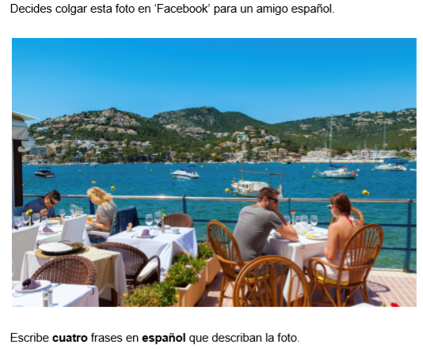
Question 1 FOUNDATION (10 marks)
You have to write 5 sentences to describe a photo
GCSE FRENCH FOUNDATION WRITING
You receive this photo from a friend
What is in this photo? Write 5 sentences in French
Same verb, different information will get you FULL Marks!
Il y a quatre personnes
Il y a un restaurant
Il y a deux femmes
Il y a deux hommes
Il y a les tables
5 sentences using PAWS
Il y a quatre personnes
Ils sont en train de manger
Il fait beau
Ils sont dans un restaurant
Ils sont contents

Slide 37
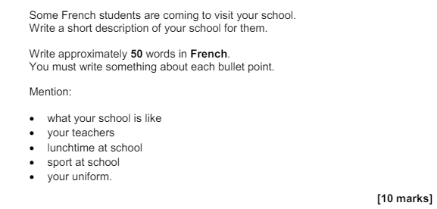
Question 2 FOUNDATION (10 MARKS)
You have to write 50 words in total on 5 bullet points!
You might want to think of it as 5 sentences of about 10 words each.
A SUCCESSFUL FORMULA
OPINION + LINK WORD + REASON
TRY TO VARY
YOUR OPINION | LINK WORDS | ADJECTIVES
J’aime mon collège | parce que | c’est assez amusant.
J’adore mon prof de maths | car | il est vraiment gentil et il m’aide beaucoup.
A midi, je mange à la cantine | puisque | les repas sont délicieux.
Je déteste le sport Je n’aime pas mon uniforme | vu que car | c’est ennuyeux. c’est inconfortable

Slide 38
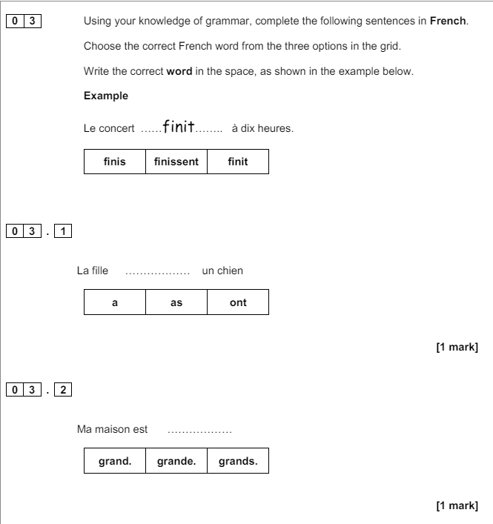
Question 3 FOUNDATION (5 marks)
Gap fill task – multi choice
Examples below

Slide 39

FOUNDATION & HIGHER TRANSLATION INTO FRENCH
GENERAL ADVICE & VAN STRATEGY
STRATEGIES FOR TRANSLATION INTO FRENCH
Read all of the sentences through once.
Work then at sentence level. For each, try to produce a French equivalent.
As you build each sentence, use a mental checklist for accuracy:
Verbs Subject – Verb agreement (Who is doing what?) Tense (When?) Position in the sentence
Adjectives Noun – Adjective agreement Position
Nouns Masculine / Feminine Singular / Plural Definite / Indefinite article
If you don’t know a word, try to think of a synonym or similar word.
If you can’t think of a suitable replacement word, use a short paraphrase to describe it.
If a whole sentence is too complex, try to express the meaning with a simpler expression.
Go through your work thoroughly. Imagine you have been given the job of marking it. Check for spelling, accents, & the items on your grammar checklist.
VAN CHECKLIST
VERBS ADJECTIVES NOUNS
VERBS
Subject – Verb agreement (Who is doing what?)
Tense (When?)
Position in the sentence
ADJECTIVES
Noun – Adjective agreement
Position
NOUNS
Masculine / Feminine
Singular / Plural
Definite / Indefinite article

Slide 40
Question 4 FOUNDATION (10 MARKS) / Question 1 HIGHER (10 marks)
You have to translate 5 sentences. Translate what you can, even if you have to miss out some words!
1 | My teacher is nice. Mon professeur est sympa. |  | Est = is
2 | I listen to music in the car. J’écoute de la musique dans la voiture. |  | J’écoute = I listen to
3 | I like to go to the cinema with my friends. J’aime aller au cinéma avec mes amis. |  | J’aime + infinitive
4 | There are many poor people in the city. Il y a beaucoup de pauvres dans la ville. |  | Il y a = There is /are
5 | I visited an interesting museum in Spain. J’ai visité un musée intéressant en France. |  | Learn past tense : Auxiliary verb + pp
KEY VERBS |  |  | VERBS + INFINITIVE
PRESENT |  | PAST | -J’aime écouter de la musique. I like to listen to music. -J’adore lire. I love to read. -Je veux visiter Espagne. I want to visit Spain. -Je vais aller au cinéma. I am going to go to the cinema. -Je voudrais être acteur. I would like to be an actor. -Je préfère habiter à Paris. I prefer to live in Paris.
Il y a = There is/are Je joue - I play Je suis = I am Je vais = I go to (I am going to) Je vois = I see Je travaille = I work Il/elle est = He/she/it is Nous: allons = We are going jouons = We play dansons = We dance Visitons = We visit achetons = We buy écrivons = We write avons = We have mangeons = We eat |  | Je suis allé(e) = I went/ I was J’ai joué = I played J’ai dansé = I danced J’ai visité = I visited J’ai acheté = I bought J’ai écrit = I wrote Nous sommes allé(e)s= We went Nous avons: joué = We played dansé = We danced visité = We visited acheté = We bought écrit = We wrote eu-We had mangé-We ate

Slide 41
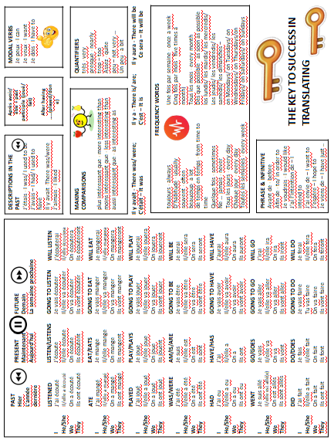

Slide 42
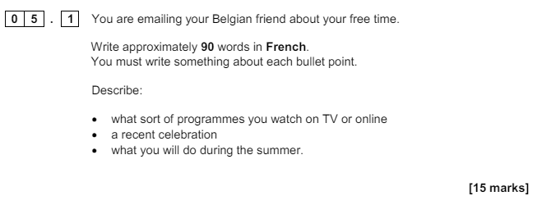
Question 5.1 or 5.2 FOUNDATION (Only answer ONE question.) 15 MARKS
Question 2.1 or 2.2 HIGHER (Only answer ONE question.) 15 MARKS
Write approximately 90 words
3 bullet points
Present, past, future time frames
Approximately 30 words per bullet point
Opinions & reasons in every bullet point
Sentence starter
THINK 5 Ws (Who, what, where, when, why) in every bullet point
Some complex structures (FRENCH FANCIES)
FAIL PROOF STRATEGY
CLUES FOR TENSES & OPINIONS
Present | Il y a-there is/are; …est comment-what is … like; tous les jours-every day; normalement-usually or verbs in present tense – take note of the endings
Past | Auxiliary verb + pp (é/i/u) endings on verbs: Qu’est-ce que tu as fait-what you did; Récemment/ récente-recently/recent; dernier-past/last
Future | Tes projets-your plans; voudrais-tu-you would like; vas-tu-you are going to; ce que tu vas faire you are going to do; ce que tu veux faire-what you want to do; prochain(e)-next; à l’avenir-in the future
Opinion | Ce que tu penses de…-what you think about; qu’est-ce que tu préfères-what you prefer; pourquoi-why; … que tu aimes et pourquoi - … that you like and why

Slide 43



90 word task
30 word bullet point STRATEGY
Your holidays last year
Sentence starter | L’année dernière
Facts (3) | Ma famille et moi sommes allés au sud de la France
Opinions + reasons | On a passé un bon moment puisque c’était non seulement intéressant mais également divertissant.
EXTRA: FRENCH FANCY
10 FRENCH FANCIES THAT HIT ALL THE SUCCESS CRITERIA FOR A HIGH GRADE
français | anglais
Pour + infinitive | In order to …
J’aime + inf car je le trouve … | I like … because I find it …
Inf + m’intéresse/m’énerve | … interests/annoys me
Le mieux/le pire | The best thing/the worst thing
C’est plus/moins… que | It’s more/ less… than
Si j’avais l’occasion, je voudrais + inf | If I had the chance, I would like to …
Si j’avais le temps, j’aimerais + inf | If I had time, I would like to…
J’allais + inf mais j’ai décidé de + inf | I was going to … but I decided to…
J’ai tendance à + inf | I usually …
J’espère + inf/ j’ai l’intention de + inf | I hope to/intend to …
Notes:
Reminder of the key elements

Slide 44
Question 3.1 or 3.2 HIGHER (Only answer ONE question.) 25 MARKS
2 Bullet points-150 words in total
(approx 75 words per bullet but NOT ESSENTIAL)
There can be an imbalance in the coverage of each bullet point as long as some coverage is evident.
A POSSIBLE STRATEGY INTRODUCTORY SENTENCE 3 IDEAS OPINION TO SUM UP THE BULLET POINT
The importance of friends
Introductory sentence linked to the bullet point | Pour moi, les amis sont très importants dans la vie.
First idea: D’abord ... | D’abord, j’ai une meilleure amie, elle s’appelle Bella, elle est non seulement amusante et compréhensive mais également fidèle
Second idea: Deuxièmement | Deuxièmement, j’aime passer du temps avec mes amis parce que c’est plus amusant qu’être seul
Third idea: De plus ... | De plus, il faut qu’un bon ami soit là pour moi
Your opinion to sum up the bullet point | En ce qui me concerne sans mes amis la vie serait très ennuyeuse et je ne voudrais pas perdre mes amis
FOR HIGH MARKS IN QUESTION 3 YOUR ANSWER NEEDS TO BE:
fully relevant, detailed with lots of information
opinions expressed with reasons
complex structures used accurately
very good variety of vocabulary & structures
a fluent piece of writing
highly accurate

Slide 45
PREPARING FOR THE LISTENING & READING EXAMS
Learn vocabulary
Learn time frames
Learn past, present & future tenses and verb endings
Learn synonyms. For example “connu” (well known) is similar to “célèbre” (famous); marcher = aller à pied = to go for a walk
Learn positive & negative opinions
Learn connectives. For example when you have to decide if an utterance is P, P&N or N connectives such as: mais (but), cependant (however), d’autre part (on the other hand/ however), lorsque (whilst), bienque (although) give the suggestion of a change in opinion, so the answer would be P&N
Remember that at Higher Tier, 50% of the questions are aimed at grades 7-9 so these questions will be very challenging. So, listen & read to the end of each question before giving an answer-there will be distractors -you need to spot them!
For example you hear: “En ce moment, il y a de plus en plus d'étudiants qui font du travail bénévole ici au Québec et dans d'autres pays du monde. Quelquefois, ils connaissent les gens qu'ils aident mais le plus souvent ce sont des inconnus..”
You have to choose from: Students in Quebec…
A: are not volunteering in such great numbers.
B: volunteer to help at home and abroad.
C: only help people they do not know.
You may choose “C” because you heard “inconnus”. The answer is B (they do voluntary work here in Quebec and in other countries of the world.”
Go on line to AQA
LISTENING EXAM ADVICE
REMEMBER:
Section A: Answer the questions in English.
Section B: Dictation. You will hear 4 short sentences three times; the first time as a full sentence, the second time in short sections and the third time again as a full sentence. You will write down what you hear for each sentence.
Maximise the 5 minutes' reading time by:
reading all the questions & question titles carefully
looking at any examples given, as these point out the level of detail required
highlighting or underlining key words which have been highlighted in the rubrics/questions
identifying the questions which have two parts to answer from the same utterance (E.G. Question 12: 12.1, 12.2)
With questions where you have to give a written answer in English:
Make sure you read the question carefully so that you know exactly how to answer.
Always follow the example, if one is given.
Ensure that you give precise answers as vague answers will not be correct. For example, if you translate “les devoirs” as “work” instead of “homework” you will not get the mark.

Slide 46
READING STRATEGIES
Prediction | What can you tell about the text from the title, exam rubric, any visuals, the layout, the punctuation?
Anticipation | Read the English questions to add to your overall sense of what the text is about, and anticipate possible answers based on real world logic and probability.
Skim reading | Read the whole text once through to add to your gist understanding. Don’t stop when there are unfamiliar words.
Scanning | Go back to the questions, one by one. Decide what information you need. Who? What? Where? When? Why? If the task is multiple choice, scan the text for those specific words. If not, scan for possible answers that fit, e.g. a person for ‘Who?’.
Evaluation | Keep the overall text and context in mind. Ensure that answers don’t contradict each other (use in-text logic) and are not impossible or unlikely (use real world logic).
Deduction & inference | In more challenging questions, the answers are not directly given but are built-up by piecing together hints from the text. Where the answer is not immediately clear, look at the sentence before and after the keyword to get more information.
READING EXAM ADVICE In Section A, answer the questions in English. In Section B, translate 5 sentences into French Read the introduction to the question. This will help you to give sensible answers. Answer every question, especially where you have to write a letter. If in doubt, have a guess! Read the whole of the sentence so that you can check that your first reaction is right. If you think the answer is ‘N’ (Now) for example, read on to make sure that this is not the distracter and that the correct answer is in fact ‘F’ (Future) or ‘P’ (Past). If you are asked to give one reason, only give one. In a questionnaire-type question, include information from the answer and the question in the questionnaire. Translate every word in the translation.
TRANSLATING FROM FRENCH INTO ENGLISH Read the sentences carefully For each sentence, try to produce an English equivalent that sounds right. You cannot often translate word for word. Mostly, you need to paraphrase: i.e. find a phrase that has the same meaning, but uses different words. Try to work out the meaning of any unfamiliar words in the sentence. Consider words surrounding the unfamiliar word and try out words that would fit, using an English sentence with gaps. E.g. Jean lit un livre = Jean *?* a book. Once you have the meaning of the sentence in your head, play with the order of the words until you have English that sounds natural when you read it. The golden rule: read aloud what you have written. If it doesn’t sound right to you, it probably isn’t.

Slide 47
SYNONYMS |  | VOCABULARY LEARNING
Promener/faire les randonnée/faire une balade Soutenir/supporter Énerver/déranger Cinquante pour cent/ la moitié Vingt-cinq pour cent / un quart grave/ sérieux nécessaire / essentiel/ impératif Il faut/ on doit Il n’y a pas de/ il y a un manque de Échouer/rater Mourir/décéder Un embouteillage/un bouchon Faire du cyclisme/faire du VTT/faire une balade à vélo Les loisirs/les passe-temps élève/ étudiant avantages/ bienfaits sain/ bon pour la santé quinze jours/ deux semaines De nos jours/aujourd’hui/actuellement travail/boulot/métier/petit job La lecture/ lire Les aliments/ la nourriture peu tranquille/ ce n’est pas tranquille/bruyant | to go for a walk to put up with To bother/annoy 50%/ half 25%/ a quarter serious necessary/ essential you have to there aren’t to fail to die traffic jam to cycle free time pupil/ student advantages healthy fortnight Nowadays job reading food Noisy | Have a word list in French & English Tick the words that you already know Try to find an English cognate to help you with the meaning. For example, “tranquille” is similar to “tranquil” in English. Divide your words into categories and learn the vocabulary in groups. Cover & say (French-English & English –French). Write the words down. Make word cards-French on one side, English on the other Test with a partner. Record the vocabulary and listen to it. Use memrise/quizlet-on line vocabulary learning site. Use vokabel.com vocabulary learning site to insert words and then test yourself (French to English & then English to French) Use Quizlet.com Give words a number using this Vocabulary Knowledge Scale: 1. I don’t remember having seen this word before. 2. I have seen this word before but I don’t know what it means. 3. I have seen this word before and I think it means … 4. I know this word: It means … 5. I can use this word in a sentence: E.G …

Slide 48
OPINIONS (FOUNDATION & HIGHER) J’adore-I love Mon ami n’aime pas-My friend doesn’t like (Other people’s opinions) À mon avis-In my opinion OPINIONS (HIGHER) Je veux que … ce soit: I want… to be | REASONS (FOUNDATION & HIGHER) Parce que/car-because REASONS (HIGHER) puisque-since; vu que-seeing that; étant donné que – given that
 | PAST TIME FRAME (FOUNDATION & HIGHER) hier-yesterday J’ai écouté-I listened to j’ai + (é) Il/elle a mangé-He/she ate il/elle a +(é) Je suis allé(e)-I went; il/elle est allé (e)-He/she went PAST TIME FRAME (HIGHER) Hier soir-last night J’ai fait mes devoirs-I did my homework Mes amis m’ont aidé-my friends helped me (Perfect tense & object pronouns)
PRESENT TIME FRAME (FOUNDATION & HIGHER) C’est-is Ce sont-are J’ai-I have Normalement/d’habitude-usually On peut-you can Il/elle travaille-he/she works (other people’s actions) On étudie-we study PRESENT TIME FRAME (HIGHER) Qu’est-ce que tu fais?-What are you doing? (Present continuous tense in English) Pour passer – for spending (inf structures often translate into gerund)
 | ADJECTIVES & INTENSIFIERS (FOUNDATION & HIGHER) beaucoup- a lot très-very relaxant-relaxing utile-useful facile-easy grave-serious
FUTURE TIME FRAME (FOUNDATION & HIGHER) la semaine prochaine-next week demain-tomorrow L’année prochaine-next year Ils vont + inf-They are going to Je vais + inf-I am going to FUTURE TIME FRAME (HIGHER) Je ferai-I will do (Future tense) Je veux voir-I want to see Ce sera-It will be (Future tense) Ce serait-It would be (Conditional tense) Ils diraient-they would say (Conditional tense)
 | COMPLEX STRUCTURES (HIGHER) C’est plus… que-is more … than L’utiliser- use it Je ne l’aime pas - I don’t like it Pour les persuader – to persuade theme on y trouve – there you find dont – of which
 | SUBJUNCTIVE (HIGHER) Il faut que – I must/I have to Bien que - although

Slide 49
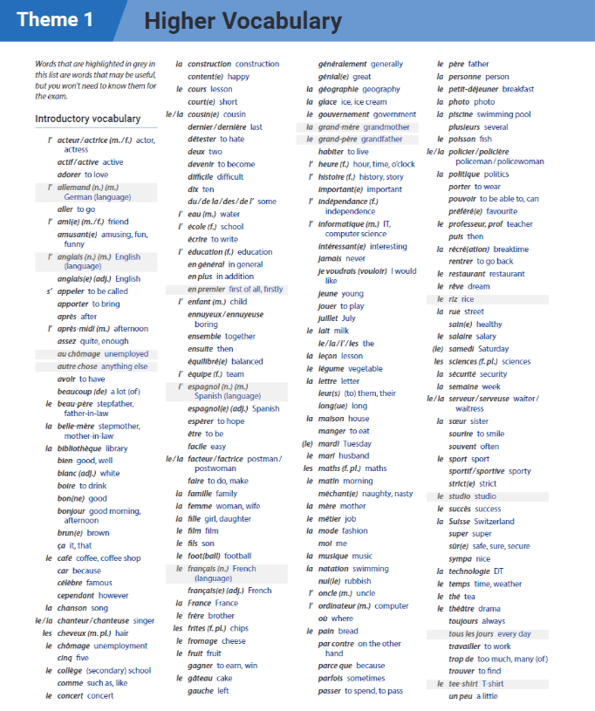

Slide 50
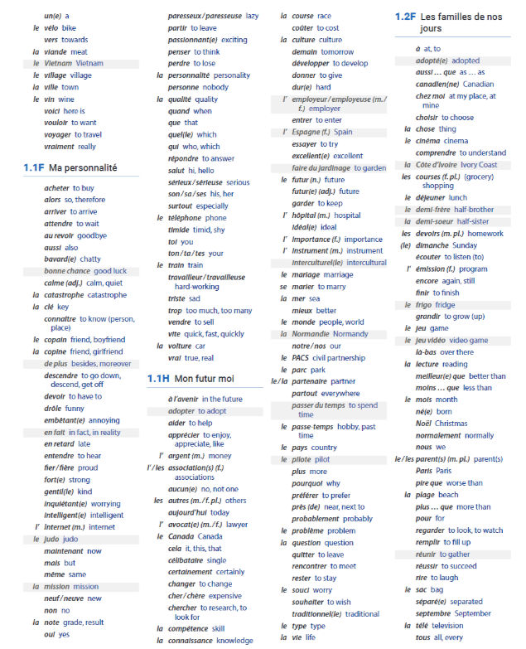

Slide 51
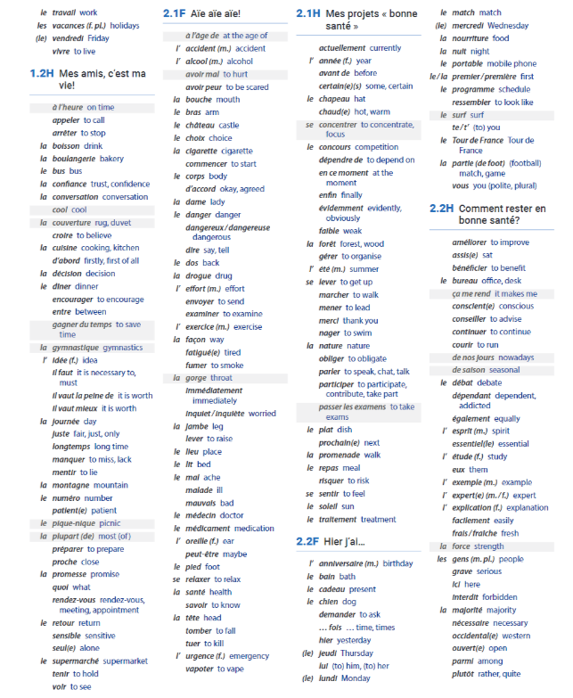

Slide 52
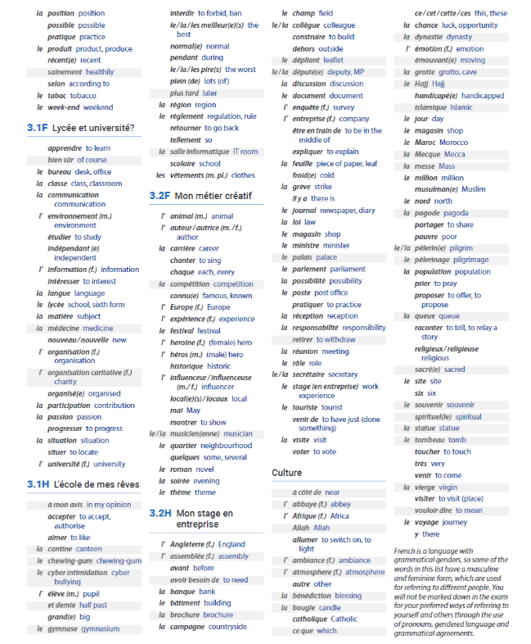

Slide 53
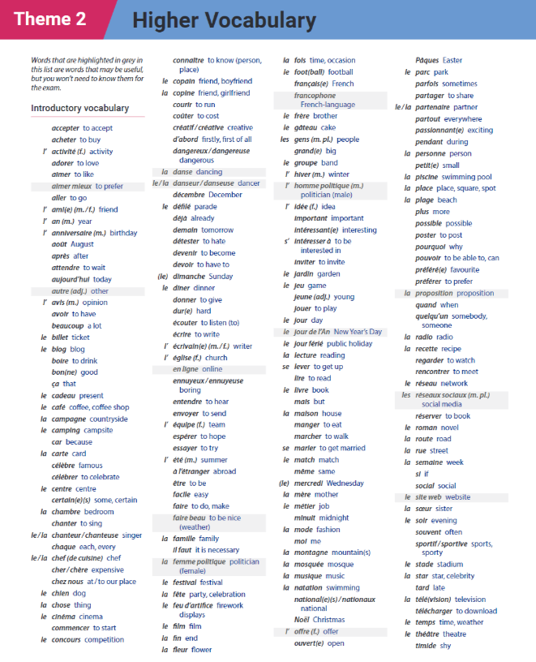

Slide 54
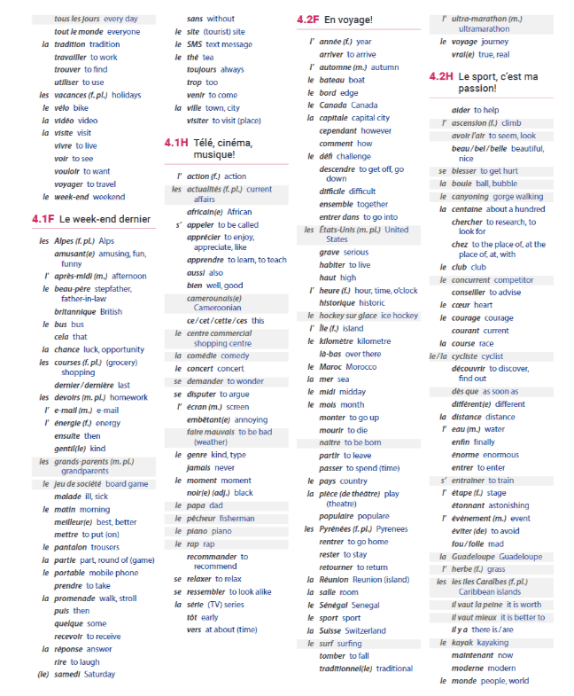

Slide 55
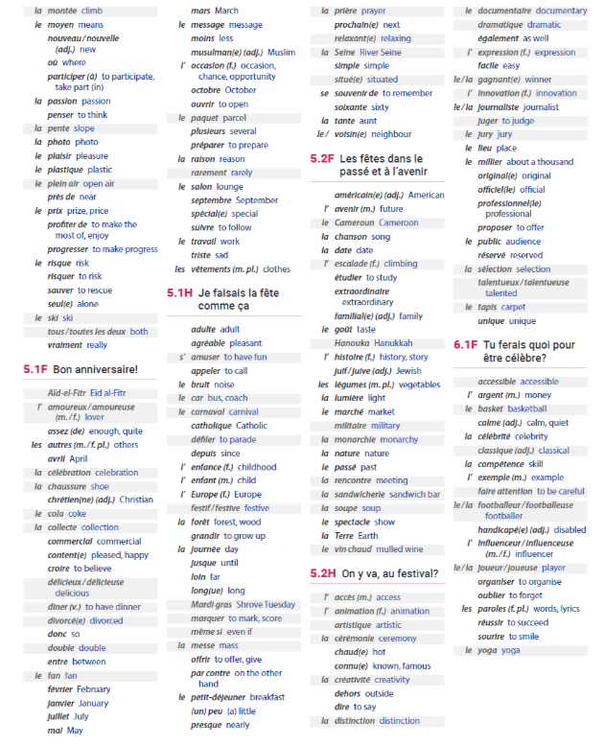

Slide 56
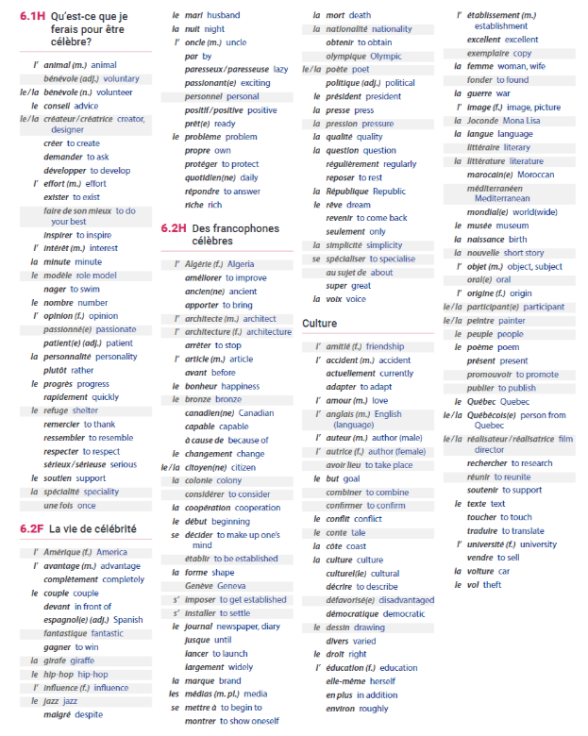

Slide 57
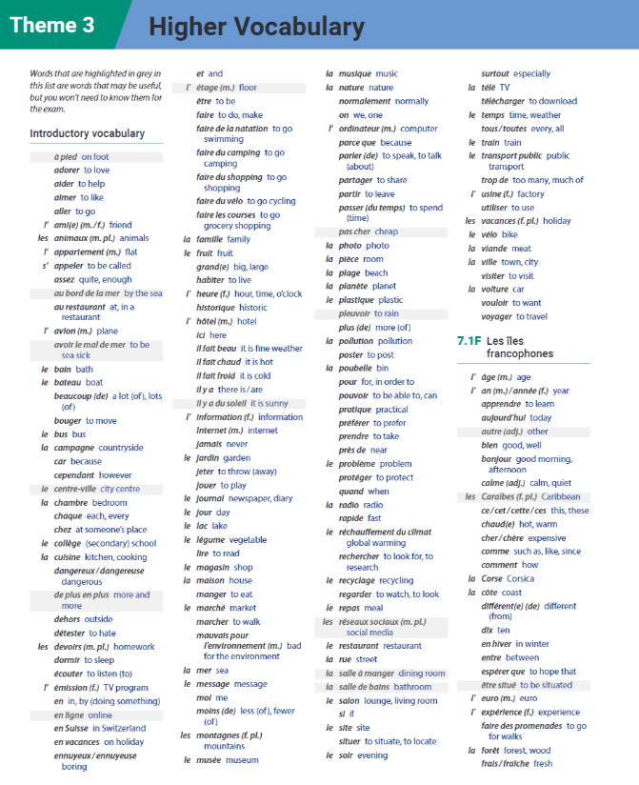

Slide 58
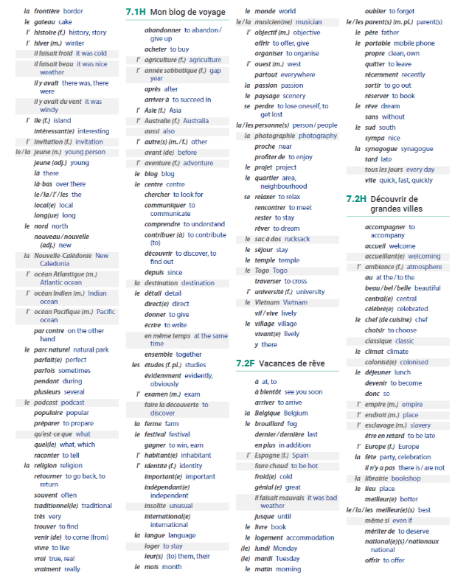

Slide 59
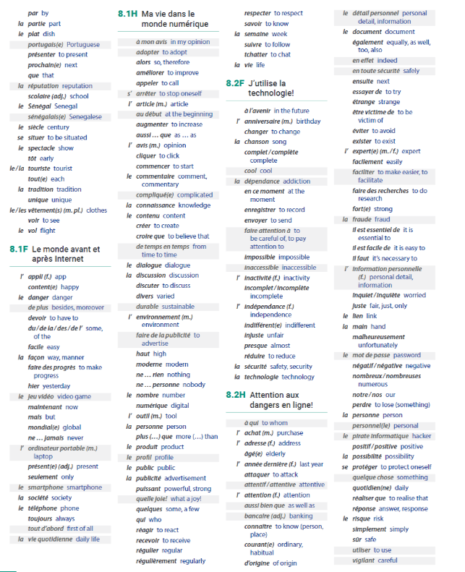

Slide 60
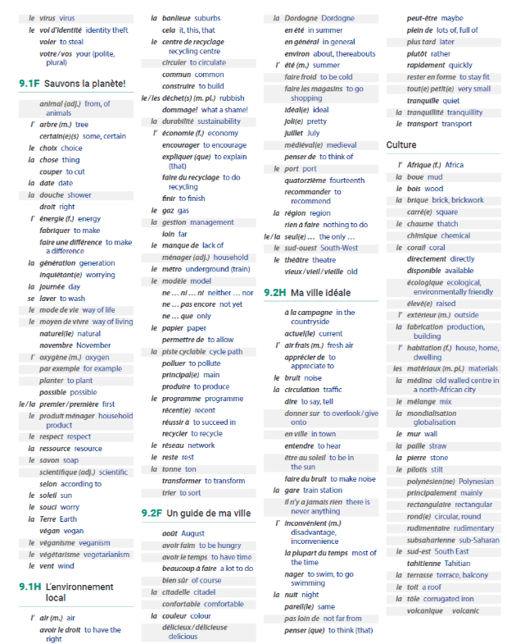

Slide 61
EXAM REVISION CHECKLIST BY SKILL
FOUNDATION & HIGHER |  | HIGHER
LISTENING & READING | Listening: Exam advice (pages 45-46) Reading Exam advice (pages 45-46) Synonyms (page 47) Listen to French. Visualise the words you hear. Write down the words you recognise. Watch programmes/ films in French (with subtitles) | 50% of questions at HIGHER TIER are aimed at grades 7-9 so they are very challenging Be exact in your answers, including all the relevant information. For example when you see or hear “au moins cinquante” the answer is “at least 50”. So “50” on its own is not accurate.
SPEAKING & WRITING | You need to be able to describe actions in 3 time frames-past, present & future, give opinions & reasons! Use LOVE IT & FRENCH FANCIES Speaking & Writing: Pages 27-44 Never waste an opportunity to use an adjective with a noun or an intensifier with an adjective! Always use très, assez or peu with intéressant Speaking: Role play preparation (pages 27-29 ) Photo card preparation (pages 33-34 ) Conversation preparation (page 35) Copy out your conversation answers onto card-different colour for each theme to help you learn them. Writing: Pages 36-45 FQ1: Photo & 5 sentences (page 36) FQ2: 50 words (page 37) FQ3: Grammar gap fill (pages 38) FQ4/ HQ1: Translation of 5 sentences (page 39-41) FQ5 / HQ2 – 90 word task (page 42) How to write a 25 word bullet point answer; 10 French fancies that ensure you meet the success criteria for grade 5+ (page 43) HQ3: 150 words (page 44) | Use the imperfect tense to describe repeated actions in the past with a time phrase such as: “Chaque jour”. Use the perfect tense to say what you have done and the pluperfect tense to say what you had done. Use the “we” form of the verb to describe the actions of others with sentence openers such as: “Mes amis et moi” or “Ma famille et moi”. Include lots of variety and French fancies Make sure your include extended sentences in your French Include the opinions of others in more than one time frame such as: “Mes amis et moi, nous aimons passer le week-end ensemble.” Or: “Chaque jour on aimait se bronzer, nager dans la piscine et jouer à la plage.”
FOR ALL 4 SKILLS | Know the basics (pages 2-6) “I” form of past, present, future verbs (pages 7-17) 10 essential verbs in 3 tenses (page 24) & 10 French fancies that ensure grade 5+ (page 39) Question words (page 28) Vocabulary & structures (pages 49-60) Vocabulary learning strategies (page 47) Little but words (page 5) Opinions & adjectives (page 21) Link words/ connectives (page 20) Use memrise.com or quizlet.com to learn vocabulary Visit useful websites for learning & revising French (list on page 63)

Slide 62
USEFUL WEBSITES FOR LEARNING & REVISING FRENCH
COURSE RESOURCES
On-line resources on KERBOODLE for HOMEWORK & independent study, covering all 4 skills (LISTENING, READING, SPEAKING & WRITING as well as GRAMMAR & VOCABULARY)
RESEARCH & REFERENCE
1. www.wordreference.com
Online dictionary – use this and not an online translator
2. http://www.conjugation.org/
Online verb conjugation tool – you type in the verb and it shows you all forms of all tenses
3. http://text-to-speech.imtranslator.net/
Paste in some (corrected!) text to the text box and choose French from the drop-down language menu – listen to how to pronounce it and practise yourself!
4. https://www.french-word-a-day.com/ to learn a new word/phrase each day
5. http://french.typeit.org/
Saves you having to know the French character codes or use insert symbol.
GRAMMAR PRACTICE
1. https://conjuguemos.com/activities/french/verb/1
All the grammar you could possibly wish for!
2. https://www.languagesonline.org.uk/Hotpotatoes/frenchindex.html
This link takes you to a grammar and vocab self-correcting activities.
VOCABULARY BUILDING & TOPIC KNOWLEDGE
1. http://www.linguascope.com/default.htm
Also needs password and login
2. http://zut.languageskills.co.uk/intermediate/year10.html
3. http:// memrise.com & http:// vokabel.com & http:// quizlet.com
4. http://freerice.com/#/french/13826
For each answer you get right on this website 10 grains of rice are donated to help the world’s hungry.
GENERAL
1. http://www.bbc.co.uk/languages/french/
All sorts on here, including listening, grammar, cultural information
2. http://www.bbc.co.uk/education/revision/french/
BBC Bitesize revision
3. https://www.thefrenchexperiment.com/ - from grammar lessons to children’s stories to help with listening practise this website has lots of great, free resources
SPEAKING PRACTICE
1. www.voki.com
Make yourself an online persona and record yourself speaking French. Save each one you make. OR paste in the text and choose a French voice to say the text for you.

Slide 63
GCSE COURSE CONTENT
THEME 1 – People and lifestyle Unit 1 – Identity and relationships with others Unit 2 – Healthy living and lifestyle Unit 3 – Education and work |  | THEME 2 – Popular Culture Unit 4 – Free-time activities Unit 5 – Customs, festivals and celebrations Unit 6 – Celebrity culture | THEME 3 – Communication and the world around us Unit 7 – Travel and torism, including places of interest Unit 8 – Media and technology Unit 9 – The environment and where people live
FRENCH ACCENTS SHORT CUTS: PRESS …
Alt Gr + vowel = á é í ó ú (Caps Lock for capitals: Á É Í Ó Ú) Alt + 133 = à Alt + 138 = è Alt + 0249 = ù Alt + 0234 = ê Alt + 0231 = ç
ACCURACY CHECKLIST (KEY STAGES 3 & 4)
MINOR ERROR: NO EFFECT ON COMMUNICATION
SP | Spelling
AC | Accent missing
ADJ | Adjectival agreement such as: vert/ verte/ verts/ vertes
GE | Gender of small but important words such as: A (un/ une), some des), the (le/ la/les), my (mon/ma/mes) etc
SERIOUS ERROR: EFFECT ON COMMUNICATION
VB | Wrong ending on verb or wrong tense
WO | Word order
INF | Infinitive needed
? | Unclear
NR | Not relevant
˄ | Missing word

