Slide 1


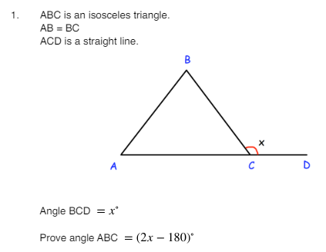
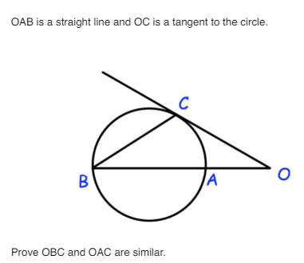
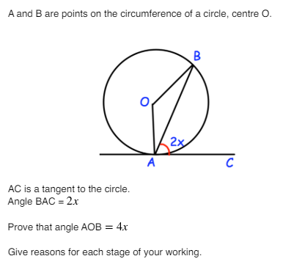
Constructing geometric proofs using known angle facts to justify missing angle results
Enter code U459, U251, U489, U130, and U808 in the Sparx independent learning section and/or
Follow this link to watch a video on “Geometric Proof”
https://corbettmaths.com/2019/12/31/geometric-proof-video/
Work through the questions below to check your understanding (solutions on next page):

Slide 2
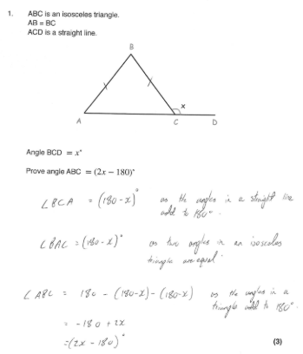
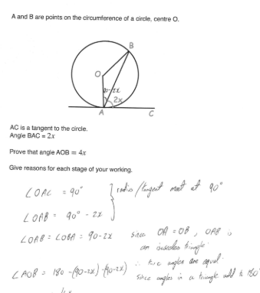
Solutions

Slide 3
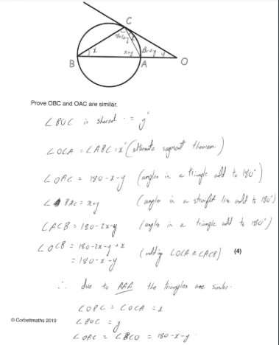
Solutions

