Slide 1


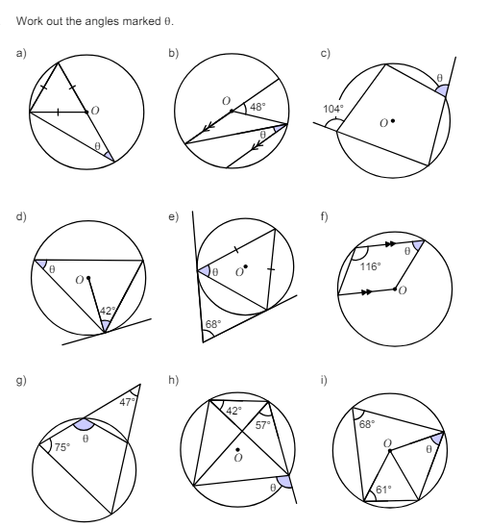
Using circle theorems to find missing angles in increasingly more complex diagrams
Enter code U459, U251, U489, U130, and U808 in the Sparx independent learning section and/or
Follow these links to watch videos on “Circle Theorems”
https://corbettmaths.com/2013/04/04/circle-theorems-theorems/
https://corbettmaths.com/2013/04/04/circle-theorems-examples/
Work through the questions below to check your understanding (solutions on next page):

Slide 2
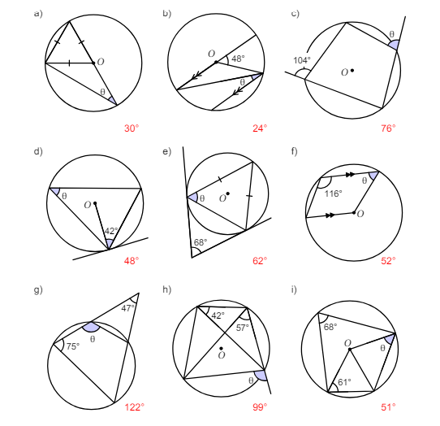
Solutions

