Slide 1




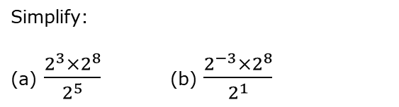
Simplifying more complex expressions using index laws
Enter code U662 in the Sparx independent learning section and/or
Follow this link to watch a video on “laws of indices”
https://corbettmaths.com/2013/03/13/laws-of-indices-algebra/
Work through the questions below to check your understanding (solutions on next page):
Q1
Simplify:
(a) ${(3^{4})}^{5}$ (b) ${(3^{5})}^{4}$
(c) ${(3^{2})}^{5}$ (d) ${(3^{−2})}^{5}$
(e) ${(3^{4})}^{1}$ (f) $3^{3}×{(3^{4})}^{0.5}$
Q2
Simplify:
(a) $\frac{2^{3}×2^{8}}{2^{5}}$ (b) $\frac{2^{−3}×2^{8}}{2^{1}}$
Q3
Find $x$:
(a) $5^{x}×5^{4}=5^{7}$
(b) $\frac{3^{x}×3^{−2}}{3^{4}}=3^{10}$
(c) ${10}^{2}×{10}^{x}=1000000$

Slide 2
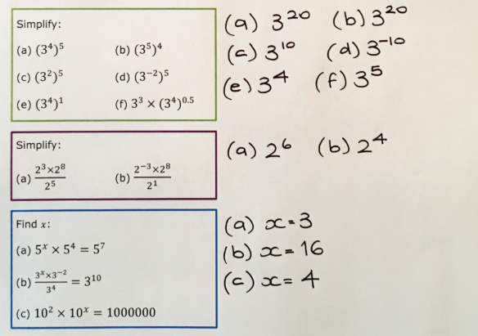
Solutions

