Slide 1


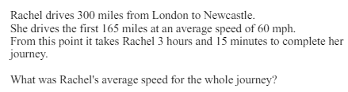
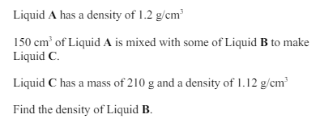
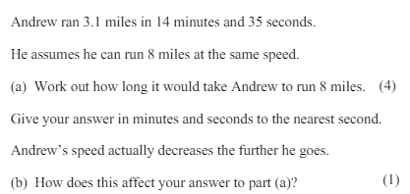
Confidently using and converting a range of compound units given in a variety of contexts
Enter code U151, U256, U910 and U527 in the Sparx independent learning section and/or
Follow these links to watch videos on Speed, density and pressure
https://corbettmaths.com/2016/01/01/speed-distance-time/
https://corbettmaths.com/2016/07/28/pressure/
https://corbettmaths.com/2016/06/07/density/
Work through the questions below to check your understanding (solutions on next page):
Q1
Q2
Q3

Slide 2
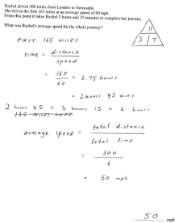
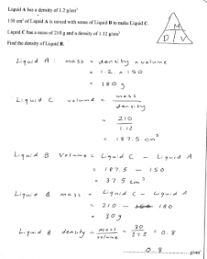
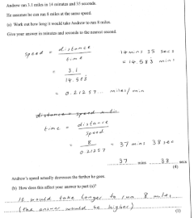
Solutions

