Slide 1


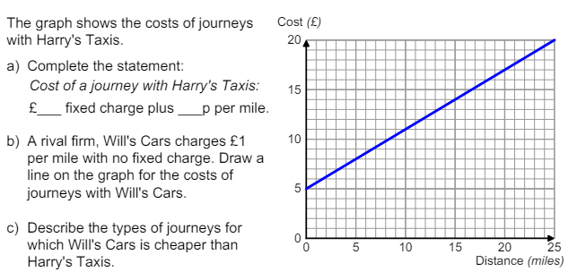
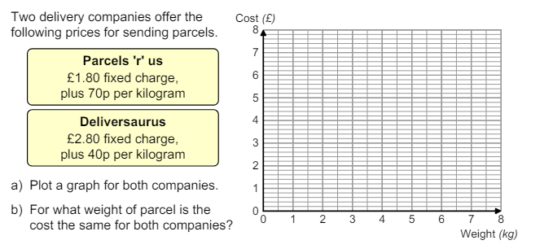
Constructing linear functions from real life problems and plotting their corresponding graphs
Enter code U652 in the Sparx independent learning section and/or
Follow this link to watch a video on “real life graphs”
https://corbettmaths.com/2021/11/18/real-life-graphs-video/
Work through the questions below to check your understanding (solutions on next page):
Q1
Q2

Slide 2
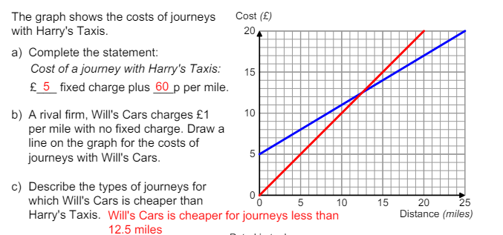
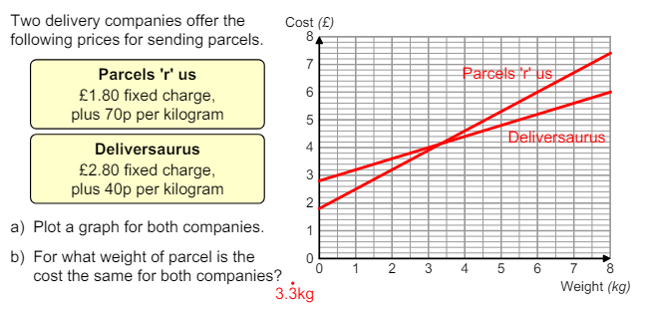
Solutions

